Slide 1
Area and Division Director Makeup Training Session
July 30, 2018

Slide 2

Welcome!
Thank You!

Slide 3
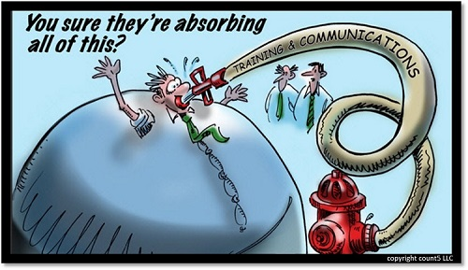

Slide 4
Agenda
Welcome/Introductions | 6:30-6:35pm
Vision / Team Development | 6:35-7:00pm | Ed Thelen
Who is the District Leadership, what are our roles, and how do you fit in?
Program Quality | 7:00-7:15pm | Rozaline Janci
Club Growth | 7:15-7:30pm | Kris Pool
Area Director Duties – Visits & Reports | 7:30-7:50pm | Rozaline Janci
Tools for Area/Division Success | 7:50-8:20pm | Kris Pool
Division TLI | 8:20-8:35pm | Rozaline Janci
Reaching Distinguished | 8:35-8:50pm | Ed Thelen
Q&A / Adjournment | 8:50-9:00pm | Ed Thelen

Slide 5

Introductions

Slide 6
Develop Successful Teams
Vision & Teams
Ed Thelen, DTM
District Director

Slide 7
Session Agenda
Your team members
Your team agreement
Team motivation
Conflict resolution in a team

Slide 8
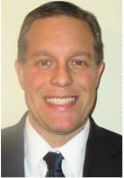
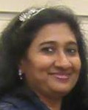
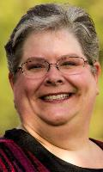
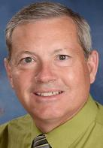
Who are we ? District 35 DEC
District Director – Ed Thelen
Program Quality Director – Rozaline Janci
Club Growth Director – Kris Pool
Immediate Past District Director – Keith Cumiskey

Slide 9
The Division Teams
 | Division A | Division B | Division D | Division F
Division Director | Carl Ervin | Ronda Borowski | Shae Schoenherr | Jackie Scott
Location | North and West Metro Milwaukee | Waukesha County | Downtown Milwaukee | South Metro Milwaukee, Racine, Kenosha
Area 1 | Dmitry Lapan | Bill Finnegan | Ron Wright | David Gagliano
Area 2 | Craig Mosey | Raj Kumar | Shelly Runte | Robert Wall
Area 3 | Liz Pollock | John Scott | Amy Bowers | Judy Bauer
Area 4 |  | Annemarie Braun |  | Jennifer Kibicho

Slide 10
The Division Teams
 | Central | Northern | Eastern
Division Director | Rick Griggs | Angela Graham | Teri McGregor
Location | Madison Metro and Southwest Wisconsin | North Central and Northwest Wisconsin | Eastern Wisconsin and Upper Michigan
Area 1 | Tom Carlson | Matt Scheuers | Larry Penke
Area 2 | Drake McGoey | Heidi Slowinski | Carol Mather
Area 3 | Amy Clements | TBD | Lori Coonen
Area 4 | Janette Jordee | Tammy Lampro | Cindy Wink
Area 5 | Cassie Volden |  | Marilyn Noble

Slide 11
District Support Team
District Administration Manager – Robin Grabinski
District Finance Manager – Jason Feucht
District Public Relations Manager – Kamal Soan
District Webmaster – Matt Wuteska
District Newsletter Editor – Christina Evans
Club Extension Chair – TBD
Club Coach Chair – Judy Bauer
… and others. These are the people with whom you’ll most likely interact

Slide 12
Area Team
area
council
area director
club president
VPM
VPE
VPE
assistant area director education
VPM
club president
VPM
assistant area director marketing
club president
VPE

Slide 13
Division Team
division council
division director
area director
assistant division director education
area director
area director
area director
assistant division director marketing
area director

Slide 14
Team Support
division council
area
council
area director
assistant division director education
division director
area director
area director
club president
area director assistant division director marketing
area director
VPM
VPE
assistant area director education
VPE
club president
VPM
VPM
assistant area director marketing
club president
VPE

Slide 15
Expectations…
As a member of the DEC …
Attend and participate at DEC meetings
  District Executive Council (DEC)
Provide input and own our District Success Plan and District budget
Provide support for one another at contests and TLIs
  Toastmasters Leadership Institute (TLI)

Slide 16
As a Leader …
Toastmaster Core Values
  Respect
  Integrity
  Service
  Excellence
I expect this to be a growth and learning opportunity for you

Slide 17
Your Team Agreement
Team Composition
Values
Team Operating Principles
Potential Obstacles
Meeting Protocol
Team Interaction and Behavioral Norms

Slide 18

Five Principles of Motivation
Understanding motivation
Focusing on value
Clarifying expectations
Recognizing your team
Leading by example

Slide 19
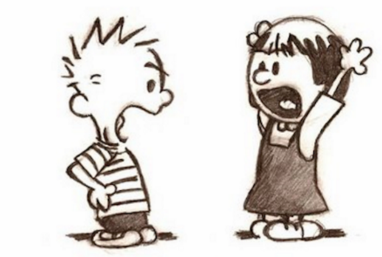
Conflict
Conflict is an expressed struggle between at least two interdependent parties who perceive incompatible goals, scarce resources, or interference from others in achieving their goals.

Slide 20
Team Conflict Resolution
Talk in private
Share responsibility and agree to resolve issues
Present viewpoint in unemotional way
Determine points of agreement and disagreement
Decide how to proceed on disagreements
Summarize discussion in writing and move forward

Slide 21
Program Quality
Rozaline Janci, DTM
Program Quality Director

Slide 22

Training Programs
Plan, organize, and direct the district’s training programs
Impact on Area/Division Directors
  Division Directors follow the division TLI agenda set by the District Trio
  District TLI
  Area Directors assist Division Directors as needed by filling roles for TLIs.
  Area Directors ensure Club officers
  attend training; give feedback to
  Division Directors on what training or
  help your clubs may need

Slide 23
Speech Contests
Responsible for all District speech contests at club, area, division, and district levels
Impact on Area/Division Directors
  Schedule contests to run within the given time frame
  Dates for Contests
    Club Contests – Jan 2, 2019 to Feb 21, 2019
    Area Contests – Feb 22, 2019 to Mar 24, 2019
    Division Contests – Mar 25, 2019 to April 28, 2019
  Humorous and International Speech Contests
  Lock in a date and time for your area and division contest now

Slide 24
District Spring Convention
Plan, organize, and direct the District conferences
Impact on Area/Division Directors
  Ensure Division winners/runners-up compete at District convention
  Chairpersons and volunteers needed to assist
  Ensure quality education as you promote event

Slide 25

District Spring Convention
Our Spring Convention is scheduled for May 10 – 11, 2019 in Green Bay
  Contest training will be held during the DEC meeting in November

Slide 26

Education Goals
Encourage all members in achieving educational awards and recognizing achievements
Impact on Area/Division Directors
  Ensure clubs complete their club success plans
  Ensure clubs follow the distinguished club program allowing members to complete their educational goals
  This will ensure club quality, people advancing, leaders trained, reports submitted,
  and a healthy dynamic member and
  club experience

Slide 27
District Executive Committee
2nd ranking officer – presides if District Director is absent
Impact on Area/Division Directors
  Quality training for you throughout the year – Trio sets agenda and Trio/AD/DD present
  Planning of Distinguished Club portion of District Success Plan
  Monthly benchmarks to touch base on progress toward our Distinguished District goals

Slide 28
Club Growth
Kris Pool, DTM
Club Growth Director

Slide 29
It’s all about the HUGS
Helping
Us Grow Stronger

Slide 30
District Mission
We build new clubs and support all clubs in achieving excellence

Slide 31
Responsibilities
Develop a marketing plan
Build and support new clubs
Strengthen existing clubs
Provide resources for struggling clubs
Drive membership growth
Ensure that club dues are paid

Slide 32

Club Growth – Club Extension
Generate, manage, and track leads
Contact and follow-up
Schedule demonstration meetings, recruit and train the team, and coordinate the submission of the chartering funds and application paperwork

Slide 33
Club Growth – Sponsors & Mentors
Recruit, train, and track sponsor/mentor for clubs that charter (or ready to charter)
Specifically:
  Develop and improve training and curriculum to effectively serve the new club
  Work with sponsors/mentors to receive credit from WHQ
  Provide training to sponsors/mentors on their responsibilities

Slide 34
Club Retention – Club Coaches
Recruits and trains club coaches to help develop action plans to aid struggling clubs
Coaches:
  CGD assigns coaches
  Receive credit toward ALS upon completion
  Works with clubs that ask for a coach (12 or fewer members)
  Assists the clubs and provides additional options

Slide 35
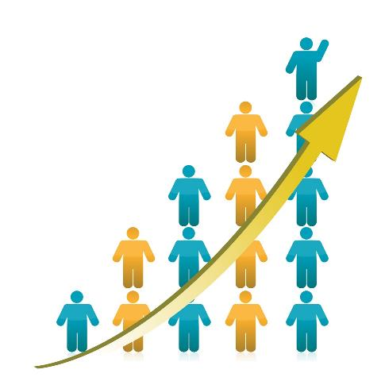
Membership Growth & Retention

Slide 36

Make Membership a Priority
Hold an Open House – and advertise it!
Membership Campaigns throughout the year
Call past members and invite them back again – talk about Pathways
Personal invitation to friends and colleagues

Slide 37

Make Membership a Priority (continued)
Celebrate a Club “Toastmaster of the Year”
Maintain a current website – information and pictures
Participate on social media – more than just a club photo
Make a flyer and put on everyone’s desk
Talk with HR

Slide 38

Make Membership a Priority (continued)
Showcase a guest speaker
Challenge a club to a membership building contest
Wear your Toastmasters pin everywhere
Take it to the streets – food trucks and farmers markets

Slide 39

Membership Retention
Club Ambassador
TLI
Contests
Convention
Speaker Exchange
Other ideas?

Slide 40

Email:
  Kris.Pool.DTM@gmail.com
Phone / Text:
  920-698-0656

Slide 41
Club Visits & Reports
Rozaline Janci, DTM
Program Quality Director

Slide 42

Club Visits
Notes:
Purpose: Develop you as a strong leader by understanding the WHY vs the WHAT

Slide 43
It’s About the Members!
Toastmasters International Mission
We empower individuals to become more effective communicators and leaders
Notes:
Why are we here? Any successful organization will have a clearly defined statement of purpose, often called a mission statement. It states why we exist. The TI mission and the Toastmasters Club mission should be burned into your memory.
TI’s mission states we exist for our members.

Slide 44
Clubs Support Members
Club Mission
We provide a supportive and positive learning experience in which members are empowered to develop communication and leadership skills, resulting in greater self-confidence and personal growth
Notes:
Clubs are created to provide the benefit to our members.

Slide 45
Districts Support Clubs
District Mission
We build new clubs and support all clubs in achieving excellence
Notes:
Districts are charged with creating and building clubs to provide the greatest opportunity for individuals to benefit from the TI program.

Slide 46
Members
Clubs – 12 to 30 Members
Areas – 3 to 6 Clubs
Divisions – 3 to 6 Areas
Districts
Regions – 3 to 9 Districts
BOD – 19 Members
TI
Notes:
It is the members that we serve, and serving members is why we exist. Looking at the pyramid you can see how the Toastmasters leadership structure is built to carry out its mission.

Slide 47
Information Flow
To Clubs
To District
Area
Director
Notes:
Area Directors are a critical link in the leadership structure. In many cases, the Area Director may be the only connection between the club and the international organization. Area Directors are the main source of information flowing in and out of the clubs.

Slide 48

Why visit your assigned clubs?
Personal contact, build rapport
Observe, provide feedback
Assist
Organize
Inform
Cheerlead
Notes:
Information can be transmitted via written media, but there are many benefits to a personal face to face visit.

Slide 49

Experiential learning
Networking
Speaking opportunities
Contribute to others’ success
Accelerate your development
Notes:
Remember that you as a director are also a member, and there are plenty of benefits to you as well.

Slide 50
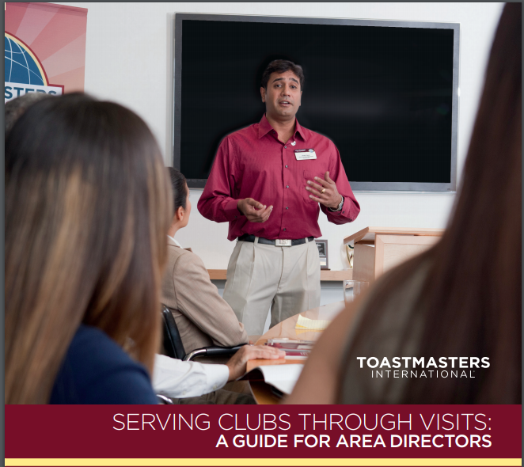
Notes:
Focus on this book is on the club visit.

Slide 51
As Area Director
One visit each half year
Conduct your visit(s) and file your report online as soon as possible
  First round visit reports by November 30
  Second round visit reports by May 31
Report provides insight to District leadership
Establish relationship with the club, provide support
Notes:
By now you should have a clear understanding of the why these few requirements are important to the success of the individual members of Toastmasters.

Slide 52
Tips
Introduce yourself to Club Presidents
Tell them WHY visits are important, what you will be doing
Ask to schedule, when is best time to visit
Schedule visits well in advance
Send report form in advance of visit
Ask for opportunity to address the club
Notes:
My two years as an Area Director were the most rewarding and beneficial for me and I hope your experience is as rewarding. Take advantage of your opportunity. Here are a few tips that may help you to be a high-achieving Area Director

Slide 53
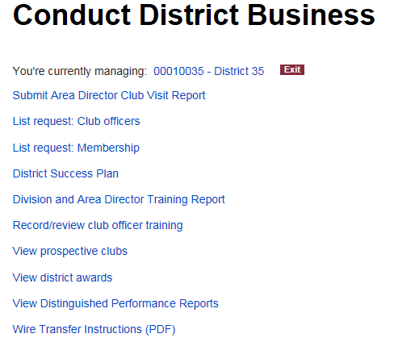
Toastmasters International
https://www.toastmasters.org/
Leadership Central > District Central
Almost everything you need to do online as a District Officer begins here!

Slide 54
Toastmasters International
Leadership Central > District Central
This is where you enter your club visit reports

Slide 55
Toastmasters International
Leadership Central > District Central
Download club officer list and membership list (of your area or division) in .csv format
Note …this probably will not be available until the 3rd week of July

Slide 56

Toastmasters International
Leadership Central > District Central
Division Directors record club officer training here

Slide 57
Toastmasters International
Leadership Central > District Central
Review the DCP status of your clubs, area, division, and district

Slide 58
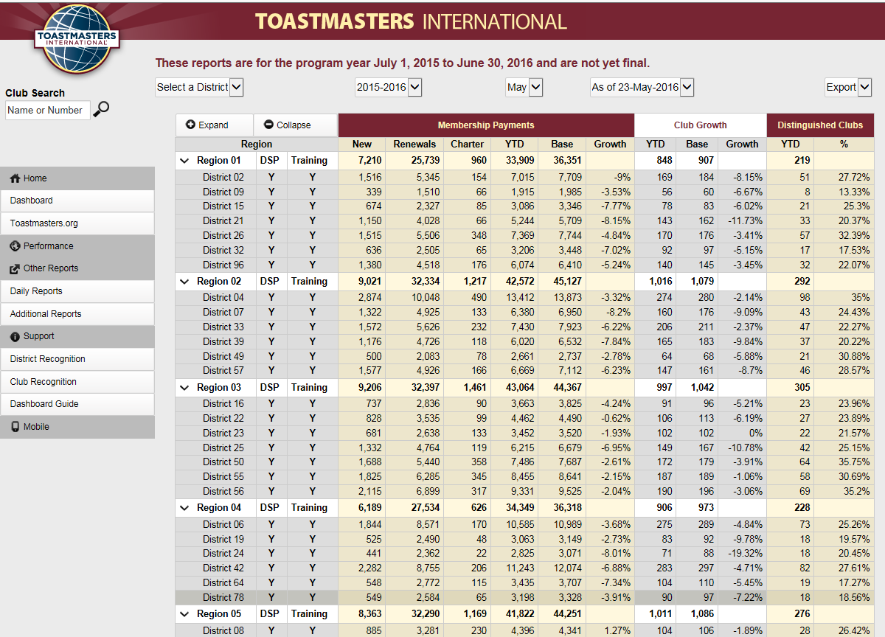
Toastmasters International
Displays both Dashboard and Daily Reports menus

Slide 59
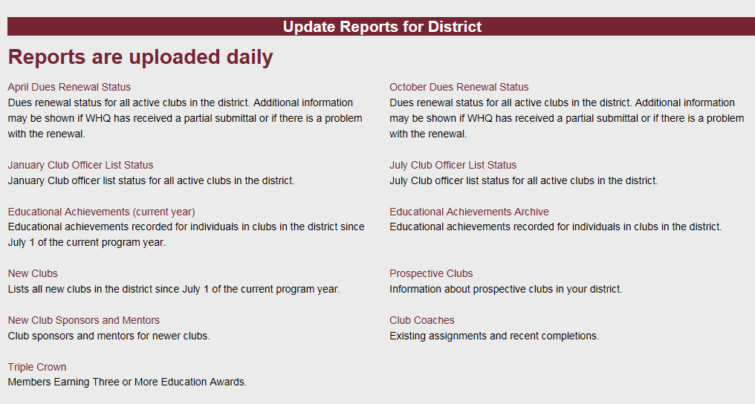
Toastmasters International
Daily reports show valuable information on the day-to-day operation of your area and division

Slide 60
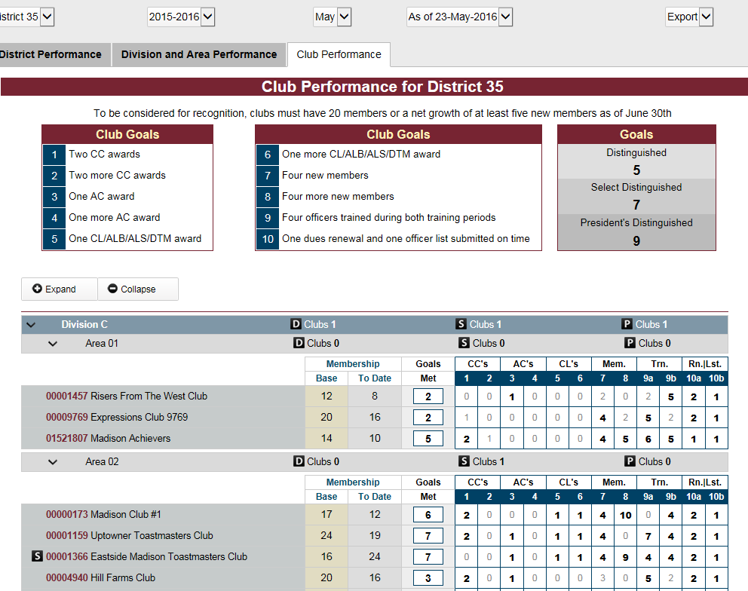
Toastmasters International
Dashboard provides you valuable information on the status of your clubs, area, and division

Slide 61
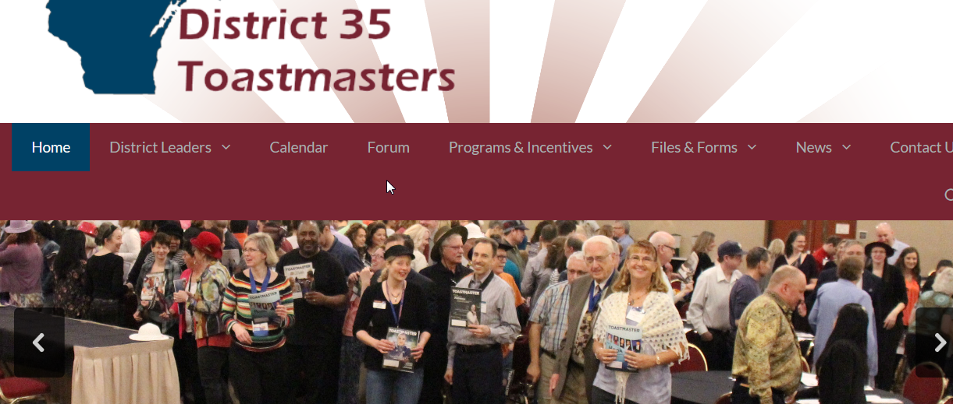
District 35 Website
Useful and timely information about what is going on in District 35
https://district35.org/

Slide 62
Tools for Area & Division Success
Kris Pool, DTM
Club Growth Director

Slide 63
Notes:
Focus on this book is on the club visit.

Slide 64

Area Director Guidance
Get a mentor to guide, coach, and encourage you
Set area goals and make plans to achieve them (consider an HPL this year)
Put important dates on calendar
Notes:
Get a mentor to guide, coach and encourage you. Also connect with the last 1-2 Area Directors/Governors for guidance. As an Area Director you have the opportunity not only to serve but also to develop transferrable skills in several corporate competencies: Public Speaking, Strategic Planning, Delegation, Marketing and Public Relations, Group Facilitation, Event Planning, Site Logistics and more! Plan to work efficiently toward DTM, if not already achieved. 2. Set Area Goals and make a plan to achieve them, using the Distinguished Area program and the Area Success Plan (consider doing an HPL project). Aim for President’s Distinguished: Distinguished clubs equal to 50% of club base plus one more Distinguished club and a net club growth of one. This is a team goal. Help your clubs be distinguished or better to achieve this goal. 3. Put important dates on your calendar
4. Prepare an “Area Director Kit” to have handy as you visit clubs and perform other duties. Some items you can include: ✓ Meeting information and lists of officers for the clubs in your area ✓ Blank copies of club visit reports ✓ Membership applications ✓ Speech contest forms & rule book ✓ Club Officer Installation Script & Gavel (if you have one) ✓ CC Manual (for when you present at clubs) ✓ Club Leadership Handbook (for reference)
5. Guide, support and motivate your clubs to achieve Distinguished or better. A. Set up at least two official club visits during two official visit rounds. • November 30 and May 31 are the deadlines to submit reports • The reports are submitted online at Toastmasters.org (District Central) • Earlier is better! Earlier submission allows more time for corrective action. • When you schedule your visit, send a copy of the club visit report and ask that the president fills out the information on the Distinguished Club goals prior to your visit. Better yet, ask for the president to send you a copy of their Club Success Plan. • If possible, present an educational talk (Successful Club Series) B. Contact club presidents monthly to discuss the progress of clubs toward the distinguished club goals and to follow up on items of concern identified during a previous visit or contact. Also encourage attendance at outside-of-club activities such as club officer training, speech contests and other district events. C.
6. Coordinate Area activities • Hold at least two Area Council Meetings per year to discuss each club’s plans and progress in the Distinguished Club programs. Attendees include Club Presidents and appointed assistants, such as Assistant Area Director Club Growth (new clubs/retention), Assistant Area Director Program Quality (Club Officer Training/Speech Contests), and others as needed. Plan for upcoming events, problem solve, and recognize achievement. • Help with training of club leaders. Working with your Division Director, set up a club officer training session. In-club training is not the first choice format. Send your records of club officers trained to your division director for him or her to record at Toastmasters International. • Hold area speech contests. Post contest information on the District 6 website as soon as possible and inform your clubs. Have someone else chair your contest. 7. Prepare your successor. Along your journey, keep notes and useful files (keep the club visit reports!) to pass on to your successor (Dropbox is one way to share files). Look for potential Area Director candidates (the District Director appoints them). Mentor your successor.

Slide 65

Area Director Guidance (continued)
Prepare an “Area Director Kit”
Guide, support, and motivate your clubs to achieve Distinguished or better
Coordinate Area activities
Prepare your successor

Slide 66

Manage Your Time Effectively
Calendar and Plan Ahead
Focus
Email
Communication
Club Visits
Club Visit Reports
Notes:
Managing Your Time Effectively The purpose of this session is to help each teammate make the most of his/her time and save time in this role.
Use your calendar and plan ahead • Get everything on a calendar early. Write down the dates you'll visit each club. Write down your training, contest, and area council dates. Record the DEC and other events on your calendar. • Allocate certain days or times of the day to spend on your role. Stick to that schedule. Toastmasters doesn’t need to be a 24/7 role.
• Focus. When you're spending time on a task, focus only on that during the time. Mixing activities (ex. TV and TM emails) isn't effective. Have a process You need a process for getting things done and completing tasks. If you have something that works, then keep doing it.
Email • This is an important topic for life in general. Good email habits will save you time each day, saving you significant time over weeks, months, and years. • Email scrambles our brains and distorts priorities. Email makes the latest and loudest communications take priority over what's really important. • Email is everyone else's agenda for you. When you need to get something done, close your email. • Shut off notifications from your phone: email, messages, etc. Unless someone's life depends on it, it can wait. • Don't check email first thing in the morning. Accomplish at least 1 important task before checking email. • Not everything needs action right away. Respond to let the other know you received the email and if/when you'll take the requested action. Then prioritize it on your list. Honor the items on your list. • Keep emails and responses brief. 5 sentences. Yes, this is hard! But, this focuses you on the purpose of your communication. Anything additional can come through a phone call or a follow up. • Clear and brief emails will usually take less time to write, less time to read, and have a better chance at getting a response. People are busy and get overwhelmed by lengthy emails.
Communication • Focus on good, 1:1 communication. Group emails almost never get responses. To save your time and be more effective, email to an individual (ex. the club president). 1:1 communications create relationships, and relationships are critical. • Add value through your communications. No one welcomes emails and communications that ask/tell them to do something. The same goes for communications that are too frequent, too long, or always expect responses. If your communications are to-do lists or have little alignment with the interests of your audience, then they won't be read. Find ways for communications to be interesting and value-adding. If the intent of your communication is to help others and make their jobs easier, then the communication will be read and responded to. Boundaries If left unchecked, activities in life can take over your life. Work, friends, church, Toastmasters, and anything else can take over your life if boundaries aren’t set. Establish up front what you can and will do in your role. Pay attention to how much time you’re spending and how much time you can spend; let others know if something is wrong. We can’t run clubs for them, and clubs don’t want us to do that for them. Set boundaries for yourself and respect the boundaries of others. We support the clubs and club leaders, and we allow them to run their clubs.
Club Visits • What's the purpose of a visit? (allow for discussion) • A visit is an opportunity for you to strengthen the relationship with the club members and leaders. It’s an opportunity to add value. Don’t treat it as a required activity or a checklist item. • It isn't just to fill out the AD Club Visit Report! • Be professional and positive. Most will see you only during this visit. Your role isn’t to inspect the club, but to add value. • Offer to serve in a role. Speak, or serve as GE or Evaluator. • If permitted, give an educational speech from the Successful Club Series.
Club Visit Reports The club visit report form is overwhelming and confusing. Making clubs complete this form weakens our relationship with them. Don’t go through the report question by question with the president; that’s time consuming and painful. Instead, keep it simple and handle most of the form offline. Club visit reports can be simple. There are 3 items we’re interested in learning from a visit report: 1. What is the club doing well? This is an opportunity for praise. 2. What are the club’s challenges? The president can provide this. 3. How can we help the club with those challenges? Submit the visit report within 3 days of your visit. It’s more important to get it done rather than make it perfect. It’s a snapshot of the club at one specific point in time and it can and will change regularly.

Slide 67

Learn How to Track Performance
http://dashboards.toastmasters.org
Distinguished Performance Dashboard
Daily Reports
Additional Reports
Notes:
Learn how to track area/club performance on the TI dashboard.
Distinguished Performance Dashboard: http://dashboards.toastmasters.org
Can we go to live internet to show it?

Slide 68
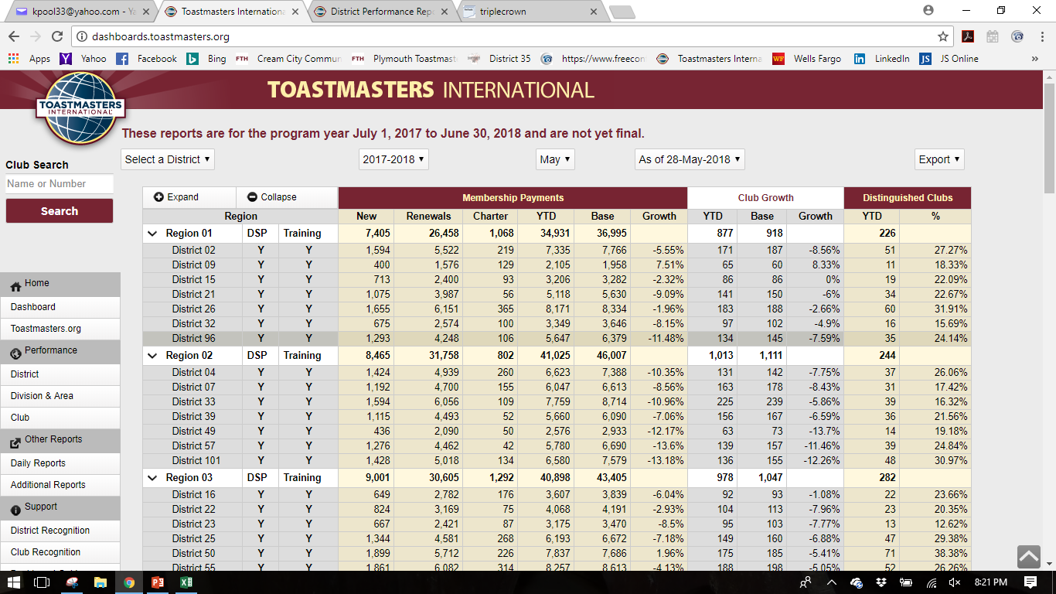

Slide 69
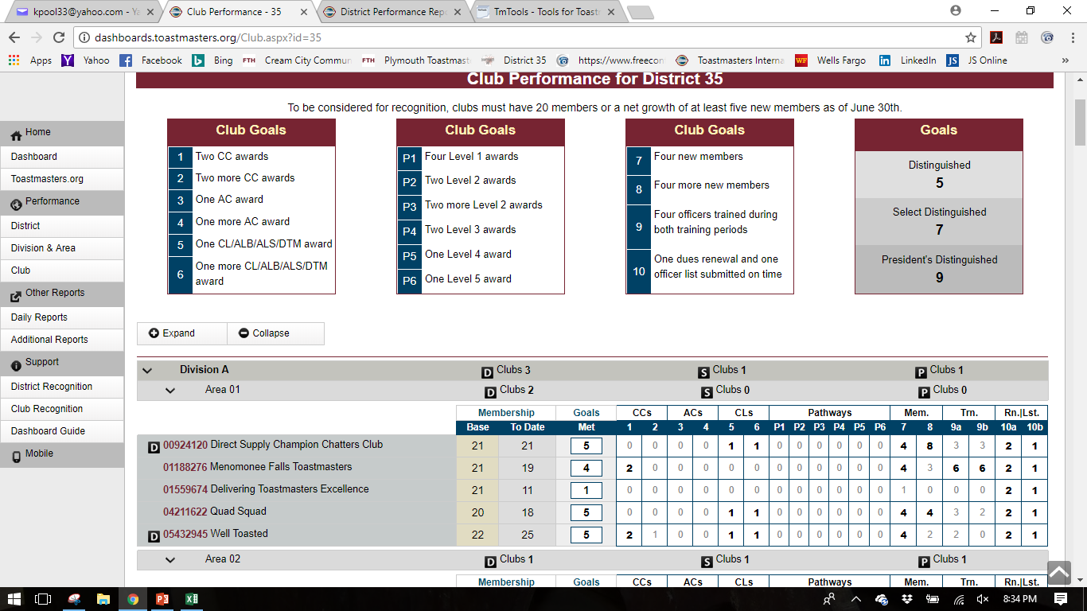

Slide 71
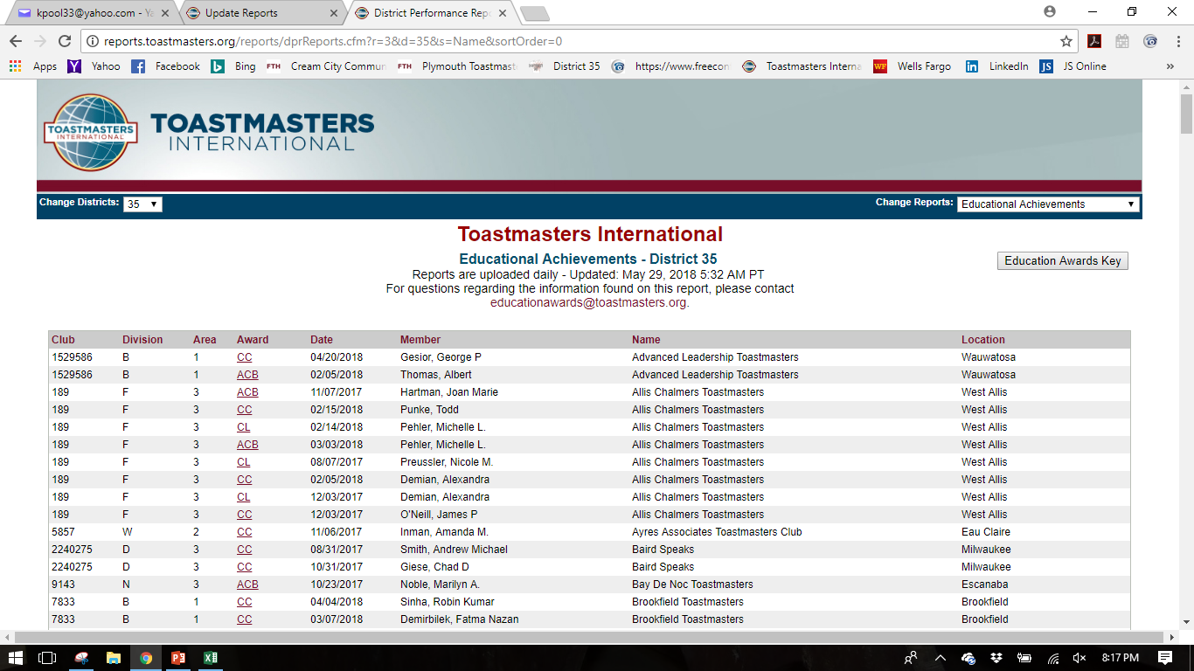

Slide 72

Don’t Forget Your Friends
http://marshalls.org/tmtools/
http://mikeraffety.com/DCPhistory.cgi

Slide 73
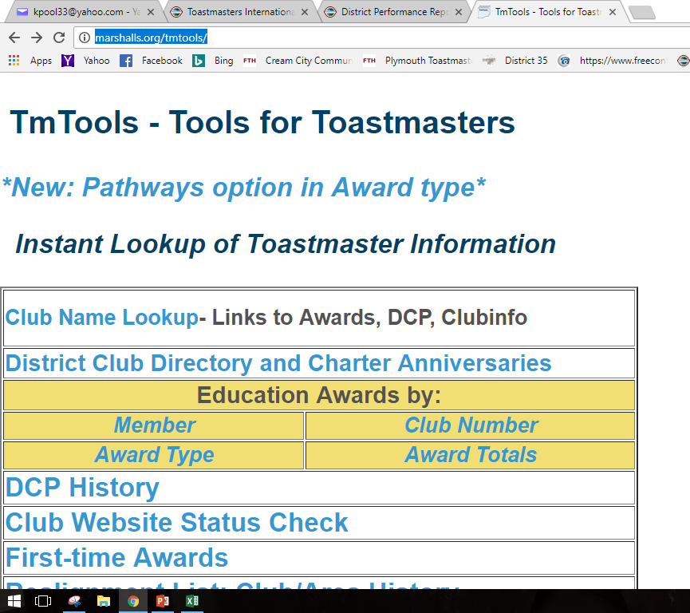

Slide 74
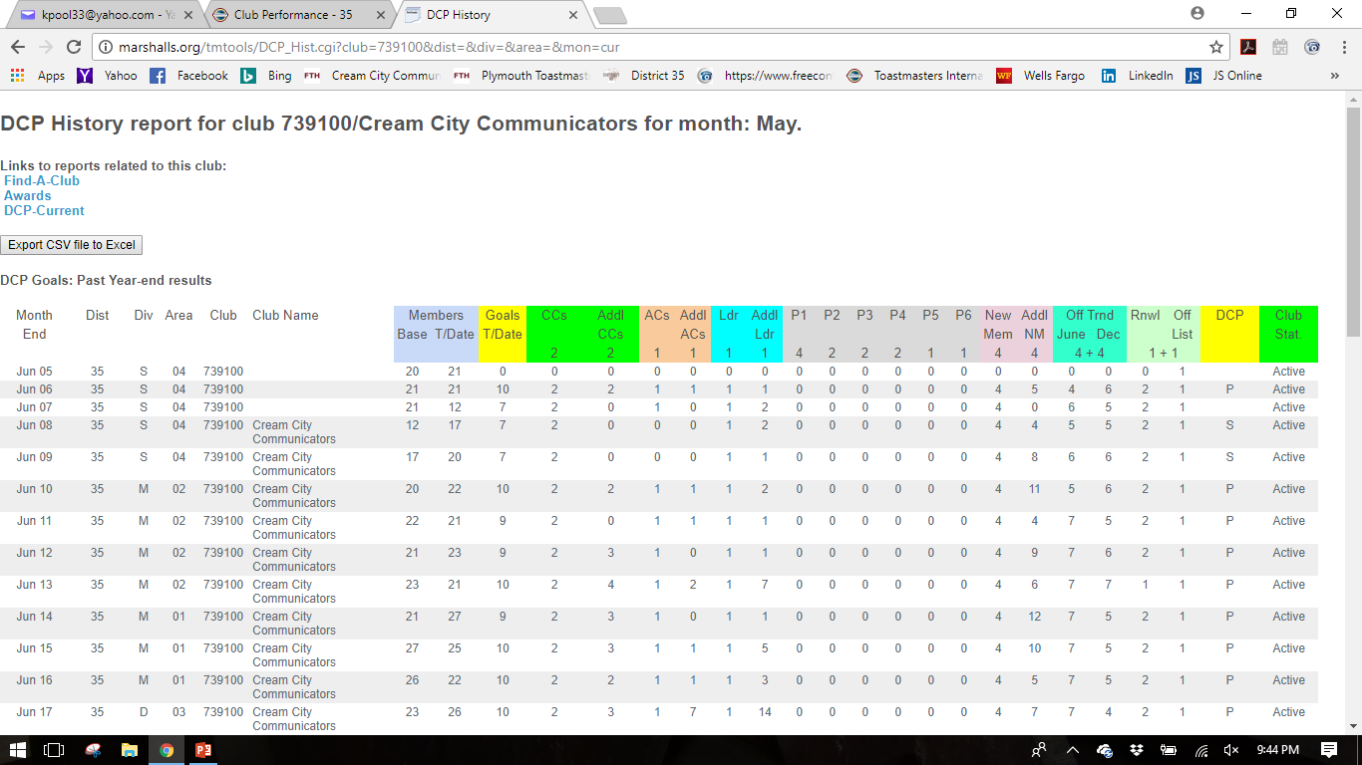

Slide 75
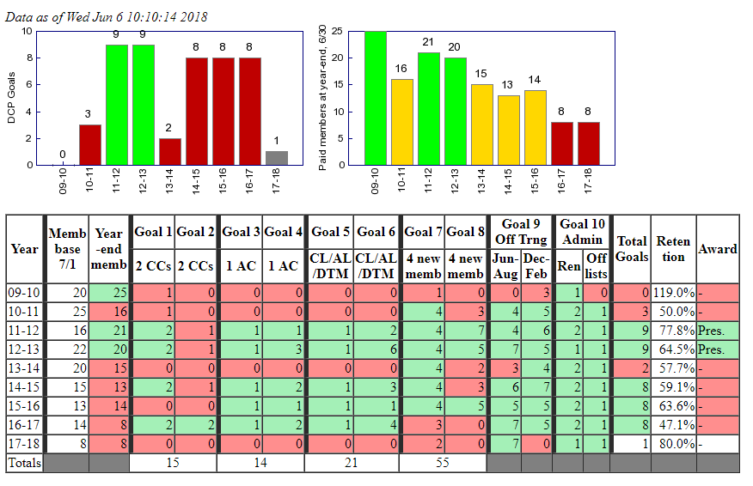

Slide 76
Email:
  Kris.Pool.DTM@gmail.com
Phone / Text:
  920-698-0656

Slide 77
Toastmasters Leadership Institute (TLI)
Rozaline Janci, DTM
Program Quality Director

Slide 78
TLI Timeframes
Summer TLI
  June 1, 2018 – August 31, 2018
Winter TLI
  December 1, 2018 – February 28, 2019
  December 1, 2018 – District TLI at Monona Terrace; TLI Dean Andy Little, DTM

Slide 79

General Agenda
Summer TLI
  Officer roles, Distinguished Club program; getting the year off to a good start
Winter TLI
  More general leadership topics; mid-year check in

Slide 80
Planning Process
Program Quality Director sets up agenda
Division Directors select dates and locations of training – post on calendar with help of Administration Manager
Division Directors work on selecting presenters for the various TLI sessions (Area Directors, seasoned Toastmasters)
Coordination of needed items done by team (PR, food/beverages, additional room setup)

Slide 81
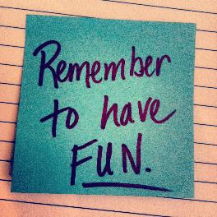
Reminders as Event Approaches
Reminders about date/location to members through various channels
Confirmation of logistics
Make this an event –
generate buzz

Slide 82
Reaching Distinguished
Ed Thelen, DTM
District Director

Slide 83
Purpose of Recognition
Distinguished Club Program (DCP) recognizes clubs that provide the positive and supportive environment that leads to member success
“Distinguished” is a reflection of success of the Club Mission, not the goal in itself
The same is true for area, division, and districts

Slide 84
Different programs at each level
Distinguished Club Program
Distinguished Area Program
Distinguished Division Program
Distinguished District Program

Slide 85
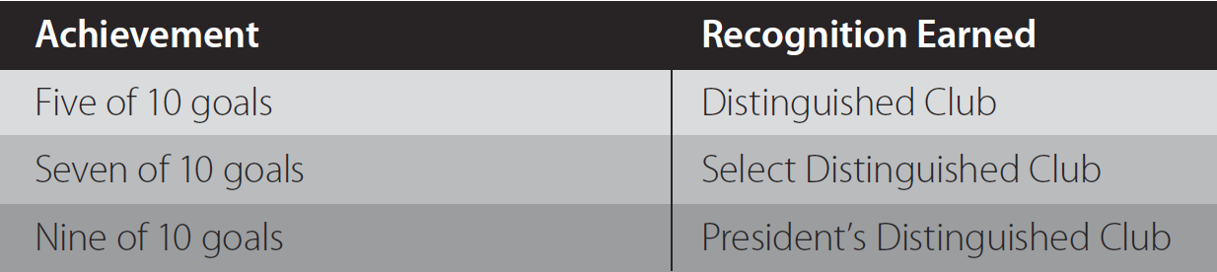
Distinguished Club Program

Slide 86
Qualifying Requirements
Membership = 20 or net growth of 5+ members as of June 30
  Base membership = July 1 roster
  Net growth = June 30 membership minus Base membership
Transfer members do not count in the term that they transfer

Slide 87
Distinguished Club Goals
Traditional Education Program
or
Pathways Education Program
  Two CCs
  Two more CCs
  One ACB, ACS, or ACG
  One more ACB, ACS, or ACG
  One CL, ALB, ALS, or DTM
  One more CL, ALB, ALS, or DTM
4 members - Level 1
2 members - Level 2
2 more members - Level 2
2 members - Level 3
1 members - Level 4
1 members - Level 5
Goals from either Education Program are acceptable this year (and next)
  Four new members
  Four more new members
  Minimum of four club officers trained during each of two training periods
  One membership dues-renewal report and one club officer list submitted on time

Slide 88
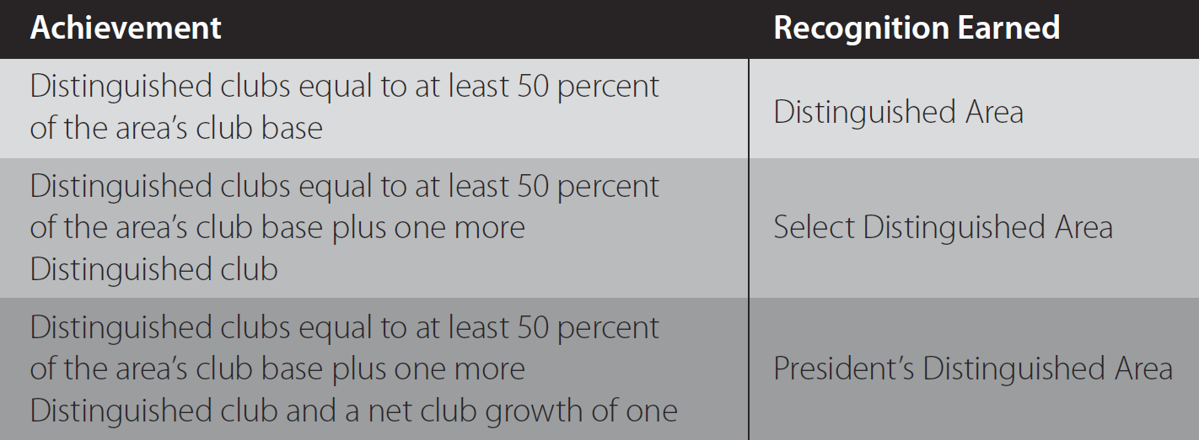
Distinguished Area Program

Slide 89
Qualifying Requirements - Area
No net club loss - paid clubs at year-end (June 30) < base
Submit the Area Director’s Club Visit Report for 75% of club base
  First round visits by November 30
  Second round visits by May 31

Slide 90
Area’s Club Base Definition
Club base = Paid clubs assigned to the area as of July 1
Clubs are considered to be paid when they have submitted a complete April dues-renewal report
  These and new clubs chartered between April 1 and June 30 are counted in the club base

Slide 91
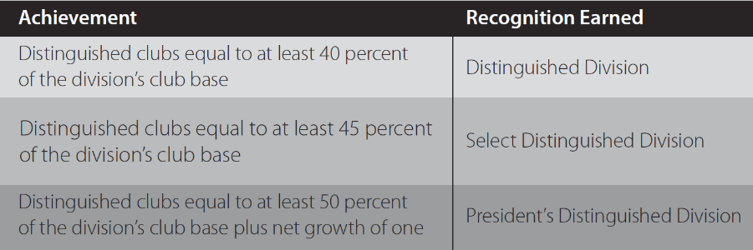
Distinguished Division Program
No net club loss - paid clubs at year-end (June 30) < base

Slide 92
Division’s Club Base Definition
Club base = Paid clubs assigned to the division as of July 1
Clubs are considered to be paid when they have submitted a complete April dues-renewal report
  These and new clubs chartered between April 1 and June 30 are counted in the club base

Slide 93
District Recognition
Achievement | Recognition
Three (3%) increase of membership payments base, three (3%) increase of club base and Distinguished clubs at least 40% of district’s club base | Distinguished District
Five (5%) increase of membership payments base, five (5%) increase of club base and Distinguished clubs at least 45% of district’s club base | Select Distinguished District
Eight (8%) increase of membership payments base, eight (8%) increase of club base and Distinguished clubs at least 50% of district’s club base | President’s Distinguished District

Slide 94
Qualifying Requirements
Submit Area and Division Director training report to WHQ by September 30, showing 85% trained
Submit District Success Plan to WHQ by September 30

Slide 95
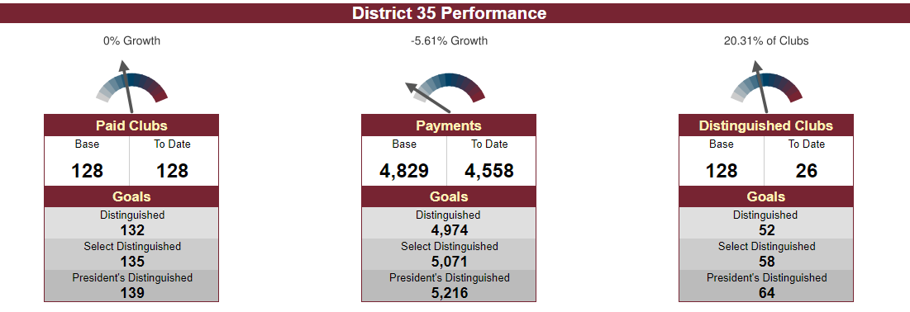
District Dashboard as of 6-12-18

Slide 96


Slide 98
DEC/District Council Meetings 2018-19
Saturday, July 21, 2018 – Division F
Saturday, August 11, 2018 – Northern
Saturday, September 15, 2018^ – Virtual
Saturday, October 20, 2018 – Central
Saturday, November 10, 2018 – Division B
Saturday, December 15, 2018 – Virtual
Key: ^ = District Council

Slide 99
DEC/District Council Meetings 2018-19
Saturday, January 19, 2019* – Division A
Saturday, February 16, 2019 – Virtual
Saturday, March 16, 2019 – Eastern
Saturday, April 13, 2019 – Division D
Saturday, May 11, 2019^ – Radisson GB
Saturday, June 15, 2019* – TBD
Key: ^ = District Council * = subject to change (January-date & June-2019-20 AD/DD Train)

