Slide 1
Honoring Area Directors
District 35
2015-2016

Slide 2
2015-2016 Area Directors
C1 – Jennifer Leny
C2 – Laura Croft
C3/C4 – Aundrea Price
C5 – David Dopkins
E1 – Bruce Bitter
E2 – Leah Strutz
E3 – Maria Armbrust
M1 – Yvonne Lumsden-Dill
M2 – Jay Kieckhafer
M3 – Kevin Krebs
M4 – Jaki Van Valin
M5 – Scott Kazin
N1 – Lois TeStrake
N2 – Ranee Graf
N3 – Patti Wills
S1 – Albert Thomas
S2 – Fred Debelack
S3 – Cindy Algiers
S4 – Theresa Flynn
S5 – James Karon
W1 – Robert Lambert
W2 – Larry Van Dyn Hoven
W3 – Brenda Michels

Slide 3
Club Ambassador Program
District 35
Spring 2016

Slide 4
Club Ambassador Recipients (1)
Janette Becker
Greg Bednar
Anita Berigan
Timothy Bojko
Amy Bowers
Jamie Cho
Pauline Dobson
Lee Gettelfinger
Nelly Gillman
Kathy Glaser-Brown
Doug Henderson
Telissa Hopgood
Teresa Hutton
Rozaline Janci

Slide 5
Club Ambassador Recipients (2)
Sue Kohut
Brad Laatsch
Chad Lawson
Matt Metivier
Christine Piela
Kris Pool
Gopi Reddy
David Reed
Martin Rettler
Shelly Runte
Linda Samens
Horst Schmidt
Shamaine Schoenherr
John Scott

Slide 6
Club Ambassador Recipients (3)
Dave Simono
Ed Thelen
Sue Van Oudenhoven
Kathy Vielhuber
Michael Wodarczyk
Matt Wuteska
Jennifer Zhang

Slide 7
Capture the Banner Program
District 35
2015-2016

Slide 8
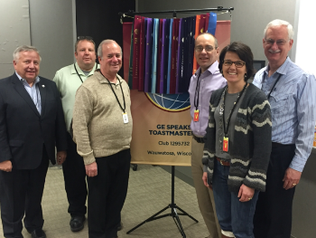
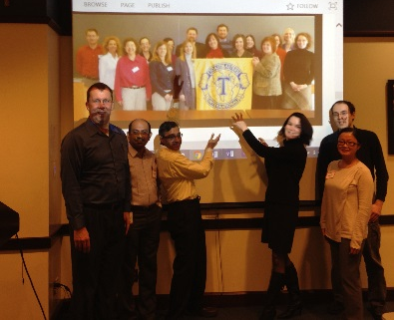
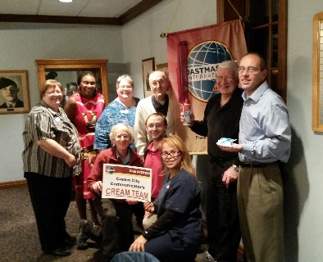
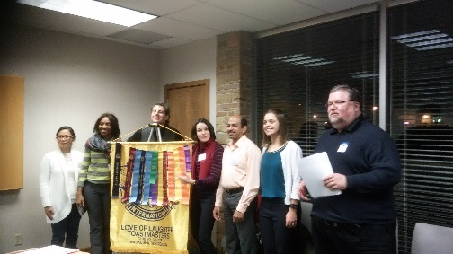

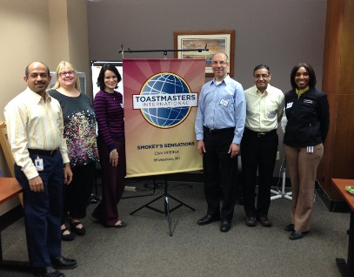
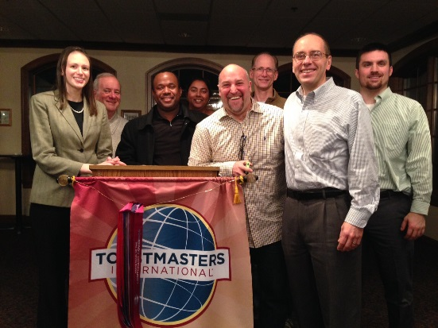
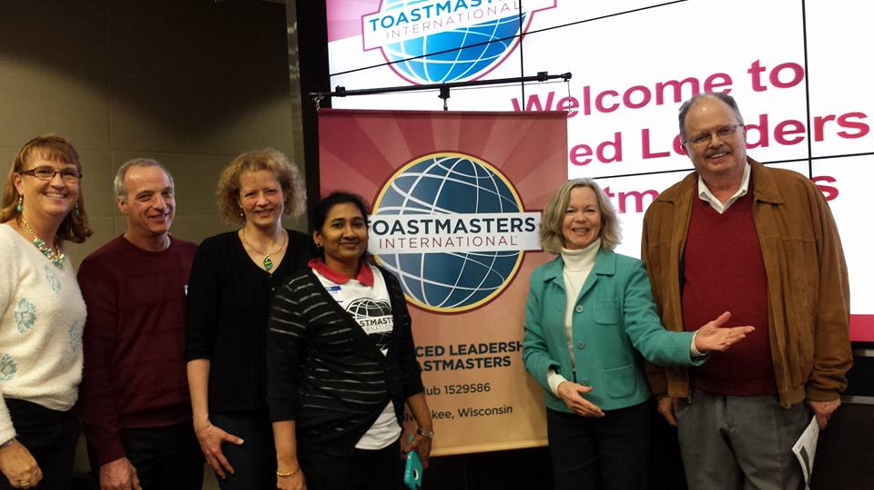
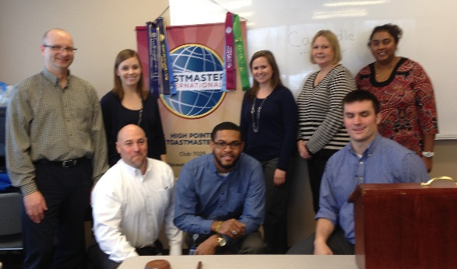
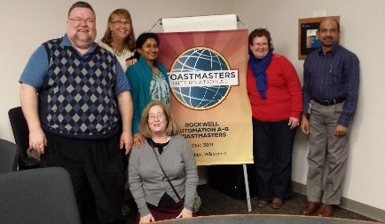
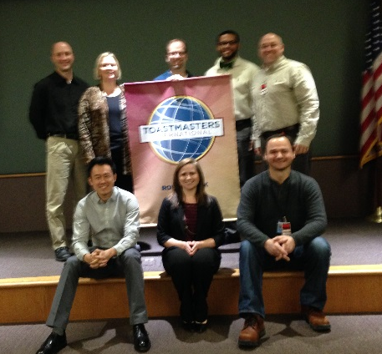
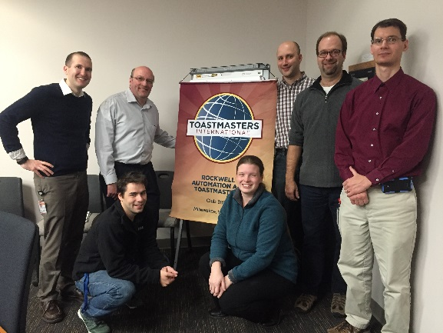
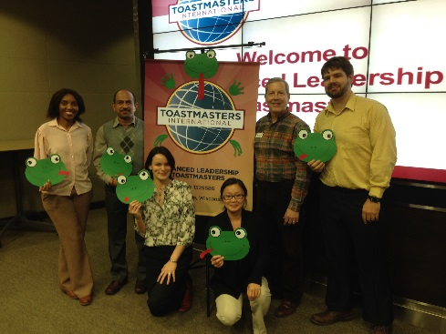
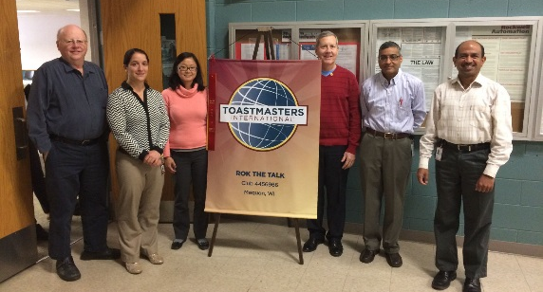
Capture the Banner
15 Club-to-club visits in 4 months

Slide 9
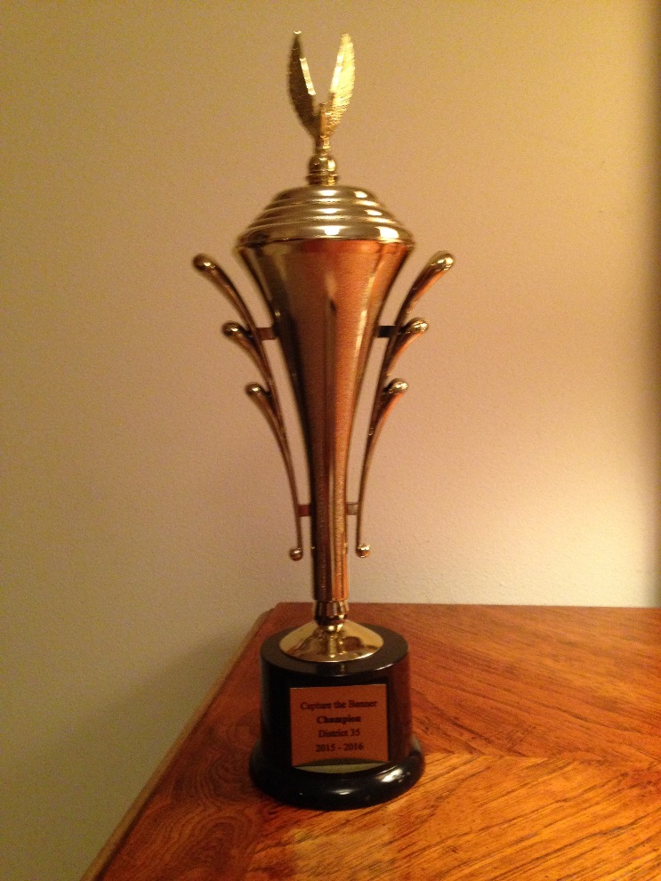
Rockwell Automation A-B Toastmasters
Visited 5 clubs, most creative and furthest distance travelled

Slide 10
Early Membership Payment Incentive
District 35
Spring 2016

Slide 11
Raffle winners ($ 20) for early dues payment
3M Menomonie Toastmasters
Direct Supply Champion Chatters Club
Kenosha Toastmasters
Marshfield Area Toastmasters
Northshore Badgers
Talkers and Shakers
Walworth County Toastmasters Club
Waukesha Toastmasters
Wingra Turning Point Toastmasters
Wisconsin Club

Slide 12
Membership Retention
District 35
Spring 2016

Slide 13
Highest membership retention
Area S1
Albert Thomas
Area Director
89.3%
Western Division
Heidi Schreiner
Division Director 77.1%

Slide 14
Recognition Awards
District 35
2015-2016

Slide 15
Best Websites
3rd Place
  Madison Achievers
2nd Place
  Eastside Madison Toastmasters
  1st Place will be announced at the Hall of Fame

Slide 16
Best Newsletters
3rd Place
  Landmark Toastmasters
2nd Place
  Royal Toastmasters
    1st Place will be announced at the Hall of Fame

Slide 17
Best Social Media Sites
3rd Place
  Brookfield Toastmasters
2nd Place
  Waukesha Toastmasters
  1st Place will be announced at the Hall of Fame

Slide 18
Seven Officers Trained - Winter
Fond du Lac Toastmasters Club 498
New Appleton Toastmasters Club
Fox Speak Toastmasters Club
Southwest Toastmasters
Tosa/Medical Club
Rumble Don’t Mumble Toastmasters
Talkers & Shakers
Eau Claire Toastmasters Club

Slide 19
Celebrating Club Coaches
Craig Meyer – Marq Our Words
  Membership 9 > 20
  Select Distinguished

Slide 20
Competent Communicator Awards
Recognizing those Toastmasters who earned 118 Competent Communicator awards from July 1, 2015 through this Convention.
Please stand and be recognized!

Slide 21
Advanced Communicator Awards
Recognizing those Toastmasters who earned 49 Advanced Communicator awards from July 1, 2015 through this Convention:
  35 Advanced Communicator Bronze
  9 Advanced Communicator Silver
  5 Advanced Communicator Gold
Please stand and be recognized!

Slide 22
Leadership Awards
Recognizing those Toastmasters who earned 156 Competent and Advanced Leadership awards from July 1, 2015 through this convention:
94 Competent Leader
33 Advanced Leader Bronze
14 Advanced Leader Silver
15 High Performance Leadership projects
Please stand and be recognized!

Slide 23
Triple Crown Achievers since 11/5/2015
Julia Boss
Keith Cumiskey
Stephanie Dolejsi
Theresa Flynn
Jim Homan
Jim Hughes
Susan Kohut
Cindy Laatsch
Chad Lawson
Nancy McCulley
Kathleen Rader
Jolene Rogers
Rozaline Janci
Linda Samens
Kathy Lynn Shine
Emily Walton
Michael Zelm

Slide 24
Distinguished Toastmasters
We invite all current DTMs
to come to the front
to create a receiving line
to welcome our new DTMs

Slide 25
Distinguished Toastmasters
Jason Anderson, DTM (earned 5/2/2015)
Irvin Snider, DTM (earned 5/22/15)

Slide 26
Distinguished Toastmasters
Earned since the Fall 2015 Conference
Susan J. Kohut, DTM
Cindy Jane Laatsch, DTM
Chad Dwight Lawson, DTM
Kathleen S. Rader, DTM
Gregory M. Bednar, DTM

Slide 27
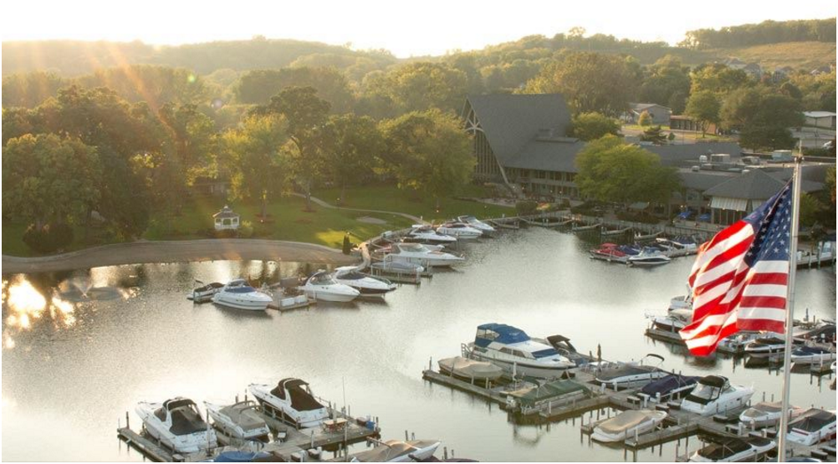
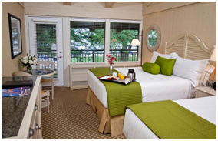
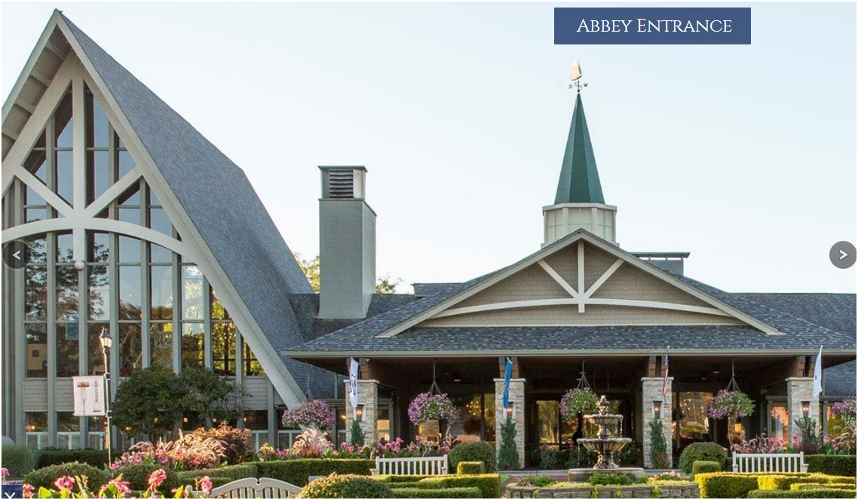
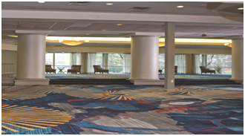
Mark your calendar for the Fall Conference Nov. 4-5, at The Abbey Resort, Fontana, WI

