Slide 1
2018 District 35 Spring Convention
Crowne Plaza Facilities needs

Slide 2
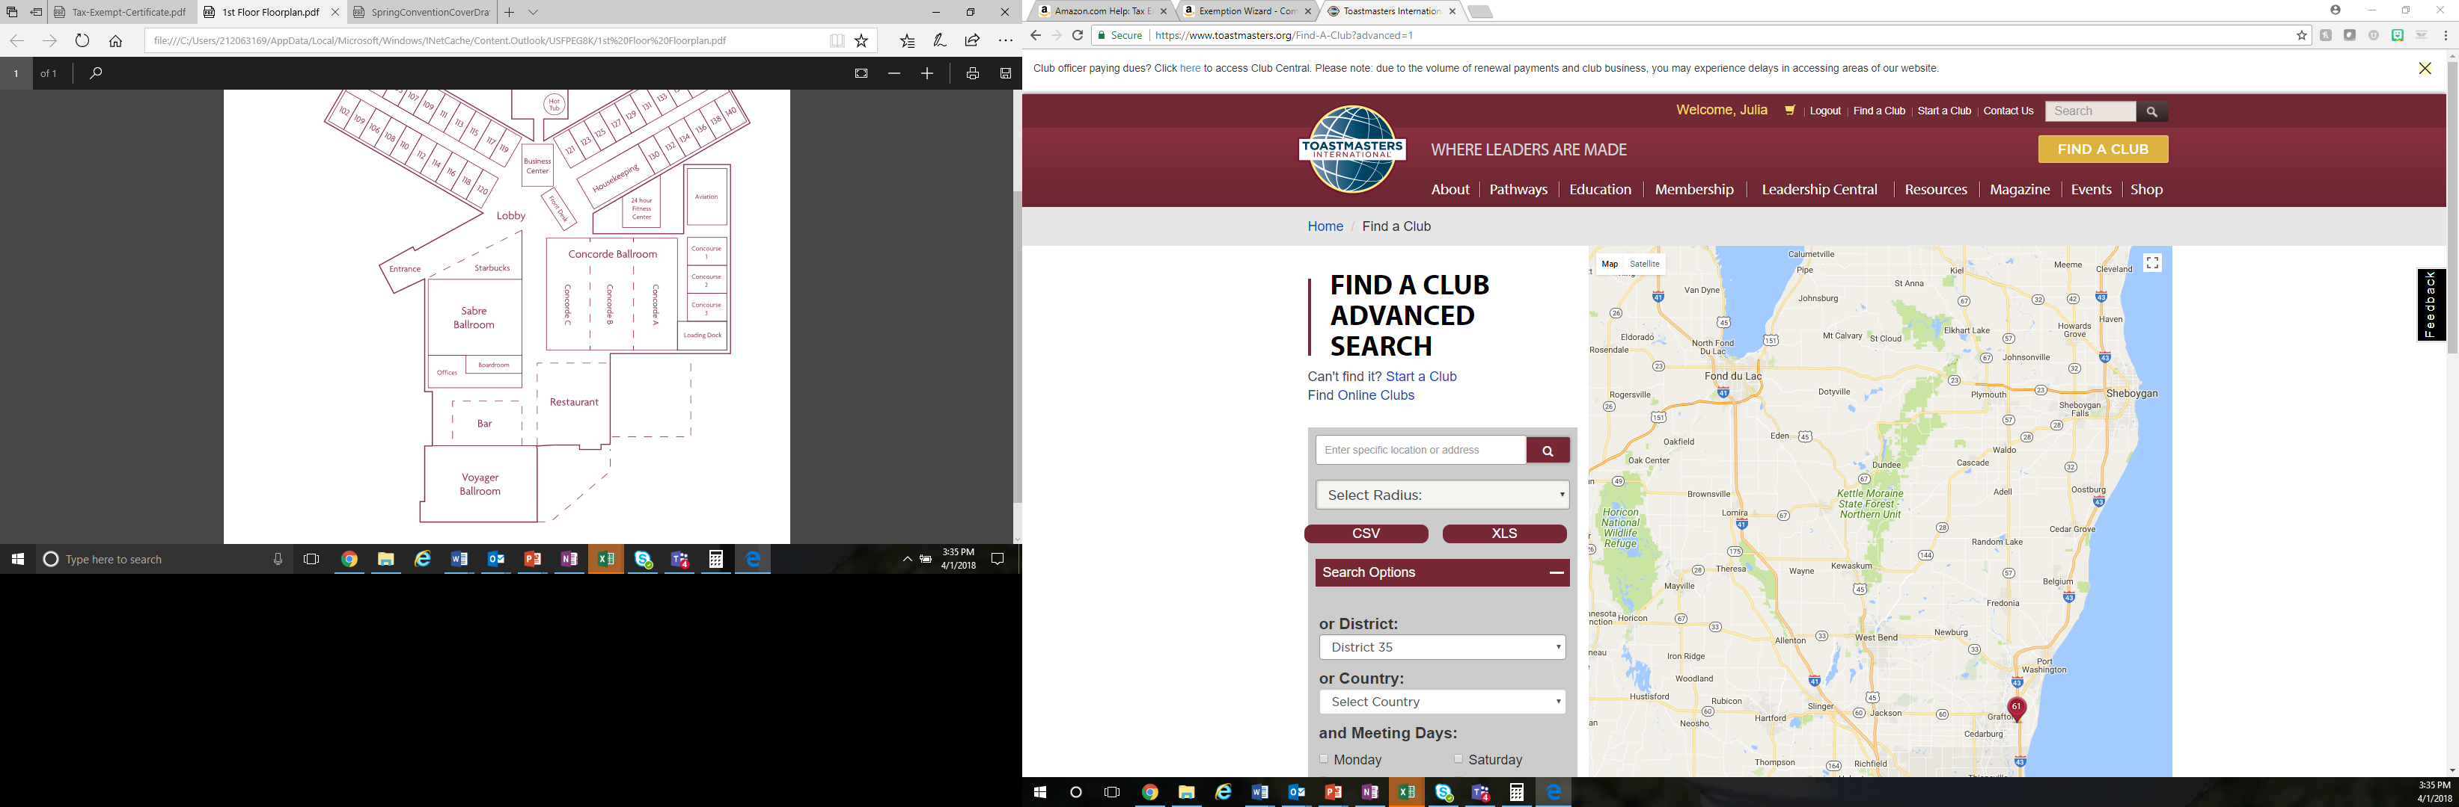
High level first floor map

Slide 3
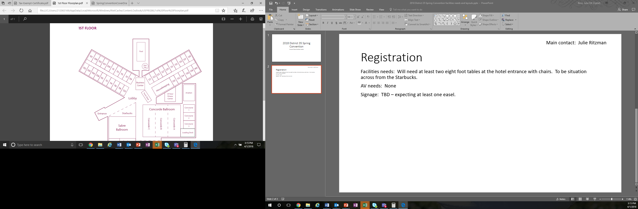
Registration
Main contact: Julie Ritzman
Location: Main entrance
Date/time: Prior to Noon 04-May
Facilities needs: Will need at least two eight foot tables at the hotel entrance with chairs. To be situated across from the Starbucks. Julie to finalize.
AV needs: None
Signage: TBD – expecting at least one easel.
Tables and chairs for registration to be place here.

Slide 4
Past District Governor/Director dinner
Main contact: Julia Boss
Location: Sabre Ballroom
Date/time: Prior to Noon 04-May
Facilities needs: Five round tables with six chairs each. One lectern on the side of the room.
Service needs: Dinner service. Will have meal plans determined ahead of time.
AV needs: None
Emergency exit
Round table with 6 chairs
Round table with 6 chairs
Lectern, no amplification required
Round table with 6 chairs
Round table with 6 chairs
Round table with 6 chairs
Round table with 6 chairs
Entry

Slide 5
Credentials
Main contact: Cindy Laatsch
Location: Main entrance
Date/time: Evening of 04-May
Facilities needs: Will need at least one eight foot table with two chairs at the hotel entrance with chairs. To be situated around the corner from the registration area. Proposing to put by the window near the rest area. Cindy to finalize.
AV needs: None
Signage: TBD – expecting at least one easel.
Tables and chairs for credentials to be place here.

Slide 6
Marketplace
Main contact: David Reed, Heidi Slowinski
Location: Hallway between Aviation and Concourse 1, Concourse 1
Date/time: Prior to Noon 04-May
Facilities needs: David and Heidi to finalize. At least 7 tables.
Signage needs: Easels for each table (7), plus signage for entry point.
AV needs: David and Heidi to finalize.
Exit doors
Entry
Aviation
Concourse 1
Two tables + easel outside of Concourse 1
Entry
Easel with signage

Slide 7
Candidate showcase
Main contact: Keith Cumiskey
Location: Hallway between Aviation and Concourse 1, Concourse 1
Date/time: Prior to 5 PM 04-May
Facilities needs: Three comfortable chairs on stage. May need smaller step up.
Signage needs: Easels for each table (7), plus signage for entry point.
AV needs: 2 microphones – lavalier, and handheld. 3 comfortable chairs on stage.
Two comfortable chairs – can we pull from hallway? – centered on the built-in stage
Entry
Built-in stage. No need for additional risers.
Aviation
Entry

Slide 8
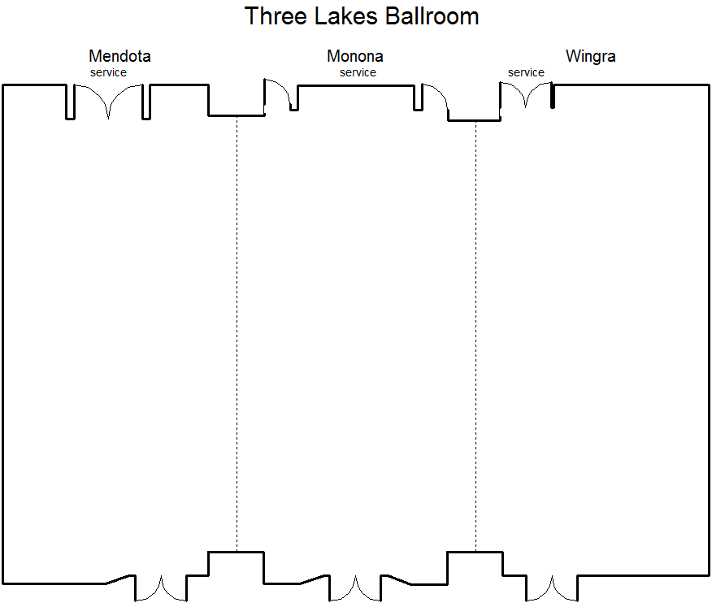
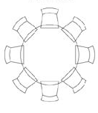
Toastmasters 11/4
Set for 168 ppl
Riser with Head table
***HT to be taken down after meeting @ 2:45PM, KEEP RISER and PODIUM****
Food Tables
Table for sound

Slide 9
Friday Fun Night
Main contact: Joyce Miller
Location: Voyager Ballroom
Date/time: Prior to 5 PM 04-May
DRAFT
Facilities needs: Five round tables with six chairs each. One lectern on the side of the room.
Service needs: Dinner service. Will have meal plans determined ahead of time.
AV needs: None
Emergency exit
Round table with 6 chairs
Round table with 6 chairs
Lectern, no amplification required
Round table with 6 chairs
Round table with 6 chairs
Round table with 6 chairs
Round table with 6 chairs
Entry

Slide 10
Main events - include
Opening Ceremonies
  Call to Order
  Club Banner Parade
  Color Guard
  National Anthem
  Morning Inspirational Message
  Welcome – District Director
  Welcome – Oak Creek Mayor (or TBD)
  Morning Keynote
  *Will need tables cleaned and set up for lunch

Slide 11
Main events – mid-day
Luncheon and awards
  Awards
  Area Director Recognition
  Luncheon Inspirational Message
  Lunch
  Afternoon Keynote
  *Will need tables cleaned and set up for dinner

Slide 12
Main events – evening
Dinner banquet and event conclusion
  Call to order
  Introduction of the head table
  Dinner inspirational message
  Welcome – District Director
  Dinner
  Conference Chair report
  District Director Message
  Installation of Officers
  Incoming District Director Address
  Hall of Fame
  *Will go late into the evening; cannot clean up until Sunday

Slide 13
Main events
Main contact: Julia Boss
Location: Concorde Ballrooms A, B, C
Date/time: Prior to 2 PM 04-May
DRAFT
Facilities needs: Round tables for ~350, head table with risers
Service needs: Will require lunch and dinner service throughout the day. Will have meal plans determined ahead of time.
AV needs: HD Ballroom Presentation Package, HD Ballroom Projector, Audio TBD

Slide 14
Education session –
District 35 - Where Leaders are Made
DRAFT
Main contact: Dick Hawley
Location: Concourse 2
Date/time: Prior to 5 PM 04-May
Facilities needs: Five round tables with six chairs each. One lectern on the side of the room.
Service needs: Dinner service. Will have meal plans determined ahead of time.
AV needs: None
Emergency exit
Round table with 6 chairs
Round table with 6 chairs
Lectern, no amplification required
Round table with 6 chairs
Round table with 6 chairs
Round table with 6 chairs
Round table with 6 chairs
Entry

Slide 15
Concourse A, B, C
Entry
Entry
Entry

Slide 16
“War room”
Main contact: Julia Boss
Location: Boardroom
Date/time: Prior to 9 AM 04-May
Facilities needs: Just need room to be cleaned prior to 9 AM 04-May. Will be using for supplies, “war room” for event.
AV needs: None
Signage: No easel required; sign taped with painter’s tape. Sign will be printed and brought with Julia on Friday morning.

Slide 17
Education session –
Walk Your Talk
DRAFT
Main contact: Diane Rose Bolash
Location: Aviation
Date/time: Prior to 5 PM 04-May
Facilities needs: Five round tables with six chairs each. One lectern on the side of the room.
Service needs: Dinner service. Will have meal plans determined ahead of time.
AV needs: None
Emergency exit
Round table with 6 chairs
Round table with 6 chairs
Lectern, no amplification required
Round table with 6 chairs
Round table with 6 chairs
Round table with 6 chairs
Round table with 6 chairs
Entry

Slide 18
Education session –
Hats off to Pathways!
DRAFT
Main contact: Judy Bauer, Sierk Oudemans
Location: Sabre Ballroom
Date/time: Prior to 5 PM 04-May
Facilities needs: Five round tables with six chairs each. One lectern on the side of the room.
Service needs: Dinner service. Will have meal plans determined ahead of time.
AV needs: None
Emergency exit
Round table with 6 chairs
Round table with 6 chairs
Lectern, no amplification required
Round table with 6 chairs
Round table with 6 chairs
Round table with 6 chairs
Round table with 6 chairs
Entry

Slide 19
Education session –
Emotional Intelligence
DRAFT
Main contact: George Gesior, Aliucha Ramos
Location: Concourse 3
Date/time: Prior to 5 PM 04-May
Facilities needs: Five round tables with six chairs each. One lectern on the side of the room.
Service needs: Dinner service. Will have meal plans determined ahead of time.
AV needs: None
Emergency exit
Round table with 6 chairs
Round table with 6 chairs
Lectern, no amplification required
Round table with 6 chairs
Round table with 6 chairs
Round table with 6 chairs
Round table with 6 chairs
Entry

Slide 20
Education session –
District 35 - Where Leaders are Made
DRAFT
Main contact: David Brooks
Location: Aviation
Date/time: Prior to Noon PM 05-May
Facilities needs: Five round tables with six chairs each. One lectern on the side of the room.
Service needs: Dinner service. Will have meal plans determined ahead of time.
AV needs: None
Emergency exit
Round table with 6 chairs
Round table with 6 chairs
Lectern, no amplification required
Round table with 6 chairs
Round table with 6 chairs
Round table with 6 chairs
Round table with 6 chairs
Entry

Slide 21
Speech contest
Main contact: Julie Abramowski
Location: Voyager Ballroom
Date/time: Prior to Noon PM 05-May
DRAFT
Facilities needs: Five round tables with six chairs each. One lectern on the side of the room.
Service needs: Dinner service. Will have meal plans determined ahead of time.
AV needs: None
Emergency exit
Round table with 6 chairs
Round table with 6 chairs
Lectern, no amplification required
Round table with 6 chairs
Round table with 6 chairs
Round table with 6 chairs
Round table with 6 chairs
Entry

Slide 22
District Council Meeting
Main contact: Keith Cumiskey
Location: Sabre Ballroom
Date/time: Prior to Noon PM 05-May
DRAFT
Facilities needs: Five round tables with six chairs each. One lectern on the side of the room.
Service needs: Dinner service. Will have meal plans determined ahead of time.
AV needs: None
Emergency exit
Round table with 6 chairs
Round table with 6 chairs
Lectern, no amplification required
Round table with 6 chairs
Round table with 6 chairs
Round table with 6 chairs
Round table with 6 chairs
Entry

