Slide 1
District 35 Awards
May 2018

Slide 2
Honoring Area Directors
District 35
2017-2018

Slide 3
2017-2018 Area Directors
A1 – Jennifer Zhang
A2 – Craig Mosey
A3 – Gail Rust
B1 – Kathy Glaser-Brown
B2 – Carl Ervin
B3 – Tom Gust
B4 – Krystyna Hoffman
C1 – Jack Hoffmann
C2 – Rick Griggs
C3 – Tom Carlson
C4 – John Krause
D1 – Alannah McReavey
D2 – Shamaine Schoenherr
D3 – Stephanie Schienke
D4 – Christina Evans
E1 – Kris Pool
E2 – Deb Martin
E3 – Teri McGregor
F1 – Ronda Borowski
F2 – Barbara Cate
F3 – Megan Slaker
N1 – Dick Hawley
N2 – Joni Lodzinski
N3 – Marilyn Noble
W1 – Angela Graham
W3 – Tim Haukeness

Slide 4
New Clubs
District 35 welcomes the following new clubs, chartered since November 2017
  Pewaukee Speaks – Pewaukee, WI
  Babbling Badgers – Waukesha, WI
  The Best “U” – Milwaukee, WI
  Water City Speakers – Oshkosh, WI
  ProSpeaks – Brookfield, WI
Please come forward and accept your club banner

Slide 5
Membership Retention
District 35
Spring 2018

Slide 6
Highest membership retention
Area D3
Stephanie Scheinke
Area Director
100%
Division D
Theresa Flynn Division Director 77.68%

Slide 7
Membership Retention Incentive
District 35
Spring 2018

Slide 8
Talk up Toastmasters
Clubs that added 5 new members in February and March - $50 gift card
NM Speaks! (8 Members)
CNH Industrial Toast Team (7 Members)

Slide 9
Winners ($ 50) for Member Retention Incentive
Menomonee Falls Toastmasters
Well Toasted
Wisconsin Club
Talkers & Shakers
Generally Speaking
Walworth County
Marq Our Words
North Shore Badgers

Slide 10
Winners ($ 50) for Member Retention Incentive
Gift of Gab Club
NM Speaks!
Summit Seekers
Riverview Toastmasters
Smokey's Sensations
Toast On Tap
Manitalkers Toastmasters Club
Deere Tales

Slide 11
Winners ($ 50) for Member Retention Incentive
Mid-Day Women's Alliance Toastmasters
Allis Chalmers Toastmasters
Superiorland Toastmasters Club
Rolling Hills Toastmasters Club
Ayres Associates Toastmasters Club

Slide 12
Seed the Lead Incentive – Lead Only
Greg Bednar
Ahmet Demirbilek
Jeff Ebel
Justin Gottfreid
Scott Kazin
Deb Martin

Slide 13
Seed the Lead Incentive – Lead and Demo Meeting
Laurie Baker
Kathy Glaser Brown
Kelly Huttelmaier
Kelly Martyn
Jim Nelson
Kamal Soan
Lakesha Stevens
Robert Wall

Slide 14
Seed the Lead Incentive – Lead, Demo Meeting and Org Meeting
Rich Boomsliter

Slide 15
Seed the Lead Incentive – Lead, Demo, Org Meetings and Charter
Judith Bauer
Gina Glover
Claudia Henley
David Letkiewicz
Andy Little

Slide 16
Club Ambassador Program
District 35
Spring 2018

Slide 17
Club Ambassador Recipients (1)
Laurie Baker
Judith Bauer
Julie Boehme
Ronda Borowski
Julia Boss
Carl Ervin
Jason Feucht (2nd)
Bill Finnegan
Jesse Franklin
Lori Geddes
Hallie Gerovac
Kathy Glaser-Brown
Pins were in your registration packet, but please stand and be recognized

Slide 18
Club Ambassador Recipients (2)
Angela Graham
Andy Little
Carol Mather
Kelly Martyn
Nancy McCulley
Alannah McReavey
Therese Miller
Craig S. Mosey
Gopi Reddy
David Reed
Julie Ritzman
Jean Rossett
Pins were in your registration packet, but please stand and be recognized

Slide 19
Club Ambassador Recipients (3)
Gail Rust
Stephanie Schienke
Kathy Shine(2nd)
Kyna Shnayderman
Heidi Shockley
Heidi Slowinski
Lakesha Stevens
Nicole Tubeszewski
Will Vertz
Ron Wright
Pins were in your registration packet, but please stand and be recognized

Slide 20
Celebrating Club Coaches
Club | Coach
Church Mutual Club | Charles Thomas Stevens, ATM, CL
Funny Business | Reginald N. Weide, ACG, ALB
Funny Business | Rick Griggs, CC, ALB
Generally Speaking Toastmasters | William Joseph M. Finnegan, ACB, CL
Green Bay Yackers | Julie A. Ritzman, ACS, ALB
Kimmunicators Club | Evelyn C. Puerto, ACS, ALB
Kimmunicators Club | Paul Freiberg, DTM
Landmark Toastmasters Club | Lori A. Geddes, ACB, ALB
Madison Achievers | David J. Barger, CL

Slide 21
Celebrating Club Coaches
Club | Coach
Manitalkers Toastmasters Club | Gina L. Glover, ACG
Marshfield Area Toastmasters | Deborah A. Ginsburg, ACG, ALB
Milwaukee Metro Spkrs Club | Kevin J. Davenport, ACS, ALB
Oak Creek Toastmasters | Jackie Breezer, ACS, ALB
Red Cedar Toastmasters | Jeff A. McRaven, ACS, ALB
Riverview Toastmasters | Gopi Reddy, ACS, CL

Slide 22
Celebrating Club Coaches
Club | Coach
Schneider Toastmasters Club | Gina L. Glover, ACG
Schneider Toastmasters Club | Bruce A. Bitter, ACS, ALB
Smokey's Sensations* | Stephanie N. Schienke, ACB, ALB
Spectacle City Club | Jesse W. Franklin, ACB, CL
Sunburst Club | Barbara A. Cate, CC, CL
The Breakfast Club | Carl W. Ervin, ACG, ALB
The Waukie Talkies | Julia Katherine Boss, DTM
* Distinguished Club

Slide 23
Celebrating Club Coaches
Club | Coach
Toastmasters of the Northwoods | Brian D Wartick
Toastmasters of the Northwoods | William R. Vertz, CC, CL
Tosa/Medical Club | Tom Gust, CC, CL
Trek Toastmasters | Kelly Ann Huttelmaier, ACB, ALB
TT & SS on TAP | Jatin Khilnani
Walworth County Toastmasters Club | Robert Scott Wall, DTM
Walworth County Toastmasters Club | Kelly Ann Huttelmaier, ACB, ALB
Words On Water Sauk Prairie Area Toastmasters | Kim Bradley-Neustadter, CC, CL
Words On Water Sauk Prairie Area Toastmasters | Becky L Schmidt, ACS, ALB

Slide 24
Public Relations
Recognition Awards
District 35
2017-2018

Slide 25
Best Website
2nd Place – Plymouth Toastmasters
  1st Place will be announced at the Hall of Fame

Slide 26
Best Newsletter
2nd Place- Rasmussen College Toastmasters
  1st Place will be announced at the Hall of Fame

Slide 27
Best Social Media Presence
2nd Place – Menomonee Falls Toastmasters
  1st Place will be announced at the Hall of Fame

Slide 28
Recognizing our clubs already Distinguished 2017-2018
Brookfield Toastmasters
Chrome Conversations
CNH Industrial Toast Team
Cream City Communicators
Direct Supply Champion Chatters Club

Slide 29
Recognizing our clubs already Distinguished 2017-2018 (cont’d)
Keynoters Club
NM Speaks!
North Shore Badgers
Reedsburg Area Club
Rumble Don't Mumble Toastmasters

Slide 30
Recognizing our clubs already Distinguished 2017-2018 (cont’d)
Sentry Toastmasters Club
Smokey's Sensations
Southwest Toastmasters
Toastmasters In Control
Waukesha Toastmasters Club
Well Toasted

Slide 31
Seven Officers Trained - Winter
Advanced Leadership Toastmasters
Allis Chalmers Toastmasters
Babbling Badgers
DJAB
Kenosha Toastmasters
NM Speaks!
Talkers & Shakers
Wisconsin Rapids Area Toastmasters Club
Ribbons were in the registration packet of your clubs officer, but please stand and be recognized

Slide 32
Elite Eight (8+ new members this year)
Direct Supply Champion Chatters Club
Gift of Gab Club
High Pointe Club
Kenosha Toastmasters
La Crosse Area Toastmasters Club
Madison Club #1
Ayres Associates Toastmasters Club
Brookfield Toastmasters
Chippewa Valley Club
Chrome Conversations
CNH Industrial Toast Team
Cream City Communicators
Ribbons were in the registration packet of your clubs officer, but please stand and be recognized

Slide 33
Elite Eight (8+ new members this year)
New Appleton Toastmasters Club
NM Speaks!
Prairie Swale Club
ROK the Talk
Sales Masters
Screamin' Eagle Speakers
Sentry Toastmasters Club
Superiorland Toastmasters Club
Toastmasters In Control
Uptowner Toastmasters Club
Waukesha Toastmasters Club
Wisconsin Club
Ribbons were in the registration packet of your clubs officer, but please stand and be recognized

Slide 34
Competent Communicator Awards
Recognizing those Toastmasters who earned 128 Competent Communicator awards from July 1, 2017 through April 30, 2018.
Please stand and be recognized!

Slide 35
Advanced Communicator Awards
Recognizing those Toastmasters who earned 61 Advanced Communicator awards from July 1, 2017 through April 30, 2018:
    38 Advanced Communicator Bronze
    14 Advanced Communicator Silver
    9 Advanced Communicator Gold
Please stand and be recognized!

Slide 36
Leadership Awards
Recognizing those Toastmasters who earned 155 Competent and Advanced Leadership awards from July 1, 2017 through April 30, 2018:
  99 Competent Leader
  34 Advanced Leader Bronze
  7 Advanced Leader Silver
  15 High Performance Leadership projects and DTMs
Please stand and be recognized!

Slide 37
Pathways Awards
Recognizing those Toastmasters who earned 11 Pathways awards from February 13, 2018 through April 30, 2018:
  8 Level 1 Awards
  1 Level 2 Award
  2 Level 4 Awards
Please stand and be recognized!

Slide 38
Triple Crown Achievers since 11/1/2017
Bonniejean Alford
Douglass Anderson
Judith Bauer
David Dopkins
Jason Feucht
Bill Finnegan
David Gagliano
Angela Graham
Paula Houlihan
Sandra Krzewinski
Pins were in your registration packet, but please stand and be recognized

Slide 39
Triple Crown Achievers since 11/1/2017
Craig Mosey
Karen Polege
Matt Scheuers
John Scott
Kyna Shnayderman
Heidi Slowinski
Irv Snider
Ed Thelen
Jerry Ward
Stephen Wittmann
Pins were in your registration packet, but please stand and be recognized

Slide 40
Multiple Triple Crown Achievers
2017-2018
Rozaline Janci
Theresa Flynn
Kris Pool
Kathy Shine

Slide 41
Distinguished Toastmasters
We invite all current DTMs
to come to the front
to create a receiving line
to welcome our new DTMs

Slide 42
Distinguished Toastmasters
Earned since the Fall 2017 Conference
Douglass Anderson - DTM
Paula Houlihan - DTM
John Scott - DTM

Slide 43
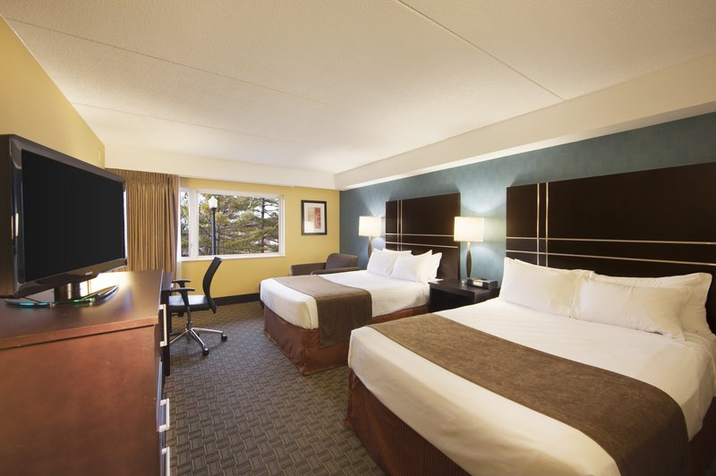
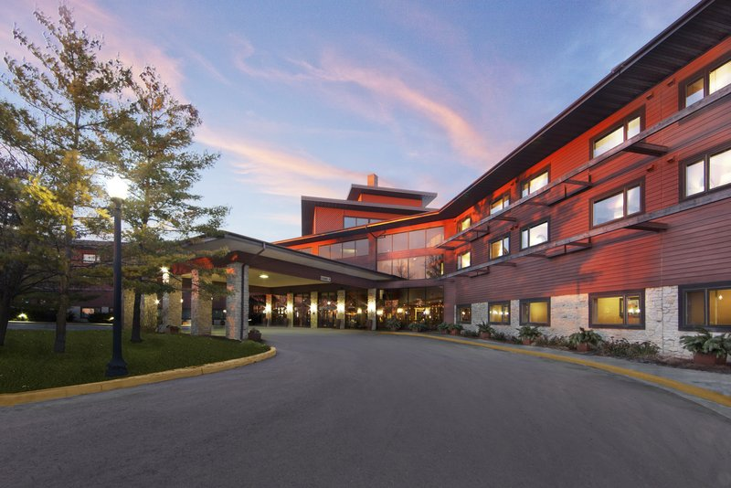
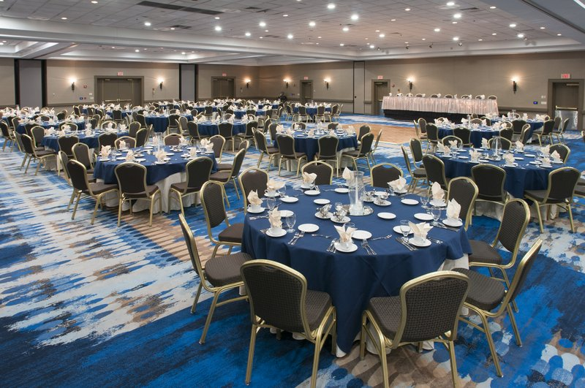
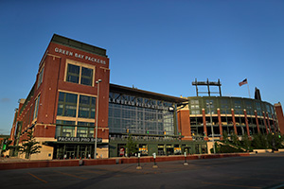
Mark your calendar for the 2019 Spring Convention May 10th & 11th at the Radisson Hotel & Conference Center Green Bay

