Slide 1
Conference Updates
Kris Pool, DTM – Spring Conference Chair 2023
March 11, 2023
DEC Meeting

Slide 2
Registration

Slide 3

Registration is OPEN!!!

Slide 4
https://district35.org/
spring-conference/

Slide 5
Different Options
Different Prices

Slide 6
DEC members
$75
DEC members – virtual
$10
Notes:
Club Registration $150 (early bird)
Club Registration $200 (regular pricing)
Club Member – with registered club $100 (early bird)
Club Member – with register club $150 (regular pricing)
Club Member – virtual only – with registered club $10.00
Individual member – no registered club $200 (early bird)
Individual member – no registered club $250 (regular pricing)
Individual member – no registered club $25
Guest – Lunch Only $45.00
Guest – Dinner Only $75.000
Optional – Sunday Luncheon $40
Invite Only – PDD/PDG $65

Slide 7
Club Registration $150
(early bird)
Club Registration $200
(regular pricing)
Notes:
Club Registration $150 (early bird)
Club Registration $200 (regular pricing)
Club Member – with registered club $100 (early bird)
Club Member – with register club $150 (regular pricing)
Club Member – virtual only – with registered club $10.00
Individual member – no registered club $200 (early bird)
Individual member – no registered club $250 (regular pricing)
Individual member – no registered club $25
Guest – Lunch Only $45.00
Guest – Dinner Only $75.000
Optional – Sunday Luncheon $40
Invite Only – PDD/PDG $65

Slide 8
Club Member - registered club $100 (early bird)
Club Member – registered club $150 (regular pricing)
Club Member – virtual only –registered club $10
Notes:
Club Registration $150 (early bird)
Club Registration $200 (regular pricing)
Club Member – with registered club $100 (early bird)
Club Member – with register club $150 (regular pricing)
Club Member – virtual only – with registered club $10.00
Individual member – no registered club $200 (early bird)
Individual member – no registered club $250 (regular pricing)
Individual member – no registered club $25
Guest – Lunch Only $45.00
Guest – Dinner Only $75.000
Optional – Sunday Luncheon $40
Invite Only – PDD/PDG $65

Slide 9
Individual member – no registered club $200 (early bird)
Individual member – no registered club $250 (regular pricing)
Individual member – no registered club $25
Notes:
Club Registration $150 (early bird)
Club Registration $200 (regular pricing)
Club Member – with registered club $100 (early bird)
Club Member – with register club $150 (regular pricing)
Club Member – virtual only – with registered club $10.00
Individual member – no registered club $200 (early bird)
Individual member – no registered club $250 (regular pricing)
Individual member – no registered club $25
Guest – Lunch Only $45.00
Guest – Dinner Only $75.000
Optional – Sunday Luncheon $40
Invite Only – PDD/PDG $65

Slide 10
Guest – Lunch Only $45
Guest – Dinner Only $75
Notes:
Club Registration $150 (early bird)
Club Registration $200 (regular pricing)
Club Member – with registered club $100 (early bird)
Club Member – with register club $150 (regular pricing)
Club Member – virtual only – with registered club $10.00
Individual member – no registered club $200 (early bird)
Individual member – no registered club $250 (regular pricing)
Individual member – no registered club $25
Guest – Lunch Only $45.00
Guest – Dinner Only $75.000
Optional – Sunday Luncheon $40
Invite Only – PDD/PDG $65

Slide 11
Optional – Sunday Breakfast $40
Invite Only – PDD/PDG Dinner $65
Notes:
Club Registration $150 (early bird)
Club Registration $200 (regular pricing)
Club Member – with registered club $100 (early bird)
Club Member – with register club $150 (regular pricing)
Club Member – virtual only – with registered club $10.00
Individual member – no registered club $200 (early bird)
Individual member – no registered club $250 (regular pricing)
Individual member – no registered club $25
Guest – Lunch Only $45.00
Guest – Dinner Only $75.000
Optional – Sunday Luncheon $40
Invite Only – PDD/PDG $65

Slide 12
Agenda

Slide 13
FRIDAY
Notes:
Club Registration $150 (early bird)
Club Registration $200 (regular pricing)
Club Member – with registered club $100 (early bird)
Club Member – with register club $150 (regular pricing)
Club Member – virtual only – with registered club $10.00
Individual member – no registered club $200 (early bird)
Individual member – no registered club $250 (regular pricing)
Individual member – no registered club $25
Guest – Lunch Only $45.00
Guest – Dinner Only $75.000
Optional – Sunday Luncheon $40
Invite Only – PDD/PDG $65

Slide 14
Time | Activity / Event
1pm – 3:30pm | Vision Boards – Your KEY
3:30pm – 7:00pm | Registration
3:30pm – 7:00pm | Raffles
4:00pm – 4:45pm | The Art of Small Talk
5:00pm – 6:30pm | PDG/PDD Dinner
4:45pm – 10:00pm | Cash Bar
5:00pm – 6:00pm | First Timers Reception
5:00pm – 7:10pm | Networking
6:45pm – 7:05pm | Contest Briefings
7:15pm – 8:30pm | Contest – Tall Tales
9:00pm – 10:30pm | Friday Fun Night

Slide 15
SATURDAY
Notes:
Club Registration $150 (early bird)
Club Registration $200 (regular pricing)
Club Member – with registered club $100 (early bird)
Club Member – with register club $150 (regular pricing)
Club Member – virtual only – with registered club $10.00
Individual member – no registered club $200 (early bird)
Individual member – no registered club $250 (regular pricing)
Individual member – no registered club $25
Guest – Lunch Only $45.00
Guest – Dinner Only $75.000
Optional – Sunday Luncheon $40
Invite Only – PDD/PDG $65

Slide 16
Time | Activity / Event
5:30am – 6:15am | Morning Walk
6:30am – 7:45am | Breakfast
7:00am – 12:00pm | Registration
7:00am – 6:00pm | Raffles
8:00am – 9:00am | Opening Ceremony
9:00am | Keynote Address –
9:45am | Break
10:00am | Education Sessions 1 & 2
10:45am | Break
11:00am | Education Sessions 3 & 4
11:45am | Break
12:00pm | Lunch & Awards

Slide 17
Time | Activity / Event
1:30pm | Keynote Presentation
2:00pm | Break
2:15pm | Contest Briefings
3:00pm | International Speech Contest
5:30pm (to 10pm) | Cash Bar
5:30pm | Cash Bar and Networking
5:45pm | Dignitary Lineup
6:00pm | Welcome
6:30pm | Dinner Banquet
7:30pm | Final Remarks
8:00pm | Break
8:20pm | Hall of Fame Presentation
8:40pm | Raffle Winners Announced
9:00pm | Adjourn
9:00pm | Social Time & Cash Bar
10pm | Event End

Slide 18
Speakers

Slide 19
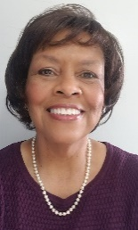
Sunday, April 30, 2023 7:00 p.m. – 8:00 p.m.
Valda Boyd Ford, DTM, Accredited Speaker
The KEYS to Being a Healthy Toastmaster
Key Takeaways:
Understand your numbers and how to make them work for you
Understand more of how your body works and what you need to do
Appreciate your ability to be a partner in your health journey

Slide 20
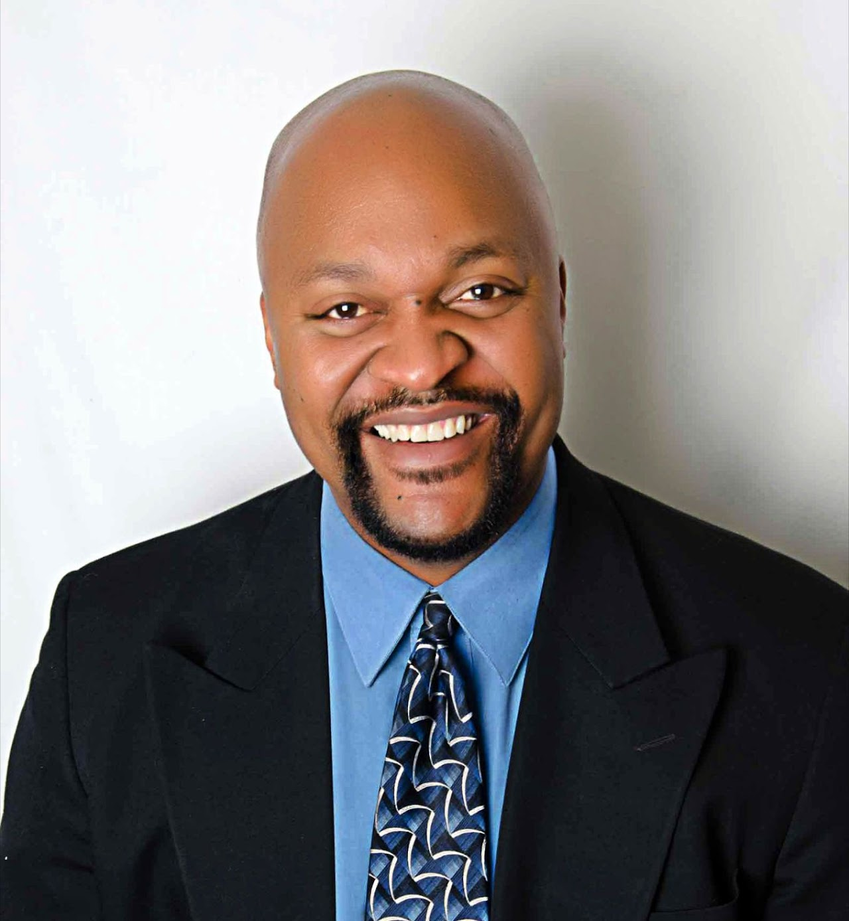
Monday, May 1, 2023 7:00 p.m. – 8:00 p.m.
Darryle Brown, DTM
TBD
Key Takeaways:
TBD
TBD
TBD

Slide 21
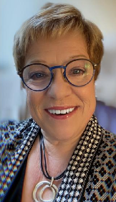
Tuesday, May 2, 2023 7:00 p.m. – 8:00 p.m.
Cindy Laatsch, DTM
Lead With Your Strengths – Do More of What You Do Best!
Key Takeaways:
Self-knowledge
How to “team” effectively
Understand your KEY leadership style

Slide 22
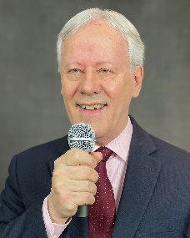
Wednesday, May 3, 2023 7:00 p.m. – 8:00 p.m.
Jim Emery, PM5, EH5
Vocal Delivery on Steroids
Key Takeaways:
The five KEY factors to bring the sound of your voice to its best
The seven KEY factors to make your vocal delivery come alive
How to rehearse so your delivery is at its best every time

Slide 23
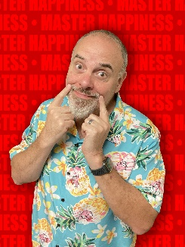
Friday, May 5, 2023 4:00 p.m. – 4:45 p.m.
Marty Jalove, EC2
The Art of Small Talk
Key Takeaways:
The different between a successful Elevator and Cocktail speech
The three Creative Conversation Starters that work with everyone
Insight into the Master Happiness Story Sorter and never run out of conversation fodder

Slide 24
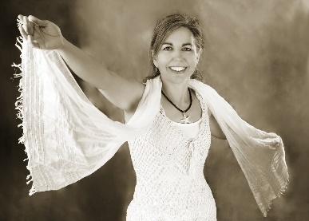
Saturday, May 6, 2023 10:00 a.m. to 10:45 a.m.
Kim Hall
The Treasures and Adventures of U
Key Takeaways:
U are valuable
U are love
U are at peace with yourself

Slide 25
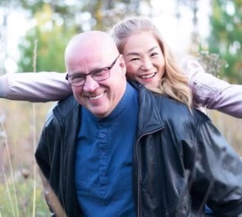
Saturday, May 6, 2023 10:00 a.m. to 10:45 a.m.
Andrew Little, DTM, PID
Let’s Build the Excitement
Key Takeaways:
Understand why excitement is important
How to build excitement
How to engage your teams to improve results

Slide 26
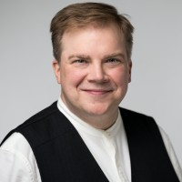
Saturday, May 6, 2023 11:00 a.m. to 11:45 a.m.
Chad Lawson, DTM
The Sharpest Tool in the Shed…. or
Discover How a Maker Mindset is the KEY to Your Future
Key Takeaways:
Define the Maker Mindset, how it can help you, and why it matters
Discover simple ways to incorporate the Maker Mindset into your daily life
Unlock the one KEY word needed to jumpstart your Maker Mindset

Slide 27
Saturday, May 6, 2023 11:00 a.m. to 11:45 a.m.
Marty Jalove, EC2
Storytelling When Speaking
Key Takeaways:
Learn the Master Happiness Storytelling Hack
Learn how to turn Trains into Roller Coasters
Step-by-step process to get your audience to think, feel, and react

Slide 28
Contests

Slide 29
FRIDAY
Tall Tales Contest

Slide 30
SATURDAY
International Speech Contest

Slide 31
Raffles / Donations

Slide 32



Slide 33
Sponsorships / Program Advertising

Slide 34
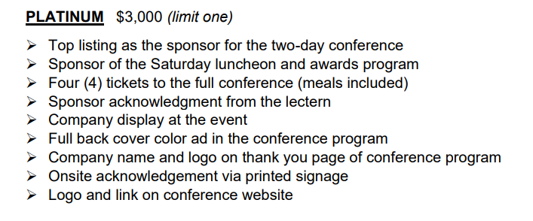

Slide 35
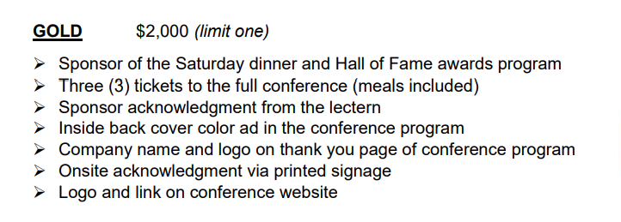

Slide 36
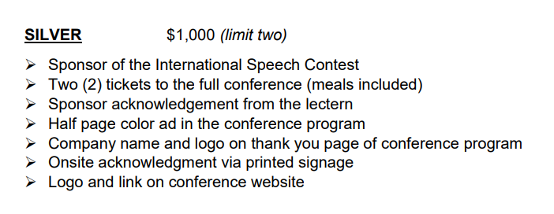

Slide 37
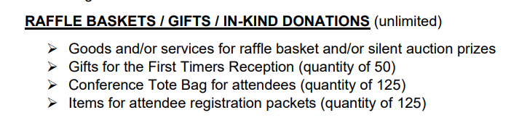

Slide 38
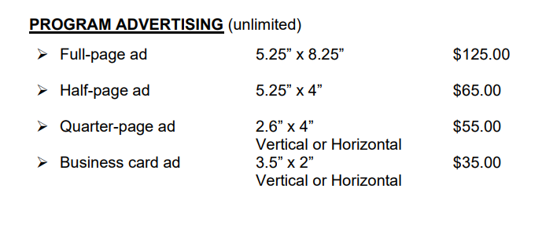

Slide 39
Volunteers

Slide 40
Room Monitors
Registration
Raffles
General Help
First Timers
Photographers
Notes:
Also need someone to give morning invocation and lunch invocation

Slide 41
Registration
Friday, May 5 |  | Name | Brief Explanation
 | 1:30pm to 4:00pm |  | Setup and registration
 | 1:30pm to 4:00pm |  | Setup and registration
 | 4:00pm - 6:00pm |  | Registration
 | 4:00pm - 6:00pm |  | Registration
 | 6:00pm - 7:30pm |  | Registration and clean up
 | 6:00pm - 7:30pm |  | Registration and clean up
Saturday, May 6
 | 6:45am - 8:30am |  | Setup and registration
 | 6:45am - 8:30am |  | Setup and registration
 | 8:30am - 10:30am |  | Registration
 | 10:30am - 12:30pm |  | Registration and Clean Up
 | 11:45am - 12:30pm |  | Clean Up

Slide 42
Room Monitors
Friday, May 5 |  | Name | Brief Explanation
 | 3:30pm - 5:00pm |  | Welcome speaker, time speaker, introduce speaker, thank speaker, hand out / collect eval forms
Saturday, May 6
 | 9:45am - 11:00am |  | Welcome speaker, time speaker, introduce speaker, thank speaker, hand out / collect eval forms
 | 9:45am - 11:00am |  | Welcome speaker, time speaker, introduce speaker, thank speaker, hand out / collect eval forms
 | 10:45am - 12:00pm |  | Welcome speaker, time speaker, introduce speaker, thank speaker, hand out / collect eval forms
 | 10:45am - 12:00pm |  | Welcome speaker, time speaker, introduce speaker, thank speaker, hand out / collect eval forms

Slide 43
Raffles and 50/50
Friday, May 5 |  | Name | Brief Explanation
 | 1:30pm to 4:00pm |  | Setup / Sell
 | 1:30pm to 4:00pm |  | Setup / Sell
 | 4:00pm - 6:00pm |  | Sell
 | 4:00pm - 6:00pm |  | Sell
 | 6:00pm - 7:30pm |  | Sell / Clean Up
 | 6:00pm - 7:30pm |  | Sell / Clean Up

Slide 44
Raffles and 50/50
Saturday, May 6
 | 6:45am - 8:30am |  | Setup / Sell
 | 6:45am - 8:30am |  | Setup / Sell
 | 8:30am - 10:30am |  | Sell
 | 10:30am - 12:30pm |  | Sell
 | 10:30am - 12:30pm |  | Sell
 | 12:30pm - 2:30pm |  | Sell
 | 12:30pm - 2:30pm |  | Sell
 | 2:30pm - 4:30pm |  | Sell
 | 4:30pm - 6:30pm |  | Sell / Clean Up
 | 4:30pm - 6:30pm |  | Sell / Clean Up
 | 8:30pm - 9:00pm |  | Move items to Hall of Fame Room / help with delivering prizes
 | 8:30pm - 9:00pm |  | Move items to Hall of Fame Room / help with delivering prizes
 | 8:30pm - 9:00pm |  | Move items to Hall of Fame Room / help with delivering prizes

Slide 45
General Volunteers
Friday, May 5 |  | Name | Brief Explanation
1 | 1:30pm to 4:00pm | Paul Anderson | Setup / Carry / Display / General Help as needed
2 | 1:30pm to 4:00pm |  | Setup / Carry / Display / General Help as needed
3 | 4:00pm - 6:00pm |  | Setup / Carry / Display / General Help as needed
4 | 4:00pm - 6:00pm |  | Setup / Carry / Display / General Help as needed
5 | 6:00pm - 7:30pm |  | Setup / Carry / Display / General Help as needed
6 | 6:00pm - 7:30pm |  | Setup / Carry / Display / General Help as needed
Saturday, May 6
1 | 7:00am - 8:15am |  | Setup / Carry / Display / General Help as needed
2 | 7:00am - 8:15am |  | Setup / Carry / Display / General Help as needed
3 | 5:30pm - 6:30pm |  | Setup / Carry / Display / General Help as needed
4 | 5:30pm - 6:30pm |  | Setup / Carry / Display / General Help as needed
5 | 8:30pm - 9:00pm |  | Setup / Carry / Display / General Help as needed
6 | 8:30pm - 9:00pm |  | Setup / Carry / Display / General Help as needed

Slide 46
Spread the Word

Slide 47
District Website

Slide 48
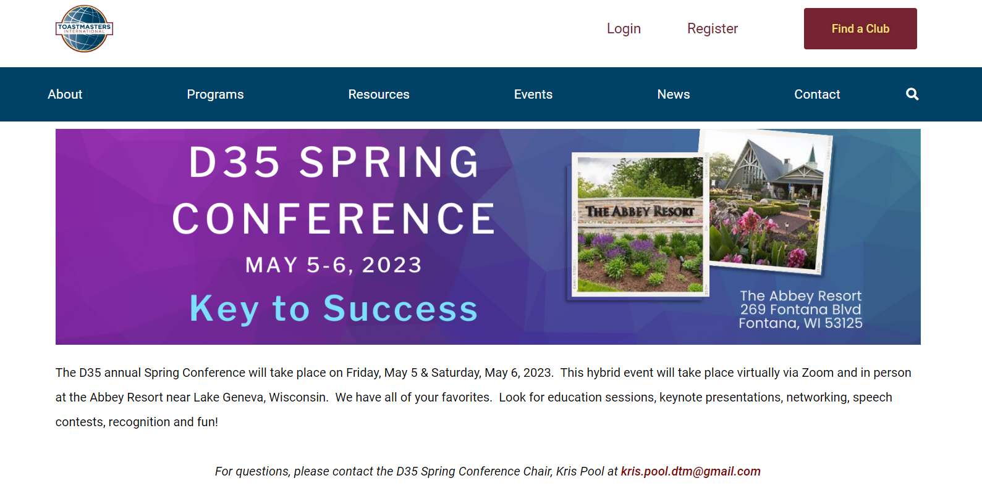

Slide 49
FAQs

Slide 50
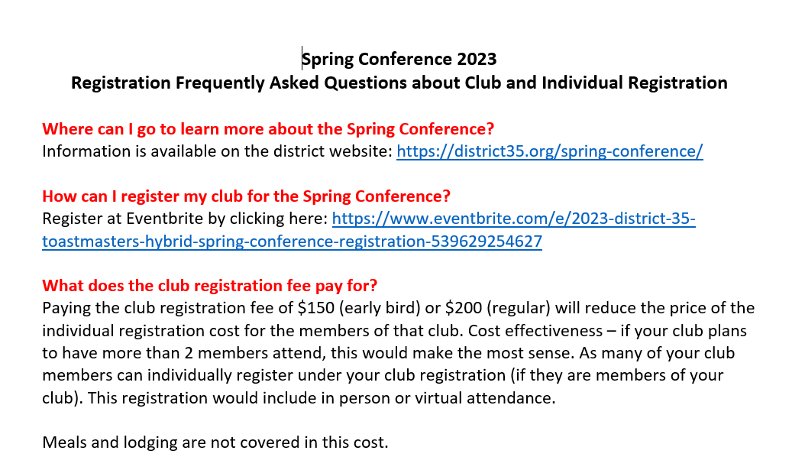

Slide 51
What Am I Missing?

Slide 52
Thank You!!!

Slide 53
Host Division – Central Division
Host Club – Walworth County Toastmasters Club
Registration – Ronda Borowski
PR – Teri McGregor and Kat Yats
Program – Tammy Jankowski
Technology – Jeff Ebel and Matt Wuteska

Slide 54
Friday Fun Night – Dave Schmitt
Emcee – David Gagliano
Education – OPEN
Raffles – OPEN
Sponsorship – OPEN
First Timers - OPEN

Slide 55
What Else Am I Missing?

Slide 56
Don’t Forget to Register!!!

