Slide 1

Top 12 Zoom Presentation Tips to Ace Your Next Online Toastmasters Meeting
Presented by:
Nick Lechnir, VP Education
La Crosse Toastmasters Club 411

Slide 2

PART I:
Preparing Your Zoom Meeting

Slide 3

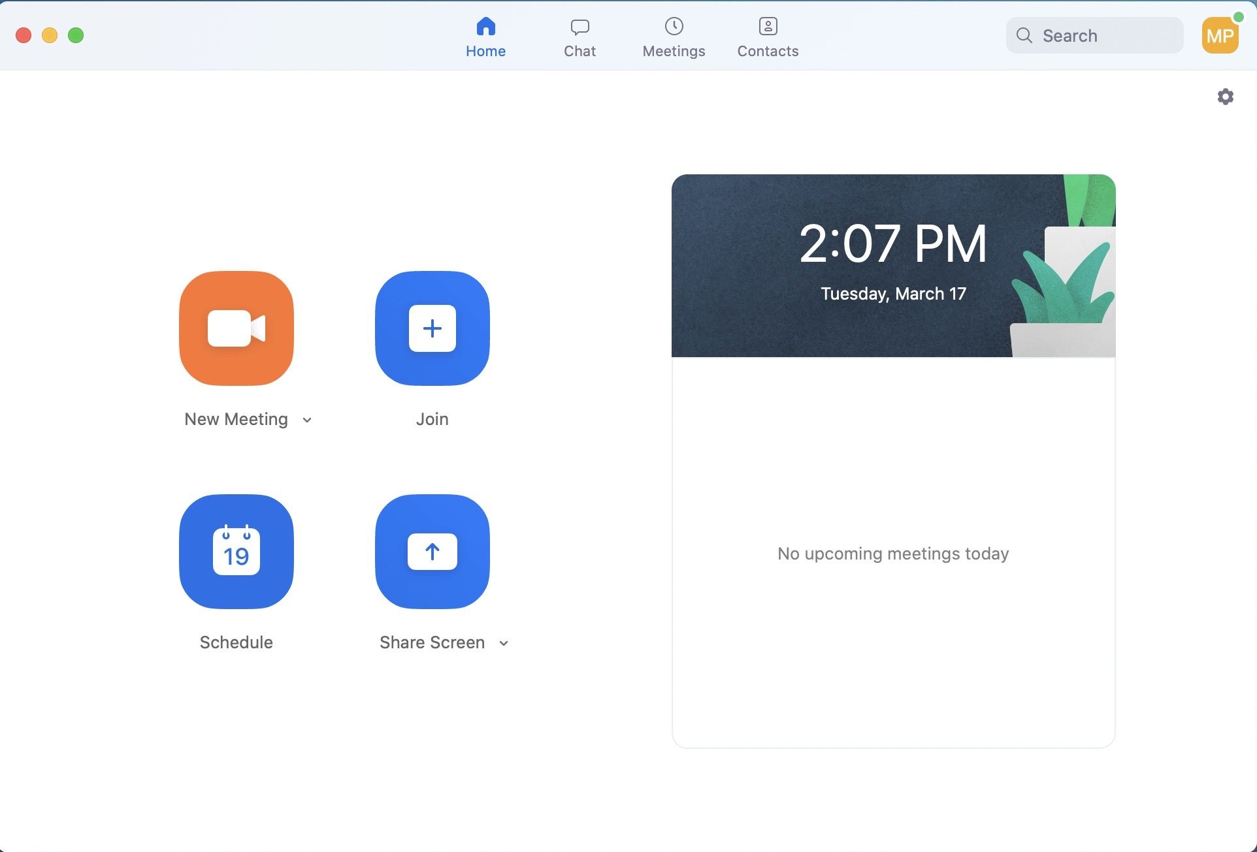

1. Check Your Equipment
INTERNET
ZOOM APP LOGIN
MICROPHONE/CAMERA

Slide 4

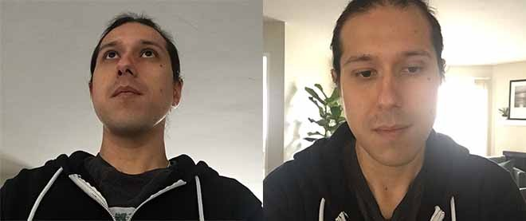
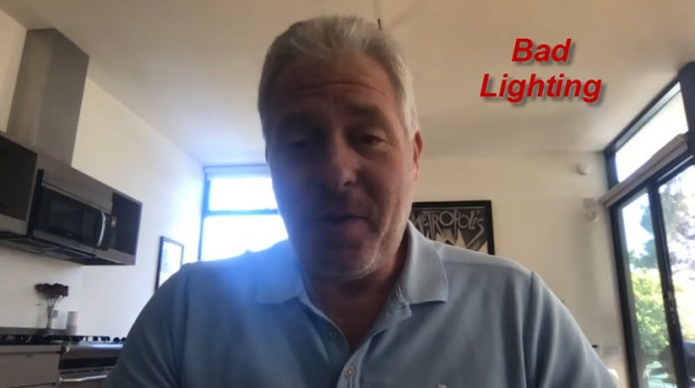
2. Draw Attention to Your Face

Slide 5
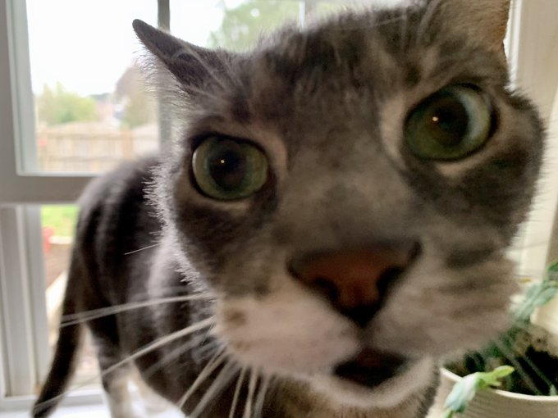
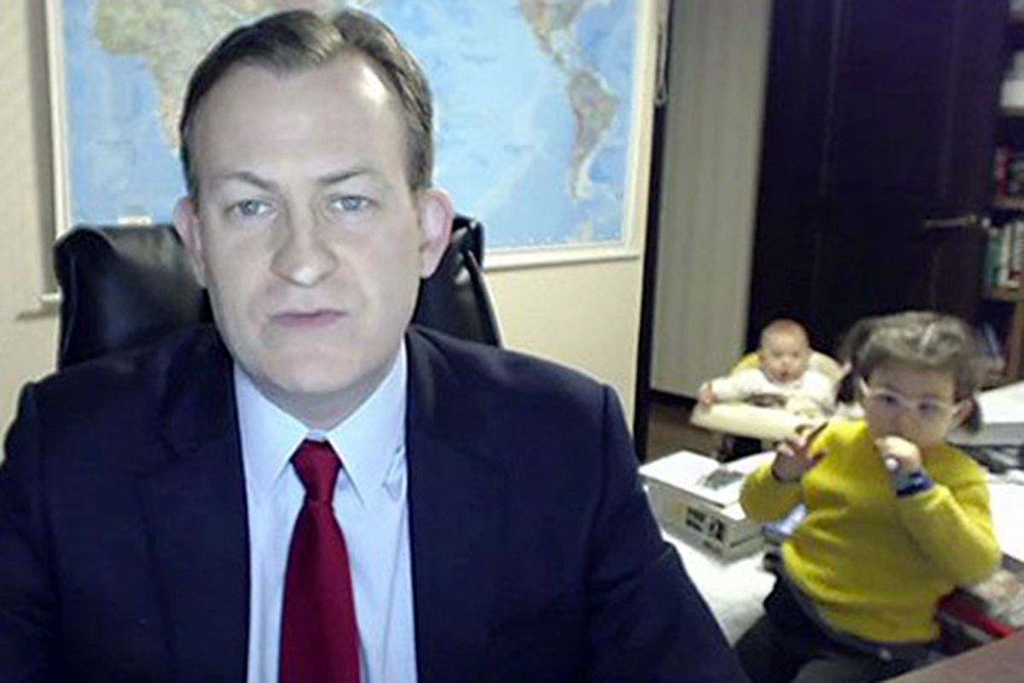
3. Minimize Potential Interruptions

Slide 6
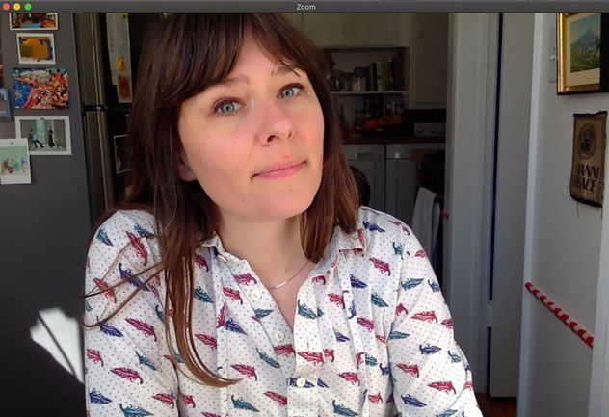
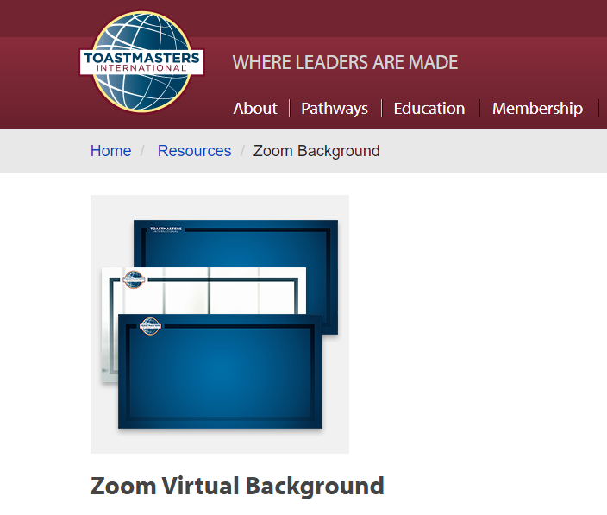
4. Tidy Up Your Background

Slide 7
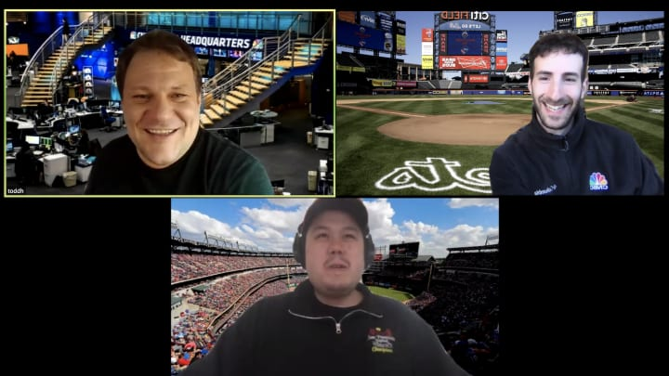
4. Tidy Up Your Background

Slide 8
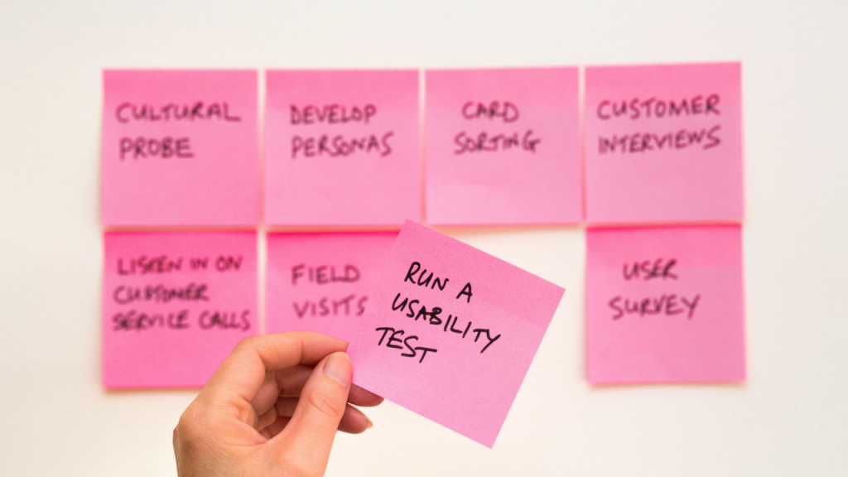
5. Notes in the Right Place

Slide 9

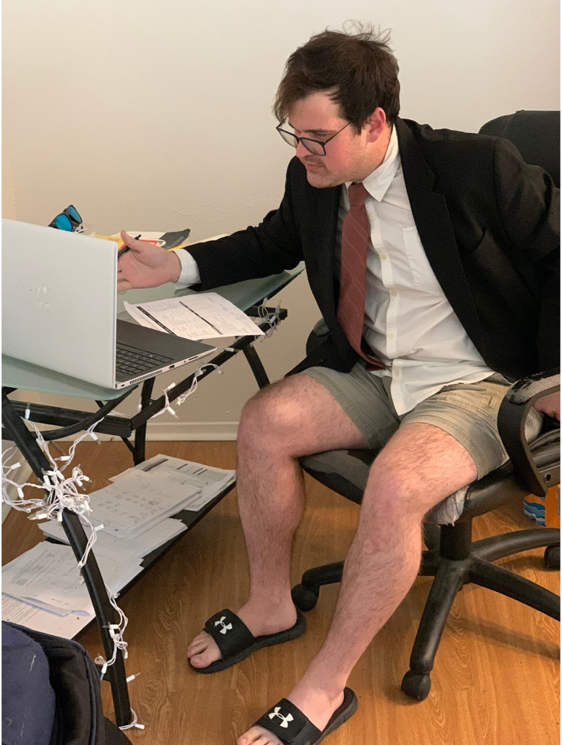
6. Ditch the Pajamas

Slide 10
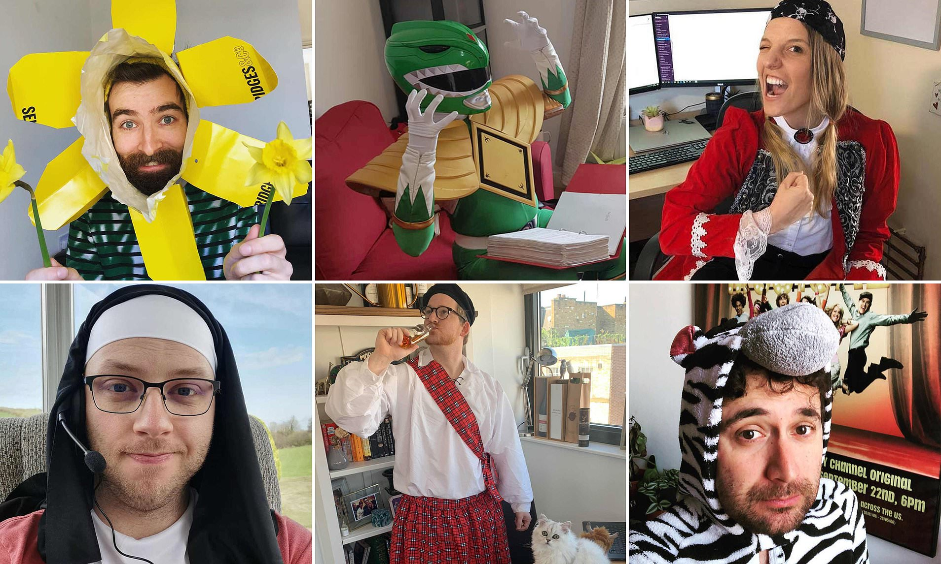
6. Dig the Pajamas!

Slide 11

PART II: Delivering Your Zoom Meeting

Slide 12
7. Start With a Bang
Start with a great story
The power of pause
Begin with intrigue
Hook them with call back
Engage with entertainment or humor
“When I was a child, I was a stage hand at my school play, but when I tripped on a cord and landed on the stage in front of the audience, I became an instant performer.”
(Don’t speak for 6 seconds)
“When life throws its worst at you, you have two choices… to stay trapped in a tunnel or to keep on walking.”
“When we discussed the urgency of xyz at our last meeting…”
“Who here knows how to juggle?” (If you do, then juggle something and show your method. If you don’t, say “Neither do I. Join the club.”)

Slide 13
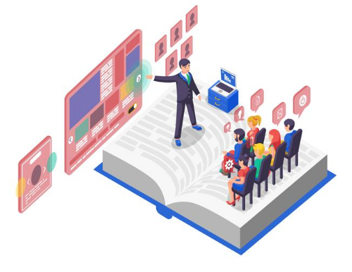
8. Design a Great Presentation
Luck favors the prepared.
Confidence doesn’t happen by accident.
Planning starts long before anyone sees the results.
Great presentations are designed that way.

Slide 14
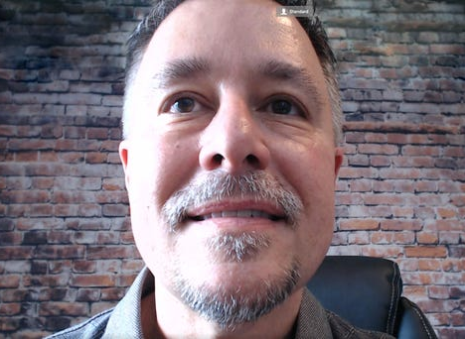
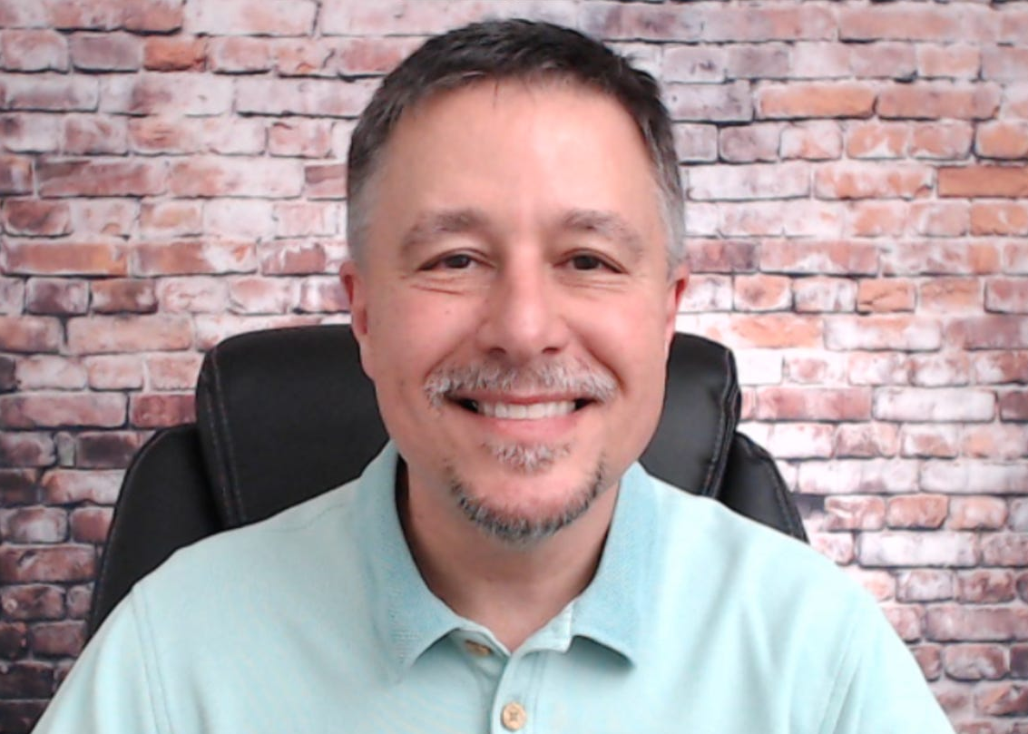
9. Eye Contact With the Audience

Slide 15
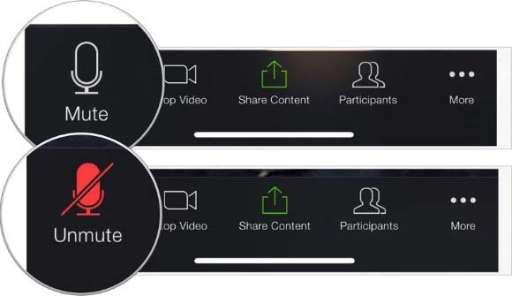
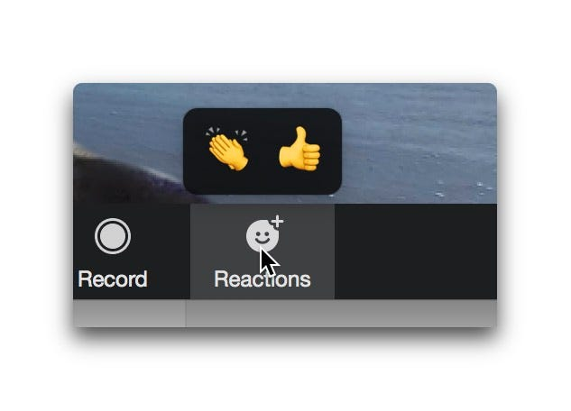
10. Regularly Pause to Engage
It’s okay to be silent on zoom.
It’s okay to mute everyone.
Lead by pausing and allowing others to respond and interact.
Use nonverbal tools such as raising hand, reactions, and chat window.

Slide 16
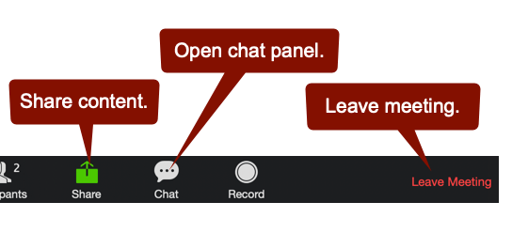
11. Use Chat to Your Benefit
Share a tip with the whole group that they can take away.
Vote privately for speaker, table topics speaker, and evaluator.
Message the group if they need to leave and not disrupt the meeting flow.

Slide 17
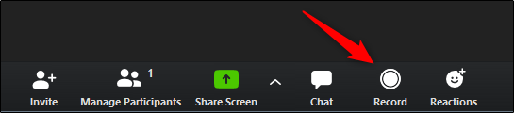
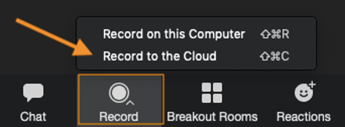
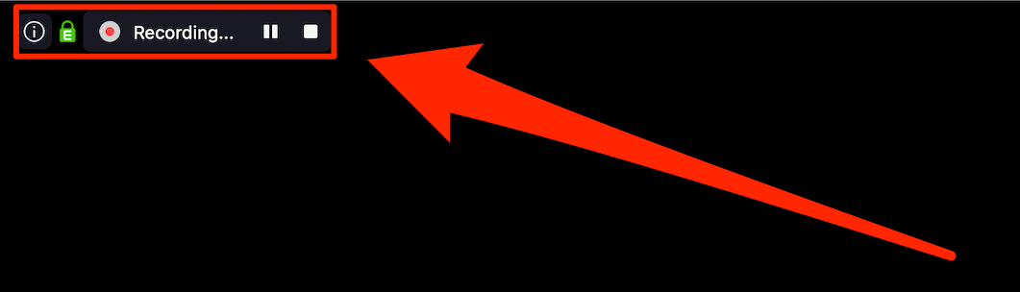
12. Record Your Presentation
As the host, you can start the recording.
If you have a pro account, you can record to the cloud.
Only the host can start, pause, or stop the recording.

Slide 18
Thank you!

