Slide 1
Live Out the Exchange
And Help This District Keep the Fires Burning

Slide 2
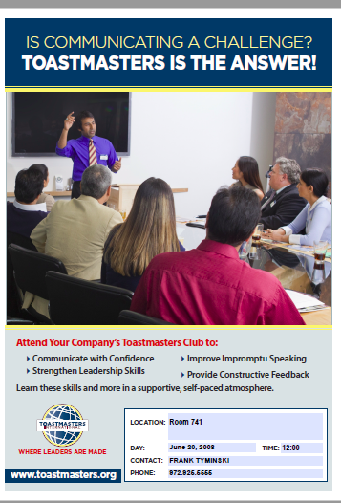

Slide 3

The Exchange
Exchange isn’t a year in your life,
it’s a life in a year
Unknown

Slide 4
Sgt. At Arms
Planning
Meeting Room Preparation
Purchasing
Robert’s Rules of Order

Slide 5
Treasurer
Budgeting
Financial Planning
Record Keeping
Money Management
Budgeting Analysis
Forecasting
Analytical Thinking

Slide 6
Secretary
Organization
Effective Documentation
Listening
Report Writing
Record Keeping
Purchasing
Confidentiality
Attention to Detail

Slide 7
VP Membership
Forecasting Listening Team Building Peer Recognition Increased Productivity Relationship Building | Sales Techniques Recruitment Procedures Hospitality Retention Quality Customer Service Right Sizing

Slide 8
VP Education
Strategic Planning Organization Forecasting Scheduling Listening Mentoring Training & Development Coaching Team Building Peer Recognition | Increased Productivity Time Management Dedication to Excellence Business Partnership Program Design & Implementation Communication Inhibitors Values Added Solutions

Slide 9
President
Communication High Performance Leadership Strategic Planning Organizational Change Delegation Forecasting Budgeting | Training & Development Peer Recognition Report Writing Presenting Effective Evaluations Coaching/Mentoring Time Management Team Building | Problem Solving Dedication to Excellence Accountability Management Increased Productivity Strategic Partnerships Diversity Awareness Respect for Others

Slide 10
Breakout Room Activity
Identify the office you held. Then tell the people in your group about the skills you gained and how you’ve used them outside of the club.
Identify the office that will help you build the skills you need to move to a different level professionally.

Slide 11
District Level Offices
District *
Division *
Area

Slide 12
More
World Headquarters
Board of
Directors
Region

Slide 14
NEXT⇒

Slide 15


Slide 16
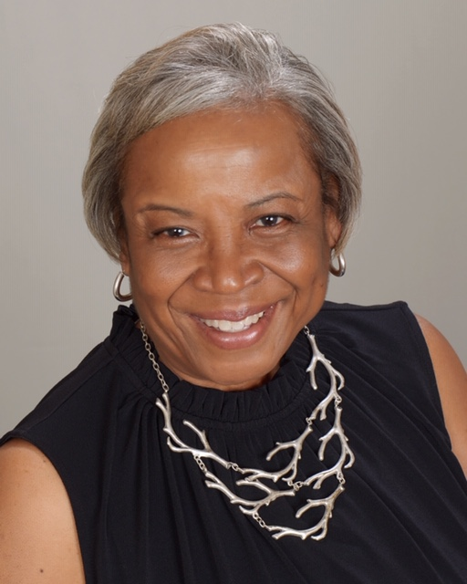
So Do I…

Slide 17
Toastmasters Promise
A Toastmaster’s Promise As a member of Toastmasters International and my club, I promise
To attend club meetings regularly
To prepare all of my projects to the best of my ability, basing them on the Toastmasters education
program
To prepare for and fulfill meeting assignments
To provide fellow members with helpful, constructive evaluations
To help the club maintain the positive, friendly environment necessary for all members to learn and grow
To serve my club as an officer when called upon to do so ***
To treat my fellow club members and our guests with respect and courtesy
To bring guests to club meetings so they can see the benefits Toastmasters membership offers
To adhere to the guidelines and rules for all Toastmasters education and recognition programs
To act within Toastmasters’ core values of integrity, respect, service, and excellence during the
conduct of all Toastmasters activities

Slide 18
Live Out the Exchange
And Help This District Keep the Fires Burning

