Slide 1
Club Quality Workshop
Kris Pool, DTM
District 35 Winter TLI
December 5, 2020

Slide 2
Objectives
Identify how the club mission supports club quality
Identify the characteristics of a quality club
Analyze your club’s embodiment of these characteristics
Notes:
When we understand the experience of the member and how it is crucial to the success of our clubs, it leads to membership retention and growth.

Slide 3
Club Mission
We provide a supportive
and positive learning experience
in which members are empowered to
develop communication and leadership skills,
resulting in greater self-confidence and personal growth.

Slide 4
Club Mission
We provide a supportive
and positive learning experience
in which members are empowered to
develop communication and leadership skills,
resulting in greater self-confidence and personal growth.

Slide 5
Member Lifecycle

Slide 6
Member Lifecycle
Re-engage
Reactivate
Retain
Recruit
Recognize & Appreciate
Onboard
Create Brand Ambassadors
Awareness
Educate
Increase Value to Members
Participate

Slide 7
Member Lifecycle
Re-engage
Reactivate
Retain
Recruit
Retain
Recognize & Appreciate
Onboard
Increase Value to Members
Create Brand Ambassadors
Awareness
Recruit
Onboard
Reactivate
Re-engage
Create Brand Ambassadors
Awareness
Recognize & Appreciate
Educate
Educate
Increase Value to Members
Participate
Participate

Slide 8

Breakout Rooms
Social media advertisement
Open houses
Quality meetings
Club officer training
Speak-a-thon
Awards ceremony
Personal phone calls and emails
New member orientation
Club t-shirt
Moments of Truth

Slide 9
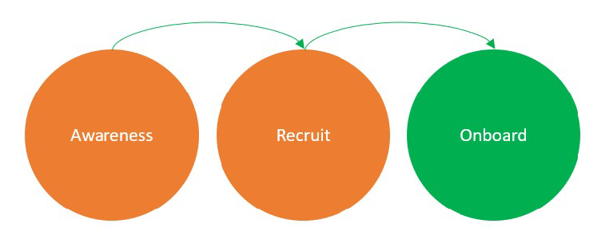
Lifecycle – Segment 1 (2 action items)

Slide 10
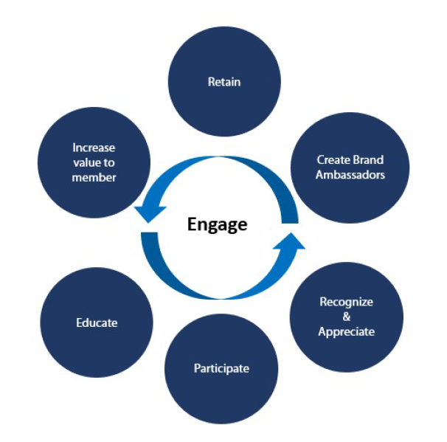
Lifecycle – Segment 2 (1 action item)

Slide 11
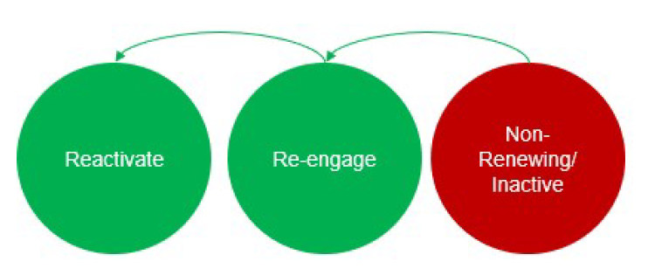
Lifecycle – Segment 3 (2 action items)

Slide 12
Breakout Rooms – Regroup and Share

Slide 13
Breakout Rooms – Regroup and Share

Slide 14
Breakout Rooms – Regroup and Share

Slide 15


Slide 16
My Challenge to You
By the end of January, have a meeting with your club officers to brainstorm action items and ideas on each of these circles
By the end of February, implement at least 3 of these action items in your club to improve the quality of your club

Slide 17
Resources for Club Quality
Successful Club Series
New Member Profile Sheet
Member Interest Survey
Club Success Plan
A Toastmaster Wears Many Hats
Club Officer Elections
Infuse Your Clubs With Creativity
Club Quality Checklist
Moments of Truth
Membership Building Programs and Materials
Master Your Meetings
Prescription for Productive Meetings
Club Coach Program
https://www.toastmasters.org/leadership-central/club-officer-tools/club-management/club-quality

Slide 18
Club Mission
We provide a supportive
and positive learning experience
in which members are empowered to
develop communication and leadership skills,
resulting in greater self-confidence and personal growth.

Slide 19
Objectives Met?
Identify how the club mission supports club quality
Identify the characteristics of a quality club
Analyze your club’s embodiment of these characteristics

