Slide 1
October 2018 DEC Meeting
October 20, 2018
UW – Platteville
Platteville, WI
Host: Central Division

Slide 2
Agenda
10:30 – 10:35 Introduction
10:35 – 10:45 Communication Standards
10:45 – 11:00 TLI Update
11:00 – 11:30 Mentoring
11:30 – 11:50 Area Director Visit Reports
11:50 – 12:05 Report Refresher
12:05 – 12:30 Team Building: Scavenger Hunt

Slide 3
Agenda
12:30 – 1:00 Lunch
1:00 – 1:25 Area/Division Director Roundtable
1:25 – 1:40 Public Relations Update
1:40 – 1:55 Persona Marketing
1:55 – 2:10 Quarterly Finance Update
2:10 – 2:15 Recognition
2:15 – 2:20 30-60-90 Day Plan
2:20 – 2:30 Q & A and Next Meeting

Slide 4
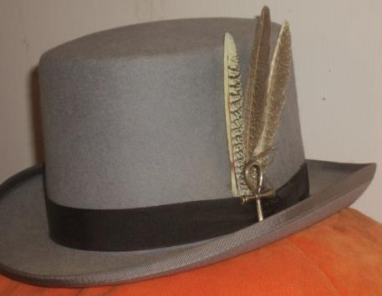
Do we all have a Feather in our CAP?
Change
Attitude
Pathways

Slide 5
Communication Standards
Ed Thelen, DTM
District Director

Slide 6
Why Are We Discussing This?
Some feedback has been received that not all clubs are receiving information:
  TLIs – dates, locations
  Virtual council meeting
All this information has been given to you either here at the DEC meeting or is on the District calendar

Slide 7
Suggested Ideas for Communication
Layout a calendar of when to do things
  Set aside an hour or two each week for District leader work
  Determine a calendar of when to send out e-mails
    Ex. Beginning of month and late the week after a DEC meeting
Respond to emails timely
  48-72 hours acknowledgment
  Week with the full response
Ask for help where needed
  Go one level up – or ask a trusted Toastmaster

Slide 8

How Can We Help
What resources do you need?

Slide 9
TLI Update
Rozaline Janci, DTM
Program Quality Director

Slide 10
44

Slide 11
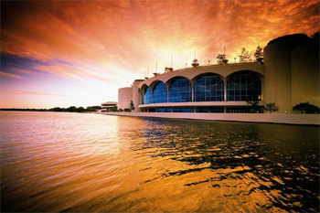
GET READY!!
Saturday, December 1, 2018
Monona Terrace, Madison, WI
See you there!

Slide 12
Registration Now Open
Register at:
  District 35 Winter Toastmasters Leadership Institute 2018-2019
Time: 9:00 am-4:00 pm
Cost: $20.00 per person (includes lunch)
Optional Cost: $25.00 per person on a 40-passenger bus from Milwaukee & Brookfield to Madison
Open to ALL MEMBERS, not just officers
  Reminder: clubs need at least 4 of the 7 officers trained

Slide 13
Education Sessions
Think Like a Negotiator - Teaching us the art of negotiation by Accredited Speaker Eldonna Lewis Fernandez, ACS, ALB
Leading Together - Emotional Intelligence and How to Develop It In You by Region Advisor Farzana Chauhan, DTM
Additional sessions include Pathways, Advanced Speaking Tips for Engaging Your Audience, Marketing Techniques to Grow Your Club Membership

Slide 14
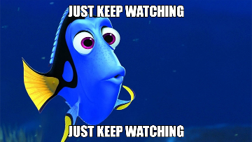
Facebook and Website
Keep watching the District 35 Facebook page and website for continued updates about the TLI training
Share with your clubs about the training
Share the makeup TLI training sessions as dates become available (encourage clubs to regularly check the district calendar for details)

Slide 15
Mentoring
Kris Pool, DTM
Club Growth Director

Slide 16

Your Challenge
Write down a one sentence definition of mentoring

Slide 17
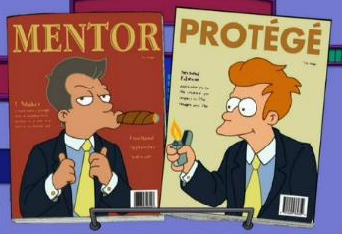
Definition of Mentoring
Mentoring is a collaborative, mutually beneficial partnership between a MENTOR and a PROTEGE
A Mentor possesses greater skills, knowledge, and experience
A Protégé is looking to increase his or her skills, knowledge, and experience

Slide 18
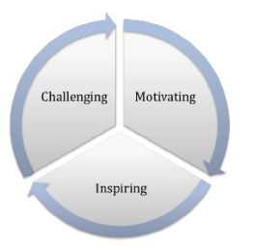
Understanding Mentoring
Mentorship refers to a personal developmental relationship that enables synergetic, purposeful conversation to reflect on experiences, make informed decisions, and act upon ideas generated

Slide 19

Mentoring as a Concept
MENTOR concept:
  M – manages the relationship
  E – encourages
  N – nurtures
  T – teaches
  O – offers mutual respect
  R – responds to the protégé’s needs
Source: http://Sydney.edu.au/sun/docs/choosing_a_mentor.pdf

Slide 20
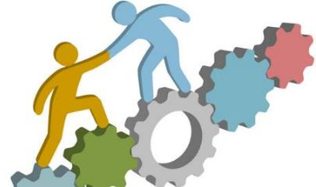
Basis of Mentoring
Mutual trust
Regular contact and conversation
Genuine belief in the process
Desire to build the “institution”
Helps both persons to “grow”

Slide 21

Principles of Mentoring – SYNERGY
Mentoring should be enriching for both mentor and protégé
Mentoring is about learning and not teaching
Protégé is empowered to take responsibility of his/her actions

Slide 22

Principles of Mentoring – RELATIONSHIP
Mentoring is a power-free partnership between the two individuals
Focus is not to make the protégé dependent but to develop the protégé’s independent critical thinking

Slide 23

Principles of Mentoring – UNIQUENESS
Understanding the concept of mentoring and how it is different from coaching and counseling is important
Mentoring must provide direction in order to channel efforts in the right direction

Slide 24
Art of Mentoring
SKILLS
ATTITUDE

Slide 25
Mentoring Skills
Skills required by mentor
Skills required by protégé
Mentorship skills

Slide 26
Skills Needed by Mentor and Protégé
Skills needed for an effective mentor:
Listening actively
Building trust
Ability to encourage
Identify goals and current reality
Provide corrective feedback
Inspiring
Managing risks
Good motivators
People orientation
Introspection
Facilitator
Skills need by protégé:
Listening actively
Reflection
Willingness to take responsibility
Asking the right questions
Deep commitment
Confidentiality & keeping trust
Ability to take initiative
Follow through on commitments
Ability to connect the dots
Willingness to learn

Slide 27
Attitude for Mentoring
START – at the start of the mentoring process, mentors to have an attitude of building trust and setting up the mentoring contract in initial meetings
DURING – during mentoring, a positive attitude of encouragement and giving directions is required
CLOSING – when the mentoring sessions are close to an end, mentors need to have an attitude of reducing dependency of protégé and make the protégé self dependent

Slide 28
Uniqueness of Mentoring
Feedback Mechanisms | Mentoring | Counseling | Coaching
Focus | Career and person development | Performance and psycho-social issues | Development and performance issues
Agenda | Set by protégé with mentor providing support, guidance, and experience sharing | Set by individuals and counselors aimed at achieving short term or long-term goals | Set by individuals with coach assisting in achieving specific goals
Engagement Period | Ongoing relationship that can last for a long period | Relationship is short term but can last longer due to breadth of issues being addressed | Relationship is for a short duration

Slide 29
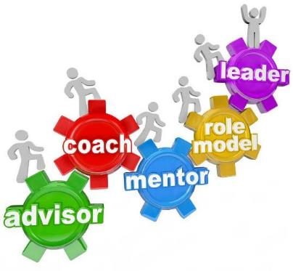
Roles Played By A Mentor
Teacher
Guide
Counselor
Motivator
Coach
Advisor
Referral Agent
Role Model
Door Opener

Slide 30
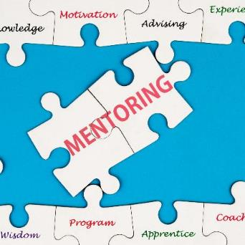
Skills Required By Mentors
Appreciative inquiry
Active listening and observations
Empathy, warmth, and respect
Concreteness and focus
“Confrontation” to “raise the bar”
Story telling and self-disclosure

Slide 31

Appreciative Inquiry
Ear of the child: “Is that so?”
Mine for the gold
Focus on life giving force
Tracking the positive energy to look at root causes of success and gifts
Enhance the “positive”

Slide 32
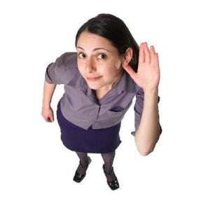
Active Listening and Observations
Being fully present
Learning to listen to what is implied
Observing the whole person
Observing one’s self in relationship with the protégé
Observing one’s breath, emotions, thoughts, and perceptions

Slide 33
Reflective Observation
A process that works on the basis of prompted reflection:
  Starts with a contextual comment/statement from the mentor
  Mentor then invites a reaction from the protégé
  Mentor then prompts protégé to reflect on the statement s/he made
  Mentor leads the realization process on the protégé through proper guidance
  This contextual realization would stay with the protégé as an awareness forever
  It is the mentor’s responsibility to keep the protégé on track through proper interventions in the process

Slide 34
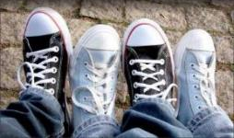
Empathy, Warmth, and Respect
Learning to get out of one’s own shoes before stepping into other’s shoes
Paraphrasing and use of synonyms
Warmth expressed through eyes, voice, and touch
Respecting the uniqueness of the person and his/her views even if you strongly disagree with them

Slide 35

Concreteness and Focus
Open ended questions precede focus
Capturing the essence and playing back
Focus on the critical aspects – vital few
Mirror “trivial many” – energy sappers

Slide 36
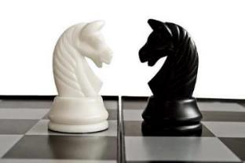
Confrontation
Confront is putting “in front”
Bringing out discrepancies between speech and actions; intent and impact; head and heart; heart and deeds, etc.
Always “raising the bar”
“Compassionate” anger when required

Slide 37

Storytelling
Choice of stories
Share only when needed
Share with full emotion – as it happened
Encourage protégé to share stories too

Slide 38

Storytelling – Do’s and Don’ts
Do’s
  Tell stories that are relevant to the context
  Tell stories that are real life examples
  Storytelling method should ensure engagement of protégé
  Make sure to describe the characteristics and settings of the story
  Preferably use voice to create the atmosphere as story progresses
  Ask protégé’s reflection on the story
  Articulate the story in a short, simple manner

Slide 39

Storytelling – Do’s and Don’ts
Don’ts
  Don’t draw conclusions early
  Don’t narrate stories that are difficult to comprehend
  There should be no hidden religious connotations
  Story shouldn’t be de-motivating

Slide 40
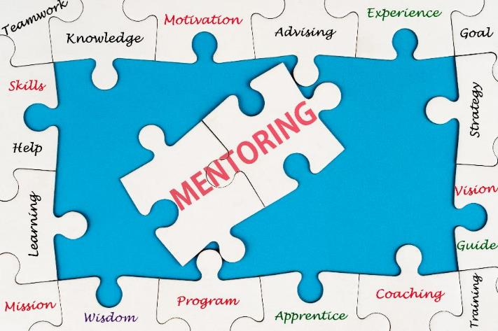

Slide 41
Area Director Official Club Visit
Amy Bowers ACB, ALB and Annemarie Braun
Area D3 and Area B4 Directors

Slide 42
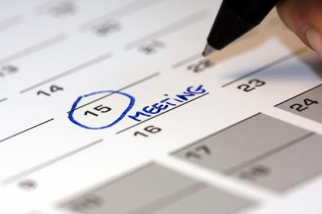
Setting up an Official Club Visit for a Report
If possible, set up an informal club visit prior
Schedule official club visit
  Add time to meet with officers before/after
  Remind them of the visit
Explain the purpose of the visit
Notes:
Amy

Slide 43
Prepare for your visit
Review club officer list and contact information
Review the report and answer questions as able
  Highlight questions that you know will need follow-up
  Foresee other related questions
Take a kit with you that includes:
  Area Director Club Visit Report
  Membership Application Forms
  Moments of Truths
  10 Paths in Pathways
  List of officers and contact info
  Upcoming Toastmasters Events list
  Speech Contest Rulebook
  Moments of Truths
Notes:
Annemarie

Slide 44
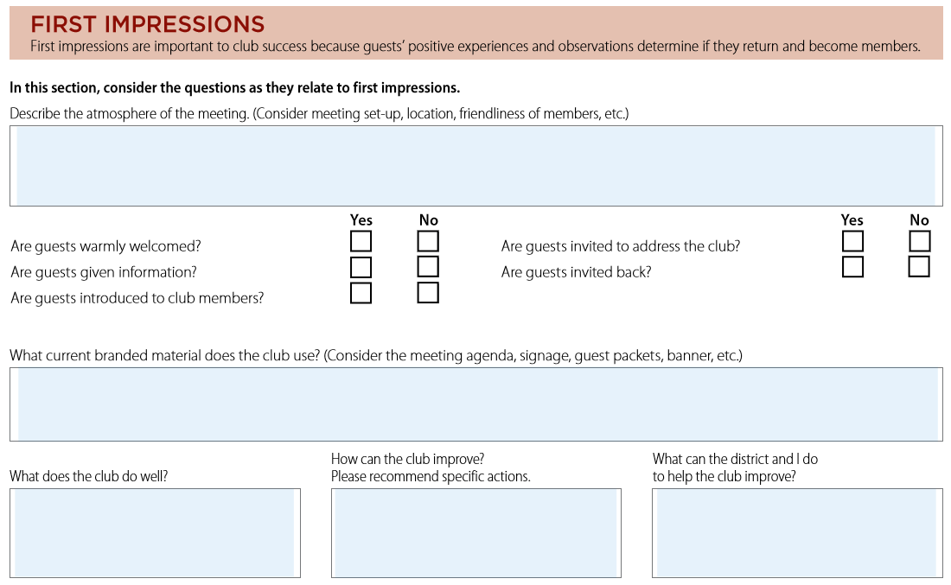
First Impressions
Notes:
Annemarie

Slide 45
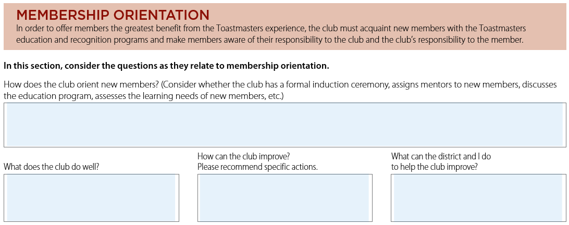
Membership Orientation
Notes:
Amy talk about how need more info than just observation, ask officers/members
Mention talk about improvements to club first before submitting on the report

Slide 46
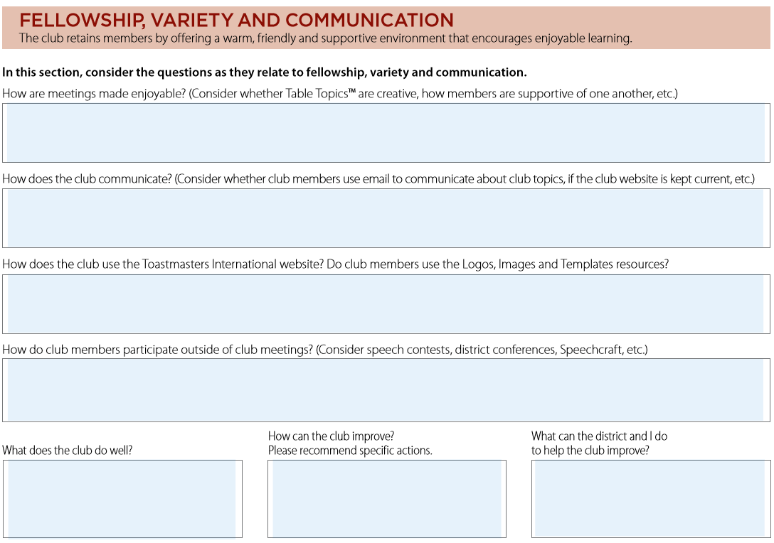
Fellowship, Variety and Communication
Notes:
Amy

Slide 47
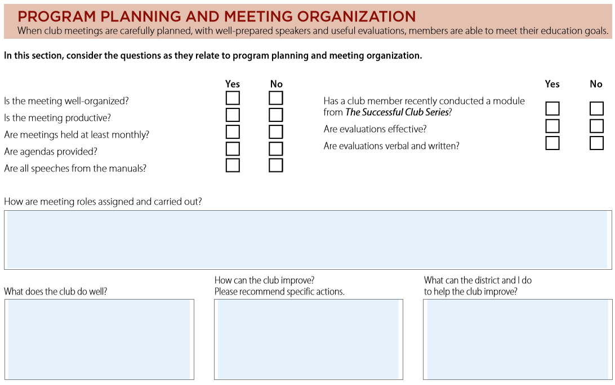
Program Planning and Meeting Organization
Notes:
Amy

Slide 48
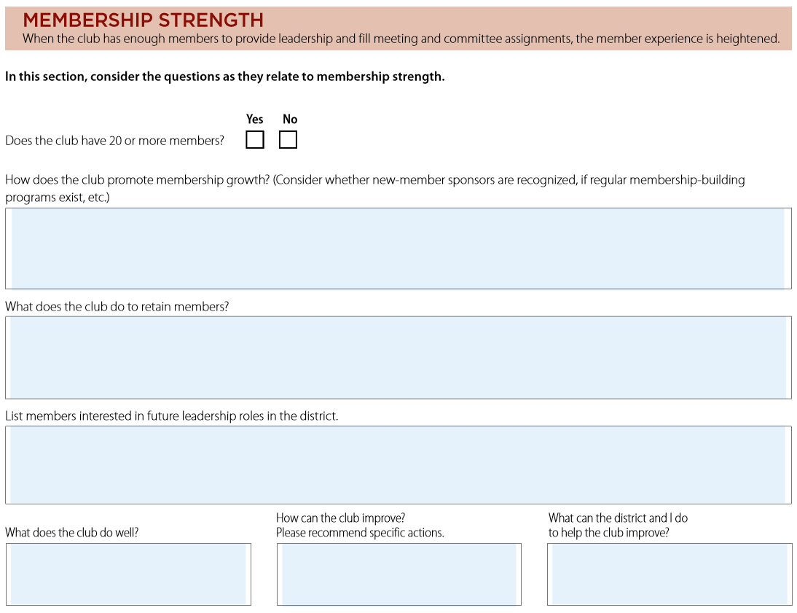
Membership Strength
Notes:
Amy

Slide 49
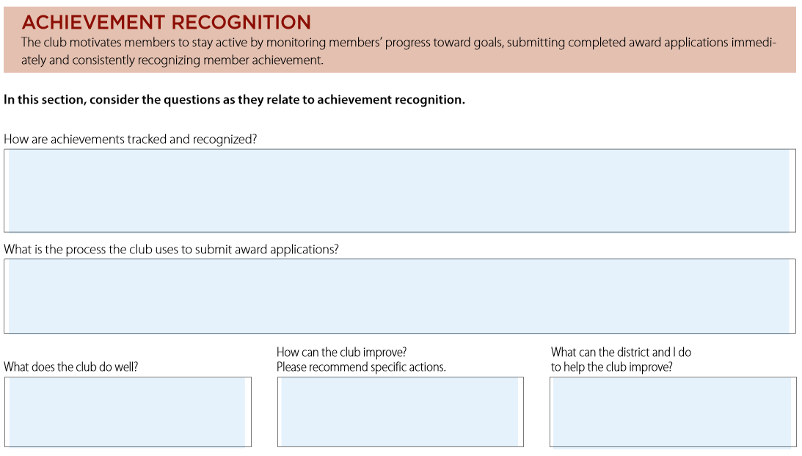
Achievement Recognition
Notes:
Amy

Slide 50
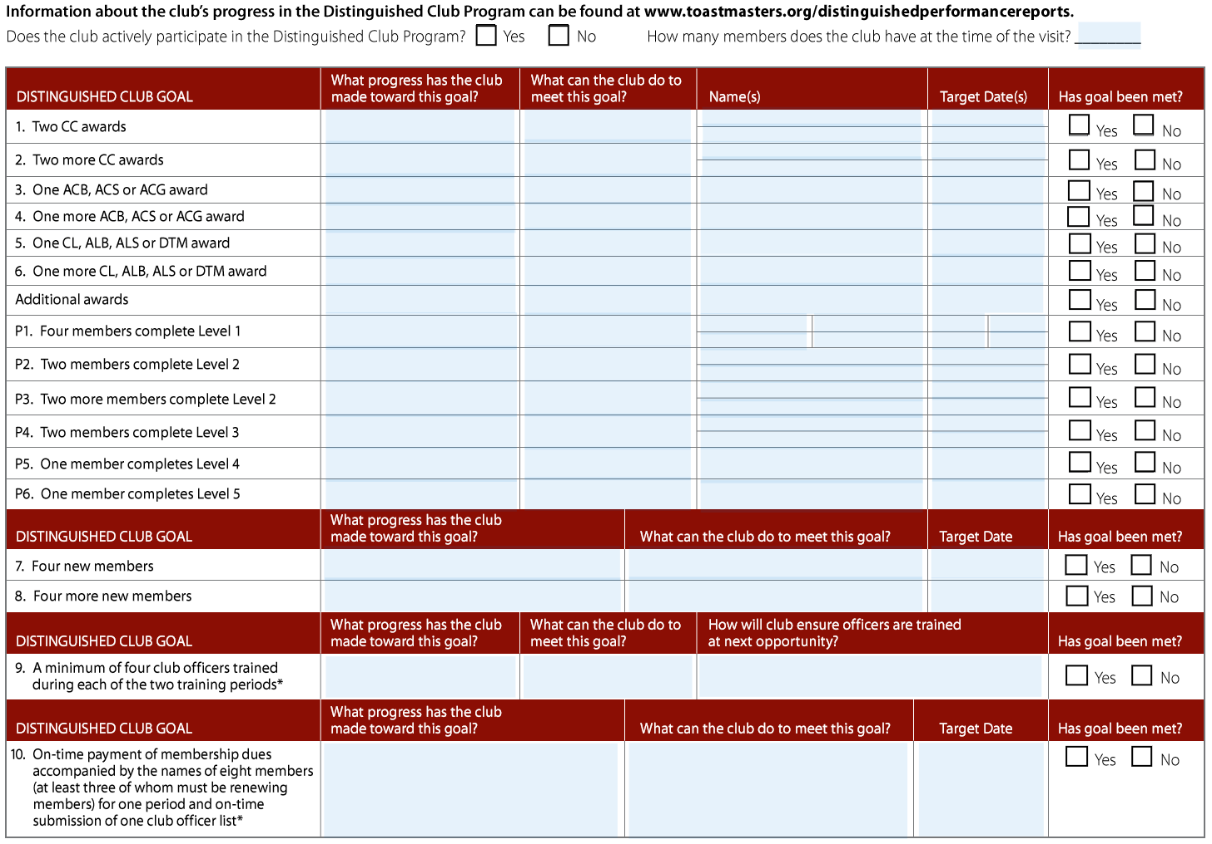
Information about the Club’s Progress in DCP
Notes:
Annemarie
-Review TM website for program year education awards by club
-Use club DCP goals/success plan to complete this

Slide 51

Other Helpful Hints and Reminders (1)
Give encouragement first; then suggestions for improvement; end with a positive note
After you submit your report, you are still able to correct it
Don’t forget to claim your mileage!
Notes:
Annemarie
prior to submitting in a report, talk with clubs as appropriate- perhaps after the meeting to the officer(s)

Slide 52
Other Helpful Hints and Reminders (2)
Remember, you are there for the clubs in your area:
  See the best club practices and point them out at the end of the meeting
  Give them a couple of suggestions, but remember, it’s up to the clubs if they make changes
  Show your excitement for the club and tell them you are there to help in any way possible
  Make sure all the officers have your contact information in case they have questions
Notes:
Annemarie
prior to submitting in a report, talk with clubs as appropriate- perhaps after the meeting to the officer(s)

Slide 53
Discussion Question
What has been the biggest challenge when reporting on your official visit?
Can you share an idea/ideas of the best practices you have encountered when filling out a club visit report?
Notes:
Break for discussion, then bring the group back together to highlight key findings

Slide 54
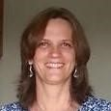
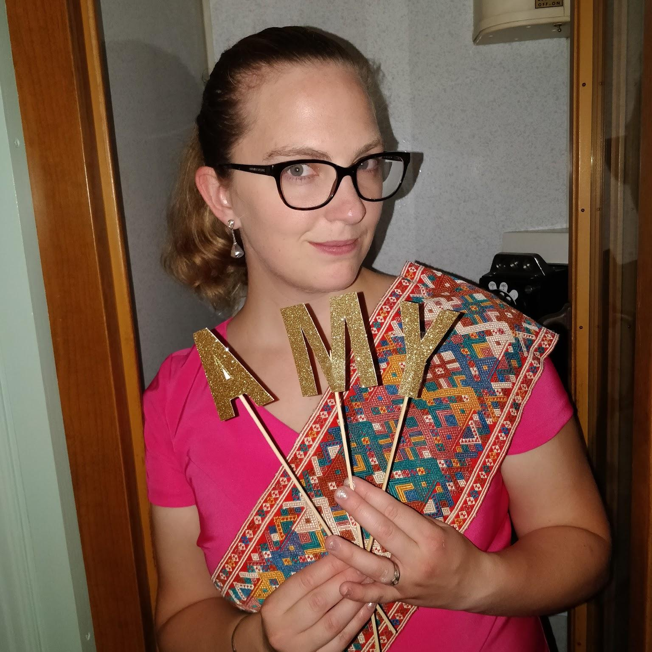
Feel free to contact us with any questions!
Annemarie Braun
Area B4 Director
braunannemarie@yahoo.com
Amy Bowers, ACB, ALB
Area D3 Director
abowers11@gmail.com
Notes:
Annemarie

Slide 55
Report Refresher
Kris Pool, DTM
Club Growth Director

Slide 56
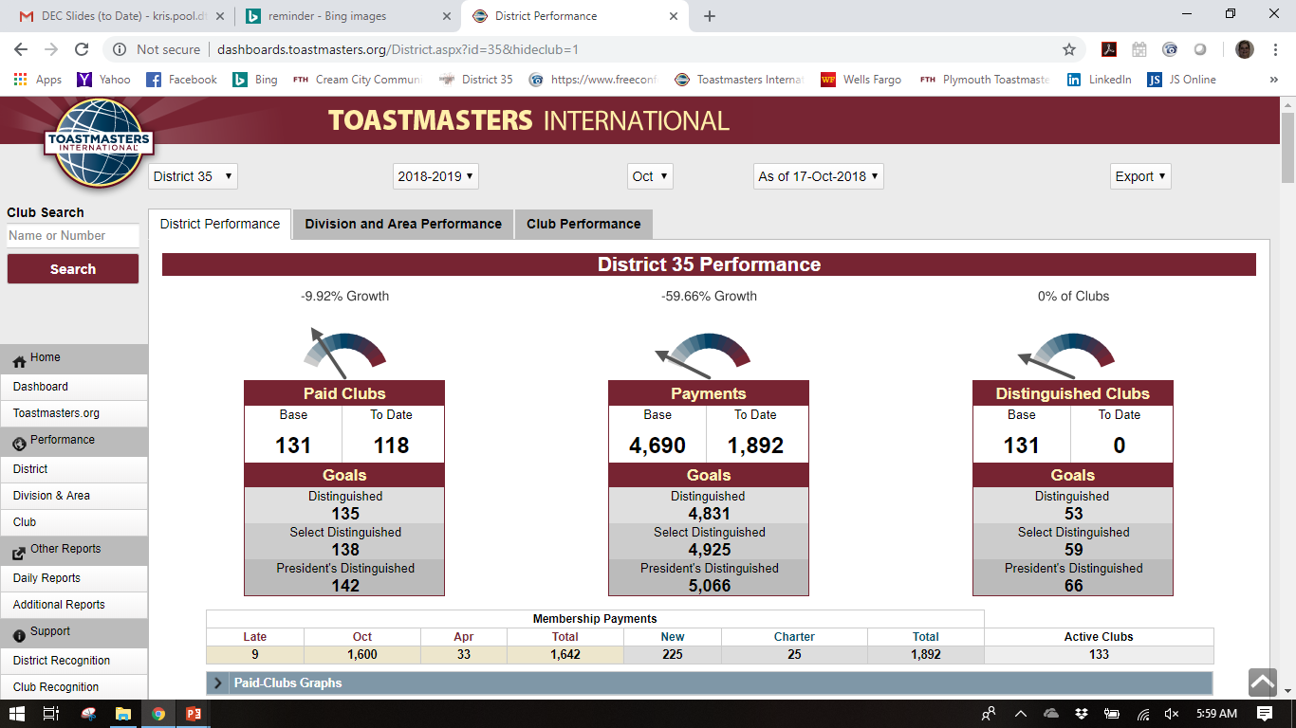

Slide 57

Learn How to Track Performance
http://dashboards.toastmasters.org
Distinguished Performance Dashboard
Daily Reports
Additional Reports
Notes:
Learn how to track area/club performance on the TI dashboard.
Distinguished Performance Dashboard: http://dashboards.toastmasters.org
Can we go to live internet to show it?

Slide 58
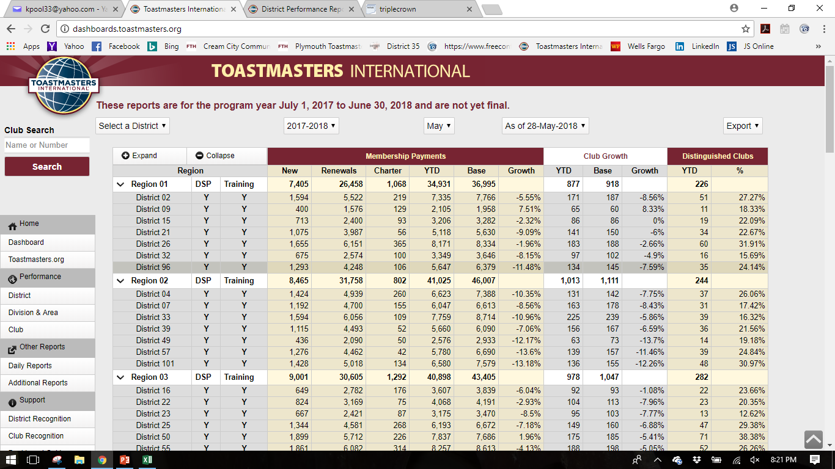

Slide 59
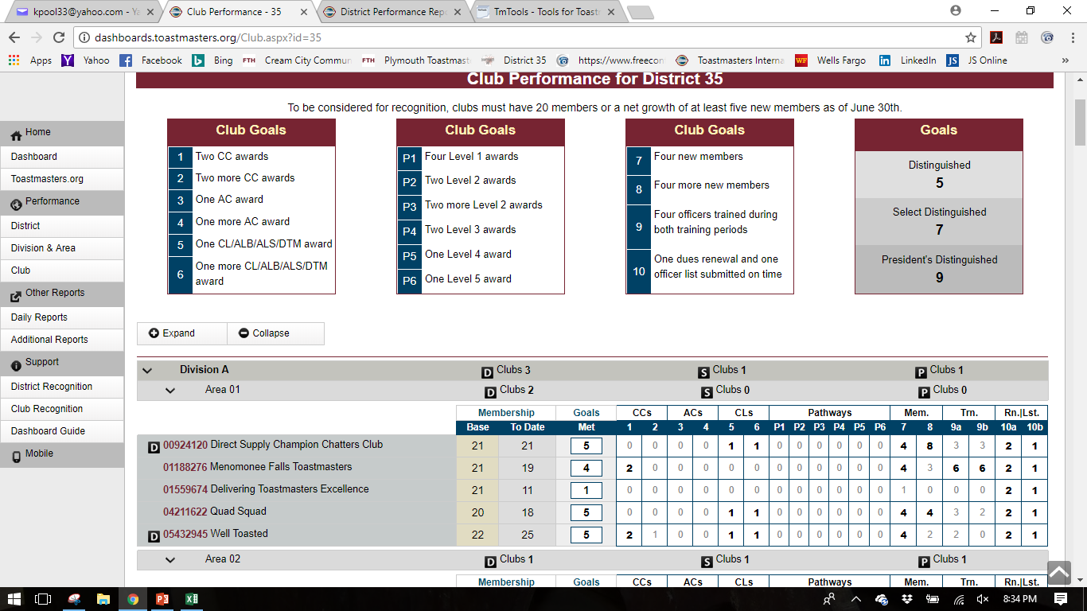

Slide 61
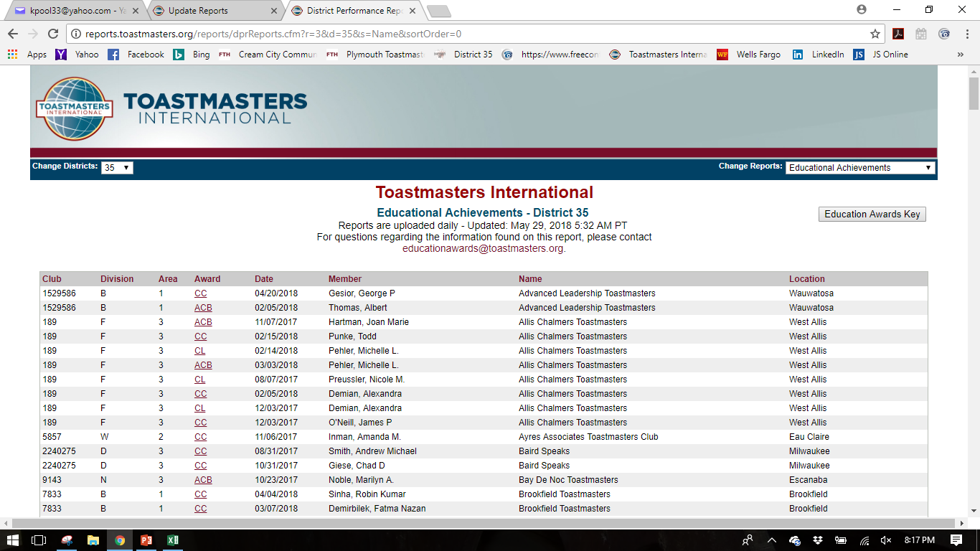

Slide 62

Don’t Forget Your Friends
http://marshalls.org/tmtools/
http://mikeraffety.com/DCPhistory.cgi

Slide 63
Team Building Exercise: Scavenger Hunt
Kris Pool, DTM
Club Growth Director

Slide 64


Slide 65


Slide 66
Area & Division Director Roundtable
District 35 Trio

Slide 67


Slide 68
Public Relations
Kamal Soan, DTM
Public Relations Manager

Slide 69
Current Metrics
Social Media Channel | Members Involved
Facebook
D35 Page | 646
D35 Group | 131
Eastern Division | 27
Southeastern Division | 46
Central Division | 103
DFAB Divisions | 35
Division D (2) | 45, 75
Division F | 54
Division B | 35
Twitter | 562
LinkedIn | 694

Slide 70
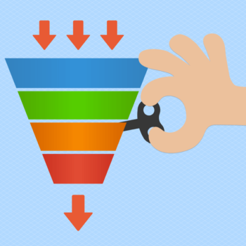
Communication – The Funnel Concept
Areas
Divisions
Clubs
District 35

Slide 71
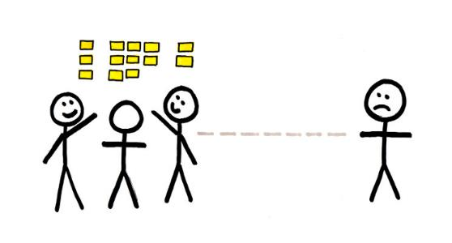
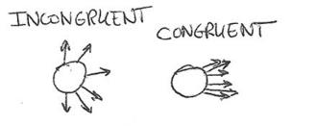
Osmotic Communication
Osmosis: the process of gradual or unconscious assimilation of ideas, knowledge, etc.

Slide 72

Communication Methods
Interactive
Push
Pull
  Facebook D35 Group
  Facebook D35 Page
    Division Pages

Slide 73

Division & Area Level Public Relations
Strongly recommend you think about PR activities at your levels

Slide 74

Division & Area Level Public Relations
Eastern Division
  Sue Witmann
Central Division
  Laura Croft
Northern Division
Southern Divisions (DFAB)

Slide 75

VP PR Survey
Understand topics of interest
Help develop better promotion of clubs

Slide 76
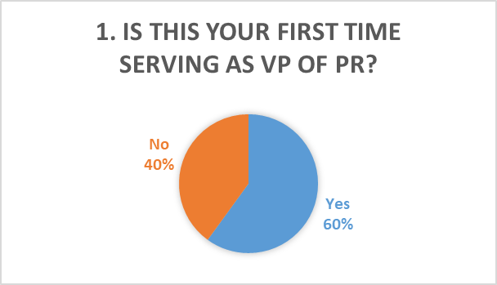
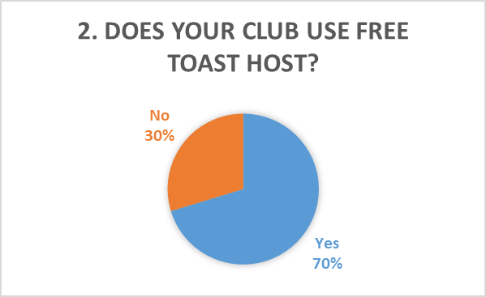
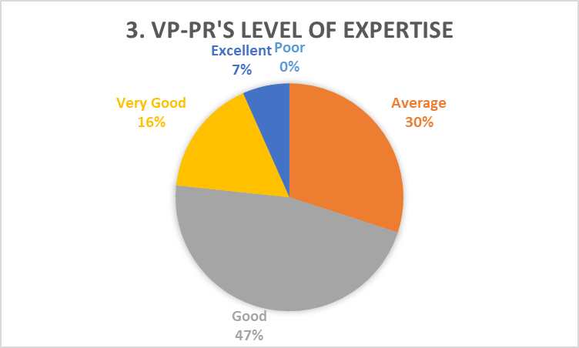
VP PR Survey (continued)
Survey – August 15 to September 15, 2018

Slide 77
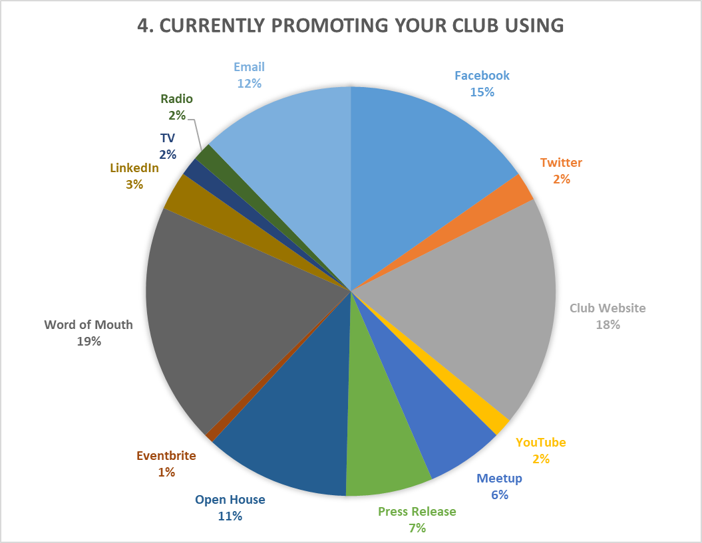
VP PR Survey (continued)

Slide 78
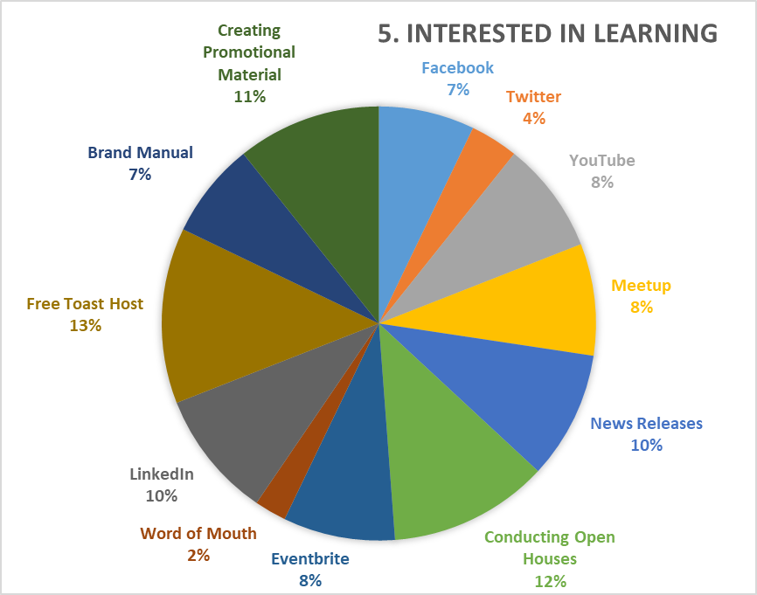
VP PR Survey (continued)

Slide 79
VP PR Survey – Educational Sessions
Date & Time | Topic of Presentation
November 8, 2018 6:30 - 7:30 PM CST | Setting Up and Customizing Your Free Toast Host Club Website
December 13, 2018 6:30 - 7:30 PM CST | Free Toast Host Part Two
January 10, 2019 6:30 - 7:30 PM CST | YouTube for Toastmasters Clubs
February 7, 2019 6:30 - 7:30 PM CST | Toastmasters Facebook Club Pages
March 7, 2019 6:30 - 7:30 PM CST | Toastmasters Facebook Groups
April 11, 2019 6:30 - 7:30 PM CST | Blogging for Toastmasters Clubs
May 9, 2019 6:30 - 7:30 PM CST | Twitter for Toastmasters Clubs
June 13, 2019 6:30 - 7:30 PM CST | LinkedIn Groups for Toastmasters Clubs

Slide 80
PR Contests 2018-2019
Best Social Media
  0 – 2 years
  2 – 5 years
  5+ years
Best Website
Best Social Media (each category)
  1st Prize - $50
  2nd Prize - $25
Best Website
  1st Prize - $50
  2nd Prize - $25

Slide 81

Additional Volunteers
Social media channel(s) operators
Content creator
Metrics analyst

Slide 82
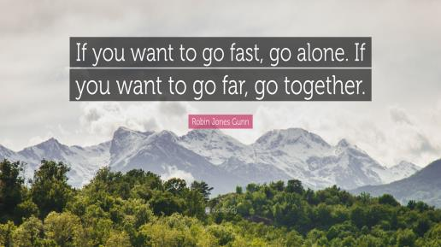

Slide 83

Contact Me
Kamal Soan, DTM
  Email: kamal.soan@gmail.com
  Cell: 931-252-0599

Slide 84
Persona Marketing
Rozaline Janci, DTM
Program Quality Director

Slide 85
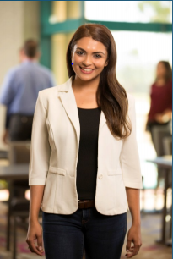
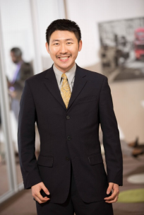
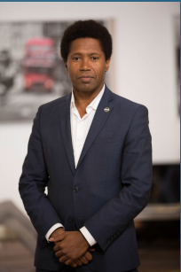
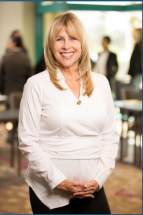
Member Personas
The Young Professional
The Career Advancer
The International Professional
The Mature Manager

Slide 86
Persona Development
Toastmasters International conducted 16 focus groups:
  San Diego, Columbus, New York City, Calgary, Houston, Bangalore, Shanghai, London
Markets selected based on TM membership counts and geographic diversity
Participants selected using a survey screen to ensure a diverse group of participants that more closely represented the average member in each location
Each group consisted of 6-8 members
These members participated in a moderated conversation related to their TM experience

Slide 87
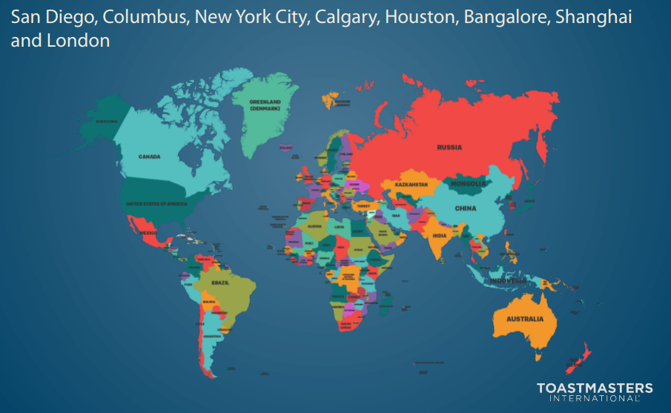
2016 Focus Groups

Slide 88

Focus Group Goals
Identify member segments
Understand the catalyst for joining Toastmasters
Determine why members choose Toastmasters over other options
Discover the reasons why members attend meetings regularly and continue their membership
Understand the unique value of Toastmasters from the member perspective

Slide 89
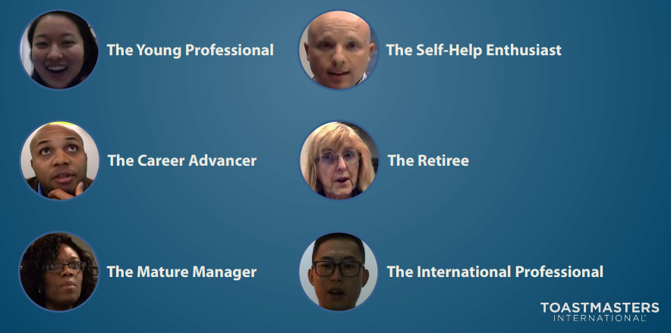
Member Personas
Six distinct member personas were clearly identified from the analysis
Each person has a unique background, set of personal characteristics and goals

Slide 90
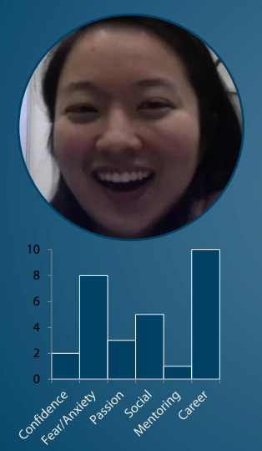
Member Personas: The Young Professional
Lack presentation skills and experience
Are shy and lack confidence
Want to network professionally
Want to be successful
Think Toastmasters structure and culture is gimmicky
Encouraged to join by a manager
Joined for professional development
Want modern tools (e.g. social media, apps)

Slide 91
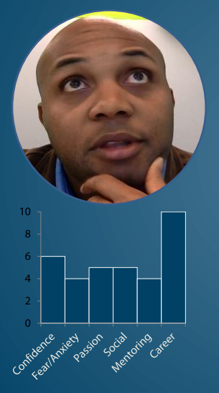
Member Personas: The Career Advancer
Joined to advance career
Will leave if skills do not continue to improve or don’t have enough time
Has some confidence and speaking abilities
Researched other development options before joining
Seeking constructive evaluation and practice
Often had an embarrassing incident that drove them to Toastmasters

Slide 92
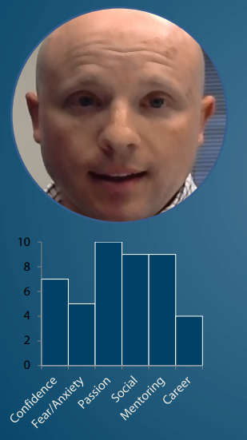
Member Personas: The Self-Help Enthusiast
Typically men
Interested in groups like AA, Landmark, and the Free Masons
Late bloomers
Socially awkward
Looking for a place to fit in or find answers
Committed and extremely enthusiastic about Toastmasters
Want to mentor others, but aren’t qualified
Follow the program as it is designed
Narcissistic qualities – believe they are good at everything

Slide 93
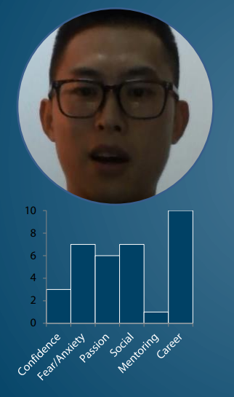
Member Personas: The International Professional
Often young and educated
Joined to practice English
Work for companies that speak and write in English
Value a safe learning environment with no judgment
Adapt to new cultural techniques and values offered in the club
Excited about the leadership path once they learn about it

Slide 94
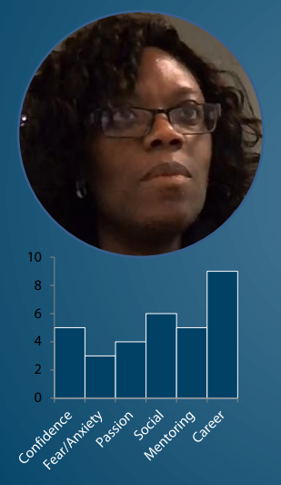
Member Personas: The Mature Manager
Typically women
Joined to network and advance career
At a low point in their career
Describe themselves as “entrepreneurs”
Have tried Dale Carnegie, Meetups, business networking groups, etc.
Has the money to pay for solutions
Realizes they are getting older and need to refresh their skills
Very talkative

Slide 95
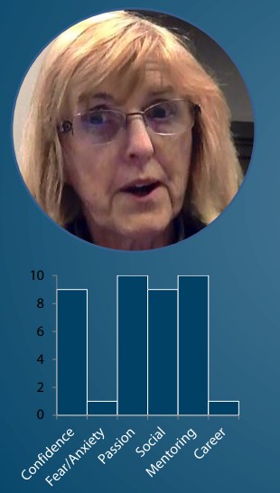
Member Personas: The Retiree
Joined for fellowship
Seeking personal fulfillment (bored)
Want to give back and be valuable to others
Don’t join to volunteer, but often do because there is no one else to do it
Likes social/fraternity time
Think they are already a great speaker
Strong/rigid views, do not like change

Slide 96
Overall Themes
First Experience
  Individuals initially lack knowledge and have limited expectations
  Starts with a fear of public speaking
  Warm welcome matters
  Accessibility and flexibility are critical
Why They Stay
  Greater self-confidence
  For the fun
  Program value: Structured and self-directed
  Diversity and being part of an international program
  There’s nothing like Toastmasters
  Impacts all aspects of their life

Slide 97

Unexpected Discoveries
Personal
  Learned to listen
  Self-awareness
  Developing others
  Other valuable skills are built
Toastmasters
  Professional speakers alongside “normal” people
  Two tracks (pre-Pathways)
  These are my people!
  It’s more than a bunch of people getting together – its development

Slide 98
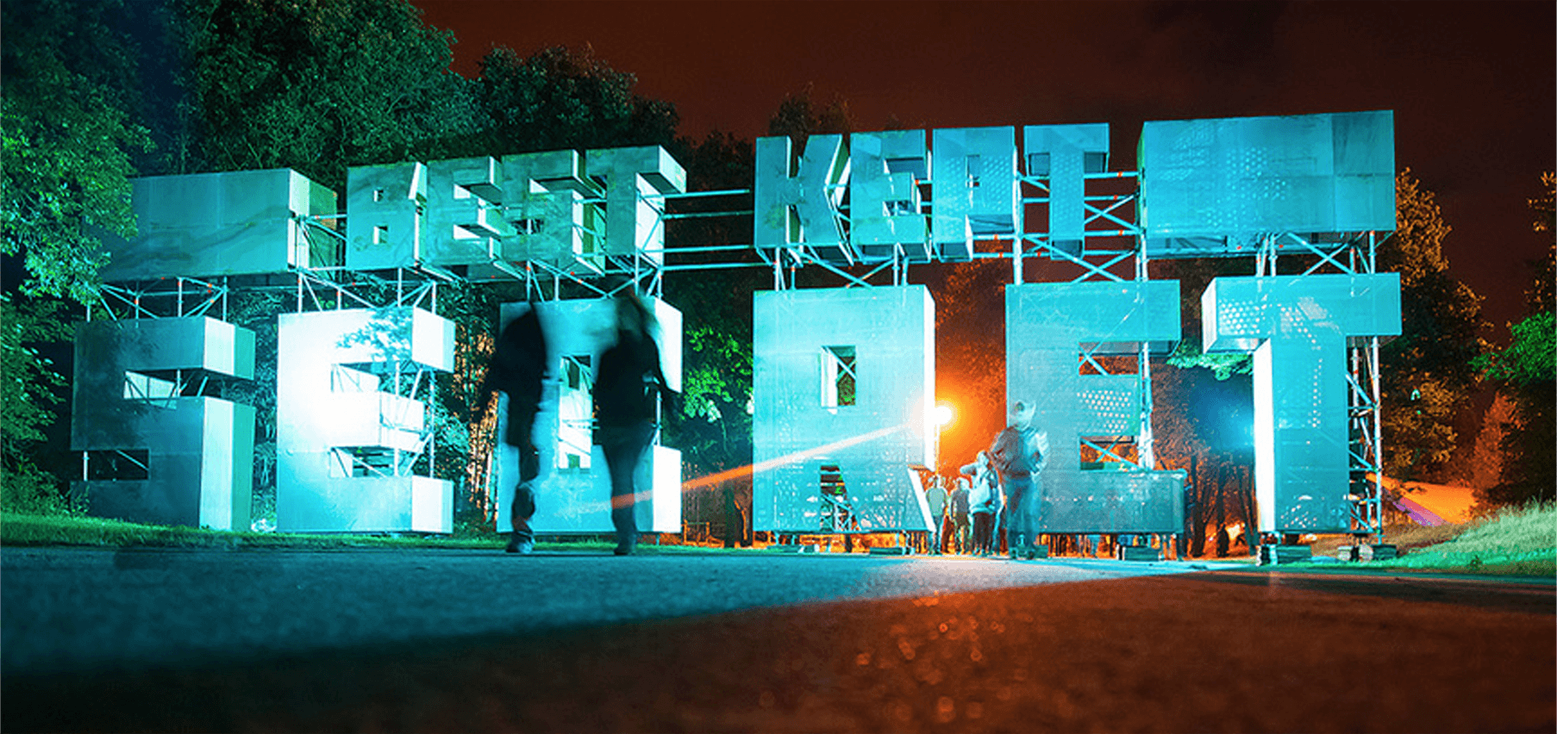
Best-kept Secret
Primary channels
  The Inviter – trusted Word of Mouth
    Friend
    Family
    Boss
    Colleague
  Google Search
Need for advertising

Slide 99
District 35 Finance Update
Jason P. Feucht, ACS, ALB
District Finance Manager

Slide 100
Overview
Financial results through August 2018
Income estimates
Travel / Mileage budget status
Reminders

Slide 101
Financial Results Through August 2018
Total Funds Available $20,278.68
    Does not including required reserves
YTD Budgeted Income $1,495 actual income $1,584
    Variance OVER budgeted income by $89.22
YTD Budgeted Expenses $14,650 actual expenses $3,709
    Variance UNDER budgeted expenses by $10,940
  Bottom Line
    Through August D35 ran at a loss of $2,124.85
    Variance UNDER planned loss ~$11,000
Notes:
Cash flow
Reserves of $11,995.10
Total Funds: 32,273.78

Slide 102
Income Estimates
District Revenue is based off membership payments
  The District Receives 25% of member dues from TI for District Expenses
  On average this is $10.23 per member payment
    Often $11.25 is used but that based on a full 6-month dues. Members that join in between pay a pro-rated rate.
Income Budget Through October is $21,319
  That is 2,084 member payments
  Currently we have 1,889 member payments according to the District dashboard
    Variance of 195 member payments
    That’s $1,994.85 we are already UNDER the income budget
Member Payments are KEY to keeping the district revenues on target

Slide 103
Travel / Mileage Budget
2018-2019 budget has required us to significantly reduce the allocations available for mileage reimbursement
FINAL District Budget Allocated Mileage
  District Director - $600
  Program Quality Director - $677.00
  Club Growth Director - $525.00
  Immediate Past District Director - $150
  Finance Manager - $150
  PR Manager - $150
  Division Director (each) - $150
  Area Director (each) - $150

Slide 104
Trio & Administration
Last Name | First Name | Role | Mileage Allocation | Mileage Spent | Variance | Allocation Remaining
Thelen | Ed | District Director | $ 600.00 | $ - | $ (600.00) | $ (600.00)
Janci | Rozaline | Program Quality Director | $ 677.00 | $ 154.24 | $ (522.76) | $ (522.76)
Pool | Kris | Club Growth Director | $ 525.00 | $ 216.64 | $ (308.36) | $ (308.36)
Cumiskey | Keith | IPDD | $ 150.00 | $ 149.76 | $ (0.24) | $ (0.24)
Feucht | Jason | Finance Manager | $ 150.00 | $ 8.00 | $ (142.00) | $ (142.00)
Soan | Kamal | Public Relations Manager | $ 150.00 | $ - | $ (150.00) | $ (150.00)
 |  |  | $ 2,252.00 | $ 528.64 | $ (1,723.36) | $ (1,723.36)

Slide 105
Division Directors
Last Name | First Name | Role | Mileage Allocation | Mileage Spent | Variance
Borowski | Ronda | Division B | $ 150.00 | $ 53.37 | $ (96.63)
Ervin | Carl | Division A | $ 150.00 | $ - | $ (150.00)
Graham | Angela | Division Northern & Area N3 | $ 300.00 | $ 554.24 | $ 254.24
Griggs | Rick | Division Central | $ 150.00 | $ 102.71 | $ (47.29)
McGregor | Teri | Division Eastern | $ 150.00 | $ 252.80 | $ 102.80
Schoenherr | Shae | Division D | $ 150.00 | $ - | $ (150.00)
Scott | Jackie | Division F | $ 150.00 | $ 137.60 | $ (12.40)
 |  |  | $ 1,200.00 | $ 1,100.72 | $ (99.28)
$99.28 remains for Division Director Mileage
Reimburse FIFO until budget is depleted

Slide 106
Area Directors
Last Name | First Name | Role | Mileage Allocation | Mileage Spent | Variance
Bauer | Judy | Area F3 | $ 150.00 |  | $ (150.00)
Bowers | Amy | Area D3 | $ 150.00 |  | $ (150.00)
Braun | Annemarie | Area B4 | $ 150.00 | $ 269.00 | $ 119.00
Carlson | Tom | Area C1 | $ 150.00 | $ 24.60 | $ (125.40)
Clements | Amy | Area C3 | $ 150.00 |  | $ (150.00)
Coonen | Lori | Area E3 | $ 150.00 |  | $ (150.00)
Finnegan | Bill | Area B1 | $ 150.00 |  | $ (150.00)
Gagliano | David | Area F1 | $ 150.00 | $ 192.19 | $ 42.19
Jordee | Janette | Area C4 | $ 150.00 |  | $ (150.00)
Kibicho | Jennifer | Area F4 | $ 150.00 |  | $ (150.00)
Kumar | Raj | Area B2 | $ 150.00 |  | $ (150.00)
Lampro | Tammy | Area N4 | $ 150.00 | $ 338.88 | $ 188.88
Lapan | Dmitry | Area A1 | $ 150.00 | $ 67.20 | $ (82.80)
Mather | Carol | Area E2 | $ 150.00 |  | $ (150.00)
McGoey | Drake | Area C2 | $ 150.00 |  | $ (150.00)
Mosey | Craig | Area A2 | $ 150.00 |  | $ (150.00)
Noble | Marilyn | Area E5 | $ 150.00 | $ 301.76 | $ 151.76
Penke | Larry | Area E1 | $ 150.00 |  | $ (150.00)
Pollock | Liz | Area A3 | $ 150.00 |  | $ (150.00)
Runte | Shelly | Area D2 | $ 150.00 |  | $ (150.00)
Scheuers | Matt | Area N1 | $ 150.00 |  | $ (150.00)
Scott | John | Area B3 | $ 150.00 | $ 54.08 | $ (95.92)
Slowinski | Heidi | Area N2 | $ 150.00 |  | $ (150.00)
Vacant (Graham) | Vacant | Area N3 | $ 150.00 |  | $ (150.00)
Volden | Cassie | Area C3 | $ 150.00 |  | $ (150.00)
Wall | Robert | Area F2 | $ 150.00 | $ 121.14 | $ (28.86)
Wink | Cindy | Area E4 | $ 150.00 | $ 74.88 | $ (75.12)
Wright | Ron | Area D1 | $ 150.00 |  | $ (150.00)
 |  |  | $ 4,200.00 | $ 1,443.73 | $ (2,756.27)
$2,756.27 remains for Area Director Mileage
Reimburse FIFO until budget is depleted

Slide 107
Reminders - Reimbursements
All expense reimbursements should be submitted via Concur
All expense reimbursements must be submitted within 60 Days of when the expense occurred.
All expense reimbursements MUST have supporting documentation (receipts, map, etc.)

Slide 108
Concur – Common Issues
Missing Documentation
    All Reimbursements MUST have supporting documentation
      This is Toastmasters International Policy
Overspending – Be aware of your allocations
    Can you / should you spend?
      Partner with Ed prior to spending
Coding Mistakes

Slide 109
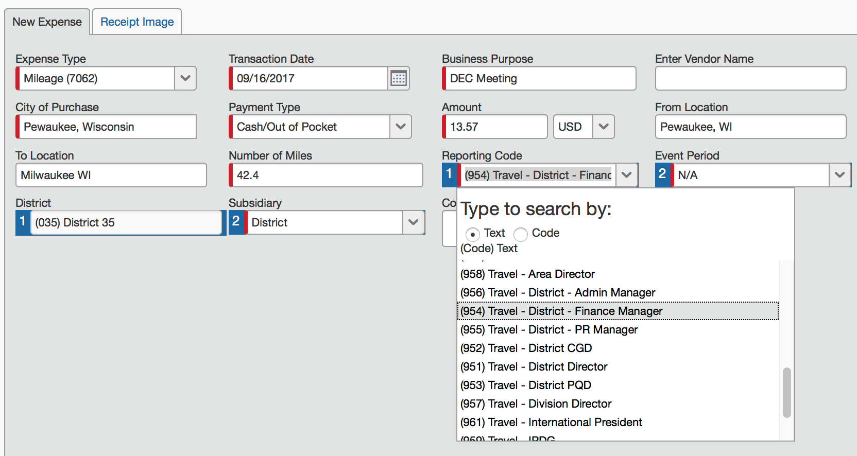
Concur – Common Issues
If your receipt is correctly attached the receipt tab will appear
When submitting Mileage the code is always “Travel” – for your role regardless of the event.
Subsidiary Should always be District

Slide 110
Other Reminders
Current Allocations
  TLI - $200 per Division per event
  Contests - $75 per Division and $40 Per Area per event
  Look for opportunities to combine events to make them more cost effective
  TI highly recommends all events run at net $0, meaning income is brought in to cover most if not all expenses
  If you charge for your event and it results in a profit, those funds must be returned to the District; they cannot be kept to have additional to spend on a future event

Slide 111
Eventbrite
Eventbrite is a great way to collect registrations as well as funds for your event
  District 35 has a master Eventbrite account, which should be used for all Area, Division and District events
  All funds collected are sent via check directly to the district
  If you want to use Eventbrite, please email me and I can get you started

Slide 112
Questions?
Remember
  Expenses need to be reported within 60 days
  Questions regarding your allocations, if is is ok to spend funds, etc. – Contact Ed
  Questions on Concur, Eventbrite, and other Finance Policies and Procedures, contact Jason

Slide 113
Recognition
Ed Thelen, DTM
District Director

Slide 114
Perfect DEC Attendance – 1st Quarter
Thank you & congratulations to these individuals that had 100% attendance in the first quarter!
Judy Bauer
Annemarie Braun
Carl Ervin
Jason Feucht
Bill Finnegan
Robin Grabinski
Angela Graham
Tammy Lampro
Teri McGregor
Jackie Scott
John Scott
Heidi Slowinski
Kamal Soan
Robert Wall

Slide 115

1st Area Director Visit Report Completed
Congratulations to the first Area Director to complete an Area Director visit report:
  Amy Bowers

Slide 116

All Area Director Visit Reports Completed
Congratulations to the first Area Director to complete an Area Director visit report:
  Annemarie Braun

Slide 117
30-60-90 Day Review
Ed Thelen, DTM
District Director

Slide 118
Your Next 30 Days (mid-November)
Make sure all TLI training recorded (November 30)
Finish up club visits and enter information for visit reports ASAP after visit (due by November 30)
District TLI – December 1, 2018
  Communicate to your clubs
  Pass along TLI information as handed down by Program Quality Director and Public Relations Manager
Plan dates for Division Makeup Winter TLI sessions (complete by end of February)
Think about dates for speech contests
Hold another Area/Division council meeting

Slide 119


Your Next 60 Days (mid-December)
Plan dates for Division Makeup Winter TLI sessions (complete by end of February)
Keep in touch with your clubs informally
Hold third or fourth Area/Division Council Meetings (virtual)
Think about dates for your Area and Division speech contests
Prepare for the upcoming holidays and enjoy them!

Slide 120
Your Next 30 Days (mid-January)
Conduct Division led make-up TLIs and record training
Put together a schedule of contacts about communication of April dues
Have dates finalized for Area contests and start getting helpers (Division get close to final dates)
Plan out 2nd round of Area Director visits – attend and file reports early!
Follow-up on/plan another round of Council meetings

Slide 121
Q & A and Wrap-Up
Ed Thelen, DTM
District Director

Slide 122


Slide 123
Next DEC Meeting
Saturday, November 10, 2018
10:30 a.m. to 2:30 p.m.
Location: Steinhafel’s Furniture
  W231N1013 County Hwy F, Waukesha, WI 53186
Hosted by Division B

Slide 124
Next DEC Meeting
Topics for DEC Meeting (partial)
  Speech Contests (Judy Bauer)
  Calendar Invitations (Robin Grabinski)
  TLI Update (Rozaline Janci)
  District Success Plan Update (Multiple)
  Team Building and Roundtable

Slide 125
