Slide 1
March 2019 DEC Meeting
March 16, 2019
Radisson Hotel & Conference Center Green Bay Green Bay, WI
Host: Eastern Division

Slide 2
Agenda
10:30 – 10:35 Introduction
10:35 – 11:15 Area/Division Director Roundtable
11:15 – 11:30 Speech Contests – Lessons Learned
11:30 – 11:45 Spring Convention Update
11:45 – 12:00 Club Growth Director Update
12:00 – 12:30 Hotel Tour

Slide 3
Agenda
12:30 – 1:00 Lunch
1:00 – 1:20 Team Building Activity
1:20 – 1:50 Mini-Division Council Meeting
1:45 – 1:55 Membership Building
2:20 – 2:25 30-60-90 Day Plan
2:25 – 2:30 Q & A and Next Meeting

Slide 4
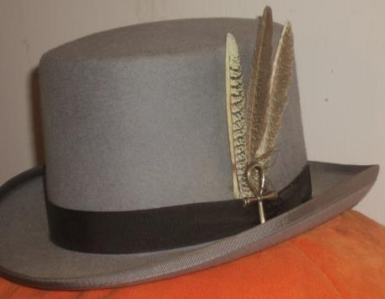
Do we all have a Feather in our CAP?
Change
Attitude
Pathways

Slide 5
Area and Division Director Round Table
District Executive Council

Slide 6
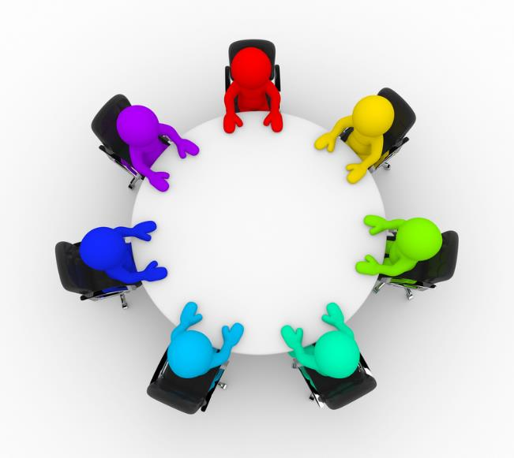

Slide 7
REMINDER: How to Access
Club membership rosters
Club officer lists
Dues payment status

Slide 8
Speech Contests – Lessons Learned
Rozaline Janci, DTM
Program Quality Director

Slide 9

General Observations
Rulebook and written materials
Eligibility
Timing
Attendance and participation

Slide 10
Rulebook and Written Materials
Materials being sent, but not always being read
Questions continue to come up when information has been supplied already
Speech Contest Rulebook
  July 1, 2018 to June 30, 2019
  Available for free download
https://www.toastmasters.org/leadership-central/speech-contests
https://www.toastmasters.org/leadership-central/speech-contests/speech-contest-tutorials

Slide 11
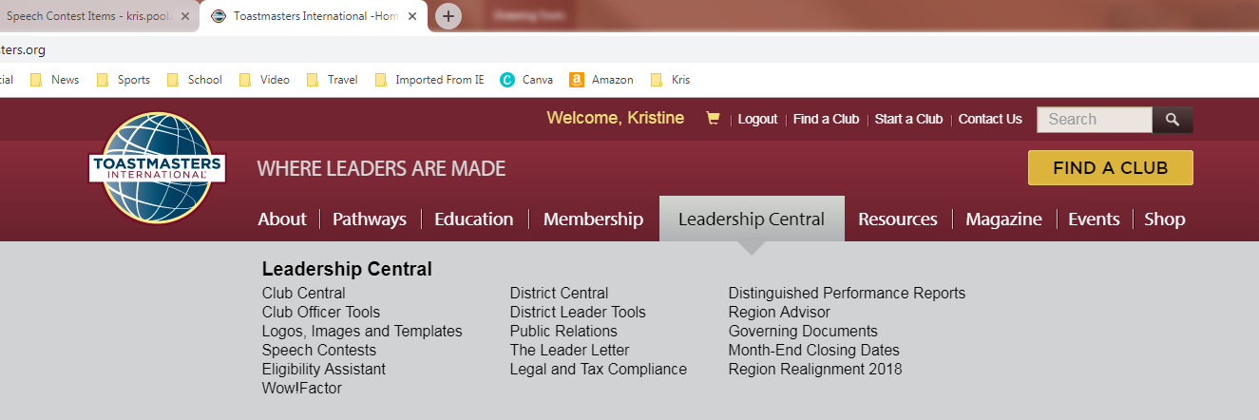
Eligibility
How to determine if a contestant (and judge) is eligible to participate
https://www.toastmasters.org/leadership-central/eligibility-assistant

Slide 12
Timing of Contestants (Rulebook pages 13-14)
6. Timing of the Speeches
  A. Two timers are appointed by the chief judge. One is provided with a stopwatch, and the other with a signaling device that displays green, yellow, and red colors.
  B. The signaling device must be in full view of each contestant.
  C. The timer with the stopwatch maintains and delivers to the chief judge the written record of elapsed time of each speech on the Speech Contest Time Record Sheet and Instructions for Timers (Item 1175).
  D. The timer managing the timing device ensures that contestants are able to view an accurate green, yellow, or red signal at appropriate times during the speech.
  E. All speeches delivered by contestants must conform to the timing guidelines for the contest.
    1. International and Humorous speeches shall be from five to seven minutes. A contestant will be disqualified if the speech is less than four minutes 30 seconds or more than seven minutes 30 seconds.

Slide 13
Timing of Contestants (continued)
F. Upon being introduced, the contestant shall proceed immediately to the speaking position.
  1. Timing will begin with the contestant’s first definite verbal or nonverbal communication with the audience. This usually will be the first word uttered by the contestant, but would include any other communication such as sound effects, a staged act by another person, etc.
  2. The speaker should begin speaking within a short time after arriving at the Speaking area, and is not permitted to delay the contest unnecessarily.
G. Timers shall provide warning signals to the contestants, which shall be clearly visible to the speakers but not obvious to the audience.
  1. For International and Humorous contests:
    a) A green signal will be displayed at five minutes and remain displayed for one minute.
    b) A yellow signal will be displayed at six minutes and remain displayed for one minute.
    c) A red signal will be displayed at seven minutes and will remain on until the conclusion of the speech.
H. Prior to announcing results, the contest chair shall announce if time disqualifications occurred, but not name the contestant(s) involved.

Slide 14
Attendance and Participation
Both seem lower than in past years
Promote your contest early and often
  Benefits of attending as an audience member
  Benefits of participating as a participant (contestant, judge, Chief Judge, Contest Master, ballot counter, timer, registration, SSA)
Judges for Division Contests
  Equal number of voting judges from each area in the division OR a minimum of 7 judges
  No chief judge, voting judge, or tiebreaker judge shall be a member of any club in which a contestant is a member

Slide 15
Spring Convention Update
Gina Glover, DTM
Spring Convention Chair

Slide 16

Club and Individual Registration is Open
Over 30 Clubs have registered!
Education Session Speaker applications are being reviewed
Marketplace applications are currently being accepted
“First Timers” receive special welcome gift
Continental Breakfast on Saturday morning
Saturday Dinner includes entertainment!
Event Sponsorships Available!

Slide 17
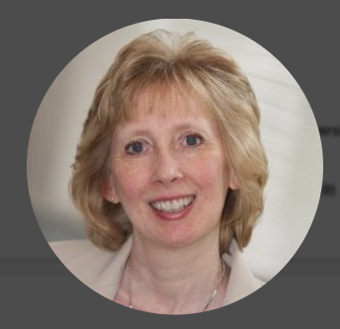
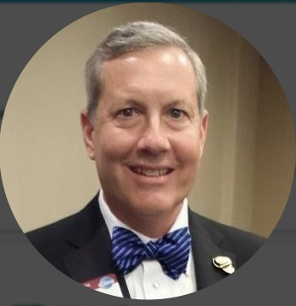
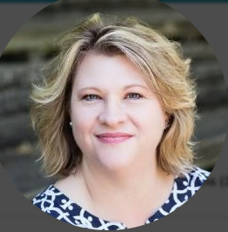
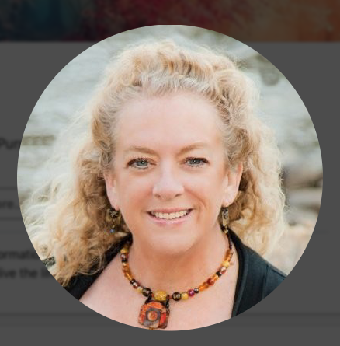
Convention Planning Team
Contest Chair, Evelyn Puerto
Green Bay Yackers
Credentials Chair, Keith Cumiskey
Rockwell Automation A-B Toastmasters
Education Session Chair, Leslye Erickson
Mid-Day Women’s Alliance Toastmasters
Facilities Chair, Mary Jo Rakowski
Green Bay Yackers

Slide 18
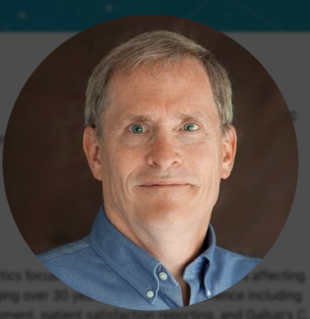
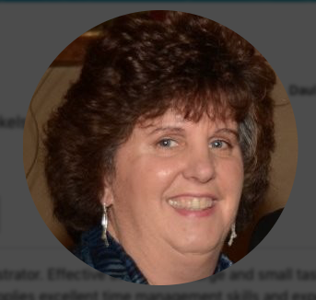
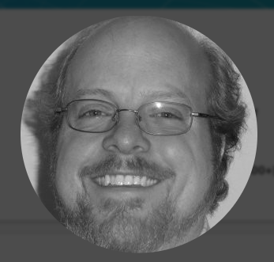
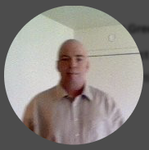
Convention Planning Team
Friday Fun Night Chair , Andy Safranski
Fox Speak Toastmasters
Hospitality Chair, Cindy Wink
Green Bay Yackers
Marketplace Co-Chair, Paul Van Dyck
Talk of the Town
Marketplace Co-Chair, David Taylor
Talk of the Town

Slide 19
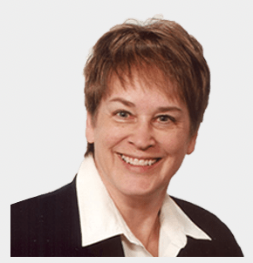
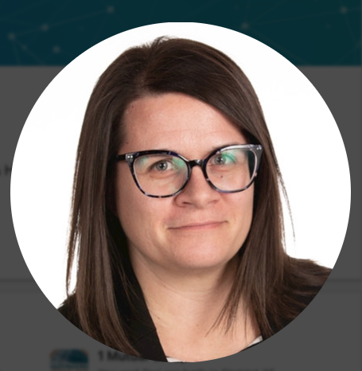
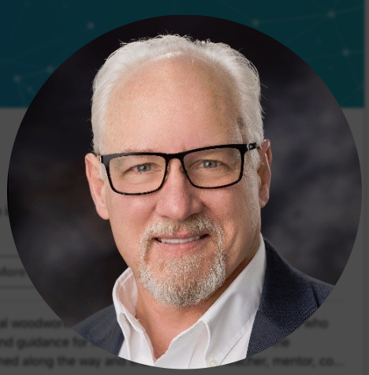
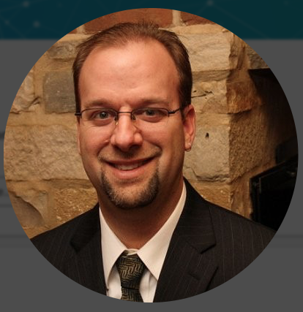
Convention Planning Team
Public Relations Chair, Lynne Finch N.E.W. Appleton Toastmasters
Registration Chair, Teri McGregor
Leading Voices
Technology Chair, Jeff Ebel
Stevens Point Toastmasters
Website Chair, Matt Wuteska
ROK the Talk

Slide 20
Friday Night Agenda
Time | Activity
4:30 – 7:00 | Registration and Credentials Open Three Clans Pre-function Area WILL CLOSE AT 7pm for contest!
5:00 – 6:30 | Past District Director Dinner Cayuga (opens into Grand Council Ballroom)
6:00 – 7:00 | Opening Night Reception Grand Council Ballroom
7:15 – 9:00 | Humorous Speech Contest (Briefings start at 6:45)
9:00 – 11:00 | Friday Night Fun – Live Music!

Slide 21
Saturday Agenda (through lunch)
Time | Activity
5:30 – 6:15 | Morning Walk/Run (Meet outside Pine Tree Grill in Lobby)
7:00 – 9:00 | Registration and Credentials Desks Open (Outside Turtle/Bear) Continental Breakfast served in Turtle
8:15 – 9:00 | Opening Ceremonies in Wolf Ballroom Club Banner Parade Participants will assemble in Bear
9:00 – 9:45 | Keynote Address – Pres Vasilev, 2013 World Champion of Public Speaking Wolf Ballroom
10:00 – 10:45 | Education Session #1 Huron Ontario Michigan
11:00 – 1:00 | Speaker – Don Bittick, International Director Followed by Luncheon and DTM Awards Ceremony Turtle/Bear

Slide 22
Saturday Agenda (after lunch)
Time | Activity
1:30 – 2:15 | Afternoon Presentation – Pres Vasilev Wolf Ballroom
2:30 – 3:15 AND 2:35 – 4:00 | Education Session #2 (Huron, Ontario, and Michigan) District 35 Business Meeting (Wolf Ballroom)
3:15 – 4:00 AND 3:30 – 4:00 | Networking Break Contest Briefings
4:00 – 6:00 | District 35 International Speech Contest (Wolf Ballroom)
6:00 – 7:00 | Networking Reception Marketplace
7:00 | Dignitaries assemble outside Wolf/Bear
7:15 – 11:00 | Dinner Banquet, Hall of Fame Awards & Contest Winners Announced Casino Night Entertainment to follow

Slide 23

Marketplace
Marketplace will be open on Saturday just after registration and will be available during all networking breaks for a total of 3 ½ hours, as follows:
  7:15 to 8:15 am
  10:45 to 11:00 am
  1:00 to 1:30 pm
  3:15 to 4:00 pm
  6:00 to 7:00 pm
Everyone who stops by and asks a question or talks with a Marketplace representative receives one playing card
At end of the night, the person with the BEST POKER hand wins a prize from this year’s convention sponsors!

Slide 24
What Else?
Program Ad Opportunities – see handout
Showcase your own club/area/division in the Marketplace
  Apply by April 5 – EXTENDED DATE!!
Updated Flyers in process with more specifics about session speakers and entertainment
Both contests will include a ”You Be the Judge” handout
Does your club want to reserve a table for dinner? Talk to Gina about this unique opportunity

Slide 25
Club Growth Director Update
Kris Pool, DTM
Club Growth Director

Slide 26
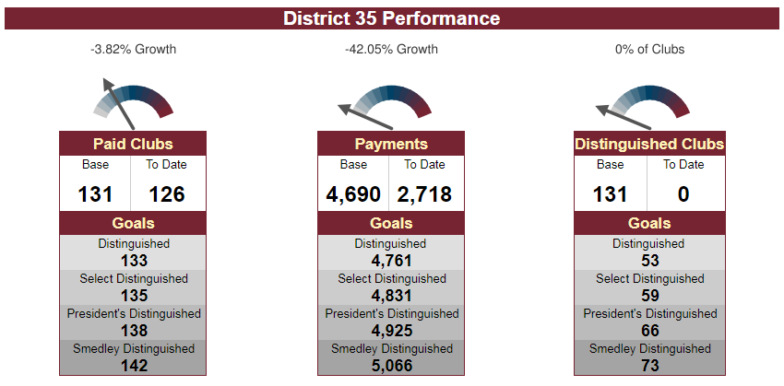

District 35 Performance

Slide 27

Clubs with 10 or Fewer Paid Members
Clubs need to have at least 8 members to be considered in “good standing”
Talk with your clubs
  Understand the impact of not being in good standing, including:
    Not being eligible to vote at District business meeting
    Members ineligible to compete/judge speech contests
    No access to Club Central
    No access to Pathways
  Eligible for a club coach
No grace period
Notes:
31 clubs

Slide 28
Clubs that Need a Club Coach
36

Slide 29
Club Coaches
Club officer should contact Kris Pool or Judy Bauer to request a club coach
Coaches that help a club achieve distinguished status by June 2019 receive $100 gift card and credit toward a district officer position Coaches that help a club achieve distinguished status by June 2020 receive credit toward a district officer position
Details on district website and https://www.toastmasters.org/leadership-central/club-officer-tools/club-management/club-quality/club-coach-program

Slide 30
Club Status
Potential clubs
  World Headquarters (Appleton)
  Sauk Prairie Healthcare (Sauk Prairie)
  UMOS (Milwaukee)
  US Venture (Appleton)
  Advocate Aurora Healthcare (specific for IT) (Milwaukee)
  WelchAllyn (Milwaukee)
In process
  Impro (Muskego)
  Blackhawk Community Credit Union (Janesville)

Slide 31


Sponsors and Mentors
2 sponsors and 2 mentors needed for each club
Work together now to meet with prospective club, demo meetings, organization meeting
Working handbook – step by step through the process – email Kris Pool for a copy

Slide 32
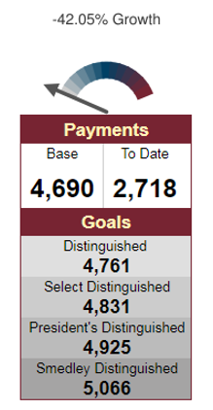
Membership Payments
Payments now being accepted
Clubs need to renew minimum of 8 to receive DCP credit
Clubs need 20 members or Net 5 (from July 1 base) to meet minimum membership requirement to achieve distinguished status
UPDATE: 2272 to 2718 payments since last month
Division Directors – Quad call on 3-24-19 for update

Slide 33

Current Membership Campaign

Slide 34
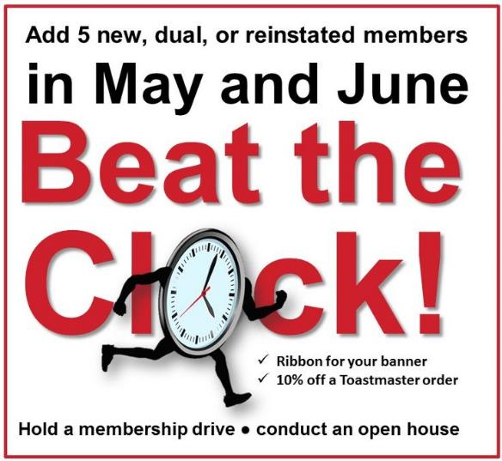
Upcoming Membership Campaign

Slide 35
Spring Convention Tour
Hotel Staff

Slide 36


Slide 37
Team Building Activity
Keith Cumiskey, DTM
Immediate Past District Director

Slide 38
Zoom
Create a unified story from a set of randomly provided pictures.
Every picture must be used
Every team member must be part of the story
Time line
  Instructions – 5 minutes
  Planning – 5 minutes
  Stories – 1 minute per team, 30 second transition between teams
  Debrief – 5 minutes
This is an excellent activity to encourage communication, tolerance, and patience.

Slide 39
Mini-Division Council Meeting
Division Teams

Slide 41
Mid-Year Training Update
District 35 Trio

Slide 42
Branding
Ed Thelen, DTM
District Director

Slide 43
Toastmasters Branding
Certain companies have iconic brands
  McDonald’s
  Nike
  Starbucks
Toastmasters has certain branding standards that need to be followed
  Logo
  Watermark
  Color
  Font
  Meeting Experience

Slide 44
Branding Governing Documents
Policy 4.0: Intellectual Property
Protocol 4.0: Intellectual Property
Bylaws of Toastmasters International, Article III, Section 6
Bylaws of Toastmasters International, Article XIII, Sections 1-4
Logos, Images and Templates page
  Leveraging the Brand video
  Brand Manuals
  Marketing Resources
  Website Templates and Free ToastHost websites
  Logo and Design Elements

Slide 45
Branding Testing

Slide 46
Branding Testing

Slide 47
Branding Testing

Slide 48
Branding Testing

Slide 49
Branding Testing

Slide 50
Branding Testing

Slide 51
Branding Testing

Slide 52
International Contest – Going Beyond District
Rozaline Janci, DTM
Program Quality Director

Slide 53
Recording International Speech Contest
The audio must be clear and without echo, static or other excessive noise
The camera must record in high definition
Only single-camera setup is permitted; use of multiple camera angles is not allowed
The camera must be placed on a tripod to maintain stability and prevent unwanted movement
The camera must have an unobstructed, in-focus view of the contestants
The entire speaking area must be visible throughout the recording
The camera must be monitored by a camera operator at all times to ensure it is recording properly
Zooming is not permitted

Slide 54
Recording International Speech Contest
The speaking area must be fully lit
The speaker’s facial expressions must be visible throughout the speech; the image should not be too bright or dark
No lighting, artificial or natural, should point directly at the camera
The recording must only contain the introduction of the winning contestant’s speech by the contest chair and the entire winning speech
The recording may not be edited in any way, such as by adding text, graphics, images, or anything that does not meet the requirements above

Slide 55
Organization Changes
Kris Pool, DTM
Club Growth Director

Slide 56
Download Files
Leadership Handbooks –
  Incoming club and district officers
  Only available as PDF file for download; no more mailings
  Hard copy NOT available in new club charter
Speech Contest Rulebook
  Only available as PDF file for download

Slide 57
Club Officer Training
Want consistencies in the training throughout the districts and division
All mid-year training attendees gave suggestions for what club officers should be trained
Part 1 – eLearning for each officer; available ahead of time and will help facilitate the transition from this year to next year’s officers
Part 2 – face to face (in person) training; more leadership type opportunities for officers

Slide 58
Pathways
December 2018
  Changes to the platform (computer, tablet, mobile devices)
  Navigator updated
Onboarding currently being updated to make it easier
Humorous path now available; additional paths being worked on

Slide 59
Upcoming Changes to Pathways
Evaluations – evaluator types and submits the evaluation and it is uploaded directly to the speaker’s profile
Digital experience – improvements so we don’t need to spend as much time on training
Communications to Trio, then to members on
Continuous improvement – Design, Build, Test, Review – changes coming in the next 24 months based on feedback from members
District Central – Pathways adoption rates to be updated quarterly; real time data being worked on

Slide 60

WOW! Factor
The Wow!Factor Project invites all club leaders and members to raise the bar to the new gold standard of creating a successful Toastmasters club.
Tips and resources will be highlighted on Toastmasters social channels.
Additionally, clubs are encouraged to submit a one-minute video entry showing/telling how they created a successful club.
https://www.toastmasters.org/wowfactor

Slide 61
30-60-90 Day Review
Ed Thelen, DTM
District Director

Slide 62
Your Next 30 Days (mid-April)
Ensure all training is recorded
Complete Area Director visits – finalize paperwork in early May
Division Contests occurring or have all plans finalized
Hold another Area/Division council meeting
Share information for Spring Convention provided by PQD and on website with clubs (are you registered yet?)
Have appointed successors recommended to DLC/likely incoming District Director or keep asking

Slide 63
Your Next 60 Days (mid-May)
Make sure all TLI training recorded (May 31)
Ensure all Area Visits completed and finalize reports in District Central (due by May 31)
Start working with your successor (should have most positions finalized by then)
  Area Directors – Share information about clubs and what you learned in the role
  Division Directors – Work in transition on TLI planning and what you learned in the role
Hold another Area/Division council meeting
Remind clubs of officer elections and submit new officer list to TI
Beat the Clock promotion (May & June membership drive)
Follow-up on low-paying clubs (less than 8 members)

Slide 64

Your Next 90 Days (mid-June)
Complete the transition plan with your successor
Continue to follow-up on low-paying clubs
Remind clubs to submit their new officer lists to TI
Encourage all incoming officers to attend summer TLI sessions
Incoming Area and Division Director training – Saturday, June 15 (no regular DEC meeting)
Breathe and relax!
  Your year is almost over!

Slide 65
Q & A and Wrap-Up
Ed Thelen, DTM
District Director

Slide 66


Slide 67
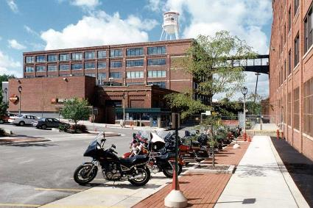
Next DEC Meeting
Saturday, April 13, 2019
  *** NOTE: This is the 2nd Saturday of April ***
10:30 a.m. to 2:30 p.m.
Host: Division D
  Harley-Davidson University
  3700 W Juneau Avenue
  Milwaukee, WI 53208

Slide 68
Next DEC Meeting
Topics for DEC Meeting (partial)
  Spring Convention Update (Rozaline Janci)
  District Success Plan Progress (Quad)
  PR Update (Kamal Soan)
  Finance Update (Jason Feucht)
  District 35 Procedures Manual (Craig Carpenter)

Slide 69


