Slide 1
January 2019 DEC Meeting
January 19, 2019
Rockwell Automation
Mequon, WI
Host: Division A

Slide 2
Agenda
10:30 – 10:35 Introduction
10:35 – 10:45 District TLI Debrief
10:45 – 11:05 Speech Contest Reminders
11:05 – 11:25 Spring Convention Update
11:25 – 12:10 Area/Division Director Roundtable
12:10 – 12:25 Finance Update
12:25 – 12:35 District Status

Slide 3
Agenda
12:35 – 1:05 Lunch
1:05 – 1:30 Team Building Activity
1:25 – 1:45 Club Growth Director Update
1:45 – 1:55 Membership Building
1:55 – 2:05 General Updates
2:05 – 2:15 Recognition
2:15 – 2:20 30-60-90 Day Plan
2:20 – 2:30 Q & A and Next Meeting

Slide 4
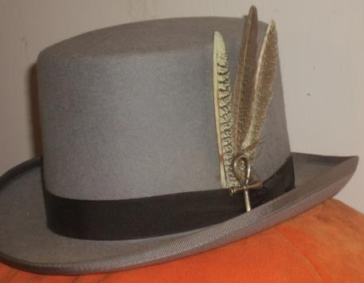
Do we all have a Feather in our CAP?
Change
Attitude
Pathways

Slide 5
District TLI Debrief
Rozaline Janci, DTM
Program Quality Director

Slide 6
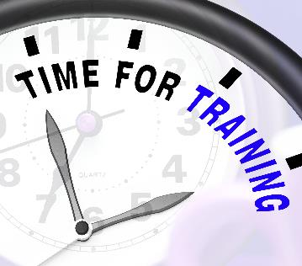
TLI – Toastmasters Leadership Institute
Makeup sessions continue through the end of February
Check District calendar for dates and details
Encourage clubs to send all 7 officers (and they don’t need to all attend the same session)
Minimum of 4 officers attend to receive DCP credit

Slide 7
Speech Contest Reminders and TBL Update
Rozaline Janci, DTM
Program Quality Director

Slide 8

Speech Contest Timeline
Clubs – January 2, 2019 – February 21, 2019
Areas – February 22, 2019 – March 24, 2019
Division – March 25, 2019 – April 28, 2019
District
  Humorous – Friday, May 10, 2019
  International – Saturday, May 11, 2019

Slide 9

Rule on Number of Contestants
District 35 has chosen to invoke the rule regarding multiple contestants moving forward to the next level contest:
  If an Area has 4 or less Clubs, 2 contestants can move forward to the Area contest
  If a Division has 4 or less Areas, 2 contestants can move on to the Division contest
Based upon the number of clubs as of July 1, 2018

Slide 10
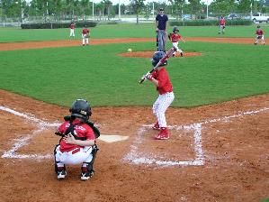
TBL – Toastmasters Baseball League
Promote at club meetings
Earn rewards for doing what clubs and members do, such as:
  Earn an education award
  New member joins club
  Open house (up to 3x)
  Raid another club
  Run Speechcraft
  Earn 5 DCP goals by March 31
Details at https://district35.org/toastmasters-baseball-league/

Slide 11
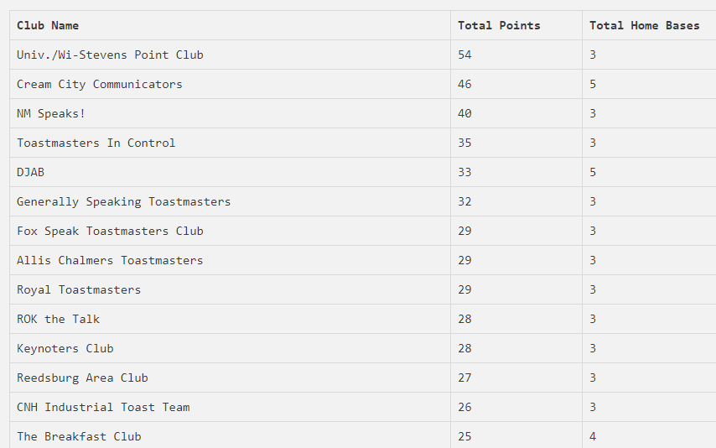
TBL – Going Strong

Slide 12
Spring Convention Update
Rozaline Janci, DTM
Program Quality Director

Slide 13
Countdown to Spring Convention
112
days

Slide 14
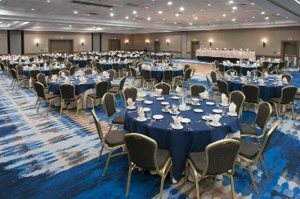
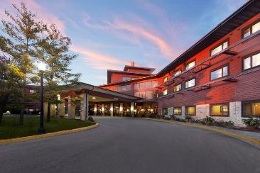
2019 Spring Convention
May 10-11, 2019 (Mother’s Day weekend)
Radisson Hotel & Conference Center, Green Bay

Slide 15
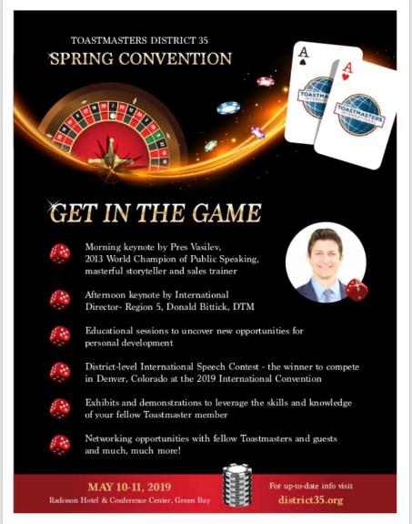
Theme: GET IN THE GAME
Notes:
It’s about creating connections, being a part of all that is offered.

Slide 16
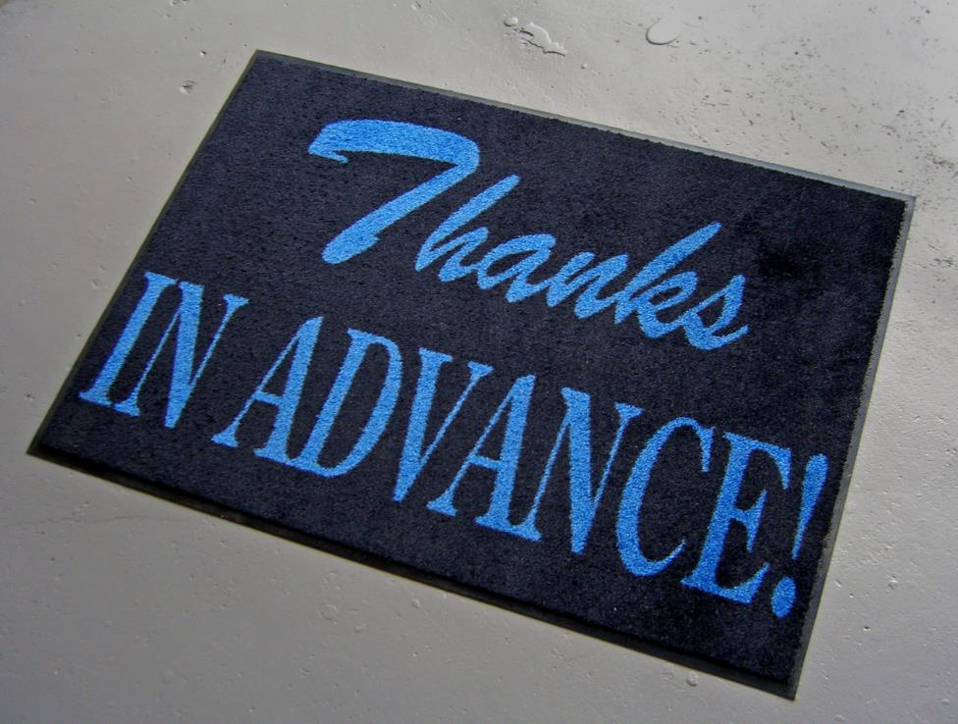

Slide 17
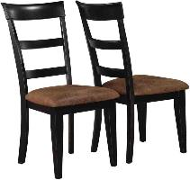
Convention Chairs
Gina Glover – Spring Convention
Terri McGregor – Registration Chair
Paul VanDyck – Marketplace, Co-Chair
David Taylor – Marketplace, Co-Chair
Cindy Wink – Hospitality Chair
Evelyn Puerto – Contest Chair
Keith Cumiskey – Credentials Chair
Leslye Erickson – Education Chair
Notes:
Terri Mcgregor - Registration chair - excited about - small talk and networking- spreadsheet to track info - nervous
Paul V - Talk of the town - market place chair - have never gone to a district - to help support this conference to green bay - reservation - do not have an idea about the market place
David S - Talk of the town - excited it is in Green bay - part of our community and showcase green bay outside packers- nervous being around high profile speakers - co-chair market place
Cindy 'vink - green bay yackers - hospitality chair
Excited about show casing green bay. What is the hospitality role - clueless - that is the reservation
Evelyn puerto - contest chair - green bay yackers - reservation - finding all the functionaries for running the contest.
Keith - immediate past - credentials - ensuring the people that attend the business mtg are authorized to vote on behalf of their club- more formal structure - oversight of the ballot counting, quorum- to do everything promotion so we have a quorum -
Leslie - E- 2 years - mid day alliance - appleton - chairing the education committee - TLI - madison - maintained friendship - with whitewater- reservation is it is a big role - people are coming for the session and so nervous of the enromity of the role

Slide 18
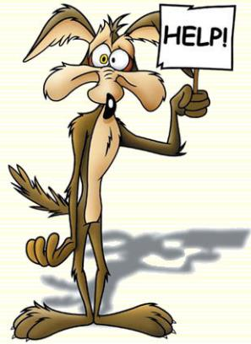
Assistance Still Needed
PR
  Kamal Soan
Friday Fun Night & Advertising
  Barb Sexmith ?
Sponsorship
  Lisa Smith
Contact Gina or Rozaline if interested in assisting
  GLGLOVER74@gmail.com
  Rozaline.Janci@usbank.com
Notes:
Open positions - kamal soan - PR - Chair - for the convention (Heidi Slowinski was earlier but due to commitments at work and Kamal is going to do it.)
Barb Sexmith - president of Mid day - considering the Friday Fun chair- Advertising
Sponsorship - continues to be open - lisa smith –

Slide 19

Promoting the Spring Convention
District website
District Facebook page
District newsletter

Slide 20
How Area and Division Directors Promote
Areas Directors share with club officers and members
Distribute flyers at club events, contests, open houses
Reinforce the benefits of attending
Remind Club Presidents & VP Education they need to vote at business meeting (or assign proxy to another club member that is attending)
Remind members & guests to REGISTER EARLY
  Ensure they have materials and meals; no guarantee of availability if they just show up

Slide 21
General Reminders
Registration is important – We need counts for food; limited on what we can do “on demand”
DEC members should set a good example and register early
There are a lot of costs (food, room rentals, etc.) involved to put on a high caliber event such as the District Convention
Area Directors – Your lunch is paid for as a thank you from the District

Slide 22
Area and Division Director Roundtable
District 35 Trio

Slide 23
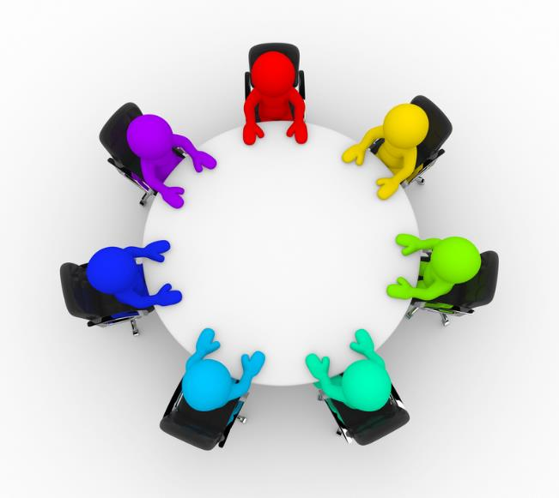

Slide 24
District 35 Finance Update
Jason P. Feucht, ACS, ALS
Finance Manager

Slide 25
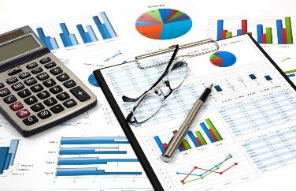
Overview
Preliminary Financial Results through December 2018
Income Estimates
District TLI
Travel / Mileage Budget Status
Reminders

Slide 26
Preliminary Financial Results Through December 2018
Total Funds Available $23,129.53
  Does not including required reserves
YTD Budgeted Income $27,491 actual income $26,760
  Variance UNDER budgeted income by $730.11
YTD Budgeted Expenses $31,844 actual expenses $23,926
  Variance UNDER budgeted expenses by $7,918.47
Bottom Line
  Through December, D35 ran at a PROFIT of $2,834.86
  Profit is currently a result of slower than expected spending
Notes:
Cash flow
Reserves of $11,995.10
Total Funds: 32,273.78

Slide 27
Income Estimates
District Revenue is based off membership payments
  D35 receives 25% of member dues from TI for District Expenses
  On average, $10.23 per member payment
    Often $11.25 is used but that is based on a full 6-month renewal dues; members that join in between pay a pro-rated rate
Income Budget Through October is $22,491
  2,198 member payments
  Currently we have 2,108 member payments according to the District dashboard
    Variance of 90 member payments
    $970 UNDER the income budget
Member payments are KEY to keeping D35 revenues on target

Slide 28
District TLI – Preliminary Profit & Loss
Districts are encouraged to run all events at a Net $0
  District 35 Budgeted: $4,000, to reduce member costs
  The District Spent: $4,661.99
TLI Income - $4,912.39
  Registration – 236: $4,720.00
  Bus – 29: $ 725.00
  Eventbrite Fees: ($532.61)
Districts are encouraged to run all events at a Net $0
  D35 budgeted $4,000 to reduce member costs
  D35 spent: $4,661.99
TLI Income: $4,912.39
  Registration – 236: $4,720.00
  Bus – 29: $ 725.00
  Eventbrite Fees: ($532.61)
TLI Expenses: $9,574.38
  Site & AV: $2,170.00
  Food & Beverage: $4,517.58
  Service Charges: $903.52
  Decorations & Giveaways: $0
  Printing: $34.84
  Bus: $795.00
  Name Badges: $160.78
  Keynote Speaker travel & accommodations: $992.66

Slide 29
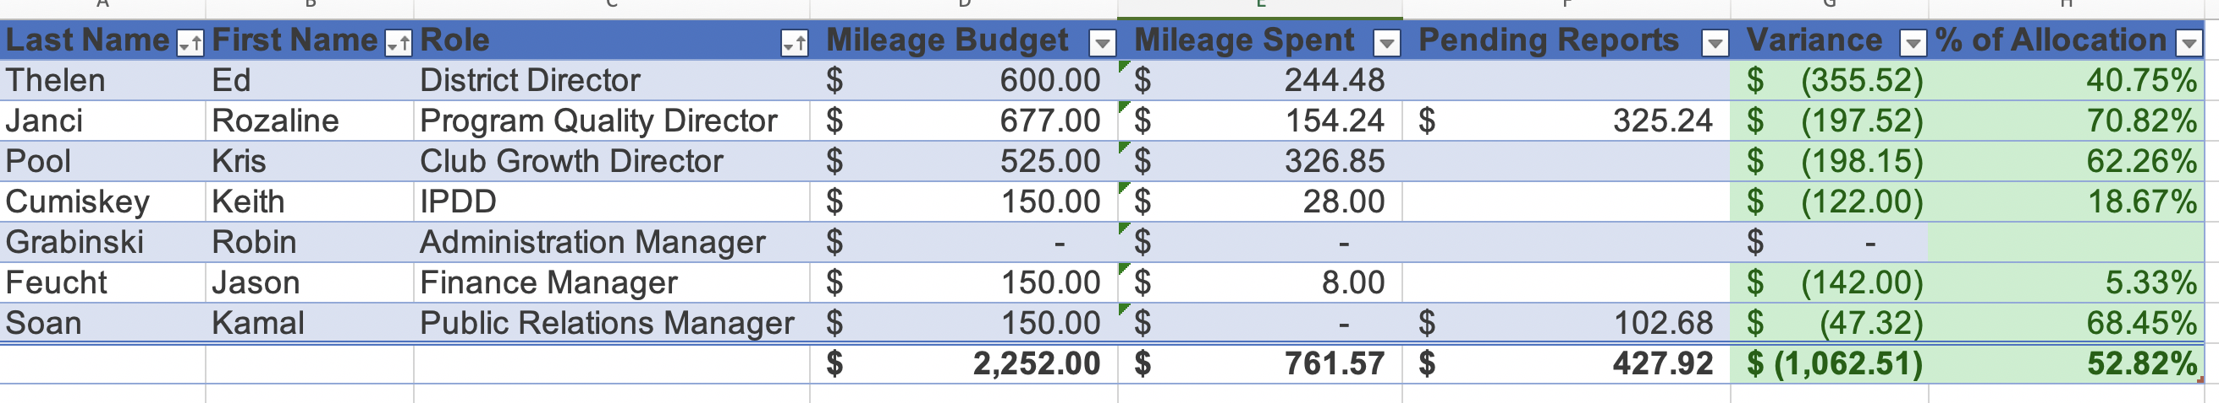
Mileage Budget - Trio & Administration

Slide 30
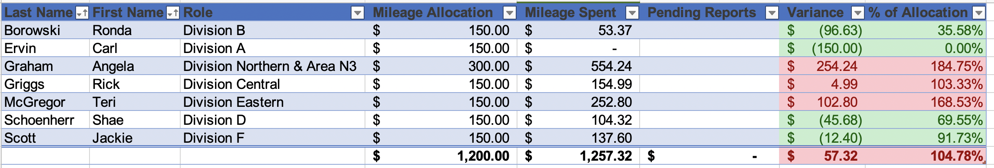
Mileage Budget - Division Directors
Division Director Mileage Budget has been depleted

Slide 31
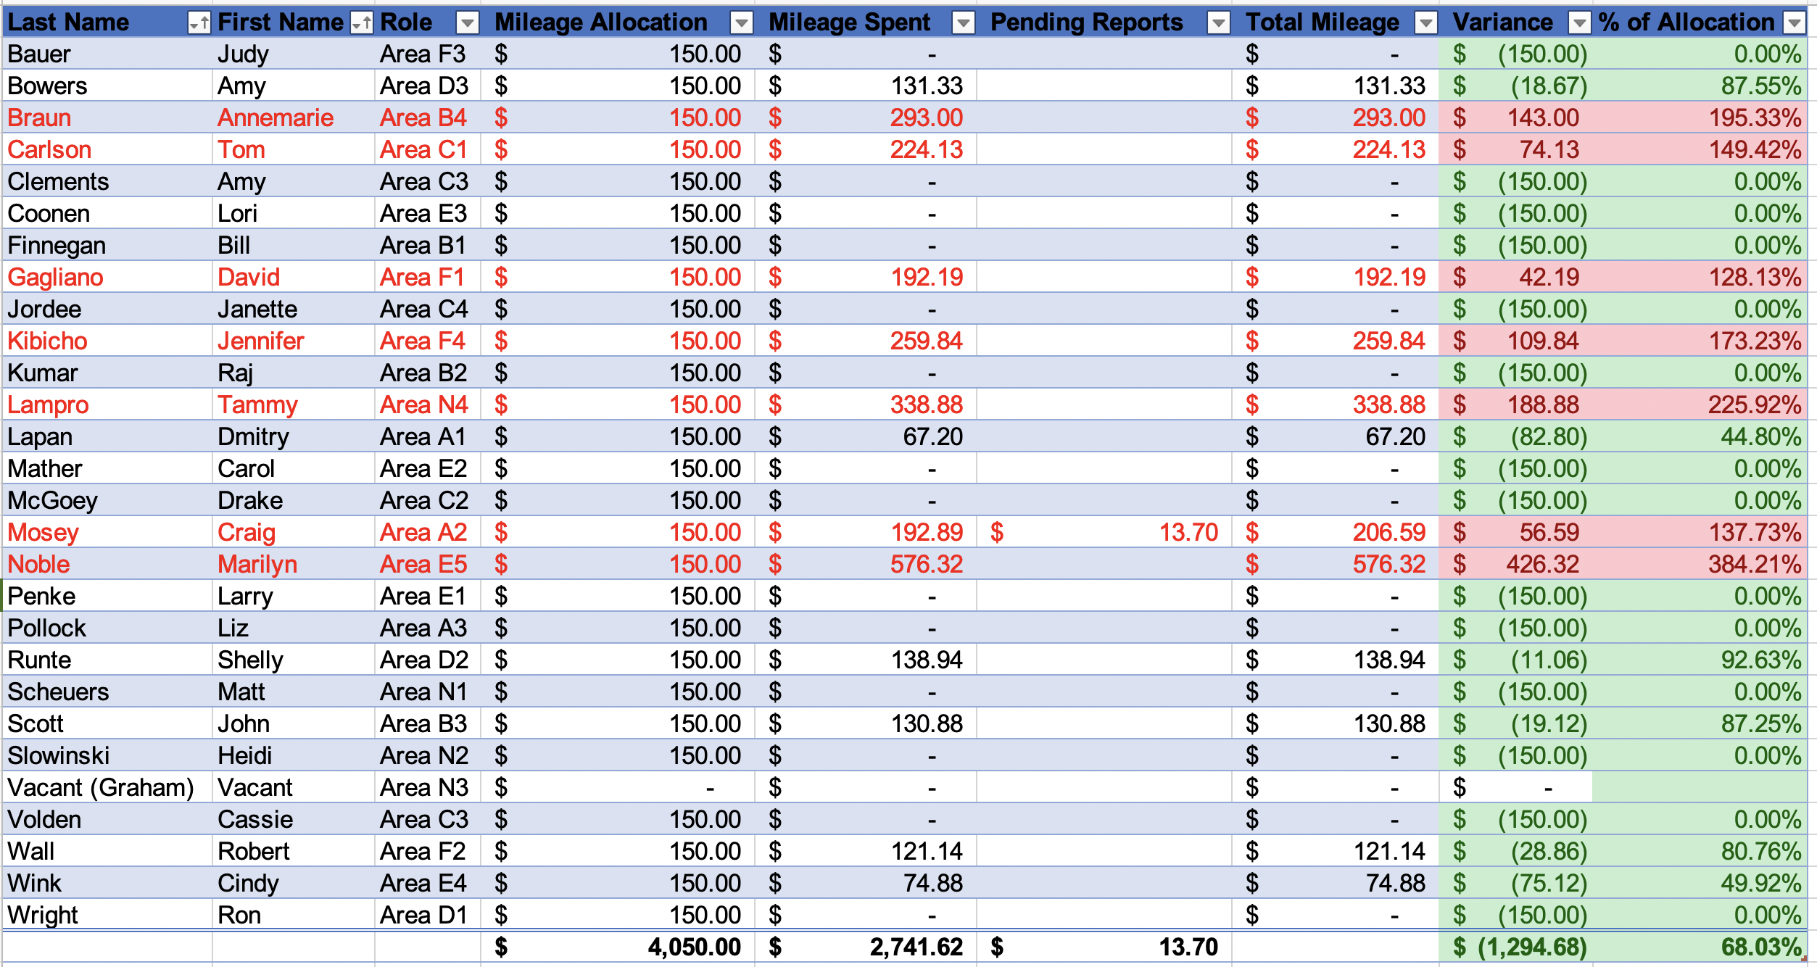
Mileage Budget - Area Directors
$1,294.68 remains in AD budget
Reimburse FIFO until budget is depleted

Slide 32
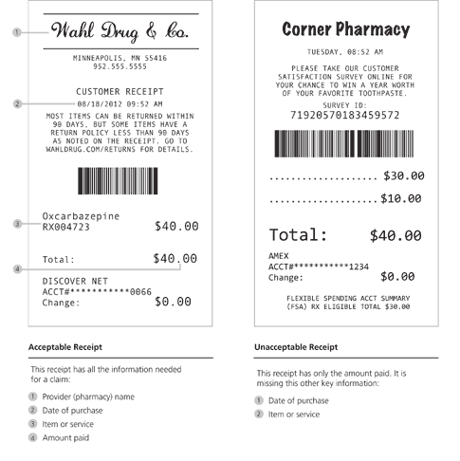
Reminders - Reimbursements
All expense reimbursements should be submitted via Concur
All expense reimbursements must be submitted within 60 days of when the expense occurred.
All expense reimbursements MUST have supporting documentation (receipts, map, etc.)

Slide 33
Other Reminders
Current Allocations
  TLI: $200 per Division per event
  Contests: $75 per Division; $40 per Area per event
  Look for opportunities to combine events to make them more cost effective when practical
  TI highly recommends all events run at net $0, meaning income is brought in to cover most, if not all, expenses
  If you charge for your event and it results in a profit, those funds must be returned to the District; they cannot be kept to have additional to spend on a future event

Slide 34

Eventbrite
Eventbrite is a great way to collect registrations as well as funds for your event
  D35 has a master Eventbrite account, which should be used for all Area, Division, and District events
  All funds collected are sent via check directly to D35
  If you want to use Eventbrite, please email me and I can get you started

Slide 35

Questions?
Remember
  Expenses need to be reported within 60 days
  Questions regarding your allocations, if is is ok to spend funds, etc.: Contact Ed
  Questions on Concur, Eventbrite, and other Finance Policies and Procedures: Contact Jason

Slide 36
District Status Update
Ed Thelen, DTM
District Director

Slide 37

Area Director Resignations
Area C3 – Amy Clements
Area C4 – Janette Jordee
Area C5 – Cassie Volden
Area F2 – Robert Wall

Slide 38

Area Director Replacement
Area C3 – Laura Croft

Slide 39

Where Do We Need Help?
Central Division needs help with the following:
  A second make-up Divisional TLI (if one is held)
  Area and Division Speech Contests
  Area Director Visits
Where can you give a few hours of your time to help?
  Carpool with others
  Quality time to plan some of your own Area/Division events

Slide 40

This Could Happen to All of You
General issue of lack of new leaders
  Don’t be complacent
  Be encouraging of new talent: “I see something in you but I don’t know what it is…”
Have some sort of topic related to this on the February virtual DEC call

Slide 41


Slide 42
Team Building Activity
Ed Thelen, DTM
District Director

Slide 43
Stand by Your Quotes
“A leader is best when people barely know he exists, when his work is done, his aim fulfilled, they will say: we did it ourselves. “
  — Lao Tzu
“Where there is no vision, the people perish. “
  — Proverbs 29:18

Slide 44
Club Growth Director Update
Kris Pool, DTM
Club Growth Director

Slide 45
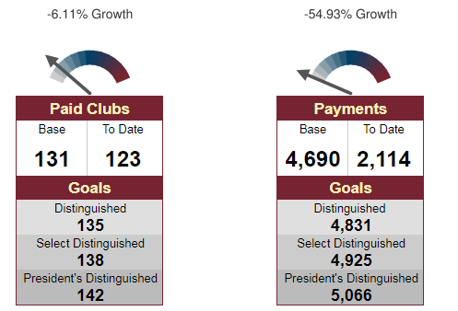

Performance Reports

Slide 46
Club Situation
Lost clubs
  Trek TM
  Deere Tales *
  Hansen’s TM *
  Funny Business
  Eau Claire TM
  3M Menomonee
  MKE Engineer
New clubs
  Speak Up!
  Words Properly Spoken TM
Submitting application
  Johnsonville TM
In process
  Blackhawk Community Credit Union
  Mammonth TM
  EQ Leadership
  Badgerland Meter
Possible
  St. Croix
  Thai Community Club

Slide 47
Club Coaches
Church Mutual Club
Generally Speaking Toastmasters
Kimmunicators Club
Landmark Toastmasters Club
Madison Achievers
Marshfield Area Toastmasters
Milwaukee Metro Spkrs Club
Oak Creek Toastmasters
Red Cedar Toastmasters
Schneider Toastmasters Club
Sheboygan Club 2121
Spectacle City Club
Sunburst Club
The Waukie Talkies
Toasters For Independence
Toastmasters of the Northwoods
Tosa/Medical Club
Walworth County Toastmasters Club
18 clubs currently have a club coach assigned
39 clubs need a coach
Club Coach
  Monthly calls with other coaches
  Requirement for DTM
  “Double Duty” – bring club to distinguished AND get district officer credit (by June 2020)

Slide 48
Membership Building
Kris Pool, DTM
Club Growth Director

Slide 49

Upcoming Membership Campaigns

Slide 50
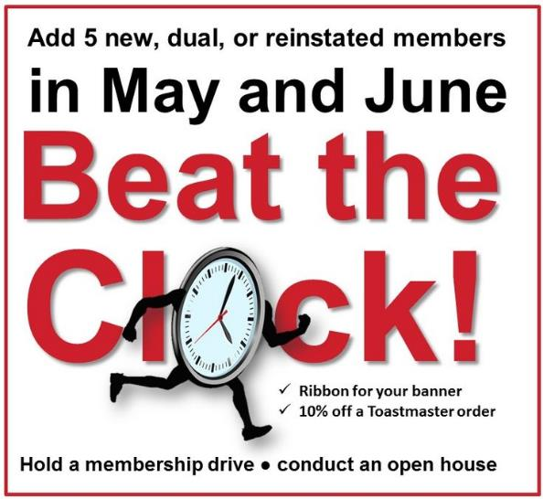
Upcoming Membership Campaigns

Slide 51
Other Membership Building Ideas
Plan Open House
  Promotion of event (flyers for members to distribute, EventBrite, Facebook, LinkedIn, Twitter, club website, local community calendars, other ideas?)
  Gain bases in TBL
Guest packet with current information
Club website / social media current
Special membership drive – put on a “show”
  Advanced speaker and beginning speaker
  Evaluators give a “model” evaluation
Membership contests – between club members or clubs in an area

Slide 52
More Membership Resources
Achieve Success – Attract & Retain members
  https://www.toastmasters.org/~/media/aed54005493241a997833b547b40337d.ashx
Let the World Know – Publicity & Promotion Handbook
  https://www.toastmasters.org/~/media/4961F7BE4B244A12A39426D0C9193CD1.ashx
Visit other district websites for different ideas too
  https://www.d25toastmasters.org/resources/membership-and-marketing-resources/

Slide 53
PR Awards
Public Relations Awards
  Best Website
  Best Social Media
See the District 35 website for more details about the qualifying criteria and judging criteria for each award
The submission deadline is March 31, 2019
Please use this entry form
Email your entry form to Kamal Soan, PR Manager at kamal.soan@gmail.com

Slide 54
District 35 General Updates
Ed Thelen, DTM
District Director

Slide 55

Toastmasters Baseball League Prizes
Rozaline already shared general updates
Prizes based upon current standings to be ordered shortly
Prizes to be delivered at _______________

Slide 56
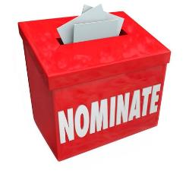
District Leadership Update (partial)
Need Division Director candidates for all but Divisions A and F
Need Area Director candidates for many Areas
Suggestions? Please forward to Ed and/or District Leadership Chair Rhonda Williams (rhondainwisconsin@gmail.com)

Slide 57
Reminders about District Awards
Public Relations Awards
  Website
  Social Media
Toastmaster of the Year
Area Director of the Year
Division Director of the Year
Have nominations in for the latter three to Ed by March 1, 2019

Slide 58
Recognition
Ed Thelen, DTM
District Director

Slide 59
Perfect DEC Attendance – 2nd Quarter
These individuals had perfect attendance at DEC meetings in the 2nd quarter

Slide 60
Perfect DEC Attendance – 1st Half of Year
These individuals had perfect attendance for the 1st half of the Toastmasters year:

Slide 61
30-60-90 Day Review
Ed Thelen, DTM
District Director

Slide 62
Your Next 30 Days (mid-February)
Make sure all TLI training is recorded by May 31
Start 2nd round of club visits and enter information for visit reports ASAP after visit (due by May 31)
Speech Contests
  Area Directors – everything ready to conduct contests?
  Division Directors – location, date, and time finalized?
Hold another Area/Division council meeting
Start generating interest for Spring Convention

Slide 63
Your Next 60 Days (mid-March)
Make sure all TLI training is recorded by May 31
Continue 2nd round of club visits and enter information for visit reports ASAP after visit (due by May 31)
Speech Contests
  Area Directors – Concluding contests
  Division Directors – Finalizing details
Hold another Area/Division council meeting
Share information for the Spring Convention provided by PQD and on website with clubs

Slide 64
Your Next 90 Days (mid-April)
Ensure all training is recorded
Complete Area Director visits – finalize paperwork in early May
Division Contests occurring or have all plans finalized
Hold another Area/Division council meeting
Share information for the Spring Convention provided by PQD and on website with clubs
Have successors recommended to DLC/likely incoming District Director or keep asking

Slide 65
Q & A and Wrap-Up
Ed Thelen, DTM
District Director

Slide 66


Slide 67
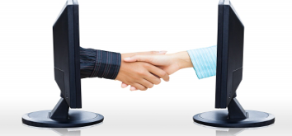
Next DEC Meeting
Saturday, February 16, 2019
9:30 a.m. to 11:30 a.m. – NOTE TIME CHANGE
Virtual Meeting
  District Success Plan Update (Multiple)
  Spring Convention Update (Rozaline)
  Speech Contest Update (Rozaline)
  Public Relations Update (Kamal)
  Finding New Leaders (TBD)
…and more

Slide 68
Next DEC Meeting
Topics for DEC Meeting
  District Success Plan Progress (Quad)
  Contest Update (Rozaline Janci)
  Spring Convention Update

Slide 69
