Slide 1
April 2019 DEC Meeting
April 13, 2019
Harley-Davidson University
Milwaukee, WI
Host: Division D

Slide 2
Agenda
10:30 – 10:35 Introduction
10:35 – 10:45 District Procedures Manual
10:45 – 11:15 Area/Division Director Roundtable
11:15 – 11:30 Finance Update
11:30 – 11:45 District Success Plan
11:45 – 12:00 Building a New Club
12:00 – 12:15 Area Communications
12:15 – 12:30 Realignment

Slide 3
Agenda
12:30 – 1:00 Lunch
1:00 – 1:25 Team Building Activity
1:25 – 1:40 Spring Convention Update
1:40 – 1:55 Pushing Toward Distinguished
1:55 – 2:10 Public Relations Update
2:10 – 2:15 Recognition
2:15 – 2:20 30-60-90 Day Plan
2:20 – 2:30 Q & A and Next Meeting

Slide 4
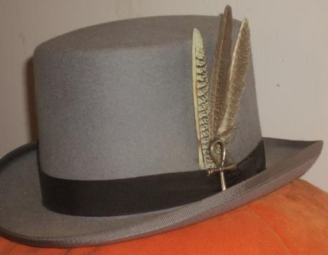
Do we all have a Feather in our CAP?
Change
Attitude
Pathways

Slide 5
District 35 Procedures Manual
Craig Carpenter, DTM
Distinguished Past District Governor

Slide 6
Area and Division Director Round Table
District Executive Council

Slide 7
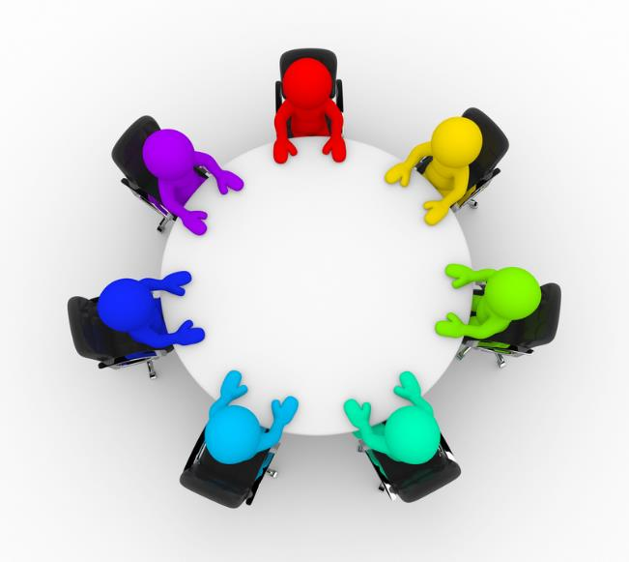

Slide 8
Finance Update
Jason Feucht, DTM
Finance Manager

Slide 9
Overview
Financial Results Through February 2019
Travel / Mileage Budget Status
Reminders

Slide 10
Financial Results Through February 2019
Total Funds Available $20,894.74
    Does not including required reserves
YTD Budgeted Income $30,690.00 actual income $30,786.60
    Variance OVER budgeted income by $96.60
  YTD Budgeted Expenses $37,949.75 actual expenses $33,045.39
    Variance UNDER budgeted expenses by $4,904.36
  Bottom Line
    Through February D35 ran at a LOSS of $2,258.79

Slide 11
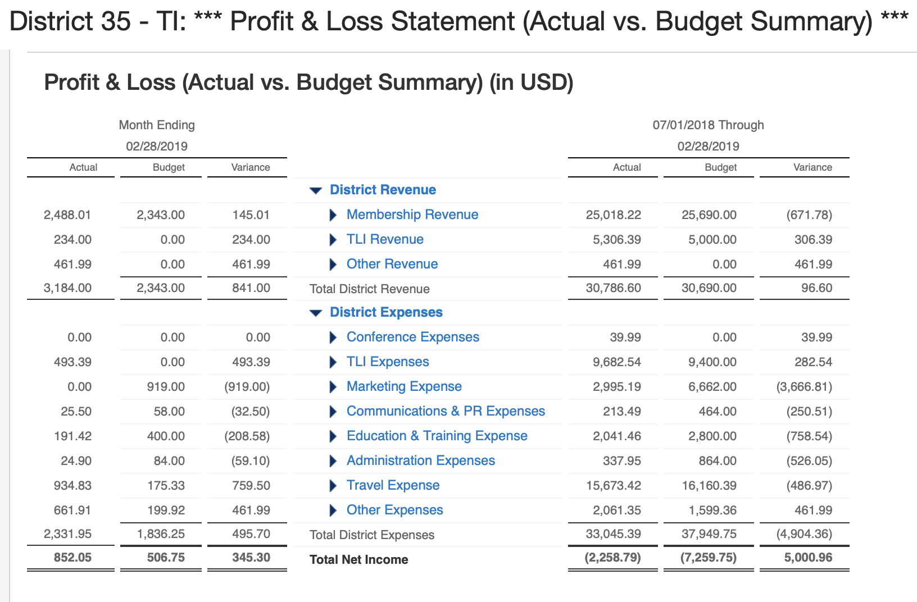
Financial Results Through February 2019

Slide 12
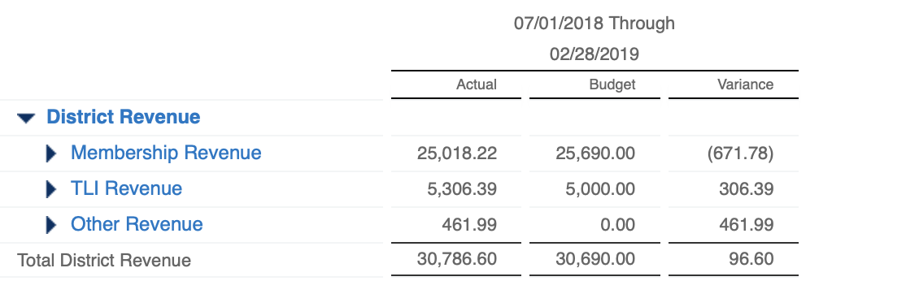

Financial Results Through February 2019
Remember! Member Payments are KEY to keeping the District revenues on target
Remember 25% of member dues comes to the District
As of February 2019,
we have 66 LESS member payments than plan.
$671.78 / $10.23 = 65.67 Payments

Slide 13
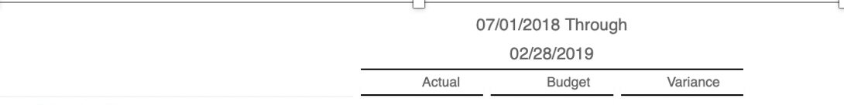
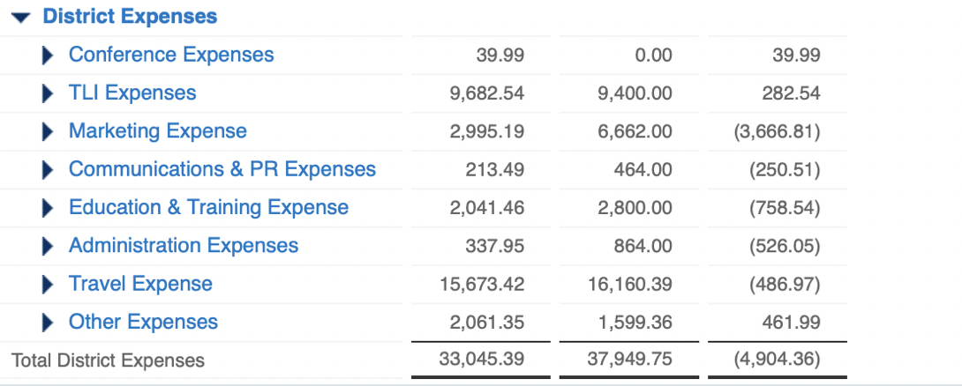
Financial Results Through February 2019
TLI
Income: $5,306.39
Expense: $9,682.54
LOSS: $4,376.15
TLI Budget
Income: $5,000
Expense: $9,400
LOSS: $4,400
Positive Variance to Budget of $23.85

Slide 14
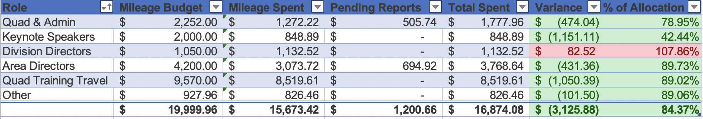
Travel Budget

Slide 15
Reminders
All expense reimbursements should be submitted via Concur
All expense reimbursements must be submitted within 60 days of when the expense occurred.
  With the end of the TM year coming up, submit all reports ASAP
All expense reimbursements MUST have supporting documentation (receipts, map, etc.)
Contest Allocations - $75 per Division
  TI highly recommends all events run at net $0, meaning income is brought in to cover most if not all expenses
  If you charge for your event and it results in a profit, those funds must be returned to the District; they cannot be kept to have additional to spend on a future event.

Slide 16

Questions?
Remember
  Expenses need to be reported within 60 days (ASAP)
  Questions regarding your allocations, if is is ok to spend funds, etc. – contact Ed
  Questions on Concur, Eventbrite, and other Finance Policies and Procedures, contact Jason

Slide 17
District Success Plan
District Quad

Slide 18
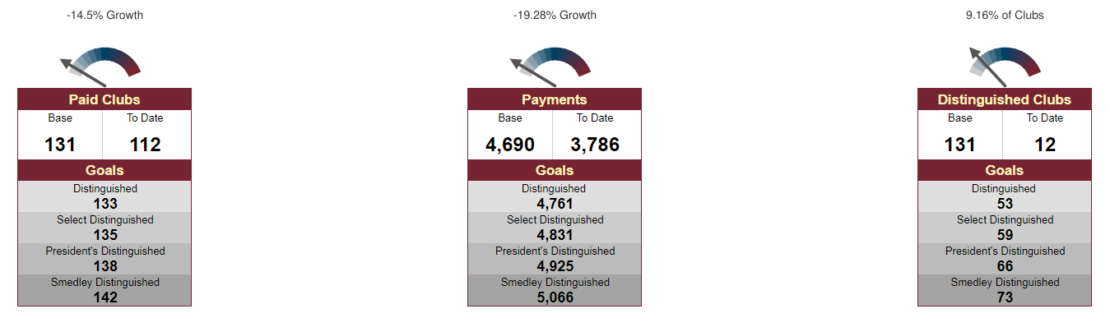
District Goals – Dashboards

Slide 19
Membership Payments – Action Items
Promote the value of Toastmasters through defined public relations efforts at District events
Facebook, e-mail, and face-to-face communication between District leaders & clubs
Have a “guidance committee” to collect and present ideas to help clubs obtain new members and maintain a higher retention percentage
Explore and use social media resources for increasing membership more efficiently
Sell the value of Pathways as a new and fresh program to improve skills

Slide 20
New Clubs – Action Items
Mentoring presentations, mentor checklist, matching mentor with mentee, mentoring coach
Media and Resources - build up available resources on the district website for clubs to use
Toastmasters Parades - multiple clubs work together and walk in a parade, wear TM items
Continue to build up pipeline & offer training on chartering, sponsoring, & mentoring

Slide 21
Distinguished Clubs – Action Items
Recognize clubs even if they do not get distinguished
Create and continue with the tiered incentive program
Getting word out about the incentives through various channels
Reach out to members of the club and not just the officers by sending out emails
Create a Pathways help line

Slide 22
Additional Goals – Action Items
Document standardization
MeetUp
District Procedures Manual Review
  Will present at April DEC meeting

Slide 23
Building a New Club Experience
Teri McGregor, VC1
Eastern Division Director

Slide 24
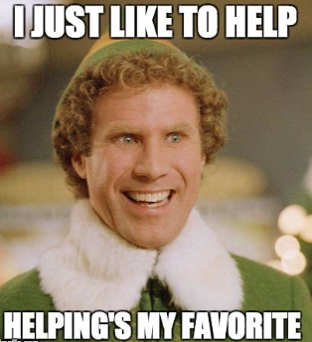
Let’s Save a Club
Notes:
My experience started 2 months into the new Toastmaster year and into my new role as Division Director when Kris Pool asked me to help transition a closing corp9orate club – Deere Tails to a new community club in Horicon WI. If Kris has ever asked you to help with something, then you know that it’s impossible to say no. Plus, when someone offers me an opportunity to take on something new, I will say yes and figure out the how later. And that’s what I did.

Slide 25
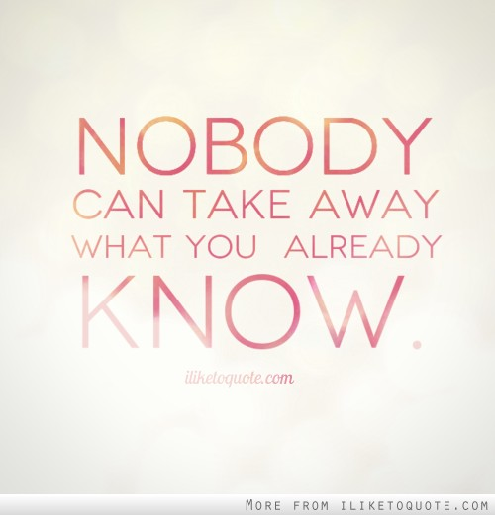
What I Already Knew

Slide 26
What I learned…
Steps to transitioning a charter
  Need 3 members of the closing club to remain active – aka – pay their dues
  A member must be assigned as a club officer so that Club Central can be accessed on line and change the by-laws.
  Once the by-laws are updated, new membership applications can be accepted and entered.
Benefits of transitioning a charter
How to get people at the meeting
Notes:
I started by following the lead. Kris planned a demo meeting by setting the date and time. She mailed letters to local businesses and organizations like the Horicon Bank and the Rotary. Besides the demo meeting team, we had one person attend. But he was the one we needed – Tony. He was enthusiastic and ready to help us get this club off the ground. We were trying to transition the club because that would be easy – or so we thought. To transition a club charter we only needed 3 things:
Plus we would have a stack of supplies saving everyone money – score!

Slide 27

Next time…
Delegate and ask for help
Don’t assume that email is best
Get everyone speaking early and often
Notes:
Naturally in a place where leaders are made – I took the lead then felt I had to do it myself. But living an hour away from Horicon I realized that I knew nothing about the community. I don’t know the people, I have no connections so I had to take a step back and rely on our friend Tony to make the personal connections and invitations.
We were collecting names and email addresses but not asking the question, how can we best reach you to notify you of future meetings? When I asked this question, I learned….

Slide 28

Next time …
Get to know the community
Ask for new member applications to be completed right away
Promote Pathways
Notes:
Horicon is a small town – less than 4000 people and it boarders Mayville – a town of approx. 5000 people. Plenty of people to support a community club, if the 2 communities got along. I had no idea that the people of Mayville don’t really like to attend events in Horicon.
What other issues could there be with trying to start a community club in a small town? Competition – chances are that if you are involved in the community, like the Lions club or the chamber of commerce, you are already stretched thin. We scheduled one Demo and it was “bring a VIP to lunch” day at the elementary school.

Slide 29

Questions?

Slide 30
Area Communications
David Gagliano, ACS, ALB
Area F1 Director

Slide 31
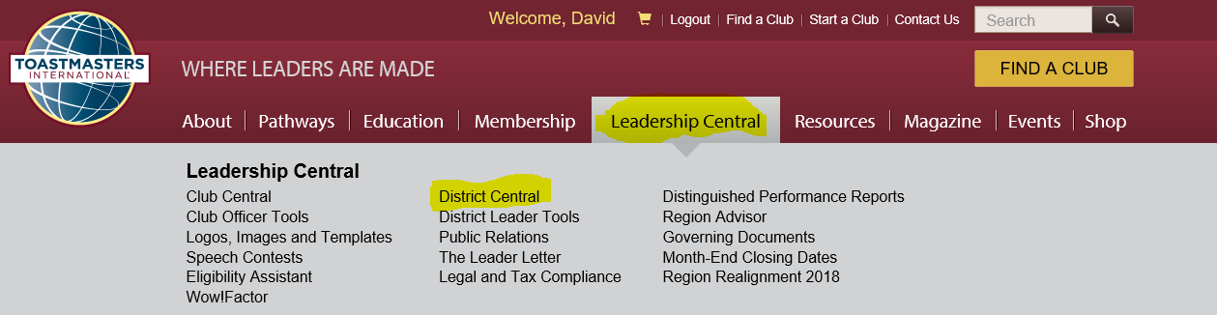
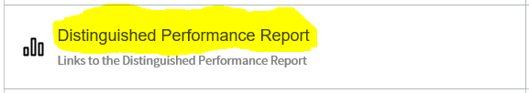
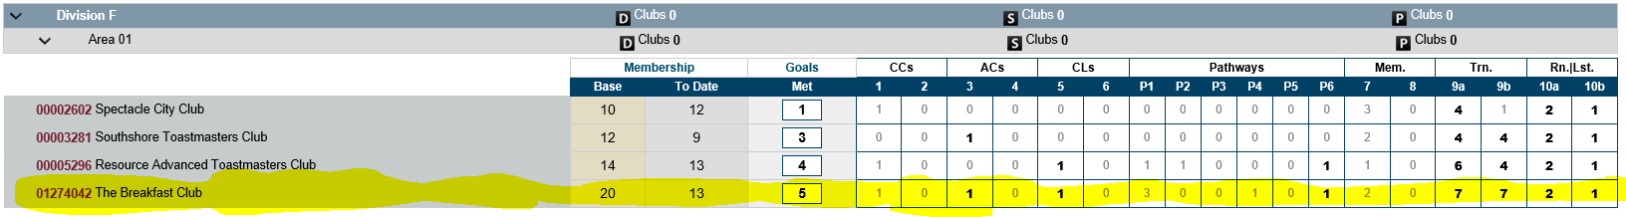
Area Communications
Area Visits
  Before your visit
    Communicate area visit date
    Review fall visit report / Ask for current DCP progress
    Print a copy of the club’s performance

Slide 32
Area Communications
Area Visits
  During your visit
    Compare their progress with the printed report
      Have the club enter any missing awards into TI website
    Review quick-win DCP goals (close to completion)
      Motivate them to committing to these quick-win goals
      If an officer has a designation of CC (or higher) and CL, the ALB is only 2 speeches away (Successful Club or Leadership Excellence Series)
    Celebrate / acknowledge members who have achieved recognition
    Celebrate / acknowledge DCP goals that have been completed

Slide 33
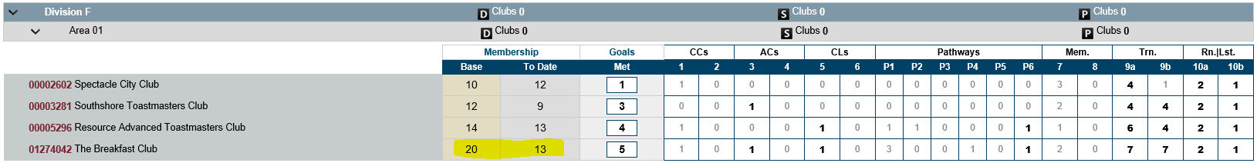
Area Communications
Area Visits
  During your visit (continued)
    Review membership status (need 5+ or 20 members)
    Final push for club Membership Drives for DCP Goals
      Club members could pair up and go to nearby businesses to promote their Toastmasters club by highlighting the benefits to the business
      Club members to invite friends, co-workers, family, etc.
      Each member to utilize social media to publicize (Facebook, Twitter, Meetup, etc.)
      Create fliers and post in near-by public locations

Slide 34
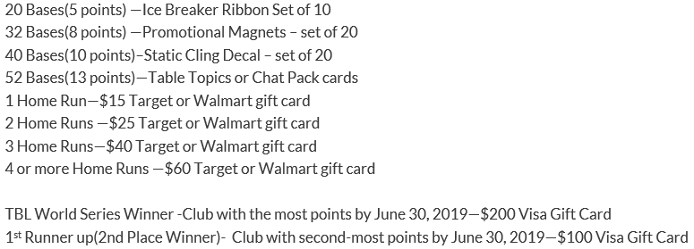
Area Communications
Area Visits
  During your visit (continued)
    Inform clubs to prepare for the following
      Officer Elections
      Succession Planning and Documentation for each role
        Smooth transitions
      Division Speech Contests (see district 35 website for dates)
      International Convention (5/10-5/11) and Speech Contests
      Final push for bases and home runs in the Baseball League

Slide 35
Area Communications
Area Visits
  After your visit
    Follow up
      International Convention Reminder (5/10-5/11)
      Club Elections and Succession Planning
      DCP Goals and Membership Status
      Celebrate / acknowledge individuals who achieved an award
      Celebrate additional DCP Goals accomplished
      Membership Drive / Status (needs +5 or minimum of 20)
    Retain results from club elections (including email addresses) to provide to incoming Area Director
    Document your role / soft handoff to incoming Area Director
    Introduce future Area Director to the clubs in your Area

Slide 36
District 35 Realignment
Cindy Laatsch, DTM
Distinguished Past District Director
Incoming Region Advisor – Region 1
Supporting Districts 7-15-39-57

Slide 37
Realignment
What is Realignment
  When a District wants/needs to change and flex
  Allowed 1x per year
  You can realign Clubs, Areas, and Divisions
  Subject to approval of District Council
  Approval sought at Annual Business Meeting at Spring Convention

Slide 38

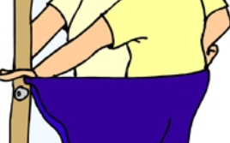
Which one are we?
Why does a TM District “realign”?

Slide 39
Factors Considered
Geographic proximity
Availability/AD– need to provide service to club
Club size and strength
Prospective clubs coming onboard
Clubs leaving District

Slide 40
You can’t …
Advanced clubs may not be segregated into areas
Cannot be segregated by club type or language
NOTE:
Clubs that charter after realignment must be placed in existing areas.

Slide 41
Process to Date
Worked with Area Directors and Division Directors – seeking “boots on the ground” input
Posted currently on district website
Once draft approved – Chair will contact each Club Board, Area, and Division Director to discuss the proposal
Approval sought at Spring Convention
Submission date to TMI – no later than 7/15/19

Slide 42

Let’s look at the Realignment Draft

Slide 43

Feedback / Comments

Slide 44
What Next?

Slide 45
Next TM Year – Now What?
Engaged members attending fun, supportive, and educational meetings
Engaged Area Directors – visiting clubs, offering guidance, service as a “Trail Guide”
Engaged Division Directors – supporting ADs with education and enthusiasm
A Trio with a vision to support members – every day of their term
Team – Plan now to educate and support your successor

Slide 46

Next TM Year – Now What?
District 35 Leaders – You Got This!

Slide 47


Slide 48
Leadership Advice from Your Role Model
Keith Cumiskey, DTM
Immediate Past District Director

Slide 49

Goals
To explore different pieces of advice on leadership styles, characteristics, attitudes, behaviors, and skills.
To identify and analyze similarities and differences among these pieces of leadership advice.

Slide 50
Instructions
Select a role model
Name the role model
Roleplay the role model
Exchange the advice cards
Read the piece of advice
Read aloud

Slide 51
Instructions (continued)
Guess the role model
Read similar pieces of advice
Read opposing pieces of advice
Reconcile the differences
Continue the process
Select a piece of advice

Slide 52
Spring Convention Update
Rozaline Janci, DTM
Program Quality Director

Slide 53

Get in the Game!
Friday, May 10
  Opening Night Networking Reception
  Credentials desk open
  Humorous Speech Contest
  Live Music!

Slide 54
Get in the Game!
Saturday, May 11
  Parade of Club Banners
  Keynote and afternoon presentation by Pres Vasilev, 2013 World Champion of Public Speaking
  Education Sessions in both morning and afternoon
  International Director of Region 5, Don Bittick, DTM
  Awards ceremony
  International Speech Contest
  Numerous networking opportunities
  Dinner Banquet, Hall of Fame awards ceremony and CASINO NIGHT entertainment

Slide 55
Registration
55 clubs registered (as of 4-12-19)
Submit individual registration forms
  Accurate head count needed for name badges, convention programs, promotional items, and food
  Order lunch and dinner to attend the pre-lunch speaker, awards and DTM ceremony, Hall of Fame, casino night
Early bird registration due April 27
  Prices increase until final cutoff date of May 1
Have you registered yet?

Slide 56
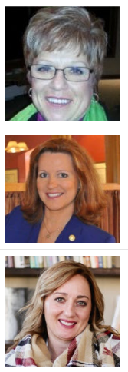
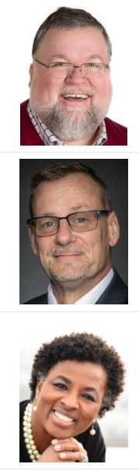
Educational Session Speakers
Cindy Laatsch:
Making Things Happen – The Art of Bluefishing
Betsy Rozelle:
Affinity-Building: the 101 of Relationship Building
Cassie Schuh:
Balance Over Burnout
John Scott:
How to Write a Great Speech (finding the fun in the dysfunctional)
Tom Swartwood:
The 15 Invaluable Laws of Growth – Get in the Game by Improving Yourself
Tina Boyle Whyte:
Know Your Hand, Play Your Cards, Get in the Game

Slide 57
Voting at Business Meeting
Club Presidents and Vice Presidents Education must check in at Credentials Desk on Friday or Saturday to receive voting ballots
  If one/both these members not attending, another member from same club may vote on their behalf by getting them to sign off on a proxy form
  Members may only carry two votes
Area Directors, Division Directors, District Team
  Check in at credentials to receive your voting ballots
  You MAY carry up to three voting ballots – yours as a district leader and up to two from your club(s)

Slide 58
Pushing Toward Distinguished
Kris Pool, DTM
Club Growth Director

Slide 59
How Close Are We?

Slide 60
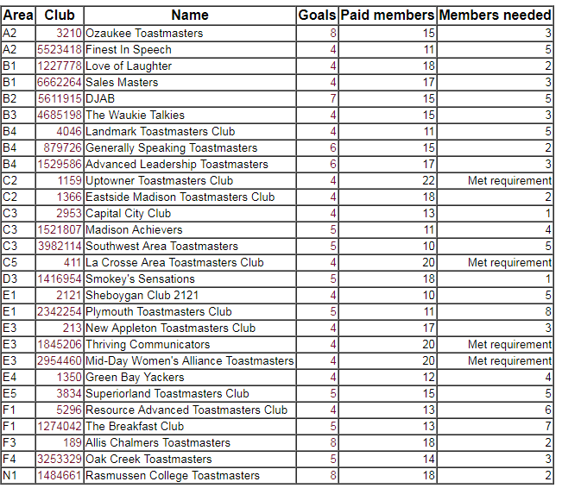
Clubs that are Almost Distinguished

Slide 61
Clubs that are Almost Distinguished

Slide 62
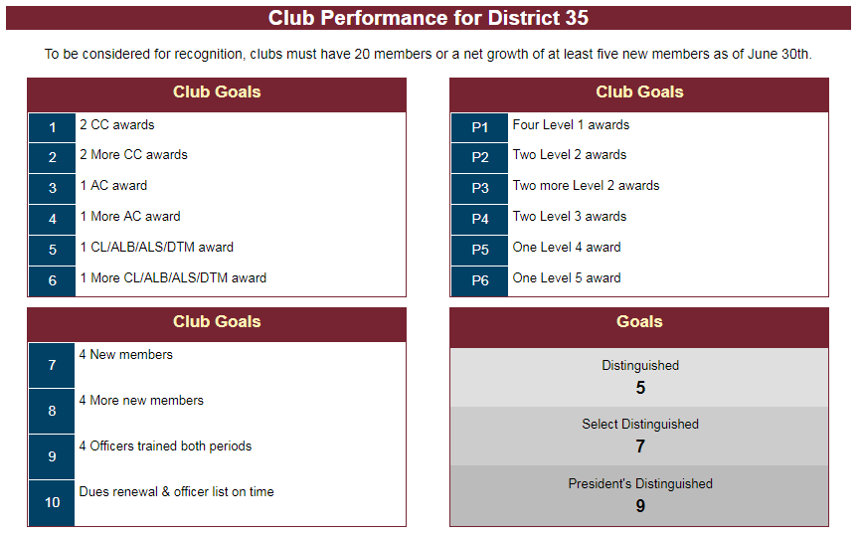
Check Club Performance (Dashboards)

Slide 63
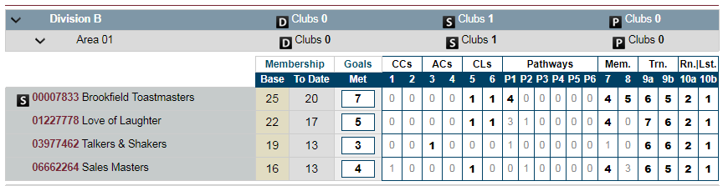
How Close is the Club?

Slide 64
Public Relations Update
Kamal Soan, DTM
Public Relations Manager

Slide 65

PR Contest 2018-19 Update
Best Social Media
  0 – 2 years
  2 – 5 years
  5+ years
Best Website
Best Social Media (3 categories)
  1st Prize - $50
  2nd Prize - $25
Best Website
  1st Prize - $50
  2nd Prize - $25
Contest closed on 3-31-19

Slide 66
VP PR Survey: Educational Sessions Update
Date & Time | Topic of Presentation | Status
November 8, 2018 6:30 to 7:30 PM CST | Setting Up and Customizing Your Free Toast Host Club Website | Completed
December 13, 2018 6:30 to 7:30 PM CST | Free Toast Host Part Two | Completed
January 10, 2019 6:30 to 7:30 PM CST | YouTube for Toastmasters Clubs | Completed
February 7, 2019 6:30 to 7:30 PM CST | Toastmasters Facebook Club Pages | Completed
March 7, 2019 6:30 to 7:30 PM CST | Toastmasters Facebook Groups | Completed
April 11, 2019 6:30 to 7:30 PM CST | Blogging for Toastmasters Clubs | Completed
May 9, 2019 6:30 to 7:30 PM CST | Twitter for Toastmasters Clubs
June 13, 2019 6:30 to 7:30 PM CST | LinkedIn Groups for Toastmasters Clubs

Slide 67
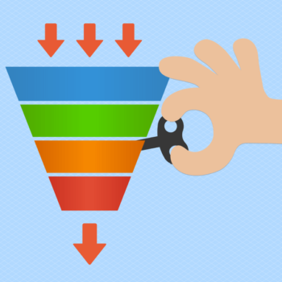
Communication
The Funnel Concept – Call for Action
Areas
Divisions
Clubs
District 35

Slide 68

Additional Volunteers
Social media channel(s) operators
Content creator
Metrics analyst

Slide 69
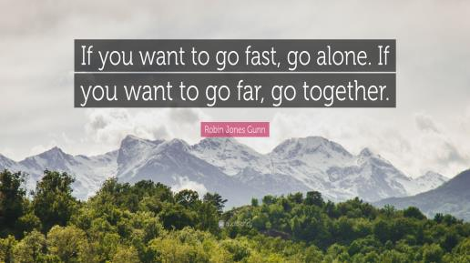

Slide 70

Contact Me
Kamal Soan, DTM
  Email: kamal.soan@gmail.com
  Cell: 931-252-0599

Slide 71
Recognition
Ed Thelen, DTM
District Director

Slide 72
Perfect DEC Attendance – 3rd Quarter
Thank you & congratulations to these individuals that had 100% attendance in the third quarter!
Name
Name

Slide 73

1st AD Visit Report Completed – 2nd Round
Congratulations to the first Area Director to complete an Area Director visit report:
  Craig Mosey

Slide 74

All Area Director Visit Reports Completed
Congratulations to the first Area Director to complete all Area Director visit reports:
  Jennifer Kibicho

Slide 75
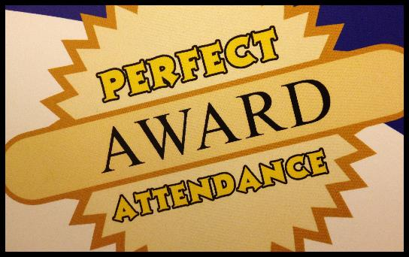
Perfect Attendance Award
Congratulations to the following individual who had perfect attendance at DEC meetings in 2018-2019
  Teri McGregor

Slide 76
30-60-90 Day Review
Ed Thelen, DTM
District Director

Slide 77
Your Next 30 Days (mid-May)
Make sure all TLI training recorded (May 31)
Ensure all Area Visits completed and finalize reports in District Central (due by May 31)
Start working with your successor (should have most positions finalized by then)
  Area Directors – Share information about clubs and what you learned in the role
  Division Directors – Work in transition on TLI planning and what you learned in the role
Hold another Area/Division council meeting
Remind clubs of officer elections and submit new officer list to TI
Beat the Clock promotion (May & June membership drive)
Follow-up on low-paying clubs (less than 8 members)

Slide 78

Your Next 60 Days (mid-June)
Complete the transition plan with your successor
Continue to follow-up on low-paying clubs
Remind clubs to submit their new officer lists to TI
Encourage all incoming officers to attend summer TLI sessions
Incoming Area and Division Director training – Saturday, June 15 (no regular DEC meeting)
Breathe and relax!
  Your year is almost over!

Slide 79
Your Next 90 Days (mid-July )
Continue to support your successor in the early days of their term
Support the new Division team by helping out at TLI
Celebrate completing your year of service
  Partake of your favorite beverage/meal, etc.
  Take some time away for some fun
  Provide yourself with an appropriate reward if you don’t like these suggestions

Slide 80
Q & A and Wrap-Up
Ed Thelen, DTM
District Director

Slide 81


Slide 82
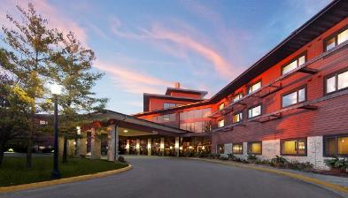
District Council Meeting
Saturday, May 11, 2019
2:30 p.m. to 4:00 p.m.
At District 35 Spring Convention
  Radisson Hotel & Conference Center
  2040 Airport Drive, Green Bay, WI 54313

Slide 83
