Slide 1
February 2019 DEC Meeting
February 16, 2019
Virtual Meeting

Slide 2
Agenda
9:30 – 9:35 Roll Call
9:35 – 9:40 Introduction
9:40 – 10:10 Succession Planning/ Finding New Leaders
10:10 – 10:25 Speech Contest Reminders
10:25 – 10:40 Spring Convention Update
10:40 – 10:55 District Success Plan Review
10:55 – 11:10 Membership Update
11:10 – 11:20 30-60-90 Day Plan
11:20 – 11:30 Q & A and Next Meeting

Slide 3
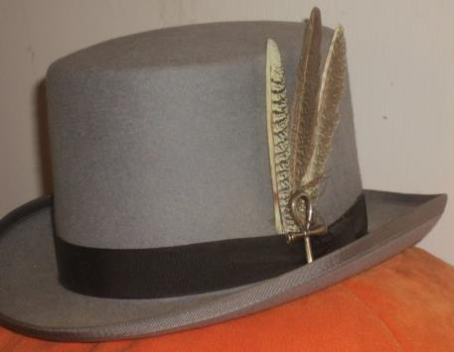
Do we all have a Feather in our CAP?
Change
Attitude
Pathways

Slide 4
Succession Planning / Finding New Leaders
Heather Perkins, DTM
Region Advisor – Region 5

Slide 5
Speech Contest Reminders
Rozaline Janci, DTM and Ed Thelen, DTM
Program Quality Director and District Director

Slide 6

Administrative Items
If you have not done so, please send details of your contests to Administration Manager Robin Grabinski (d35.robingrabinski@gmail.com)
Turnaround time should generally be 48-72 hours
If you do not see your event within this timeframe, please follow up and include District Director Ed in your correspondence

Slide 7

Speech Contest Timeline
Clubs – January 2, 2019 – February 21, 2019
Areas – February 22, 2019 – March 24, 2019
Division – March 25, 2019 – April 28, 2019
District
  Humorous – Friday, May 10, 2019
  International – Saturday, May 11, 2019

Slide 8
Quad Attendance at Area Contests
District 35
Speech Contests - Quad Attendance
Spring 2019
Date | Area/Division | Time | Location | Type of Contest | Ed | Rozaline | Kris | Keith | Notes
2/22/2019 | B3 | 6:30 p.m. | Steinhafels, Waukesha | Area |  |  |  | x
2/23/2019 | E5 | 8:00 a.m. | Escanaba, Michigan | Area |  |  | x |  | Also E5 TLI
2/23/2019 | N3 & N4 | 9:00 a.m. | Keyes Chevrolet, Menomonie | Area | x
2/28/2019 | D3 | 5:30 p.m. | Rapkin Auditorium, Milwaukee | Area | x
3/2/2019 | B4 | 9:00 a.m. | Citizens Bank, New Berlin | Area | x
3/2/2019 | E1 | 9:15 a.m. | Mead Public Library, Sheboygan | Area |  |  | x
3/2/2019 | B1 | 5:00 p.m. | Steinhafels, Waukesha | Area | x
3/2/2019 | C3 & C5 | 9:00 a.m. | Bank of Prairie du Sac, Prairie du Sac | Area |  |  |  | x
3/8/2019 | F2 | 5:30 p.m. | CNH Industrial, Sturtevant | Area | x
3/9/2019 | N1 & N2 | 9:30 a.m. | Rasmussen College, Wausau | Area |  | tentative
3/9/2019 | F4 | 10:00 a.m. | Steinhafels, Waukesha | Area | x |  | x
3/9/2019 | E4 | 12:30 p.m. | Brown County Library, Green Bay | Area |  |  |  | x
3/14/2019 | D2 | 5:30 p.m. | Harley-Davidson, Milwaukee | Area | x
3/14/2019 | A1 (Humor) | 6:00 p.m. | Rockwell Automation, Mequon | Area |  | tentative
3/15/2019 | B2 | 5:30 p.m. | Steinhafels, Waukesha | Area | x

Slide 9
Spring Convention Update
Rozaline Janci, DTM
Program Quality Director

Slide 10
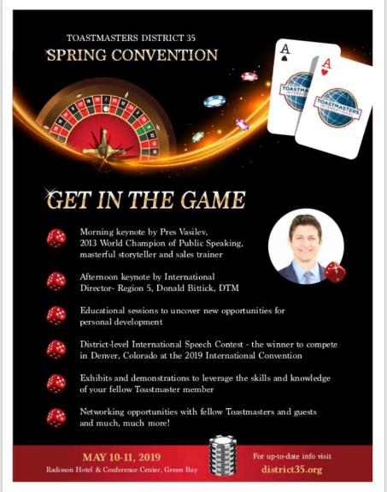
Notes:
It’s about creating connections, being a part of all that is offered.

Slide 11
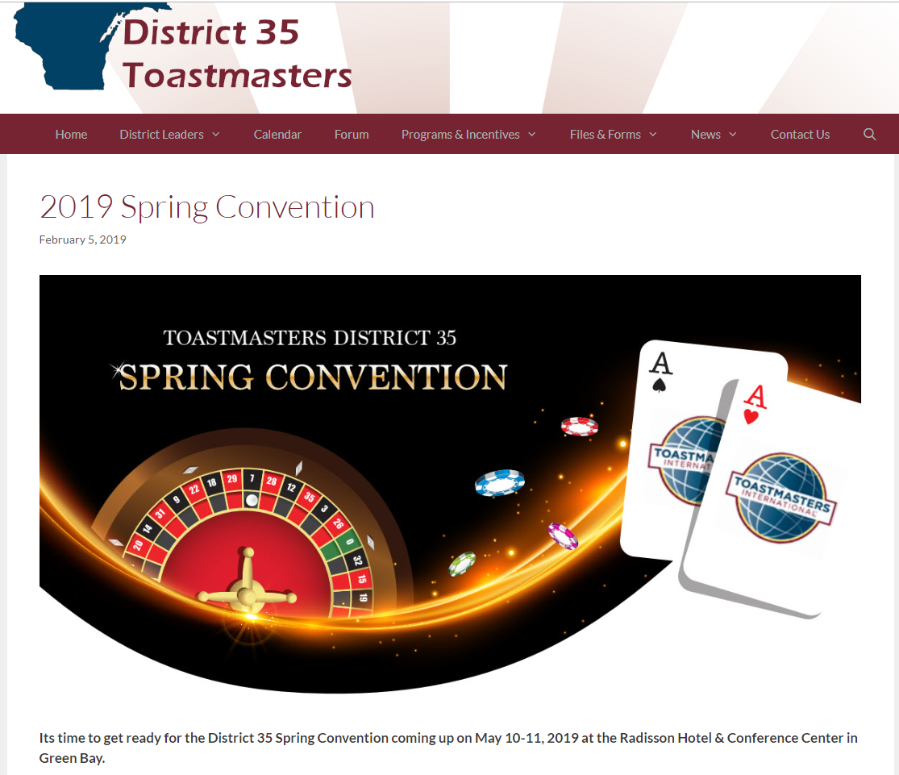
district35.org/2019-spring-convention/

Slide 12

Timeline
February 1 – Club registration is OPEN
February 8 – Education Session Speakers can apply
March 1 – Individual registration opens
March 15 – Deadline for Education Session Speakers
May 1 – Registration deadline

Slide 13

Sponsorship Opportunities

Slide 14
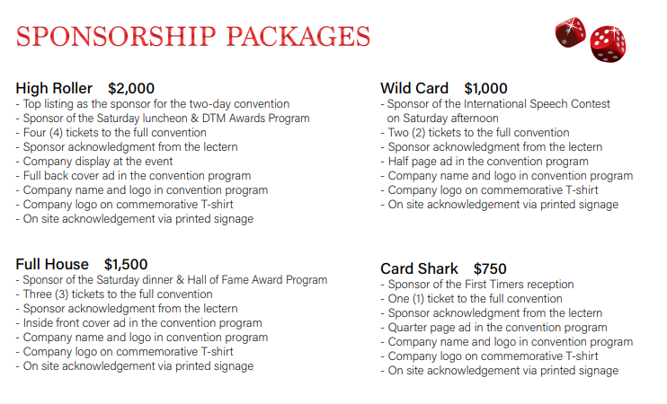

Slide 15
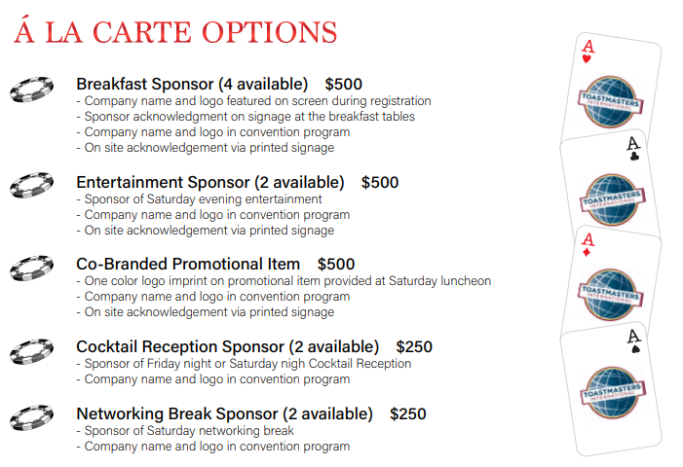

Slide 16
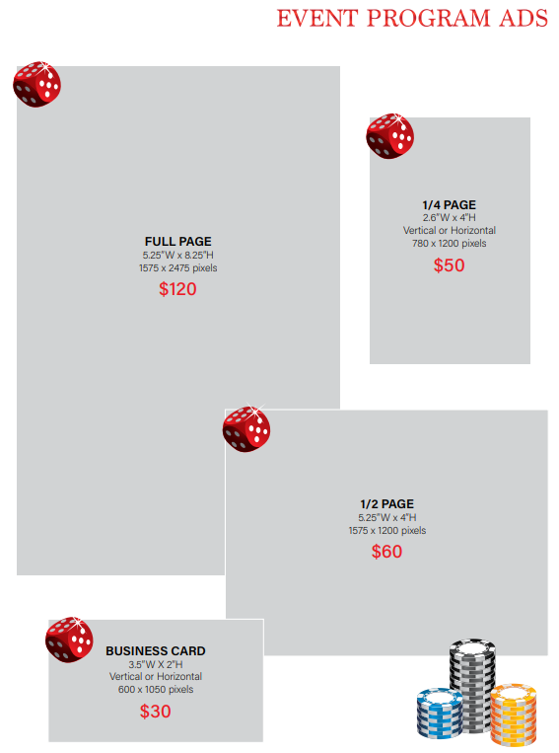

Slide 17
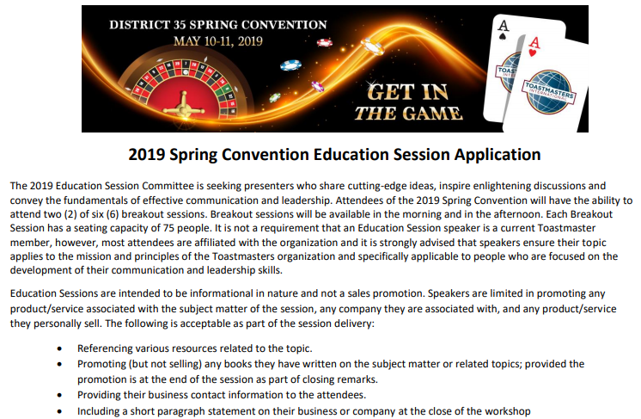

Slide 18

Why Serve on a Conference Committee
HPL project
Growth and leadership
Impact on the District
Conference in your backyard
Hard work and lots of fun!
Meet people throughout the District and beyond
Leave a legacy
Contact Gina or Rozaline if interested in assisting
  GLGLOVER74@gmail.com OR Rozaline.Janci@usbank.com
Notes:
Open positions - kamal soan - PR - Chair - for the convention (Heidi Slowinski was earlier but due to commitments at work and Kamal is going to do it.)
Barb Sexmith - president of Mid day - considering the Friday Fun chair- Advertising
Sponsorship - continues to be open - lisa smith –

Slide 19
District Success Plan
District Quad

Slide 20
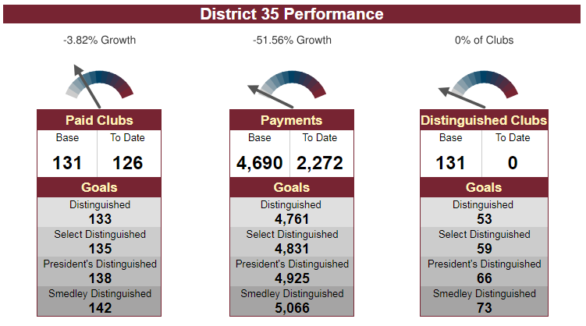

District Goals - Dashboards

Slide 21
Membership Payments – Action Items
Promote the value of Toastmasters through defined public relations efforts at District events
Facebook, e-mail, and face-to-face communication between District leaders & clubs
Have a “guidance committee” to collect and present ideas to help clubs obtain new members and maintain a higher retention percentage
Explore and use social media resources for increasing membership more efficiently
Sell the value of Pathways as a new and fresh program to improve skills

Slide 22
New Clubs – Action Items
Mentoring presentations, mentor checklist, matching mentor with mentee, mentoring coach
Media and Resources - build up available resources on the district website for clubs to use
Toastmasters Parades - multiple clubs work together and walk in a parade, wear TM items
Continue to build up pipeline & offer training on chartering, sponsoring, & mentoring

Slide 23
Distinguished Clubs – Action Items
Recognize clubs even if they do not get distinguished
Create and continue with the tiered incentive program
Getting word out about the incentives through various channels
Reach out to members of the club and not just the officers by sending out emails
Create a Pathways help line

Slide 24
Additional Goals – Action Items
Document standardization
MeetUp
District Procedures Manual Review
  Will present at April DEC meeting

Slide 25
Membership Update
Kris Pool, DTM
Club Growth Director

Slide 26
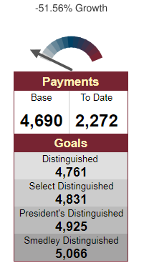
Membership Payments
Payments now being accepted
Clubs need to renew minimum of 8 to receive DCP credit
Clubs need 20 members or Net 5 (from July 1 base) to meet minimum membership requirement to achieve distinguished status

Slide 27
Reminders for all Clubs
March 31 deadline for dues renewals
No worries – Pay early
  Toastmasters.org website may be difficult to connect during the last days of the month
Non-payment by member and/or club by April 1
  Not in good standing
  No Pathways access (or Club Central if an officer)
  Not eligible to compete or participate in contests
Resources available
  Open houses, personal reminders, community calendars, social media, district leadership, networking
Notes:
Over 16,000 clubs are trying to access the website in a tight window, and connecting may be difficult. Don’t worry – pay early

Slide 28

Current Membership Campaign

Slide 29
Other Membership Building Ideas
Plan Open House
  Promotion of event (flyers for members to distribute, EventBrite, Facebook, LinkedIn, Twitter, club website, local community calendars, other ideas?)
  Gain bases in TBL
Guest packet with current information
Club website / social media current
Special membership drive – put on a “show”
  Advanced speaker and beginning speaker
  Evaluators give a “model” evaluation
Membership contests – between club members or clubs in an area

Slide 30
More Membership Resources
Achieve Success – Attract & Retain members
  https://www.toastmasters.org/~/media/aed54005493241a997833b547b40337d.ashx
Let the World Know – Publicity & Promotion Handbook
  https://www.toastmasters.org/~/media/4961F7BE4B244A12A39426D0C9193CD1.ashx
Visit other district websites for different ideas too
  https://www.d25toastmasters.org/resources/membership-and-marketing-resources/

Slide 31
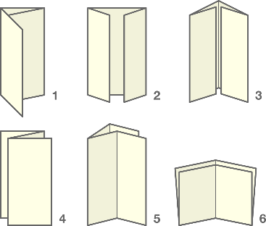
Clubs Folding
No action required – clubs are known to be folding

Slide 32
Clubs Folding
Trek Toastmasters (C2)
Funny Business (C3)
Milwaukee Engineer (D1)
Deere Tales (E2) (transition to Mammoth TM)
Hansen’s Toastmasters (F3) (transition to community club?)
Eau Claire Toastmasters Club (N3)
3M Menomonie Toastmasters (N3)

Slide 33
Clubs Not in Good Standing
Minimum dues not paid for October dues cycle
Must pay October and April renewals or face suspension and go through the reinstatement process to be in good standing
Talk with the club officers and make sure they understand the ramifications
  Do they intend to fold or are they willing to work over the next six weeks to reinstate members?

Slide 34
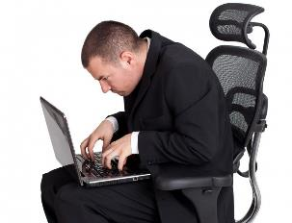
Clubs Not in Good Standing
Words on Water Sauk Prairie Area Toastmasters (C1)
Manitalkers Toastmasters Club (E1)
Copper Country Toastmasters (E5)
Prostmasters (D1)

Slide 35

Clubs with 10 or Fewer Paid Members
Clubs need to have at least 8 members to be considered in “good standing”
Talk with the clubs
  Understand the impact of not being in good standing, including:
    Not being eligible to vote at District business meeting
    Members ineligible to compete/judge speech contests
    No access to Club Central
    No access to Pathways
  Eligible for a club coach
No grace period
Notes:
31 clubs

Slide 36
Clubs with 10 or Fewer Paid Members
Tosa/Medical Club (A3) **
Empower Train Toastmasters Club (A3)
High Pointe Club (B2)
Pewaukee Speaks (B3)
Landmark Toastmasters Club (B4) **
Hill Farms Club (C1)
Capital City Club (C3)
Prairie Swale Club (C3)
Southwest Area Toastmasters (C3)
Wingra Turning Point Toastmasters (C4)

Slide 37
Clubs with 10 or Fewer Paid Members
Walworth County Toastmasters Club (C4) **
Organically Speaking (C4)
TT & SS on Tap (D1)
Toast on Tap (D2)
The Best “U” (D2)
Sheboygan Club 2121 (E1) **
Fond du Lac Toastmasters Club (E2) **
Schneider Toastmasters Club (E4)
Bay De Noc Toastmasters (E5)
Southshore Toastmasters Club (F1) **

Slide 38
Clubs with 10 or Fewer Paid Members
Sunburst Club (F2) **
SpeakEasy Toastmasters (F3)
Milwaukee Metro Spkrs Club (F4) **
Oak Creek Toastmasters (F4) **
Wausau Morning Toastmasters Club (N1)
Marshfield Area Toastmasters (N1) **
Eclectic Image Club (N3)
Red Cedar Toastmasters (N3) **
New Richmond Toastmasters (N3)
Heart of Eau Claire (N4)
United Toastmasters (N4)

Slide 39

Club Coaches
Monthly calls with other coaches
Requirement for DTM
“Double Duty” – bring club to distinguished AND get district officer credit (by June 2020)

Slide 40

Clubs that Met Minimum Dues
Thank you to the clubs that have already paid and will be in good standing on April 1
Please continue to pay for members over the minimum of 8 – we want all your members to renew!

Slide 41

Clubs that Met Minimum Dues
Ozaukee Toastmasters
Toastmasters in Control
DJAB
Uptowner Toastmasters Club
Eastside Madison Toastmasters Club
Chrome Conversations
Green Bay Yackers

Slide 42
Timeline for AD and DD
AD – start contacting your clubs; ask the pertinent questions
DD – participate on Quad call on 3/10/19
AD & DD – updates at 3/16/19 DEC meeting; division breakout sessions to discuss status and actions
DD – participate on Quad call on 3/24/19 to follow-up

Slide 43
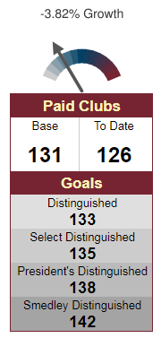
New Clubs / Leads in the Works
Inpro
Blackhawk Community Credit Union
World Headquarters
Schlitz Audubon Nature Center
Welch Allyn
EQ Leadership
Badgerland Meter
St. Croix
Thai Community Club

Slide 44

Sponsor and Mentor Teams
Get your team together – 2 sponsors and 2 mentors
Work together now to meet with prospective club, demo meetings, organization meeting
Working handbook – step by step through the process – email Kris Pool for a copy
Contact Kris Pool for the lead information

Slide 45
Recognition
Ed Thelen, DTM
District Director

Slide 46


Slide 47
30-60-90 Day Review
Ed Thelen, DTM
District Director

Slide 48
Your Next 30 Days (mid-March)
Make sure all TLI training is recorded by May 31
Continue 2nd round of club visits and enter information for visit reports within 48 hours after visit (due by May 31)
Speech Contests
  Area Directors – Concluding contests
  Division Directors – Finalizing details
Hold another Area/Division council meeting
Share information for the Spring Convention provided by PQD and on website with clubs

Slide 49
Your Next 60 Days (mid-April)
Ensure all training is recorded
Complete Area Director visits – finalize paperwork in early May
Division Contests occurring or have all plans finalized
Hold another Area/Division council meeting
Share information for the Spring Convention provided by PQD and on website with clubs
Have appointed successors recommended to DLC/likely incoming District Director or keep asking

Slide 50
Your Next 90 Days (mid-May)
Make sure all TLI training recorded (May 31)
Have all Area Visits completed and finalize reports in District Central (due by May 31)
Start working with your successor (should have most positions finalized by then)
  Area Directors – Share information about clubs and what you learned in the role
  Division Directors – Work in transition on TLI planning and what you learned in the role
Hold another Area/Division council meeting

Slide 51
Q & A and Wrap-Up
Ed Thelen, DTM
District Director

Slide 52


Slide 53
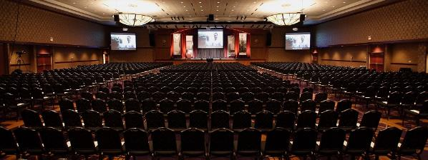
Next DEC Meeting
Saturday, March 16, 2018
10:30 a.m. to 2:30 p.m.
Host: Eastern Division
  Radisson Hotel & Conference Center
  2040 Airport Drive, Green Bay, WI 54313

Slide 54
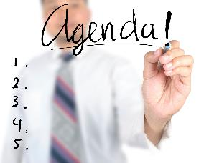
Next DEC Meeting
Topics for DEC Meeting (partial)
  Spring Convention Update – Convention Chair Gina Glover
  Area/Division Director Roundtable
  Team building exercise – IPDD Keith Cumiskey
  PR Update – Kamal Soan
  Tour of facilities

Slide 55


