Slide 1
August 2018 DEC Meeting
August 11, 2018
HSHS Sacred Heart Hospital
Eau Claire, WI
Host: Northern Division

Slide 2
Agenda
10:30 – 10:35 Introduction
10:35 – 10:50 Communication Standards
10:50 – 11:15 Area/Division Director Round Table
11:15 – 11:30 District Success Plan
11:30 – 12:30 Area/Division Director Tools for Club Growth

Slide 3
Agenda
12:30 – 1:00 Lunch
1:00 – 1:20 Team Building Exercise
1:20 – 1:50 Budget
1:50 – 2:05 District Council Meeting
2:05 – 2:15 30-60-90 Day Plan
2:15 – 2:30 Q & A and Next Meeting

Slide 4
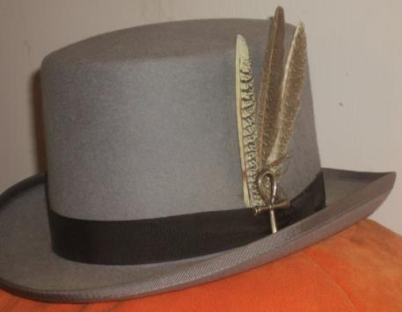
Do we all have a Feather in our CAP?
Change
Attitude
Pathways

Slide 5
International Business Meeting Proxies
Keith Cumiskey, DTM
Immediate Past District Director

Slide 6
What is a proxy and why do I care?
Every year, Toastmasters International holds a Business Meeting where every Toastmasters club in the world has the opportunity to vote on candidates for the Board of Directors and proposed amendments to the Bylaws of Toastmasters International.
There is a difference between candidates and changes to the Bylaws can greatly affect the direction of our organization.
Our District trio (Ed Thelen - District Director, Rozaline Janci - Program Quality Director, and Kris Pool - Club Growth Director) will spend several hours at the International Convention interviewing candidates and attending the Candidate Showcase to make the most educated choices for us.

Slide 7
Three options for proxy assignment
Assign proxy to a club delegate
Assign proxy to another active Toastmaster
Assign proxy to the District Director
International proxies follow a different process from District conference proxies

Slide 8
Two types of proxies
Instructed Proxy
The club has indicated a preference for a particular officer and director candidate and the proposal; the proxy holder must vote as instructed.
Uninstructed Proxy
The club has not indicated a preference for a particular candidate or the proposals. The proxy holder votes as they believe is in the best interest of the organization, and the vote is not be governed by any other person, group, or caucus.

Slide 9
Proxy assignment – District 35 *
131 active clubs
75 assigned to District Director
9 assigned to another Toastmaster
47 unassigned – 36% (list hand out)
Area Directors, please encourage your clubs to assign their proxy
* As of August 10, 2018

Slide 10
Area/Division Director Roundtable
Rozaline Janci, DTM
Program Quality Director
and
Kris Pool, DTM
Club Growth Director

Slide 11
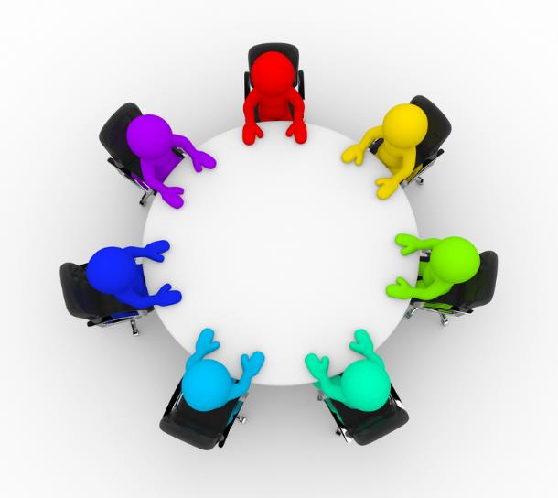

Slide 12
District Success Plan Update
Ed Thelen, DTM
District Director

Slide 13
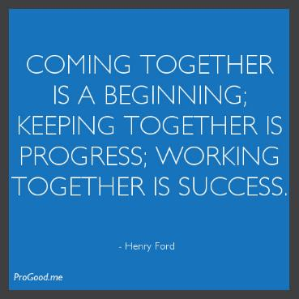
Intro to the Plan
Team members
Values
Operational Principles
Obstacles
Meeting Protocol
Team Interaction

Slide 14
Membership Payments
Promote value of Toastmasters through District events
Improve communication of events/incentives for members
Have a “guidance committee” to collect ideas to help clubs
Explore social media resources for increasing membership
Sell the value of Pathways

Slide 15
Club Growth
Mentoring presentations, mentor checklist, matching mentor with mentee, mentoring coach
Media and Resources – build up the available resources on the district website for clubs to use
Toastmasters in Parades – multiple clubs work together and walk in a parade, wear TM items, handout TM flyers/information
Continue to build up pipeline & offer training on chartering, sponsoring, and mentoring

Slide 16
Distinguished Clubs
Recognize clubs even if they do not get distinguished
Create and continue with the tiered incentive program
Get word out about the incentives through various channels
Reach out to members of the club and not just the officers by sending out emails
Create a Pathways help line

Slide 17
Additional Goals
Create consistent documentation procedures
Centralize the use of MeetUp
Review the District Procedures Manual

Slide 18
Starting From Scratch – How to Sponsor New Clubs
Kris Pool, DTM
Club Growth Director
Notes:
The role of sponsor is integral to the success of a new Toastmasters club.

Slide 19

Introduction
Enhance your leadership skills
Develop project management abilities
Expand your expertise
Notes:
Chartering a new club provides even more than this. You also have the opportunity to do the following: Enhance your leadership skills Develop project-management abilities Expand your marketing expertise

Slide 20

Session Topics
A sponsor’s duties
Establish a corporate club
Launch a community club
Feed their enthusiasm
Complete the charter
Plan the presentation

Slide 21

A Sponsor’s Duties
Organize the new club
Set up regular club meetings
Complete the paperwork
Plan the charter presentation
Notes:
So what does it take to reap all of these benefits and develop these skills? It takes a commitment to performing the duties of a new club sponsor. Your duties as a new club sponsor are:
Organize the new club
Set up regular club meetings
Complete the paperwork and
plan the charter presentation

Slide 22

Types of Clubs
Corporate
Community
Advanced
Specialty
Notes:
Before a new club is organized, you need to know what kind of club it is going to be.
Corporate
Community
Advanced
Specialty
This session will focus on Corporate Clubs, but most of the information can easily be used for the other types of clubs.

Slide 23
The New Club Information Kit
How to Build a Toastmasters Club
Forms
Promotional brochures
The kit is free and
can be requested from World Headquarters
by email at
newclubs@toastmasters.org
Notes:
One of the fundamental tools for starting a new club is the New Club Information Kit (Item 123). This kit includes:
How to Build a Toastmasters Club (Item 121) that includes the following:
■ Application to Organize a Toastmasters Club (Form 1)
■ Charter Payments (Form 2)
■ Toastmasters Charter Membership Application (Form 3)
■ Charter Club Officer Information (Form 4)
■ Club Information (Form 5)
■ Toastmasters Club Constitution for Member Clubs of Toastmasters International (Form 6A)
■ Addendum of Standard Club Options (Form 6B)
Promotional brochures for recruiting members
■ Take the First Step (Item 8954)
■ Find your voice. (Item 99)
■ Develop Your Leaders From Within (Item 103)
■ All About Toastmasters (Item 124)n methods for chartering corporate clubs. Many of these same techniques can be used to establish other types of clubs.

Slide 24

Toastmasters Teamwork:
Corporate Clubs
Two sponsors
Two mentors
District director
Club growth director
Other Toastmasters and district leaders
Notes:
Another tool for starting a new club is your support team. The team working to charter a new club usually consists of the following:
Two sponsors
Two mentors
■ Experienced members who may join the newly chartered club and provide support and guidance through the new club’s first six months to one year
The district director ■ Responsible for appointing all sponsors and mentors for new Toastmasters clubs
The club growth director ■ Responsible for assisting the district director with appointing sponsors and mentors
Other Toastmasters and district leaders who have chartered new clubs and are resources for advice and information
NOTE: Appointment The names of sponsors must appear on the Application to Organize sent to World Headquarters. The district director or club growth director can also appoint sponsors by emailing newclubs@toastmasters.org with the names of those sponsors. Having a charter officer sign and return the Get Credit form to World Headquarters is the final step to ensure you are awarded for your sponsorship.

Slide 25

Identify Your Target
Company
  Size
  Location
  Revenue
Key contacts and decision-makers
Company
  Strategies
  Key initiatives
  Priorities
  Focus and mission
  Recent news articles
Notes:
Most often, the district director and club growth director will already have a lead for a new club— that is, a company or group already has expressed interest in forming a club. This makes the next steps for charting a club a little easier. Other times, an individual may need to produce his or her own leads. When generating leads, the way to establish a corporate club is to secure the support of a person within the organization who can authorize the formation of the club. Research before you begin approaching companies. Start by making a list of organizations in your area, and then review their websites.
You should look for the following: Company: ■ Size (preferably 250+ employees) ■ Location ■ Revenue ■ Industry
Key contacts or decision-makers within the organization
Company’s: ■ Strategies ■ Key initiatives ■ Priorities ■ Focus and mission ■ Recent news articles pertaining to the company Use the information you gather to show a company how it will specifically benefit from the Toastmasters education program.

Slide 26

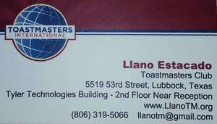
Introduce Yourself
Send a letter
Send an email
Notes:
After completing the research, send an email or letter of introduction to each company contact giving some brief information about Toastmasters.
Follow these guidelines for an effective email or letter of introduction:
Letter: ■ Print on high-quality Toastmasters stationery. ■ Hand-address and stamp the envelope.
Email and letter: ■ Provide preliminary information about Toastmasters using facts from your research. ■ Tell them you will call by phone in a few days to schedule a face-to-face appointment
It is also helpful to include the brochure Develop Your Leaders From Within (Item 103).

Slide 27

After the Introduction
Set an appointment
Prepare for the meeting
Share about other corporations
Wrap it up
Notes:
After you send the email or letter of introduction, follow these steps:
Call the decision-makers you contacted by email or letter and make an appointment to see them. ■ Do not spend a lot of time giving details about Toastmasters; this is what the face-to-face meeting is for.
Prepare for the meeting. ■ Use the research and consider what you know about the company’s needs. For example, if you know that the cost is one of the company’s major concerns, compare the cost-efficient value of Toastmasters training to other common types of training.
Plan questions to ask during the meeting. ■ Design questions to expose as much information as possible about the value that the organization places on leadership and communication skills. ■ Ask contacts about personal life development and how leadership and communication skills have played a part in it.
During the meeting, share the names of other corporations or local companies that already are benefiting from the Toastmasters program. Note: You can print copies of a list of companies from the Toastmasters International website at www.toastmasters.org/corporatesponsors.
Wrap it up. ■ When the discussion comes to a conclusion, give a value statement of Toastmasters membership that meets the needs of the organization.
NOTE: If the person you meet with does not have the authority to authorize the formation of a club, find out who does and offer to meet with that individual. Provide any information that person will need to make the decision.

Slide 28
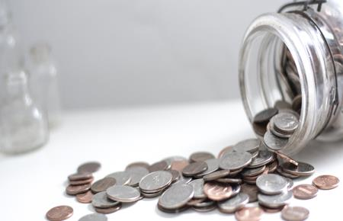
Discussing the Finances
Finalize its financial commitment
Determine what portion of the club costs the company will pay
Notes:
Discussing financial matters can be an uncomfortable task. It is important to be transparent and broach the subject. After the company has given its conceptual support, finalize its financial commitment and determine what portion of the club costs the company will pay. Usually the company pays the charter fee and new member fee for each member, while members pay their dues. Some companies pay for the banner and other club materials.

Slide 29

Money Matters
Designate a club officer to hold the payments
Hold the payments until they are sent to Toastmasters International
Deposit the payment into another club’s account
Notes:
Before conducting a demonstration meeting, whether it’s for a potential corporate or community club, plan how to handle any money collected from the prospective club. A sponsor or one of the new club’s officers may begin to collect payment for dues and fees from prospective members during or soon after the club’s first meeting. Many clubs choose to open a checking account at this stage. In many countries, it is necessary that the club register as a not-for-profit association before an account may be opened. World Headquarters will apply for this registration for all U.S. clubs. In other countries, the officers of the new club should check with local banks to see what type of documentation is required. For a corporate club, if the management will be covering the club’s expenses, the club will need to handle that internally.
If a club has collected payments from prospective members but does not have a bank account of its own, it may select one of the following options, at its own discretion: Designate a club officer to hold the payments until the club has opened an account. Hold the payments until they are sent to Toastmasters International. Deposit the funds into another local club’s account with the agreement of the other club. Mentors advise and assist the club in selecting which option best suits its needs.

Slide 30
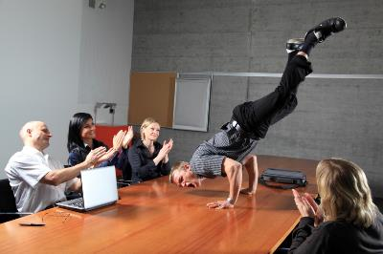
Roles at a Demonstration Meeting
Toastmaster
Timer
Ah-Counter
Grammarian
General Evaluator
Speaker
Evaluator
Topics Master
Notes:
A demonstration meeting is a sponsor’s opportunity to show prospective members how a Toastmasters meeting is conducted and what the Toastmasters program can do for them. A carefully, well-conducted meeting will excite prospective members and make them eager to form a club. A typical demonstration meeting requires eight or more experienced Toastmasters, each of whom assumes a meeting role, such as the following: 1. Toastmaster 5. General Evaluator 2. Timer 6. Speaker 3. Ah-Counter 7. Evaluator 4. Grammarian 8. Topicsmaster

Slide 31

The Demonstration Meeting
Keep the meeting within time limits
Include three aspects
Select a team
Select Toastmasters for various roles
Invite high-level representatives
Have each guest sign a guest book
Notes:
Remember, your goal is to pique interest. Following are some suggestions to help you plan the meeting: Keep the meeting short and within time limitations. If time is limited, include only: ■ A short Table Topics™ session ■ One prepared speech ■ One evaluation For example, if a sponsor is trying to charter a corporate club and the company has allotted 30 minutes for the demonstration meeting and any other information you plan to present, the sponsor must plan accordingly. Select a demonstration meeting team that will present a good, typical, yet abbreviated Toastmasters club meeting. Select Toastmasters to assume various roles: ■ A speaker to present a speech ◆ Consider the average speaking experience of the prospective members. ◆ A relatively inexperienced speaker who is not too polished will be less likely to intimidate the prospective members. ◆ An advanced speaker may illustrate how the Toastmasters program helps members become more skilled speakers. ◆ The Toastmaster should make this distinction clear to the audience. ■ An evaluator ◆ for an inexperienced speaker should be positive and gentle, yet helpful. ◆ for an experienced speaker should be more specific, showing that an advanced speaker receives a more detailed evaluation. Invite high-level representatives of the sponsoring organization (if any). ■ Their presence will show prospective members that the organization supports the new club. ■ Introduce these representatives at the beginning of the demonstration meeting. Have each person who attends the meeting sign a guest book and provide their name, address, telephone number, and email address.

Slide 32

Before & After the Demonstration Meeting
Appoint prospective members
Ask for volunteers
Volunteers need not speak
Prospective member comes to lectern when called
Toastmaster acts as narrator
Toastmaster describes the role
Notes:
What happens if a sponsor cannot find eight or even three Toastmasters to conduct a demonstration meeting? A sponsor can have a demonstration meeting even if he or she is the only Toastmaster! If a sponsor is conducting a demonstration meeting alone, the sponsor acts as both Toastmaster of the meeting and narrator. Before the demonstration meeting, appoint prospective members to roles or ask for volunteers. Emphasize none of the volunteers will have to speak. During the demonstration meeting, the Toastmaster calls on one of the prospective members, who comes to the lectern and is welcomed by the Toastmaster. The Toastmaster then steps to the side and acts as narrator. Briefly describe what the prospective member would say and do in the assigned role.

Slide 33

After the Demonstration Meeting
Introduce the sponsors and mentors
Question & Answer
Toastmasters share success stories
Complete Application to Organize
Submit Application to Organize and charter fee
Notes:
Introduce the sponsors and mentors explaining of their roles and responsibilities. Conduct a brief question-and-answer session with the prospective members, allowing the demonstration team to answer the questions. Ask Toastmasters members to share success stories, explaining to the audience how Toastmasters training has helped them in their careers and in their family and community lives. Complete the Application to Organize form that is included in How to Build a Toastmasters Club in the New Club Information Kit (or download at www.toastmasters.org/121. Submit the Application to Organize to World Headquarters with the $125 fee. Note: If the company will not cover club expenses, or will partially cover expenses, or if sponsoring a community club, explain the following: • Charter fees • International and club dues • Other potential costs (banner, administrative supplies, etc.) Ensure that each potential member understands the individual cost.

Slide 34
Toastmasters Teamwork:
Community Clubs
Two sponsors
Two mentors
District director
Club growth director
Other Toastmasters and district leaders
Notes:
LAUNCH A COMMUNITY CLUB Toastmasters Teamwork The support team for community clubs is the same as for company clubs: Two sponsors Two mentors The district director ■ Responsible for appointing sponsors and mentors for community clubs. V15 V16 V14 STARTING FROM SCRATCH – HOW TO SPONSOR NEW CLUBS 13 The club growth director Other Toastmasters and district leaders who have chartered new clubs before and are resources for advice and information Use the New Club Information Kit (Item 123) in the establishment of a community club.
Note: A sponsor will not need to perform the research that is necessary to establish a corporate club. It is not necessary to write a formal introductory email or letter. Much of a sponsor’s energy is spent marketing a community club to gain local interest. Unlike a corporate club, a sponsor does not have the ease of a company’s intranet or email to communicate to employees. Work with the district to market and publicize the club to the community.

Slide 35

Steps to Chartering
Plan a demonstration meeting
Publicize the meeting
Contact the local chamber of commerce
Display posters and announcements
Target specialized groups
Notes:
Follow these steps to charter a community club.
Plan a demonstration meeting. ■ Schedule the meeting two to four weeks in advance. ■ Publicize and promote the meeting. Note: Get free promotion materials from www.toastmasters.org/marketingresources or purchase items from the online store at www.toastmasters.org/shop.
Collaborate with the district public relations manager to publicize the demonstration meeting in the media. ■ Send announcements to local publications and be sure to include a photo of one of the speakers of action. ■ Send public service announcements to radio and TV stations with taglines that announce the date, time, and place.
Contact the local chamber of commerce for a list of businesses and invite the owners and managers to the demonstration meeting.
Place posters and announcements on the following: ■ Community bulletin boards ■ Apartment complex laundry rooms and club houses ■ Public libraries ■ Community college campuses ■ Strip malls ■ Local businesses V17 STARTING FROM SCRATCH – HOW TO SPONSOR NEW CLUBS 14
Target specialized groups, using invitation mailings, that will contribute a strong nucleus of potential members to the new club, such as the following: ■ Employees of small businesses ■ Religious groups ■ Military personnel

Slide 36

Feed Their Enthusiasm!
Announce the next meeting
Select temporary officers
Follow up with reminder notices
Collect dues
Pay the charter fee
Conclude with recognition
Notes:
After a sponsor has built up the prospective members’ interest with the demonstration meeting for either a community or corporate club, the next challenge is to keep that interest and enthusiasm for the club going until the club is ready to charter. Trainer: Ask the participants, “How do you keep the prospective members’ interest and enthusiasm?” Write the answers on a flipchart or white board. A sponsor needs to focus the group on the future and capitalize on the group’s eagerness. The following are steps to maintain enthusiasm to charter a club: 1. At the end of the demonstration meeting, announce the following: ■ Date ■ Time ■ Place of next meeting 2. Ask the group to select a temporary: ■ President ■ Treasurer ■ Sergeant at Arms 3. Follow up with reminder notices. Make sure all attendees have given their: ■ Name ■ Address ■ Telephone number ■ Email address 4. Ask the temporary treasurer to collect the money from those who have decided to join. 5. Obtain enough money to pay the charter fee so that members can receive the educational and administrative manuals needed to conduct club meetings. Note: The usual practice for collecting the charter is to divide the $125 by the number of members you believe will be joining the club, then add that fraction to each charter member’s dues. V18 STARTING FROM SCRATCH – HOW TO SPONSOR NEW CLUBS 15 6. Conclude by thanking everyone for coming and acknowledge the meeting hosts, participants, and anyone else who assisted with the event. Most prospective clubs do not charter immediately. It can take eight or more meetings before the club can complete the charter requirements. Your job is to keep the enthusiasm going; to ensure everyone stays involved and excited about the new club

Slide 37
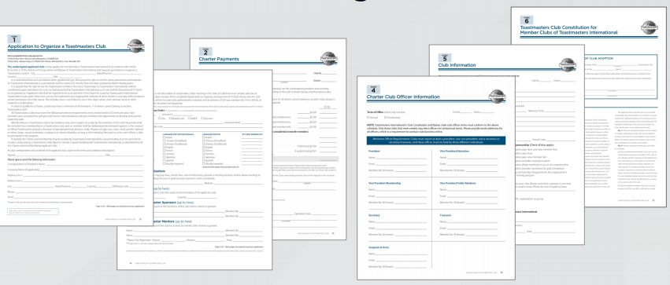
Complete the Charter
www.Toastmasters.org/121
Notes:
Complete the Charter As soon as the prospective club reaches 20 members, complete the charter application forms and send them, along with the new members’ fees and dues, to World Headquarters. You will find details about the chartering process and paperwork in the How to Build a Toastmasters Club (Item 121) manual at www.toastmasters.org/121.

Slide 38

Plan the Presentation
Invite the guests
Plan the meal / refreshments
Publicize the charter presentation
Form committees
Include a short meeting
Prepare a printed program
Notes:
The presentation of the charter marks the debut of a new Toastmasters club and is an excellent opportunity to recognize those who helped form the club. It’s also a chance to generate publicity for the club, so plan the event carefully. Invite all guests with formal invitations. ■ Contact an area director, division director or district director well in advance of the ceremony date so he or she can plan to attend. ■ Include those individuals instrumental in chartering the club, as well as the following: ◆ Company officials ◆ Local government figures ◆ Area and division directors ◆ Other district officers If another club helped to sponsor the new club, invite its members to attend. Note: Remember to be considerate of the club budget and plan for expenses involved for these guests. Publicize the charter presentation. Use the following tips when preparing your publicity efforts for corporate and community clubs: ■ Coordinate your publicity efforts with your district public relations manager. ■ Send an announcement to the local media as soon as the charter presentation date is set. ■ Follow up with a more detailed release as close to the date as deadlines will allow. H2 V19 V20 STARTING FROM SCRATCH – HOW TO SPONSOR NEW CLUBS 16 ■ If local publications cannot send a photographer to the meeting, send them a photo of the presentation with a caption identifying the following: ◆ People ◆ Date ◆ Place ◆ Occasion Form committees to handle such things as the following: ■ Decorations ■ Seating ■ Arrangements for special guests ■ Entertainment (if any) ■ Registrations ■ Refreshments ■ Banquet service
Note: The Toastmasters International manual Put on a Good Show – Meeting Planner Handbook (Item 220) can help you in your preparations. Include a short Toastmasters meeting followed by the charter presentation. Prepare a printed program. Trainer: Close the program by directing sponsors to How to Build a Toastmasters Club (Item 121) for details about charting clubs as well as information regarding chartering speciality or advanced clubs.

Slide 39
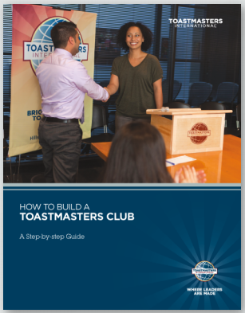
Resources

Slide 40


Slide 41
Minefield
Keith Cumiskey, DTM
Immediate Past District Director

Slide 42
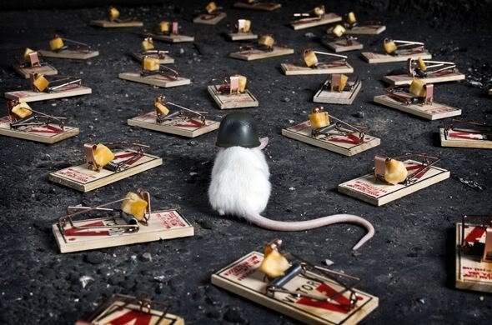

Slide 43
Instructions
Create a “minefield” of obstacles to negotiate
Teams of four members
Blindfold one team member
Team members are not allowed to touch each other
One team member provides instructions using only the following words “Forward, back, left, right, stop”
Penalty – 30 seconds for each obstacle stepped on or stepping out of bounds. Disqualified for remaining out of bounds (i.e. walking outside of the course is not allowed)
Objective – Blindfolded member proceeds from the start to finish line in the shortest amount of time

Slide 44
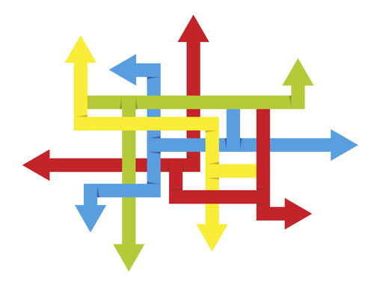
Variation
Three team members provide directions

Slide 45

Variation
No limitation on verbal directions provided by teammates

Slide 46
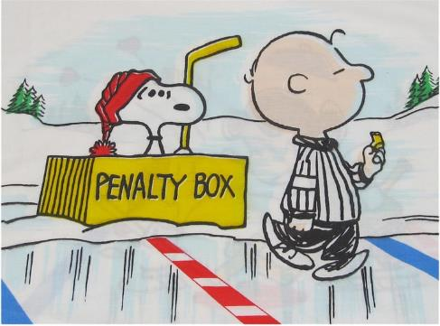
Variation
Penalty is now 5 seconds per obstacle

Slide 47
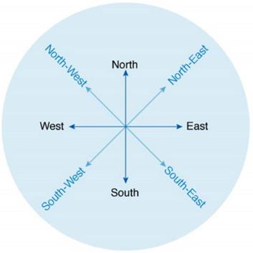
Variation
Another team is allowed to provide “direction” (in addition to your own team)
Still no touching

Slide 48
District 35 Finance & Budget Update
Jason P. Feucht, ACB, ALB
District Finance Manager

Slide 49
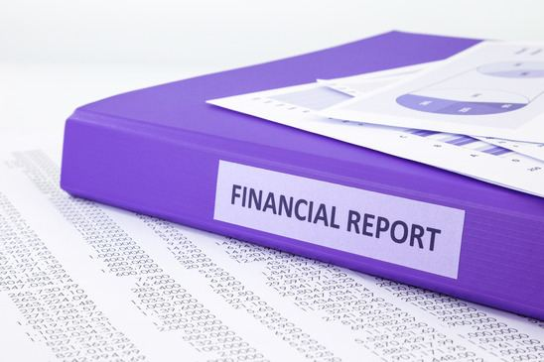
Overview
2017 - 2018 Preliminary Financial Results
2018 – 2019 Preliminary DRAFT Budget
Reminders

Slide 50
2017-18 Preliminary Financial Results
Total Funds Available $23,425.96
  (less required reserves)
YTD Budgeted Income $77,139
  Actual income $73,627
  Variance UNDER budgeted income by $3,512
YTD Budgeted Expenses $109,198
  Actual expenses $83,624.18
  Variance UNDER budgeted income $25,573.82
Bottom Line
  2017-18 ran at a loss of $9,996.72
  Variance UNDER planned loss ~ $22,000
Notes:
Cash flow
Started 2017 with $35,897.30
Ended Year with $23,425.96
Negative Cash Flow of $12,471.34
Caused by Planned spending over income and Changes in Required Reserves.
Income
Member Payments UNDER budget by $1,358.61
Conference Revenue UNDER Budget by $1050.48
TLI UNDER budget by $1,215.44
Expenses
Conference Expenses UNDER budget by $2,934.61
This resulted in Conferences resulting in a small profit
TLI UNDER budget by $1,889.77
Marketing UNDER Budget by $9,312.00
Communication & PR UNDER budget by $1,261.43
Education & Training (DEC Meetings) OVER budget by $232.95
Speech Contests UNDER by $2,202.75
Administration UNDER by $557.52
Travel UNDER by $7,684.67
Due to a lower amount of Funds available and Changing Expenses at TLI, I do not advise planning to run as much of a deficit as last year. I actually recommend, as close to a Net $0 budget as we can get.

Slide 51
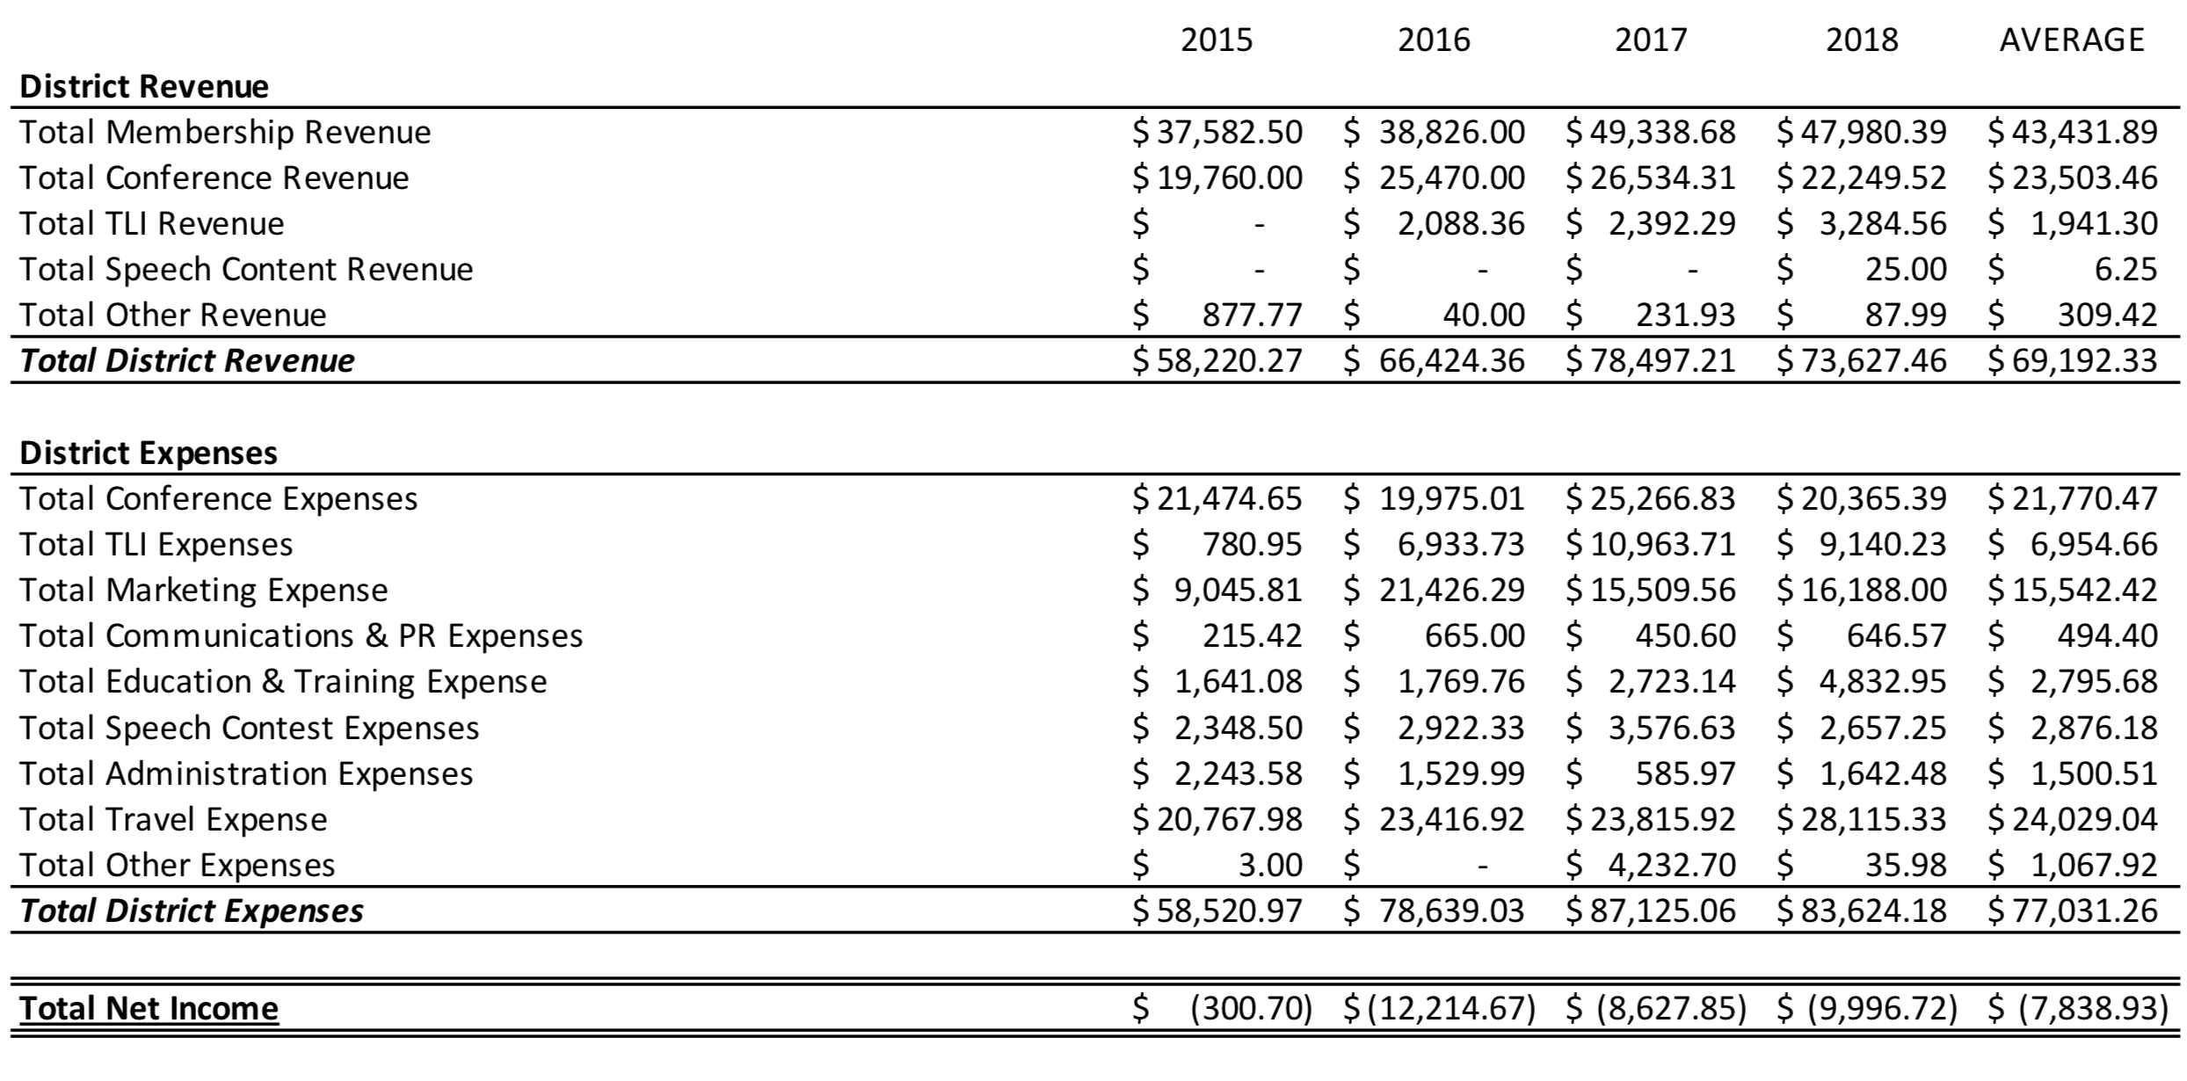
Financial History
Notes:
As a prerequisite to starting a 2018-2019 budget I pulled together the last 4 years. Which is shown in the chart above.
Some items of note:
2016 vs 2017 there is a marked increase in Membership Revenue – This is partially due to the increase in membership dues.
We have been spending AGAINST our reserves the last 4 years to spend down the amount we have in overall reserves. I’m recommending a significant reduction in that going forward, and strongly suggest we work towards a $0 loss budget.

Slide 52
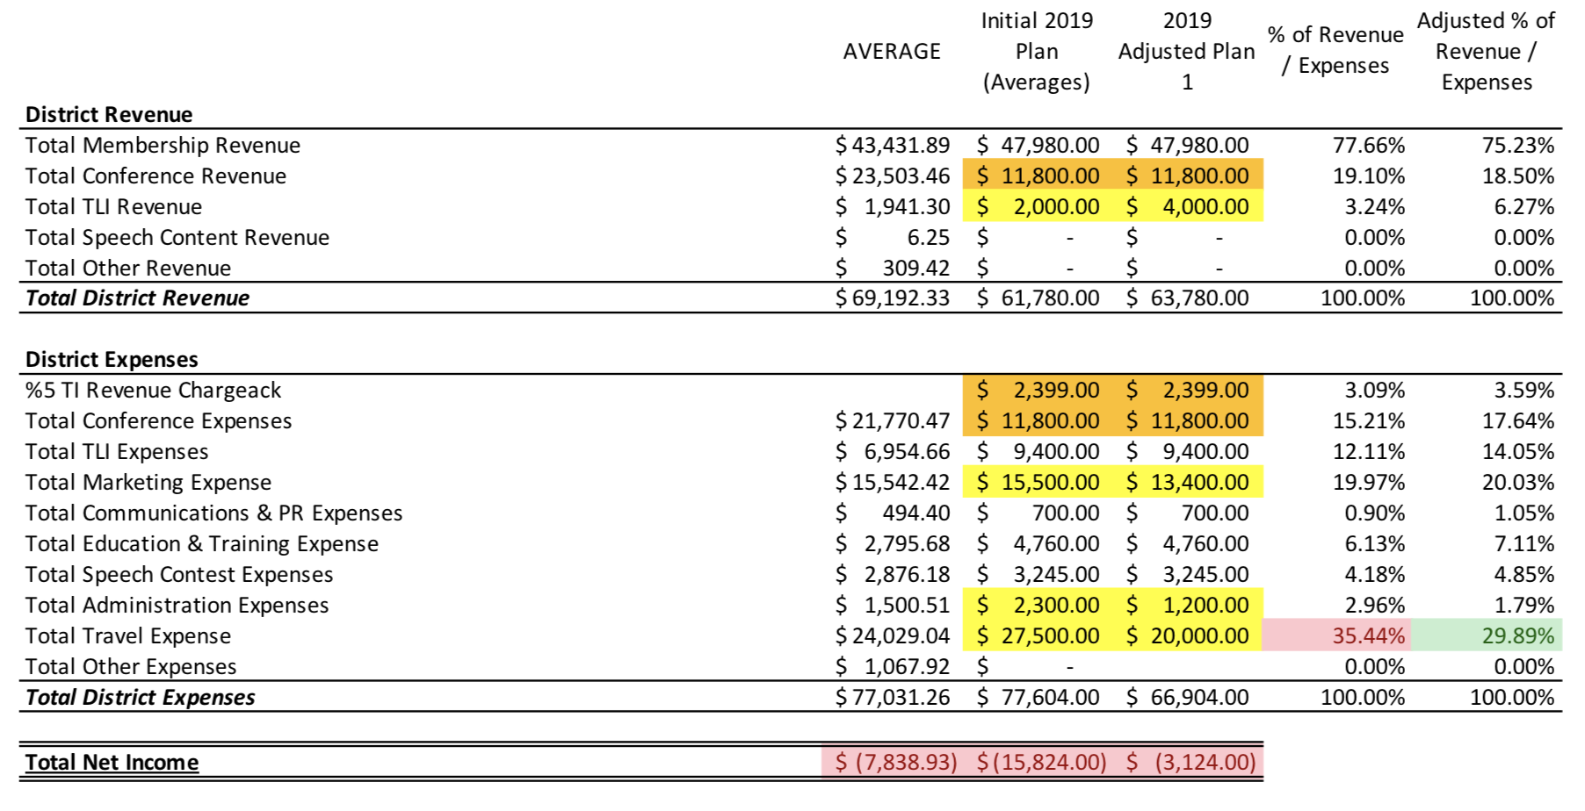
Preliminary Draft Budget
Notes:
Additional conversations need to occur with the Trio before we finalize the budget.
What we see here is the 4 year average as well as the Initial budget and the First Draft adjusted budget.
The initial budget is based off of averages with some informed changes (Orange).
- Revenues projected are given to us by TI and are reflected here in both plans, the are based off the previous Toastmaster Year
Conference Revenue was reduced by ½ (as well as the Corresponding Expenses) due to having only one conference
TI is introducing a new chargeback of 5% to pay for additional accounting and other expenses the Home Office is incurring for District Operations
Issues with Initial budget
Loss of $15k is not sustainable with our current cash position and required reserves
Per TI Rule, Travel expenses cannot exceed 30% of Total District Expenses.
Result is adjusted budget v1
Changes are indicated in Yellow
Suggesting we consider increasing the Income of TLI to increase revenue and reduce the amount of money the district looses. Consider running like a convention and get to $0 impact
Reduced some marketing expenses by $2,100
Eliminated “Misc.” Marketing Budget
Slightly Reduced Club Coaches Budget & Rebuilding Clubs budget to match 2018 expenses rather than Average.
Reduced Administration Budget by $1,100
Eliminated Budget for Purchases of AV equipment (Sound System)
Eliminated Budget for Purchases of Equipment
In the past this is where we put expenses like the banner stands that every division has.
Our Projector came out of this budget
Reduced Travel Budget by $7,500
Decreased budget for Mileage by just over ½
Bottom line is still a $3,000 loss. Ideally I would like to see un increase additional revenues or realistically reduce additional expense to get to a Net $0 budget to stop the drain on reserves.
As we work toward a FINAL budget this will be a point of discussion.

Slide 53
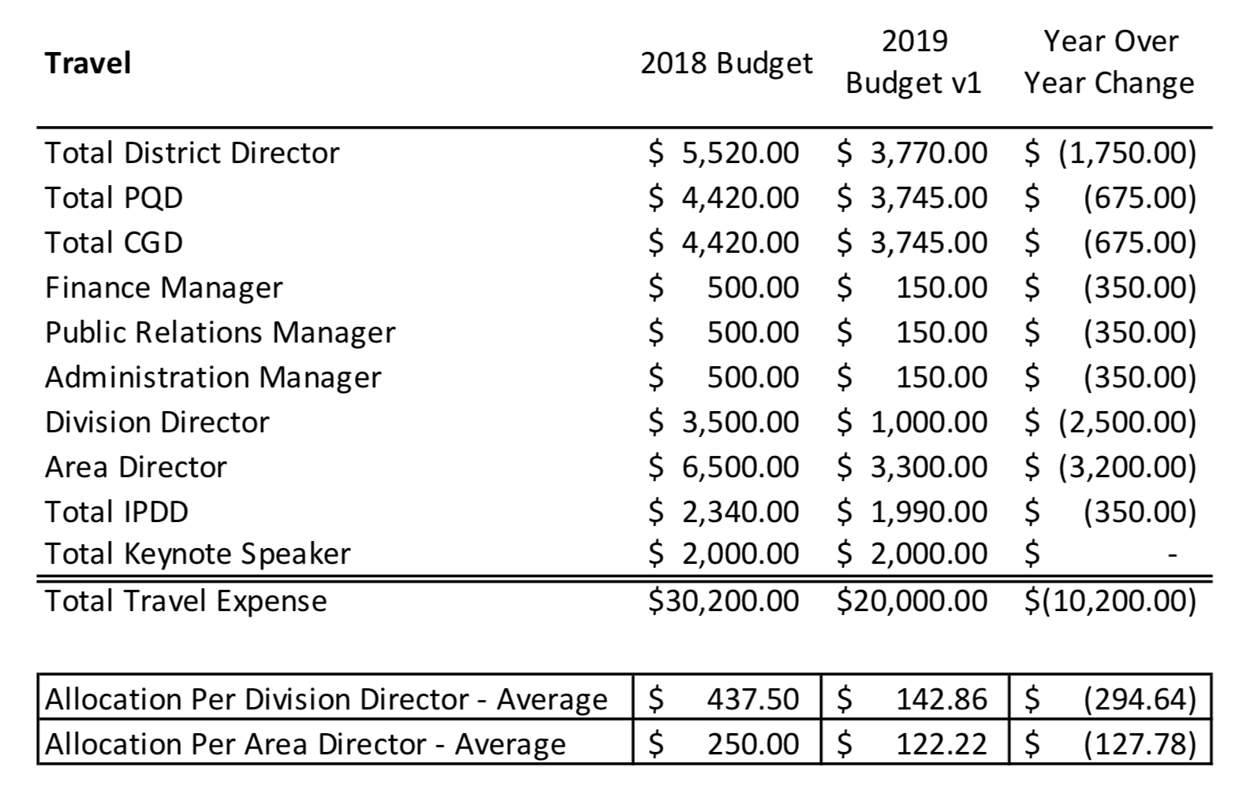
Impact of Proposed Reduction in
Mileage Reimbursement
Notes:
Focusing much of the needed reductions on Mileage, we are using the majority of funds to support our members
And bring the allocations within TI Gudeline as a percent of Expenses.
This hits us each in the amount of reimbursement allocation available to us.
While still preliminary, it is very likely that we will have to cut off Transportation reimbursements. How exactly we do that will need some discussion with the Trio
The proposed reductions are all in Mileage across generally across all roles.
The Trio and IPDD have some additional expenses built in for Training and Attendance at International Convention.
- What shows here is the per person budgetary change.
We could cut off when each person hits this average
We Could reallocate based on Division and the higher need to travel in some areas more than others
We could cut off at the maximum per role.
More to come on this…

Slide 54

Reminders – Reimbursements
All expense reimbursements should be submitted via Concur
All expense reimbursements must be submitted within 60 days of when the expense occurred.
All expense reimbursements MUST have supporting documentation (receipts, map, etc.)

Slide 55
Concur – Common Issues
Missing Documentation
  All reimbursements MUST have supporting documentation
    This is Toastmasters International Policy
Overspending – be aware of your allocations
  Can you / should you spend?
    Partner with Ed prior to spending
Coding Mistakes

Slide 56
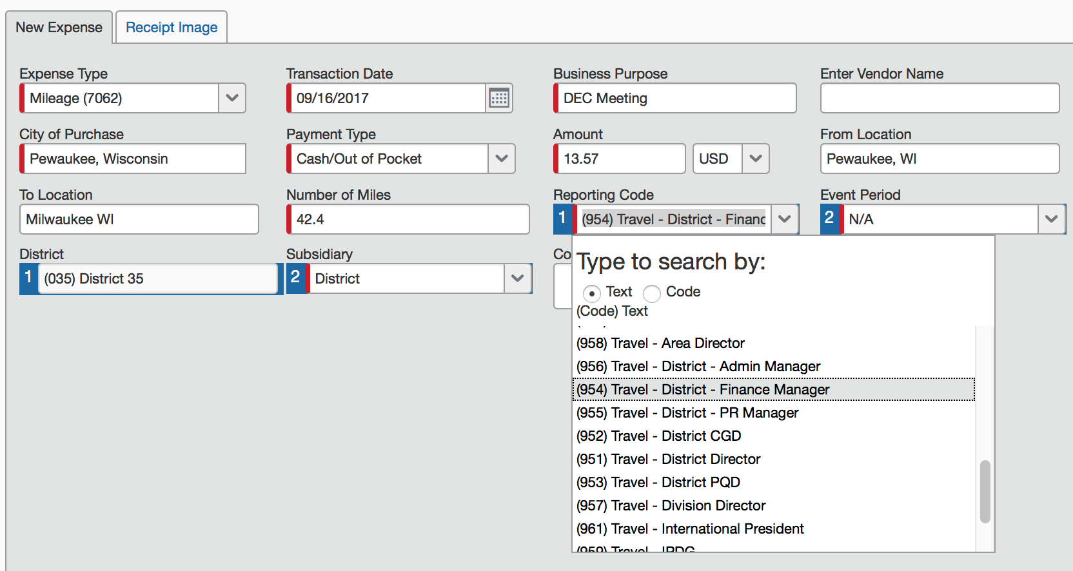
Concur – Common Issues
If your receipt is correctly attached, the receipt tab will appear
When submitting Mileage the code is always “Travel” – for your role regardless of the event.
Subsidiary Should always be District

Slide 57
Other Reminders
Current Allocations
  TLI – $200 per Division per event
  Contests
    $75 per Division
    $40 per Area per event
  If you charge for your event and it results in a profit, those funds must be returned to the District; they cannot be kept to have additional to spend at a future event

Slide 58

Eventbrite
Eventbrite is a great way to collect registrations as well as funds for your event.
  District 35 has a master Eventbrite account
    Use for all Area, Division, and District events
  All funds collected are sent via check directly to the district
  If you want to use Eventbrite, please email Jason to get you started

Slide 59

Questions?
Remember
  Expenses need to be reported within 60 days
  Questions regarding your allocations, if is is okay to spend funds, etc. → Contact Ed Thelen
  Questions on Concur, Eventbrite, and other Finance Policies and Procedures → Contact Jason Feucht

Slide 60
District Council Meeting Update
Ed Thelen, DTM
District Director

Slide 61
When Is It?
September 15, 2018
10:30 a.m. – 12:00 p.m.
(may need time on front end for registering voters)

Slide 62
What will be the format?
Similar to District Council Meeting at previous Fall Conferences
  Reports
  Voting – Budget
Notices
  Electronic Vote – 4 weeks
  Agenda – 14 days

Slide 63
What tools will we be using?
Tools Recommended by Toastmasters
  Meeting – GoToMeeting
  Voting – Election Buddy
Team will be in place to assist in the use of these tools

Slide 64
30-60-90 Day Review
Ed Thelen, DTM
District Director

Slide 65
Your Next 30 Days (mid-September)
District Council Meeting – Get the word out!
Membership dues – October 1
Conduct TLIs – Record training
Continue club visits (and file reports)
Follow-up on/another round Council meetings
District TLI – December 1, 2018
  Communicate to your clubs
  Pass along information as communicated down from Program Quality Director/Public Relations Manager
  Complete your registration for Winter TLI (if available)

Slide 66
Your Next 60 Days (mid-October)
Record TLI training (before November 30)
Continue club visits (and file reports)
Hold second or third Area/Division Council Meetings
District TLI – December 1, 2018
  Communicate to your clubs
  Pass along TLI information as handed down by Program Quality Director and Public Relations Manager
Complete your registration for Winter TLI

Slide 67
Your Next 90 Days (mid-November)
Make sure all TLI training recorded (November 30)
Finish up club visits and enter information for visit reports ASAP after visit (due by November 30)
District TLI – December 1, 2018
  Communicate to your clubs
  Pass along TLI information as handed down by Program Quality Director and Public Relations Manager
Plan dates for Division Makeup Winter TLI sessions (complete by end of February)
Think about dates for speech contests
Hold another Area/Division council meeting

Slide 68
Q & A and Wrap-Up
Ed Thelen, DTM
District Director

Slide 69


Slide 70

Next DEC Meeting
Saturday, October 20, 2018
10:30 a.m. to 2:30 p.m.
Location: TBD
Hosted by Central Division

Slide 71
