Slide 1
November 2018 DEC Meeting
November 10, 2018
Steinhafels Furniture
Waukesha, WI
Host: Division B

Slide 2
Agenda
10:30 – 10:35 Introduction
10:35 – 11:00 Team Building:
DEC Celebrity
11:00 – 11:45 Speech Contests
11:45 – 12:00 Calendaring
12:00 – 12:20 Identifying Resources for Clubs
12:20 – 12:30 District Success Plan

Slide 3
Agenda
12:30 – 1:00 Lunch
1:00 – 1:15 District Leader Nominations
1:15 – 1:45 Area/Division Director Roundtable
1:45 – 2:00 TLI Update
2:00 – 2:10 Finance Reminders
2:10 – 2:15 Recognition
2:15 – 2:20 30-60-90 Day Plan
2:20 – 2:30 Q & A and Next Meeting

Slide 4
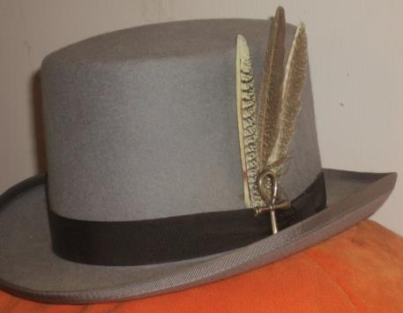
Do we all have a Feather in our CAP?
Change
Attitude
Pathways

Slide 5
DEC Celebrity
Keith Cumiskey, DTM
Immediate Past District Director

Slide 6
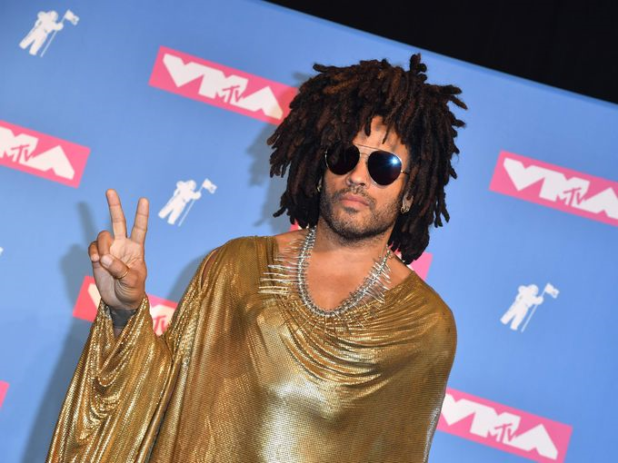
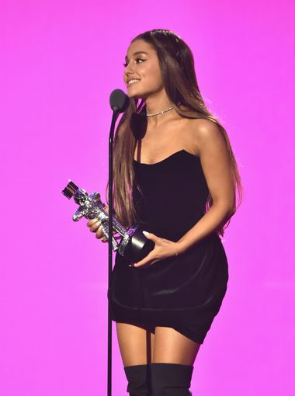
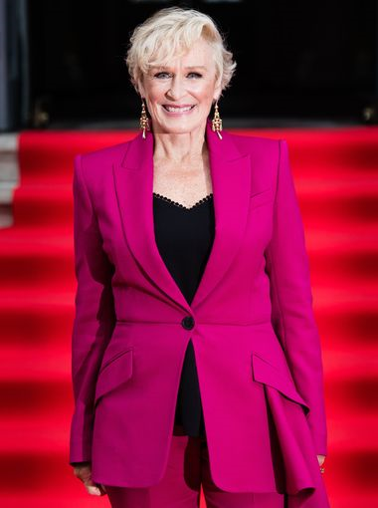
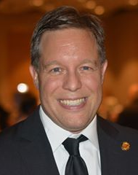
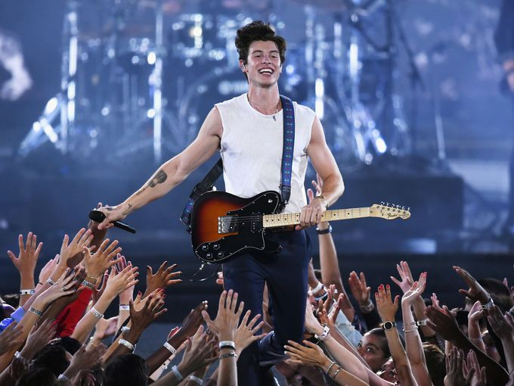

Slide 7
Instructions – Round One
Two teams
All DEC member names placed in a bowl
Team 1 member randomly chooses a name from the bowl and attempts to describe the person to their teammates. He or she tries to get their team to guess which DEC member it is by giving characteristics of that person
Your description may not contain the person’s name (or anything like their name), what they are currently wearing, or their TM role – judge’s discretion
When successful, draw another name and repeat
You have one minute to guess as many names as possible
If you don’t know who the person is, pass to the next team
Team 2 repeats
Goal is to guess the most names

Slide 8

Round Two
Same as round one, but each moderator can only use ONE word to describe each name drawn

Slide 9

Round Three
Same as the previous rounds, but each moderator can’t use words to describe drawn names, but instead must act them out

Slide 10
Speech Contests
Judy Bauer, DTM
Past District Governor and
Area F3 Director

Slide 11


Slide 12
Calendaring
Robin Grabinski
Administration Manager

Slide 13


Slide 14
Understanding Resources for the Clubs
Carl Ervin, DTM
Division A Director

Slide 15

Session Objectives
Identify your role with clubs
Fulfill your responsibilities with the clubs and members
Find resources that help you fulfill your responsibilities

Slide 16

Missions
TOASTMASTERS INTERNATIONAL MISSION
We empower individuals to become more effective communicators and leaders
DISTRICT MISSION
We build new clubs and support all clubs in achieving excellence
CLUB MISSION
We provide a supportive and positive learning experience
in which members are empowered to develop
communication and leadership skills,
resulting in greater self-confidence and personal growth

Slide 17
Values and Envisioned Future
TOASTMASTERS INTERNATIONAL VALUES
Respect – Integrity – Service – Excellence
TOASTMASTERS INTERNATIONAL ENVISIONED FUTURE
To be the first-choice provider of dynamic, high-value, experiential communication and leadership skills development

Slide 18
Service to Members
Members are the heart and foundation
of Toastmasters International
Each service level is in support of the member
MEMBERS
CLUBS
AREAS
DIVISIONS
DISTRICTS
REGIONS
BOARD OF DIRECTORS
WORLD HEADQUARTERS

Slide 19
Club Responsibility Action Plan
What do you need to do to create memorable club meetings?
 | YOU | YOUR CLUB
STOP DOING
START DOING
DO DIFFERENTLY

Slide 20

Club Ideas
Cups are used to collect ballots
Instead of ribbons winners are given fortune cookies
Ribbons are attached to banners with clips so they may be removed and folded following the meeting
Guest packets are updated to include Pathways and new TM HQ address in Colorado
Designate a backup person in case you can’t attend

Slide 21

Club Ideas
Keep an inventory of supplies and order in bulk from World Headquarters to save on shipping
Create an emergency kit with a timer sheet, 20 ballots, a page of inspirational quotes, humor and Table Topics ideas, and red, yellow and green paper. Then, if you’re ever locked out of your meeting place, you can hold your meeting anyway
Have an elevator pitch to describe Pathways
Others?

Slide 22

Resources
Toastmasters District 35 https://district35.org/
Toastmasters International www.toastmasters.org
Governing Documents www.toastmasters.org/govdocs
District Leader Roles www.toastmasters.org/districtleaderroles
Toastmasters International District Recognition Program (Item1490) www.toastmasters.org/1490

Slide 23
And More Resources
Club Leadership Handbook http://www.toastmasters.org/CLH
Membership Growth http://www.toastmasters.org/1159_MembershipGrowth
The Leader Letter http://www.toastmasters.org/LeaderLetter
Master Your Meetings (Item1312) http://www.toastmasters.org/ 1312

Slide 24
And Even More Resources
Distinguished Club Program and Club Success Plan (Item 1111) www.toastmasters.org/1111
Moments of Truth (Item 290) www.toastmasters.org/290
Ordering club supplies www.toastmasters.org/successfulmeetings
The Leader Letter http://www.toastmasters.org/LeaderLetter

Slide 25
Division Director Resources
How to Build a Toastmasters Club (Item 121) www.toastmasters.org/build
Club Leadership Handbook (Item 1310) www.toastmasters.org/1310
Toastmasters International District Recognition Program (Item1490) www.toastmasters.org/1490
Distinguished Club Program and Club Success Plan (Item 1111) www.toastmasters.org/1111

Slide 26
Division Director Resources - Additional
Speech Contest Rulebook (Item 1171) www.toastmasters.org/build
Training Club Leaders (Item 217) www.toastmasters.org/217
Governing Documents www.toastmasters.org/govdocs

Slide 27
Area Director Resources
Serving Clubs through Visits: A Guide for Area Directors (Item 219)
  www.toastmasters.org/219
How to Build a Toastmasters Club (Item 121) www.toastmasters.org/121
Club Leadership Handbook (Item 1310) www.toastmasters.org/1310
Toastmasters International District Recognition Program (Item 1490) www.toastmasters.org/1490

Slide 28
Area Director Resources - Additional
Distinguished Club Program and Club Success Plan (Item 1111)
  www.toastmasters.org/1111
Speech Contest Rulebook (Item 1171) www.toastmasters.org/1171
Training Club Leaders (Item 217) www.toastmasters.org/217

Slide 29

Too much to do in too little time?
Delegate!
Gives members a chance to contribute while giving you valuable leadership experience!

Slide 30

This concludes the session
Carl Ervin
Division A Director District 35
cw_ervin@yahoo.com

Slide 31
District Success Plan
District Trio

Slide 32
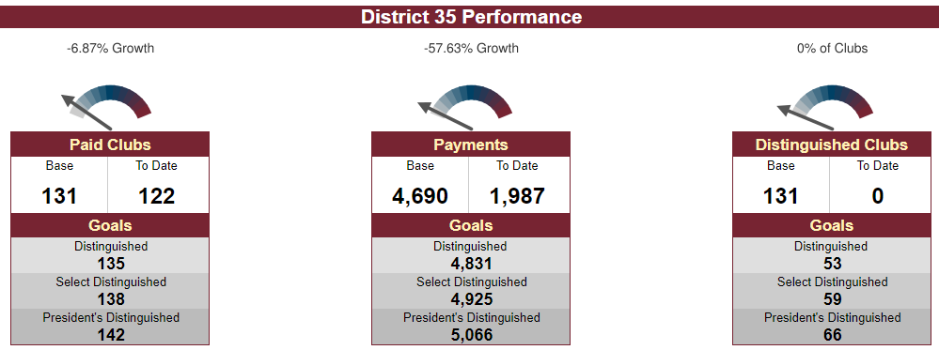
District Goals - Dashboards

Slide 33
Membership Payments – Action Items
Promote the value of Toastmasters through defined public relations efforts at District events
Facebook, e-mail, and face-to-face communication between District leaders & clubs
Have a “guidance committee” to collect and present ideas to help clubs obtain new members and maintain a higher retention percentage
Explore and use social media resources for increasing membership more efficiently
Sell the value of Pathways as a new and fresh program to improve skills

Slide 34
New Clubs – Action Items
Mentoring presentations, mentor checklist, matching mentor with mentee, mentoring coach
Media and Resources - build up available resources on the district website for clubs to use
Toastmasters Parades - multiple clubs work together and walk in a parade, wear TM items
Continue to build up pipeline & offer training on chartering, sponsoring, & mentoring

Slide 35
Distinguished Clubs – Action Items
Recognize clubs even if they do not get distinguished
Create and continue with the tiered incentive program
Getting word out about the incentives through various channels
Reach out to members of the club and not just the officers by sending out emails
Create a Pathways help line

Slide 36


Slide 37
District Leadership Nominations
Rhonda Williams, DTM
Past District Director

Slide 38


Slide 39
Area & Division Director Roundtable
Keith Cumiskey, DTM
and
Ed Thelen, DTM

Slide 40


Slide 41
TLI Update
Ed Thelen, DTM
District Director

Slide 42
21

Slide 43
Registration Now Open
Register at:
  District 35 Winter Toastmasters Leadership Institute 2018-2019
Time: 9:00 am-4:00 pm
Cost: $20.00 per person (includes lunch)
Optional Cost: $25.00 per person on a 40-passenger bus from Milwaukee & Brookfield to Madison
Open to ALL MEMBERS, not just officers
  Reminder: clubs need at least 4 of the 7 officers trained

Slide 44
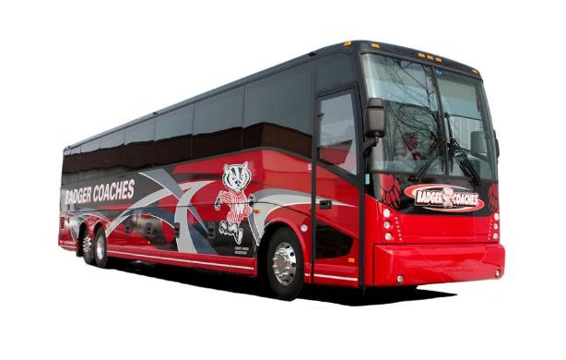
Don’t want to drive? Take the bus!
For Divisions A, B, D, & F
Badger Coach Lines

Slide 45
Education Schedule
8:30-9:30 Registration and Icebreaker(s)
9:30-9:45 Remarks from Trio &
TLI Dean Andy Little
9:45-10:45 Think Like a Negotiator
10:45-11:00 Break
11:00-12:00 Pathways – Kathy Shine
12:00-1:00 Lunch and Recognition

Slide 46
Education Schedule
1:00-1:45 Effective Communications – Eldonna Fernandez
1:45-2:30 Leading Together –
Farzana Chohan, Region Advisor
2:30-2:45 Break
2:45-3:15 Building Clubs
3:15-3:45 The Importance of Listening
3:45-4:00 Wrap-Up and Prizes

Slide 47
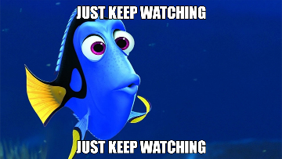
Facebook and Website
Keep watching the District 35 Facebook page and website for continued updates about TLI training
Share with your clubs about the training
Share the makeup TLI training sessions as dates become available (encourage clubs to regularly check the district calendar for details)

Slide 48
District 35 Finance Update
Jason P. Feucht, ACS, ALS
District Finance Manager

Slide 49
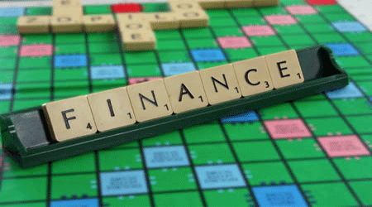
Overview
Income Estimates
Travel / Mileage Budget Status
Reminders

Slide 50
Income Estimates
District Revenue is based off membership payments
  The District receives 25% of member dues from TI for District expenses
  On average, this is $10.23 per member payment
Income Budget Through October is $21,319
  2,084 member payments
  Currently we have 1,972 member payments according to the District dashboard
    Variance of 112 member payments
    That’s $1,145.76 we are already UNDER the income budget
    Since the district budget is based on last years actuals, we have $1,145.76 less in income than we did at the same time last year
Member Payments are KEY to keeping the district revenues on target
This is not a one-time issue; the District will be facing these issues for the foreseeable future.
Notes:
- Often $11.25 is used but that based on a full 6 month dues. Members that join in between pay a pro-rated rate.

Slide 51
Travel / Mileage Budget
As discussed at previous DEC meetings, the 2018-2019 budget has required us to significantly reduce the allocations available for mileage reimbursement
The FINAL District Budget Allocated Mileage as Follows:
  District Director - $600
  Program Quality Director - $677.00
  Club Growth Director - $525.00
  Immediate Past District Director - $150
  Finance Manager - $150
  PR Manager - $150
  Division Director (each) - $150 – Collective Budget of $1,200
  Area Director (each) - $150 – Collective Budget of $4,050

Slide 52
Trio & Administration
Last Name | First Name | Role | Mileage Budget | Mileage Spent | Pending Reports | Variance | % of Allocation
Thelen | Ed | District Director | $ 600.00 | $ 149.76 | $ 94.72 | $ (355.52) | 40.75%
Janci | Rozaline | Program Quality Director | $ 677.00 | $ 154.24 |  | $ (522.76) | 22.78%
Pool | Kris | Club Growth Director | $ 525.00 | $ 216.64 | $ 110.21 | $ (198.15) | 62.26%
Cumiskey | Keith | IPDD | $ 150.00 | $ 28.00 |  | $ (122.00) | 18.67%
Grabinski | Robin | Administration Manager | $ - | $ - |  | $ -
Feucht | Jason | Finance Manager | $ 150.00 | $ 8.00 |  | $ (142.00) | 5.33%
Soan | Kamal | Public Relations Manager | $ 150.00 | $ - |  | $ (150.00) | 0.00%
 |  |  | $ 2,252.00 | $ 556.64 | $ 204.93 | $ (1,490.43) | 33.82%
The Trio and administrators each have a line item on the budget; once an individual reaches that budget, they no longer have funds to expend.
Any future reimbursement over the budget will require District Director Pre-Approval prior to a report being submitted; reports with out a pre-approval email will be sent back to the requester.

Slide 53
Division Directors
Last Name | First Name | Role | Mileage Allocation | Mileage Spent | Pending Reports | Variance | % of Allocation
Borowski | Ronda | Division B | $ 150.00 | $ 53.37 |  | $ (96.63) | 35.58%
Ervin | Carl | Division A | $ 150.00 | $ - |  | $ (150.00) | 0.00%
Graham | Angela | Division Northern & Area N3 | $ 300.00 | $ 554.24 |  | $ 254.24 | 184.75%
Griggs | Rick | Division Central | $ 150.00 | $ 102.71 | $ 52.28 | $ 4.99 | 103.33%
McGregor | Teri | Division Eastern | $ 150.00 | $ 252.80 |  | $ 102.80 | 168.53%
Schoenherr | Shae | Division D | $ 150.00 | $ - | $ 104.32 | $ (45.68) | 69.55%
Scott | Jackie | Division F | $ 150.00 | $ 137.60 |  | $ (12.40) | 91.73%
 |  |  | $ 1,200.00 | $ 1,100.72 | $ 156.60 | $ 57.32 | 104.78%
Division Director Mileage is reimbursed out a collective pool for all Division Directors; includes an extra allocation due to the N3 area not having an AD
The Division Directors have expended the entire Annual budget for District Director Mileage.
Any Report submitted after 10/31 will be sent back unapproved.
If there are special circumstances, any report from a Division Director REQUIRES District Director Pre-Approval prior to a report being submitted; reports with out a pre-approval email will be sent back to the requester unapproved.

Slide 54
Area Directors
Last Name | First Name | Role | Mileage Allocation | Mileage Spent | Pending Reports | Variance | % of Allocation
Bauer | Judy | Area F3 | $ 150.00 | $ - |  | $ (150.00) | 0.00%
Bowers | Amy | Area D3 | $ 150.00 | $ - |  | $ (150.00) | 0.00%
Braun | Annemarie | Area B4 | $ 150.00 | $ - | $ 269.00 | $ 119.00 | 179.33%
Carlson | Tom | Area C1 | $ 150.00 | $ 24.60 |  | $ (125.40) | 16.40%
Clements | Amy | Area C3 | $ 150.00 | $ - |  | $ (150.00) | 0.00%
Coonen | Lori | Area E3 | $ 150.00 | $ - |  | $ (150.00) | 0.00%
Finnegan | Bill | Area B1 | $ 150.00 | $ - |  | $ (150.00) | 0.00%
Gagliano | David | Area F1 | $ 150.00 | $ 192.19 |  | $ 42.19 | 128.13%
Jordee | Janette | Area C4 | $ 150.00 | $ - |  | $ (150.00) | 0.00%
Kibicho | Jennifer | Area F4 | $ 150.00 | $ - | $ 259.84 | $ 109.84 | 173.23%
Kumar | Raj | Area B2 | $ 150.00 | $ - |  | $ (150.00) | 0.00%
Lampro | Tammy | Area N4 | $ 150.00 | $ 338.88 |  | $ 188.88 | 225.92%
Lapan | Dmitry | Area A1 | $ 150.00 | $ 67.20 |  | $ (82.80) | 44.80%
Mather | Carol | Area E2 | $ 150.00 | $ - |  | $ (150.00) | 0.00%
McGoey | Drake | Area C2 | $ 150.00 | $ - |  | $ (150.00) | 0.00%
Mosey | Craig | Area A2 | $ 150.00 | $ - | $ 141.75 | $ (8.25) | 94.50%
Noble | Marilyn | Area E5 | $ 150.00 | $ 301.76 | $ 274.56 | $ 426.32 | 384.21%
Penke | Larry | Area E1 | $ 150.00 | $ - |  | $ (150.00) | 0.00%
Pollock | Liz | Area A3 | $ 150.00 | $ - |  | $ (150.00) | 0.00%
Runte | Shelly | Area D2 | $ 150.00 | $ - | $ 130.68 | $ (19.32) | 87.12%
Scheuers | Matt | Area N1 | $ 150.00 | $ - |  | $ (150.00) | 0.00%
Scott | John | Area B3 | $ 150.00 | $ 54.08 | $ 76.80 | $ (19.12) | 87.25%
Slowinski | Heidi | Area N2 | $ 150.00 | $ - |  | $ (150.00) | 0.00%
Vacant (Graham) | Vacant | Area N3 | $ - | $ - |  | $ -
Volden | Cassie | Area C3 | $ 150.00 | $ - |  | $ (150.00) | 0.00%
Wall | Robert | Area F2 | $ 150.00 | $ 121.14 |  | $ (28.86) | 80.76%
Wink | Cindy | Area E4 | $ 150.00 | $ 74.88 |  | $ (75.12) | 49.92%
Wright | Ron | Area D1 | $ 150.00 | $ - |  | $ (150.00) | 0.00%
 |  |  | $ 4,050.00 | $ 1,174.73 | $ 1,152.63 | $ (1,722.64) | 57.47%
Area Director Mileage is also a Pool
Area Directors have expended more than 50% of their collective annual budget
Once the pool is exhausted, any future reimbursement over the budget will require
District Director Pre-Approval prior to a report being submitted; reports with out a pre-
approval email will be sent back to the requester.

Slide 55
Next Steps
As these limitations will not be going away…
  I’ve discussed with the Trio the need look into what policies of the district, and its reimbursement structure; may need to change in the future to better manage costs and travel expenses.
  Our current reimbursement rates and structure are not sustainable without having to cut off reimbursements like we need to already with Division Director mileage.
  I have started looking into budgets of other districts to understand their costs and reimbursement structure.

Slide 56
Reminders - Reimbursements
All expense reimbursements should be submitted via Concur
All expense reimbursements must be submitted within 60 Days of when the expense occurred.
All expense reimbursements MUST have supporting documentation (receipts, map, etc.)

Slide 57
Other Reminders
Current Allocations
  TLI - $200 per Division per event
  Contests - $75 per Division & $40 Per Area per event
  Look for opportunities to combine events to make them more cost effective
  TI highly recommends all events run at net $0, meaning income is brought in to cover most if not all expenses
  If you charge for your event and it results in a profit, those funds must be returned to the District; they cannot be kept to have additional to spend on a future event.

Slide 58
Eventbrite
Eventbrite is a great way to collect registrations as well as funds for your event
  District 35 has a master Eventbrite account which should be used for all Area, Division, & District Events
  All funds collected are sent via check directly to the District
  If you want to use Eventbrite, please email me and I can get you started

Slide 59

Questions?
Remember
  Expenses need to be reported within 60 days
  Questions regarding your allocations, if is is ok to spend funds, etc. – Contact Ed
  Questions on Concur, Eventbrite, and other Finance Policies and Procedures Contact Jason

Slide 60
Recognition
Ed Thelen, DTM
District Director

Slide 61
Perfect DEC Attendance – 1st Quarter
One person I forgot from last month had 100% attendance in the first quarter!
Carol Mather

Slide 62

Area Director Visit Reports Complete
Thank you & congratulations to these individuals that have completed all their Area Director Visit Reports!
Annemarie Braun
Heidi Slowinski
Tammy Lampro (United Toastmasters not meeting)

Slide 63
30-60-90 Day Review
Ed Thelen, DTM
District Director

Slide 64


Your Next 30 Days (mid-December)
Plan dates for Division Makeup Winter TLI sessions (complete by end of February)
Keep in touch with your clubs informally
Hold third or fourth Area/Division Council Meetings (virtual)
Think about dates for your Area and Division speech contests
Prepare for the upcoming holidays and enjoy them!

Slide 65
Your Next 60 Days (mid-January)
Conduct Division led make-up TLIs and record training
Put together a schedule of contacts about communication of April dues
Have dates finalized for Area contests and start getting helpers (Division get close to final dates)
Plan out 2nd round of Area Director visits – attend and file reports early!
Follow-up on/plan another round of Council meetings

Slide 66
Your Next 90 Days (mid-February)
Make sure all TLI training recorded (May 31)
Start 2nd round of club visits and enter information for visit reports ASAP after visit (due by May 31)
Speech Contests
  Area Directors – Everything ready to conduct contests
  Division Directors – Location, date, and time finalized
Hold another Area/Division council meeting
Start generating interest for Spring Convention

Slide 67
Q & A and Wrap-Up
Ed Thelen, DTM
District Director

Slide 68


Slide 69
Next DEC Meeting
Saturday, December 15, 2018
9:30 a.m. to 11:30 a.m. – NOTE TIME CHANGE
Virtual Meeting
  Details forthcoming on platform to be used

Slide 70
Next DEC Meeting
Topics for DEC Meeting (partial)
  District Success Plan Progress (Quad)
  TLI Update (Rozaline Janci)
  Training Session – based upon July roundtable feedback

Slide 71
