Slide 1
December 2018 DEC Meeting
December 15, 2018
Virtual Meeting

Slide 2
Agenda
9:30 – 9:35 Introduction
9:35 – 9:50 Program Quality Update
9:50 – 10:35 Speech Contests
10:35 – 10:50 District Success Plan Review
10:50 – 11:05 District Awards
11:05 – 11:10 Recognition
11:10 – 11:20 30-60-90 Day Plan
11:20 – 11:30 Q & A and Next Meeting

Slide 3
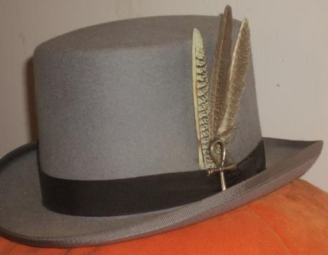
Do we all have a Feather in our CAP?
Change
Attitude
Pathways

Slide 4
Program Quality Update
Rozaline Janci, DTM
Program Quality Director

Slide 5

District TLI – December 1, 2018
Thank you to our speakers, TLI coordinators, and participants!
Everyone worked diligently to make it a successful event
If you missed Madison’s TLI, be sure to attend the Division level makeup session(s)
Check the district calendar for details on the Division TLI sessions: https://district35.org/events/

Slide 6
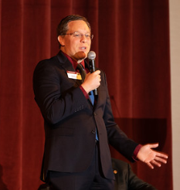

Slide 7
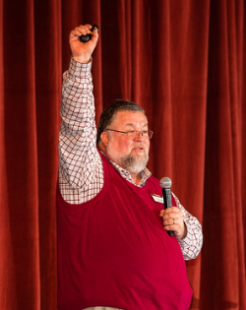
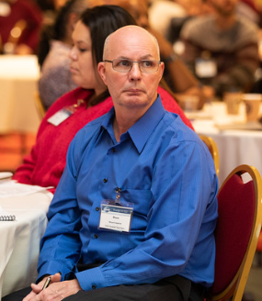

Slide 8
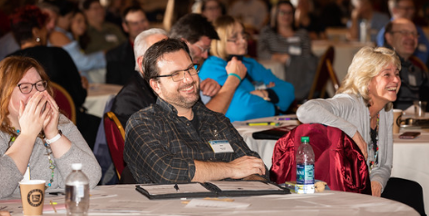
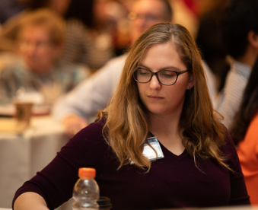

Slide 9
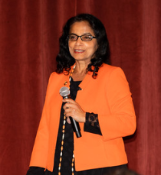
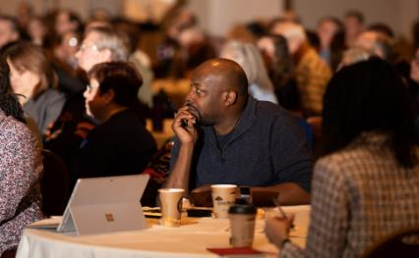

Slide 10
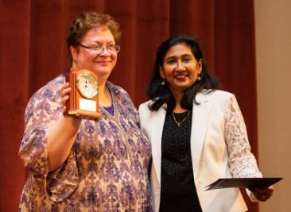
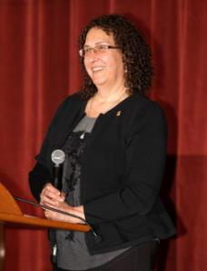

Slide 11
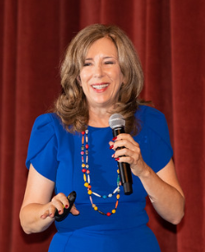

Slide 12

Contest Season Begins January 2019
Humorous and International Speech Contests
Hold contests:
  Club: January 2 – February 21, 2019
  Area: February 22 – March 24, 2019
  Division: March 25 – April 28, 2019
  District:
    Humorous – Friday, May 10, 2019
    International – Saturday, May 11, 2019

Slide 13
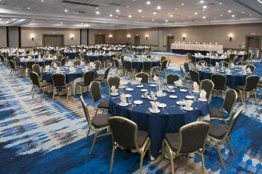
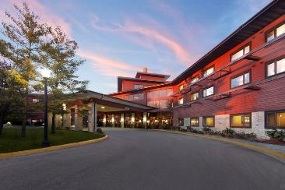
2019 Spring Convention
May 10-11, 2019 (Mother’s Day weekend)
Radisson Hotel & Conference Center, Green Bay
Read upcoming district newsletters for additional details about this event

Slide 14
Contest Planning
Keith Cumiskey, DTM
Immediate Past District Director

Slide 15
Why are we discussing this today?
60% of current area/division directors have not planned an area or division contest
Don’t assume that your previous TM roles have equipped you … there is a lot involved in planning a contest which you haven’t experienced
Remember the reason for contests
  Gain speaking experience
  Learn by observing proficient speakers
  The effort you and your contest team put forth directly impacts the members’ experience

Slide 16

Planning vs. Execution
Both are important
At November DEC meeting, Judy Bauer provided valuable insight into how to execute a successful contest
This presentation will focus on how to plan for a successful contest

Slide 17
Engage your clubs… early
This is where your investment in building relationships pays off
Open, inviting and closed loop communication with your clubs
Division Directors
  Your area directors should be actively involved in planning your division contest with you
  Consider coordinating dates of your area contests to not fall at the same date/time
When should I start planning?
  Area directors: at least by the 1st full week of January
  Division directors: at least by the 2nd full week of February
Don’t | Do
Email exclusively | Engage by phone or in person
“We’re having a contest … let me know if you can attend, help, compete, etc.” | “In order that our contest is successful, I need the name of your contestant(s) and who will serve as judge, timer, ballot counter, etc. by February 2nd.”
Assume that Club X never participates | Sell the idea that this is a great experience for everyone involved
Communicate at the last minute | Give your clubs plenty of time to internally discuss, prepare, and promote

Slide 18

First Priorities
Location
Date/Time
Contest Chair
Read, don’t skim, the rule book
Read the rule book again

Slide 19

Key Roles to Fill
It is your responsibility to assign these roles and hold them accountable:
Contest Toastmaster
Chief Judge
  Judges
  Tie-breaker judge
  Timers
  Ballot counters
Registration Chair
Food/Beverage Chair (if you are providing)
Facilities Chair
Sergeant at Arms
Your team needs to work together… not in silos

Slide 20

Contest Toastmaster
If they have not performed this role, make sure they have a:
  Coach
  Script
Sets the tone for the entire contest
Have all speaker bios in advance
Be prepared
A contest master that appears uncertain or unprepared will dampen the mood of the entire contest

Slide 21
Chief Judge
Chooses judges
  Understands judges’ eligibility (speech contest rulebook)
  Division contest – you may have to wait on some judge selections until after the completion of area contests
Choose tie breaking judge (known only to them)
Choose timers and ballot counters
Should be well-versed in the speech contest rulebook
These should be done in advance, not winging it like we may do at a club meeting

Slide 22
Registration
Why would you like to know how many people are coming in advance?
  Adequate amount of food/beverage
  Enough seating
  Enough agendas
Sign-in sheets at registration desk
  Members and Guests
  Dignitaries (current DEC members, past District Directors)
Collect money at registration (if there is a fee)
  Make sure you have a cash box
  Excess money (profit) belongs to the District
District 35 has an Eventbrite account which is available to use … contact Jason Feucht

Slide 23
Other Roles
Food and Beverage
  Set up before doors open
  Work with registration chair to understand expected attendance
  Work with contest chair to establish budget
Sergeant at Arms
  Secures the room during the contest
  No entry / exit during the contestant speeches

Slide 24
Facilities
Speaking area
  Lighting
  Sight lines
Audio (as appropriate)
Lectern (for Contest Toastmaster)
Registration desk
Candidates corner (distinct from registration or other literature)
Signage - clearly directing attendees to the contest room, registration, candidates corner, etc.
Other literature area (may be at registration desk)
Food/drink area
Access to restrooms (announce at beginning of contest, along with evacuation instructions)
Assign set up / clean up responsibly

Slide 25

Publicize
What if you organized a contest and no one came?
Notify District Administration Manager using previously established format
Social media
  Personal
  Division
Flyers – at a minimum, include the following information
  Date and Location
  Doors open at…
  Contestant / officials briefing at…
  Contest begins at…
  Contest ends at…
  Cost to attend
Press release – A great way to promote Toastmasters

Slide 26
Agenda
Prepare an agenda in advance
Calculate the minimum / maximum amount of time for each segment
  Opening comments – 10 minutes
  Chief Judge – Brief overview of rules – 5 minutes
  * Speeches – 7 minutes x number of speakers
  * Silence – 1 minute x number of speakers
  * Speaker transition – 1 minutes x number of speakers
  * Interviews / Certificates of participation – 2 minutes x number of speakers (flexible depending on the number of contestants)
  Certificates of appreciation – 2-5 minutes depending on how many you want to recognize
  * Awards – 2 minutes
  Closing comments – 5 minutes
Are you having two contests at the same event ? (hint… yes, you are)
  Double the time for * items above

Slide 27

Agenda (continued)
Contestant and judge briefing – 30 minutes prior to contest start – Why?
  There is always someone who is late
  An experienced Contest Toastmaster or Chief Judge should be able to complete in 15 minutes
Do not list contestants’ club or educational achievements on the agenda (although it is acceptable to list contestants’ names and club names… just not together)
Promote upcoming events (e.g. Division contest, District contest)

Slide 28
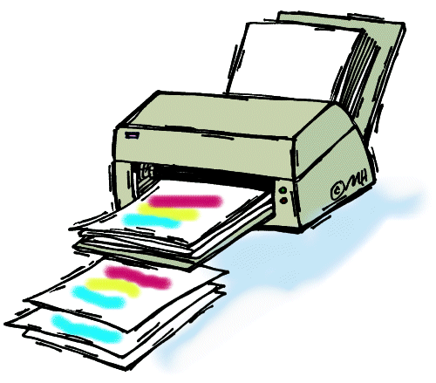
Print
Agendas
Forms (several)… make things easy on yourself; most of these are in the speech kit on Toastmasters International website
  International Speech Contest
  Humorous Speech Contest
  Download and make copies; have extras of each form
Any other flyers or literature not related to the contest
Be classy… print the certificates on card stock
Best practice… pre-print 1st, 2nd, and 3rd place certificates for each contestant and toss out the unused certificates after the contest

Slide 29
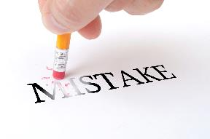
Common Mistakes…
This doesn’t have to be you
Don’t start planning soon enough
Don’t have a roadmap
I can just do it all myself, right?
Schedule a practice “walk through” a week prior to the contest
  Step-by-step, beginning with “doors open”
  Onsite is best
  At a minimum, teleconference

Slide 30

Resources
Contest in a box
  Checklists
  Timeline
  Assignments by role
Toastmasters International website
Experienced past District leaders
Your Program Quality Director, Rozaline Janci, is the trio member accountable for speech contests

Slide 31
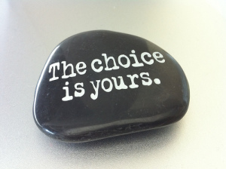
Summary
Speech contests can be a lot of stress and frustration… if you don’t plan
Speech contests can be a rewarding experience for you, your team, participants, and attendees… if you do plan
Stretch and develop your leadership skills

Slide 32
District Success Plan
District Quad

Slide 33
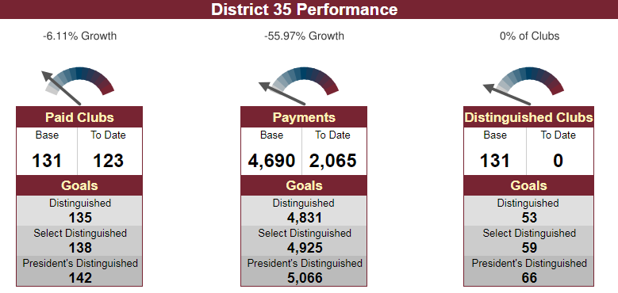
District Goals - Dashboards

Slide 34
Membership Payments – Action Items
Promote the value of Toastmasters through defined public relations efforts at District events
Facebook, e-mail, and face-to-face communication between District leaders and clubs
Have a “guidance committee” to collect and present ideas to help clubs obtain new members and maintain a higher retention percentage
Explore and use social media resources for increasing membership more efficiently
Sell the value of Pathways as a new and fresh program to improve skills

Slide 35
New Clubs – Action Items
Mentoring presentations, mentor checklist, matching mentor with mentee, mentoring coach
Media and Resources - build up available resources on the district website for clubs to use
Toastmasters Parades - multiple clubs work together and walk in a parade, wear TM items
Continue to build up pipeline and offer training on chartering, sponsoring, and mentoring

Slide 36
Distinguished Clubs – Action Items
Recognize clubs even if they do not get distinguished
Create and continue with the tiered incentive program
Getting word out about the incentives through various channels
Reach out to members of the club and not just the officers by sending out emails
Create a Pathways help line

Slide 37

Additional Goals – Action Items
Document Standardization
MeetUp
District Procedures Manual Review

Slide 38
District Awards
Kris Pool, DTM
Club Growth Director

Slide 39


Slide 40
PR Contests
Best Website
  Layout, presentation, content, promotion of Toastmasters
Best Social Media
  Channel presence, quality, relevance
Focus on Toastmasters Branding, Visual Appeal, Contact Information
Start making changes and improvements now for the greatest impact!
Details on judging criteria available: https://district35.org/public-relations-contest-2019/

Slide 41

PR Contests
Best Website:
  1st Place - $50 gift card
  2nd Place - $25 gift card
Best Social Media:
  Clubs Chartered 0-2 years
    1st place - $50; 2nd place -$25
  Clubs Chartered 2-5 years
    1st place - $50; 2nd place -$25
  Clubs Chartered 5+ years
    1st place - $50; 2nd place -$25
Submission deadline is March 31, 2019

Slide 42
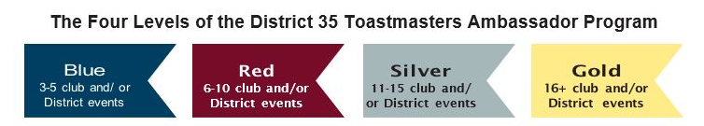
Toastmasters Ambassador of the Year
Details at: https://district35.org/ambassador-form/

Slide 43

Triple Crown
Member earns any three (3) education awards between July 1 and June 30
Any combination of traditional and Pathways education programs

Slide 44

Elite 8
Add eight (8) new members in one Toastmasters year
Ribbon for your club banner
Congratulations:
  Toastmasters in Control
  La Crosse Area TM Club
  Cream City Communicators
  Sabre Speakers
  Church Mutual Club
  UW – Stevens Point Club

Slide 45

Upcoming Membership Campaign

Slide 46
District Recognition at Spring Convention
Area Director of the Year
Division Director of the Year
Toastmaster of the Year
Details: https://www.toastmasters.org/-/media/files/department-documents/district-documents/recognition-checklist.ashx

Slide 47
Recognition
Ed Thelen, DTM
District Director

Slide 48
Area Director Visit Reports Complete
Craig Mosey
Dmitry Lapan
Bill Finnegan
Raj Kumar
John Scott
Annemarie Braun
Tom Carlson
Drake McGoey
Janette Jordee
Shelly Runte
Amy Bowers
Larry Penke
Carol Mather
Lori Coonen
Cindy Wink
Marilyn Noble
David Gagliano
Robert Wall
Judy Bauer
Jennifer Kibicho
Matt Scheuers
Heidi Slowinski
Richard Bryans

Slide 49
Divisions with Reports Complete
Division B – Ronda Borowski
Eastern Division – Teri McGregor
Division F – Jackie Scott
Northern Division – Angela Graham
Division A (Carl Ervin) and Division D (Shae Schoenherr) – 1 report away
Central Division (Rick Griggs) – not far behind!

Slide 50
First Division with 100% Complete
Eastern Division
Eastern Division Director Teri McGregor will receive a $25 Toastmasters gift certificate to use for items for Eastern Division at the January DEC Meeting

Slide 51
30-60-90 Day Review
Ed Thelen, DTM
District Director

Slide 52
Your Next 30 Days (mid-January)
Conduct Division led make-up TLIs and record training
Put together a schedule of contacts about communication of April dues
Have dates finalized for Area contests and start getting helpers (Division get close to final dates)
Plan out 2nd round of Area Director visits – attend and file reports early!
Follow-up on/plan another round of Council meetings

Slide 53
Your Next 60 Days (mid-February)
Make sure all TLI training recorded (May 31)
Start 2nd round of club visits and enter information for visit reports ASAP after visit (due by May 31)
Speech Contests
  Area Directors – Everything ready to conduct contests
  Division Directors – Location, date, and time finalized
Hold another Area/Division council meeting
Start generating interest for Spring Convention

Slide 54
Your Next 90 Days (mid-March)
Make sure all TLI training recorded (May 31)
Continue 2nd round of club visits and enter information for visit reports ASAP after visit (due by May 31)
Speech Contests
  Area Directors – Concluding contests
  Division Directors – Finalizing Details
Hold another Area/Division council meeting
Share information for the Spring Convention provided by PQD and on website

Slide 55
Q & A and Wrap-Up
Ed Thelen, DTM
District Director

Slide 56


Slide 57

Next DEC Meeting
Saturday, January 19, 2018
10:30 a.m. to 2:30 p.m.
Host: Division A
  Location: TBD

Slide 58
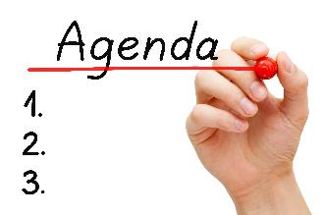
Next DEC Meeting
Topics for DEC Meeting (partial)
  Program Quality Update from PQD Rozaline Janci
  Area/Division Director Roundtable
  Another exciting team building exercise led by IPDD Keith Cumiskey
  Other updates from your leadership team!

Slide 59


