Slide 1
District 35
July 2018
DEC Meeting
July 21, 2018
Steinhafels Furniture
Waukesha, WI
Host – Division F

Slide 2
Agenda – July 21, 2018
10:30 – 10:35 Introduction
10:35 – 10:40 Communication Standards
10:40 – 11:05 Area/Division Director Round Table
11:05 – 11:20 Public Relations Manager
11:20 – 11:35 TLI Update
11:35 – 11:55 Team Building - Communication Styles

Slide 3
Agenda – July 21, 2018
11:55 – 12:25 Lunch
12:25 – 2:05 District Success Plan
2:05 – 2:15 30-60-90 Day Plan
2:15 – 2:30 Q & A and Next Meeting

Slide 4
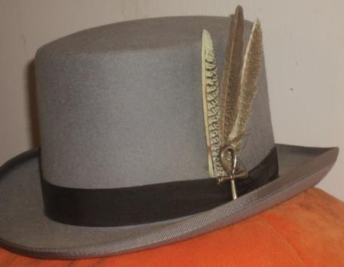
Do we all have a feather in our CAP?
Change
Attitude
Pathways

Slide 5
Communication Standards
Ed Thelen, DTM
District Director

Slide 6

Communication from District Director
E-mail
  If URGENT (Mon-Fri) – ethelen@humana.com
  Otherwise – edmthelen@gmail.com
Response time
  I try to respond in 48 hours – at
  least to acknowledge, even if I
  don’t have the answer
  Poke me again if you haven’t
  heard from me in a while

Slide 7
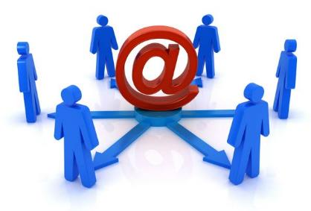
Usage of District Lists
Club Officer and Membership Lists
  Trio – all of District
  Division Directors – for their Division
Can share with appropriate parties as needed
Please treat as CONFIDENTIAL information

Slide 8
Area & Division Director Roundtable
Kris Pool, DTM
Club Growth Director

Slide 9
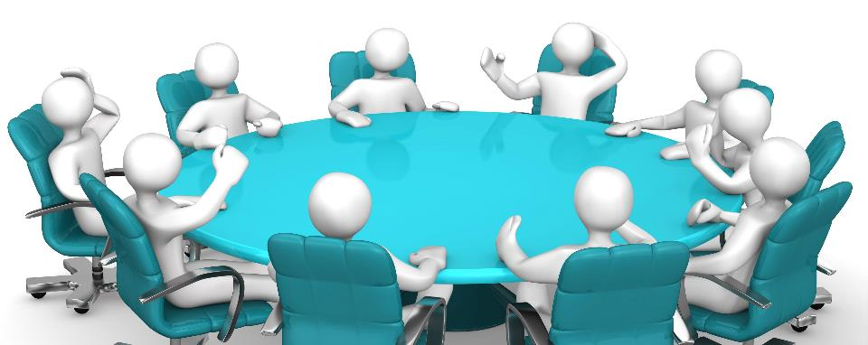

Slide 10
Public Relations
Kamal Soan, DTM
Public Relations Manager

Slide 11
Current Metrics
Social Media Channel | Members Involved
Facebook
D35 Page | 611
D35 Group | 65
Adventures in District 35 | 29
Eastern Division | 19
Southeastern Division | 47
Central Division | 95
DFAB Divisions | 32
Division D (2) | 44, 70
Division F | 53
Division B | 34
Twitter | 558
LinkedIn | 693

Slide 12
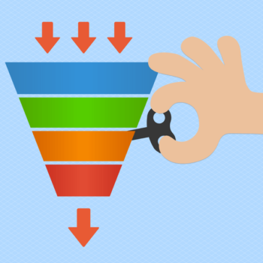
Communication – The Funnel Concept
Areas
Divisions
Clubs
District 35

Slide 13

Division & Area Level Public Relations
Strongly recommend to think about PR activities at your levels

Slide 14

VP PR Survey
Understand topics of interest
Help develop better promotion of clubs

Slide 15
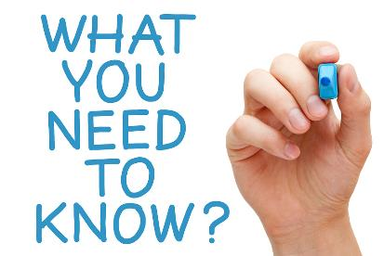
Items Under Consideration
Kudos and achievements (club and member)
Incentives
Current metrics
Social media channels
TLI
District newsletter

Slide 16
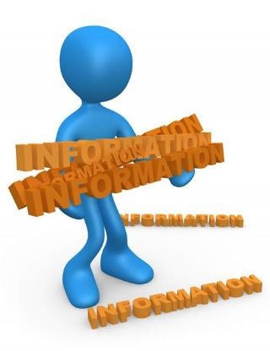
Information Gathering
New clubs chartering
Success stories
Photos from recent events
Future meeting information

Slide 17

Additional Volunteers
Social media channel(s) operators
Content creator
Metrics analyst

Slide 18

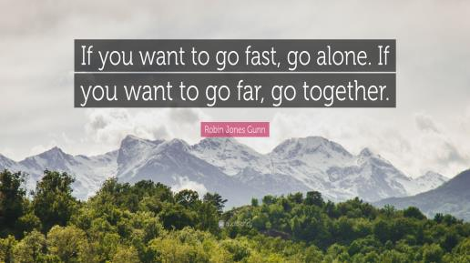

Slide 19

Contact Me
Kamal Soan, DTM
  Email: kamal.soan@gmail.com
  Cell: 931-252-0599

Slide 20
TLI Update
Rozaline Janci, DTM
Program Quality Director

Slide 21
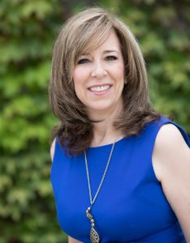
District 35 TLI Keynote
Eldonna Fernandez
Learn more:
https://eldonnalewisfernandez.com/

Slide 22

Other District 35 TLI Information
TLI Dean – Andy Little, DTM, PID
Looking for additional volunteers

Slide 23
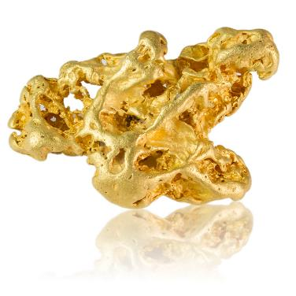
Division Led TLI – Brief Discussion
90 seconds
Each Division Director: share your “golden nugget” from the TLI session(s) you’ve conducted

Slide 24
Team Building – Communication Styles
Ed Thelen, DTM
District Director

Slide 25

Survey
Did everyone take the survey ahead of time as requested?
Did you think you found out some interesting things about yourself?

Slide 26
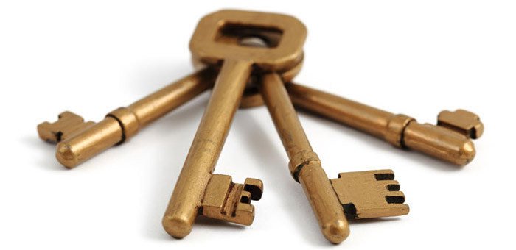
Key – Number to Style
1 – Action
2 – Process
3 – People
4 – Idea

Slide 27
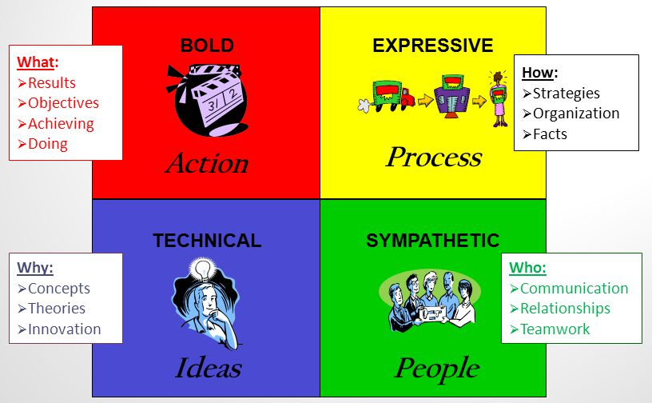

Slide 28

Review of Quad Results
Review chart
Any surprises?

Slide 29

Activity – Mark Divisions
Mark your scores
Mark where you are on the grid

Slide 30
District Success Plan
District 35 Trio

Slide 31
Missions
Toastmasters International Mission
  We empower individuals to become more effective communicators and leaders.
District Mission
  We build new clubs and support all clubs in achieving excellence.
Club Mission
  We provide a supportive and positive learning experience in which members are empowered to develop communication and leadership skills, resulting in greater self-confidence and personal growth.

Slide 32
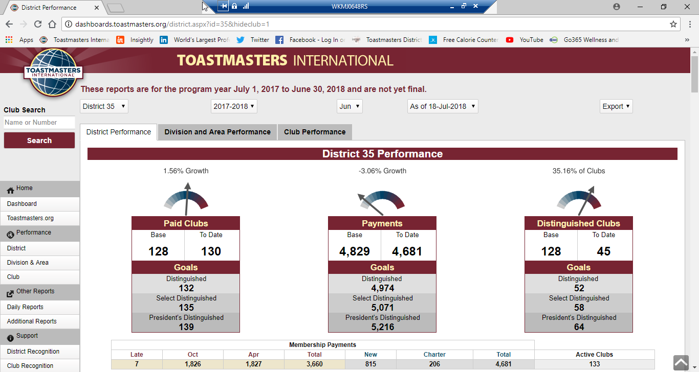
Three Measurable Goals

Slide 33
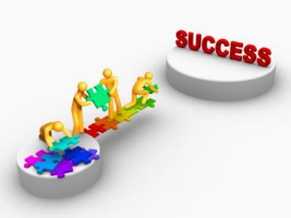
District Success Plan
Roadmap for the year
Collective input from all DEC members
Supports the District mission and goals; supported by the District budget
Planning begins today and will continue to work on details through August
We will review implementation periodically

Slide 34
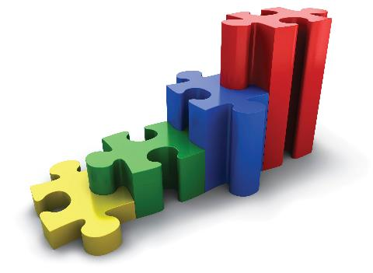
Steps
Break into teams
Define current situation (15 min)
Brainstorm strategies, resources (45 min)
Summarize, define next steps (15 min)
Present to assembled DEC (3 min)

Slide 35
30-60-90 Day Review
Ed Thelen, DTM
District Director

Slide 36
Your Next 30 Days (pre-Convention August)
Schedule and conduct club visits (and file reports)
Schedule and conduct your first council meetings
Obtain club and officer lists (should be available online by late July)
Conduct TLIs - record training (Division Directors)
Get Toastmasters business cards (optional)
Update your profile on District website
Encourage your clubs to record their proxies for International Convention

Slide 37
Your Next 60 Days (mid-September)
Membership dues – October 1
Conduct TLIs - Record training
Continue club visits (and file reports)
Follow-up on/another round Council meetings
District TLI – December 1
  Communicate to your clubs
  Pass along information as communicated down from Program Quality Director/Public Relations Manager
  Complete your enrollment for TLI (if available)

Slide 38
Your Next 90 Days (mid-October)
Record TLI training (before November 30)
Continue club visits (and file reports)
District TLI – December 1
  Communicate to your clubs
  Pass along TLI information as handed down by Program Quality Director and Public Relations Manager
Complete your enrollment for Winter TLI

Slide 39
Q & A and Wrap-Up
Ed Thelen, DTM
District Director

Slide 40
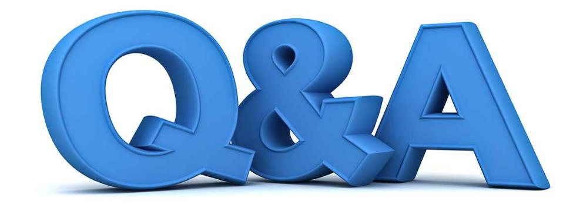

Slide 41

Next DEC Meeting
Saturday, August 11, 2018
10:30 a.m. to 2:30 p.m.
HSHS Sacred Heart Hospital
900 West Clairemont Avenue
Eau Claire, WI
(approximately 3 ½ to 4 hours from Milwaukee)
Hosted by Northern Division

Slide 42
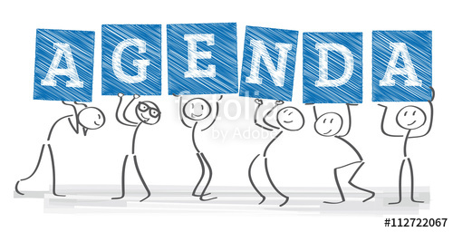
Agenda Topics Include
Club Growth Information for Area/Division Directors – Kris
Budget Review – Jason
Team Building Activity – Keith
Rozaline and Ed will have information to share too…

Slide 43
