Slide 1
Social Media & Acronyms
Used in Communication Tools
Officer Training
Seek – Learn – Grow
Summer 2019
Notes:
As one of the three officers that are Base Camp Managers, you will have additional access regarding Pathways.
As Vice President Education, you will help members achieve their goals by giving them speaking opportunities and tracking their progress.
The President and Secretary will back up the Vice President Education in your role as base camp manager.
We will go over in this session your responsibilities as a Base Camp Manager.

Slide 2

Toastmasters International
TM
  Toastmasters
TI
  Toastmasters International
WHQ
  World Headquarters

Slide 3
Training
COT
  Club Officer Training
TLI
  Toastmasters Leadership Institute
DCP
  Distinguished Club Program
    Distinguished, Select Distinguished, Presidents Distinguished
CSP
  Club Success Plan

Slide 4
Clubs and Officers
President
VPE
  Vice President Education
VPM
  Vice President Membership
VPPR
  Vice President Public Relations
SAA / S@A
  Sergeant at Arms
SEC
  Secretary
TREAS
  Treasurer
CEC – Club Executive Committee

Slide 5
Areas and Divisions
AD
  Area Director
  Formerly Area Governor
DivD
  Division Director
  Formerly Division Governor

Slide 6
Districts
DD
  District Director
  Formerly District Governor
PQD
  Program Quality Director
  Formerly LGET (Lt. Governor Education & Training)
CGD
  Club Growth Director
  Formerly LGM (Lt. Governor Marketing)
IPDD and PDD
  Immediate Past District Director and Past District Director
  Formerly Past District Governor

Slide 7
More from the District
PRM
  Public Relations Manager
  Kamal Soan
  Formerly PRO – Public Relations Officer
Administrative Manager
  Robin Grabinski
  Formerly District Secretary
Finance Manager
  Spring Sun
  Formerly District Treasurer

Slide 8
Your District Leadership
Trio
  The top three leaders in the district – DD, PQD, CGD
  DD – Rozaline Janci
  PQD – Kris Pool
  CGD – Teri McGregor
Quad
  The top four leaders in the district – DD, PQD, CGD, IPDD
  IPDD – Ed Thelen

Slide 9
DEC vs DC
DEC
  District Executive Committee
  Consists of top district officers plus all AD and DivD
DC
  District Council
  Consists of the DEC plus all club presidents and VPE
  Meet twice a year
    September – voting on budget
    May – election of incoming district leadership, realignment
    Assign proxy to vote on club’s behalf – to another club member

Slide 10
District Leadership → Club Leadership
DD
PQD
CGD
PRM
Admin Manager
Finance Manager
Logistics Manager
IPDD
DSP – District Success Plan
DDP – Distinguished District Plan
President
VPE
VPM
VPPR
Secretary
Treasurer
SAA
IP President
CSP – Club Success Plan
DCP – Distinguished Club Program

Slide 11
Regions and International
RA
  Region Advisor (14 regions worldwide)
ID / PID
  International Director / Past International Director
IP / IPIP / PIP
  International President
  Immediate Past International President
  Past International President
WCPS / PWCPS
  World Champion of Public Speaking
  Past World Champion of Public Speaking

Slide 12
Education Program
Traditional / Legacy / Classic Education Program
  Communication
    CC – Competent Communicator
    ACB – Advanced Communicator Bronze
    ACS – Advanced Communicator Silver
    ACG – Advanced Communicator Gold

Slide 13
Education Program
Traditional / Legacy / Classic Education Program
  Leadership
    CL – Competent Leader
    ALB – Advanced Leader Bronze
    ALS – Advanced Leader Silver
      HPL – High Performance Leadership
      LDREXEC – Leadership Excellence Award
    DTM – Distinguished Toastmaster

Slide 14
Education Program
REP – Revitalized Education Program
Pathways
  DL – Dynamic Leadership
  EC – Effective Coaching
  EH – Engaging Humor
  IP – Innovative Planning
  LD – Leadership Development
  MS – Motivational Strategies
  PI – Persuasive Influence
  PM – Presentation Mastery
  SR – Strategic Relationships
  TC – Team Collaboration
  VC – Visionary Communication
  Competed Levels: L1 – L2 – L3 – L4 – L5

Slide 15

SM – Social Media
Facebook
Twitter
Instagram
Twitter
LinkedIn
Website
Others ??

Slide 16

Club Website
Keep up to date
Keep correct!
Free Toasthost websites

Slide 17
Club Facebook Page
Post regularly
Ask each member/officer to post once a month
Promote meetings
Ask all your members to “LIKE” and “SHARE” the post
Include pictures and “tag” the people when possible

Slide 18
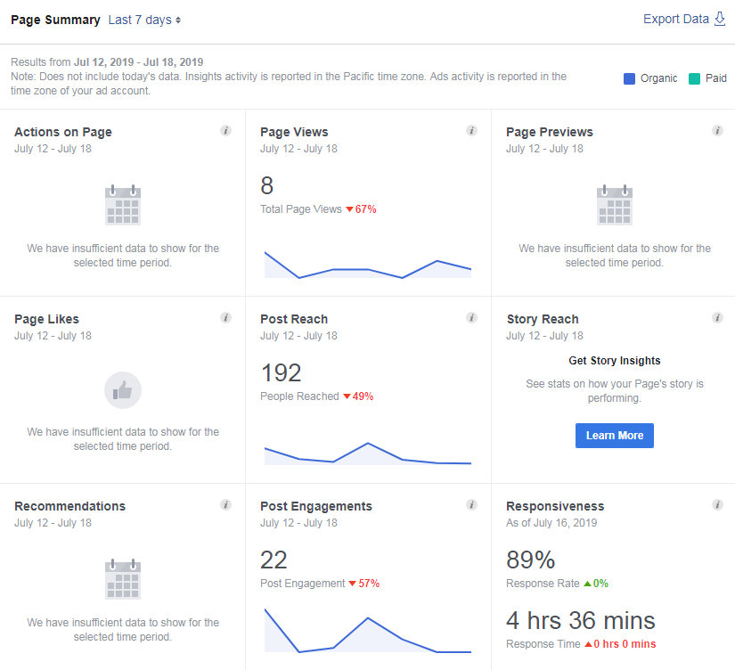
Facebook Insights

Slide 19
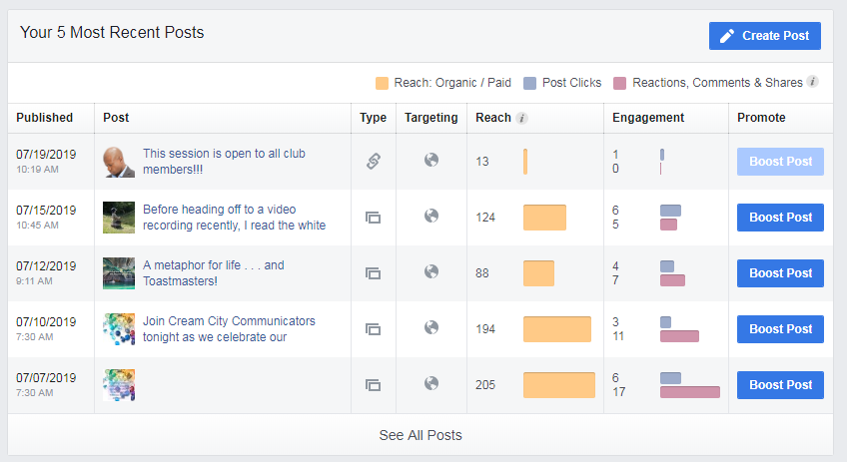
Facebook Insights

Slide 20

TSN – Try Something New

Slide 21


Slide 22

Notes:
Any questions?
This presentation will be posted on the District website by August, https://district35.org

