Slide 1
The WOW! Factor and Club Success Plan
Officer Training Extravaganza
Seek – Learn – Grow
Summer 2019

Slide 2


Slide 3

What is the WOW! Factor Project?
Invites all club leaders and members to raise the bar to the new gold standard of creating a successful Toastmasters club.
Tips and resources will be highlighted on Toastmasters social channels.
Clubs are encouraged to submit a one-minute video entry showing/telling how they created a successful club.

Slide 4

Goal of WOW! Factor Project
To raise the bar of clubs across the globe to be more uniform and top-performing.
As International President Lark Doley puts it, “this will be our new gold standard!”

Slide 5
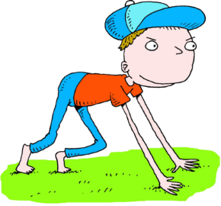
Ready, Set, WOW!
On your mark…
  Begin with a deep dive analysis
  Be proud of accomplishments
  Be realistic about what needs tweaking
  Find gaps and areas of weakness during the first month

Slide 6
Ready, Set, WOW!
Get set…
  Fill in the gaps during the second month
  Strive to be “the best club possible”
  Hold open houses and recruit new members

Slide 7

Ready, Set, WOW!
WOW!
  By the third month, be in full force to pump up your WOW! Factor
  Get members to think and say “WOW!” when they attend a meeting

Slide 8

Targets to Hit
Re-assess Toastmasters goals
Improve club experience to meet goals
Promote club mission to share membership benefits
Publicize when and where clubs meet
Retain members by supporting personal and professional goals
Recruit new members through open houses
Notes:
Learning Opportunity: Re-assess Toastmasters goals – ask Base Camp Managers to open up the dashboard and review the progress percentage of each member.

Slide 9

Are You In?
Are you committed to The WOW! Factor Project?
Tell Toastmasters International how your club is working to raise the bar of club quality
  Completing club quality checklist?
  Hosting an open house?
  Utilizing Wow! Factor tools and resources?
  Other ways?
https://www.toastmasters.org/wowfactor%20we%20are%20in

Slide 10

Show and Tell
Follow these steps to participate:
  Reflect, analyze, and assess your current club experience
  Film a one-minute telling TI what makes your club so great and different
  To submit, email marketing@toastmasters.org for upload instructions.
  To post on social channels, use #wowfactor

Slide 11
Assess Your Goals
Is your club a good example of The WOW! Factor Project and how can you improve?
Are you personally an example of The WOW! Factor and how can you take it up a notch?
What sets your club apart from other clubs?
Take a poll – what are the “wows” of your club, according to members?
Which Toastmasters tools/modules have you utilized to “wow” members?

Slide 12

Additional Resources
https://www.toastmasters.org/wowfactor

Slide 13
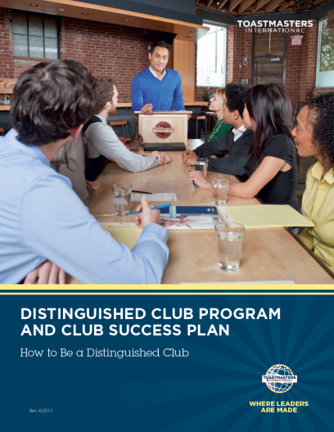

Slide 14

Set SMART Goals

Slide 15
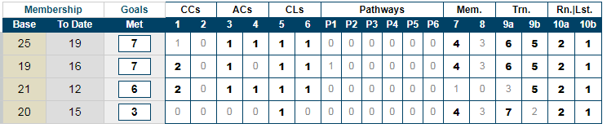
Do You Know How You’re Performing?
Distinguished Performance Reports

Slide 16
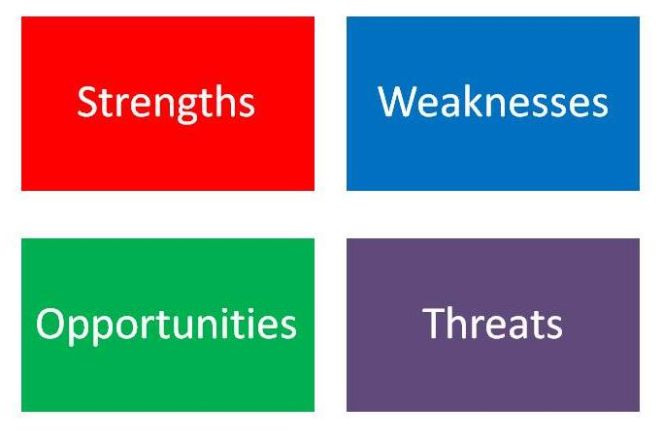
Conduct a SWOT Analysis

Slide 17
Sample SWOT Analysis
Strengths Well-developed Club Success Plan and budget Club officers who have properly set expectations about duties | Opportunities Speech contests Membership-building contests Speechcraft (Item 204) The Successful Club Series (Item 289)
Weaknesses No presence on social networks Club website has not been updated recently CL manual not being used | Threats Low attendance Members not properly prepared for speeches Dues not paid Members not engaged during meetings

Slide 18

Action Plan
What actions need to be taken?
What resources are available?
Who is responsible?
When must the action be completed?

Slide 19

Notes:
Roll up your sleeves and let’s get to work!
Small group breakouts to begin going through checklist and brainstorm ideas for Club Success Plan.

Slide 20


Slide 21


Slide 22

Notes:
Thank you for learning more about The WOW! Factor and taking the steps to begin building your Club Success Plan this year.

Slide 23

Notes:
Any questions?
This presentation will be posted on the District website (www.district35.org) in August.

