Slide 1
Treasurer
Officer Training Extravaganza
Seek – Learn – Grow
Summer 2019
Notes:
Congratulations on your election! As treasurer you are the club’s accountant. You are responsible for managing the bank account, collecting dues and submitting forms to World Headquarters.

Slide 2

Agenda
Treasurer Role
Treasurer Responsibilities
Treasurer Resources
Notes:
First, treasurers learn about their role within the club. Then, they identify
the responsibilities of their role within club and club executive committee
meetings. To conclude, treasurers find specific resources to help them
fulfill their responsibilities.

Slide 3

Treasurer Role
Notes:
TELL treasurers they can find information about their role in the Club
Leadership Handbook (Item 1310).
ASK
What is the essence of the treasurer role?
▪ The treasurer is the club’s accountant
ASK
▪ What are the responsibilities of the treasurer?
▪ Oversee accounts
▪ Collect membership dues
▪ Pay bills
▪ Your role as treasurer as stated in the Club Constitution and Standard Bylaws of Toastmasters International is: “The treasurer is responsible for club financial policies, procedures, and controls. The club treasurer receives and disburses, with the approval of this club, all club funds; pays to Toastmasters International all financial obligations of this club as they come due; and keeps an accurate account of all transactions. The club treasurer shall make financial reports to this club and to the club executive committee quarterly and upon request, and shall transmit the accounts and all undistributed funds to the successor in office at the end of the club treasurer’s term.”
▪ The constitution provides a definition. Yet, there are many responsibilities that make up the day-to-day activities of a treasurer.
▪ Everything you do as treasurer should support the club mission.
And what is our club mission? We provide a supportive and positive learning experience in which members are empowered to develop communication and leadership skills, resulting in greater self-confidence and personal growth.
Let’s take a closer look at your responsibilities and the tools you can use to fulfill your role.

Slide 4

Treasurer
The Club Meeting
Outside the Club Meeting
The Executive Committee
Notes:
▪ Your treasurer responsibilities are in three categories:
▪ The Club Meeting
▪ Outside the Club Meeting
▪ The Executive Committee
We’ll start by exploring your club meeting responsibilities.

Slide 5

The Club Meeting
Before club meetings
During club meetings
Notes:
▪ Your club meeting responsibilities are split into two types:
▪ Before Club Meetings
▪ During Club Meetings

Slide 6

Before Club Meetings
Prepare a financial report
Notes:
Before Club Meetings:
Prepare a financial report as necessary to be presented at the
meeting.

Slide 7
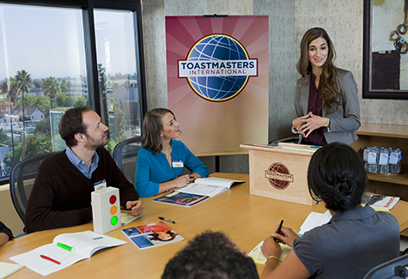
During Club Meetings
Collect membership dues
Report on club finances
Notes:
▪ During Club Meetings
▪ Collect any payable membership-renewal dues and fees from
members.
▪ Present the club financial report when necessary.

Slide 8

Outside the Club Meeting
Prepare a budget
Provide bank with a bank signatory card
Collect and pay dues
Submit new member applications
Issue checks for club expenses
Keep financial records
Notes:
Outside the Club Meeting
▪ Prepare a budget.
▪ Provide the bank with a bank signatory card.
▪ Collect and pay dues to World Headquarters.
▪ Submit new member applications and dues to World Headquarters.
▪ Issue checks to cover club expenses.
▪ Keep records of all financial transactions.

Slide 9

Outside the Club Meeting
Present financial reports
Submit club accounts for audit
Attend executive committee meetings
Reconcile deposits, expenditures and cash on hand
Receive financial correspondence
Prepare for audit committee
Notes:
▪ Present verbal and written quarterly financial reports to the executive committee.
▪ Submit club accounts for audit.
▪ Attend executive committee meetings.
▪ Reconcile deposits, expenditures, and cash on hand each month.
▪ Receive all bills and other financial correspondence for the club.
▪ Prepare for the audit committee near the end of your term of office.

Slide 10

The Executive Committee
Prepare a budget
Present financial reports
Submit club accounts for audit
Work with executive committee on Club Success Plan
Notes:
Now that we’ve looked at your club meeting responsibilities, we’ll look at your executive committee responsibilities.
▪ Prepare a budget.
▪ Present verbal and written quarterly financial reports.
▪ Submit club accounts for audit to the audit committee.
▪ Work with the executive committee on the Club Success Plan
Now that we’ve looked at your responsibilities in and out of the club, as well as your executive committee, we can explore the specifics.

Slide 11

Treasurer Responsibility Action Plan
How will you fulfill this responsibility?
When will each action be completed?
Who is available to help you?
What materials and resources can you use?
Notes:
Open discussion among participants
▪ How will you fulfill this responsibility? (What specific actions will you complete?)
▪ When will each action be completed?
▪ Who is available to help you?
▪ What materials and resources can you use?

Slide 12

Getting Started
Attend district-sponsored club-officer training program (today – thank you!)
Read materials
Meet with outgoing executive committee
Meet with outgoing treasurer
Meet with current executive
committee
Review Policies and Protocol
Prepare a budget
Notes:
There are several resources available to help you in your role as treasurer.
Getting Started:
▪ Attend district-sponsored club-officer training program. ▪ Read the Club Leadership Handbook (Item 1310) and Distinguished Club Program and Club Success Plan (Item 1111).
▪ Meet with the outgoing executive committee to transfer any necessary information.
▪ Meet with the outgoing treasurer to transfer any necessary files or information.
▪ Meet with the current executive committee and develop the Club Success Plan and budget.
▪ Review the Policies and Protocol section in the Governing Documents.
▪ Prepare a budget.
▪ Review the records of the past treasurer and most recent
quarterly financial report.
▪ Review the audit committee’s most recent report.
▪ Provide the bank with a bank signatory card.
▪ Create a simple financial record-keeping system if one is not in
place.

Slide 13
Getting Started
Review records, financial reports, and audit committee’s report
Provide bank with a signatory card
Create a record-keeping system, if needed
Notes:
▪ Review the records of the past treasurer and most recent
quarterly financial report.
▪ Review the audit committee’s most recent report.
▪ Provide the bank with a bank signatory card.
▪ Create a simple financial record-keeping system if one is not in
place.

Slide 14
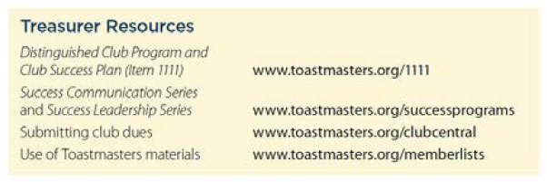
Additional Resources
Notes:
There are many resources available to the treasurer through the
Toastmasters website and manuals.
Additional resources can be found in the Club Leadership
Handbook (Item 1310) in the Treasurer section.

Slide 15

Notes:
▪ In this session, you learned about the role and responsibilities of a treasurer.
▪ Your responsibilities include managing the club bank account, collecting and submitting dues, keeping accurate records and preparing a budget.
▪ Serving as the treasurer will improve your accounting and organizational skills, especially with regards to receiving and managing money, preparing budgets, keeping accurate records and disbursement of funds.
INSTRUCT treasurers to take the session evaluation.

Slide 16

Notes:
Any questions?
This presentation will be posted on the District website (www.district35.org) in August.

