Slide 1
Secretary
Officer Training Extravaganza
Seek – Learn – Grow
Summer 2019
Notes:
Congratulations on your election to secretary! In this position, you facilitate the smooth operation of the club by maintaining vital records. You maintain the club’s written history so that future club officers will have this important information.

Slide 2

Agenda
Secretary Role
Secretary Responsibilities
Secretary Resources
Notes:
After completing this session, you will be able to:
▪ Identify your role within the club
▪ Fulfill your responsibilities within the club and club executive committee
▪ Find resources that help you fulfill your responsibilities

Slide 3

Secretary Role
Notes:
TELL secretaries they can find information about their role in the Club
Leadership Handbook (Item 1310).
ASK
▪ What is the essence of the secretary role?
▪ Maintaining and managing club records, files, and correspondence
▪ Ensuring the club is organized and up to date
Your role as secretary as stated in the Club Constitution and Standard Bylaws of Toastmasters International is: “The club secretary is responsible for club records and correspondence. The club secretary has custody of the club’s charter, constitution, and bylaws and all other records and documents of this club; keeps an accurate record of the meetings and activities of this club and of the club executive committee; maintains an accurate and complete roster of individual members of this club, including the address and status of each individual member; and transmits the same to the successor in office. The club secretary provides notices of meetings as required by this constitution, and immediately notifies World Headquarters of Toastmasters International of any change in the roster of individual members.”
The constitution provides a definition. Yet, there are many responsibilities that make up the day-to-day activities of a secretary. Everything you do as secretary should support the club mission.
What is the club mission?
▪ We provide a supportive and positive learning experience in which members are empowered to develop communication and leadership skills, resulting in greater self-confidence and personal growth.

Slide 4

Secretary Responsibilities
The Club Meeting
Outside the Club Meeting
The Executive Committee
Notes:
Your secretary responsibilities are in three categories:
▪ The Club Meeting
▪ Outside the Club Meeting
▪ The Executive Committee
▪ We’ll start by exploring your club meeting responsibilities.

Slide 5
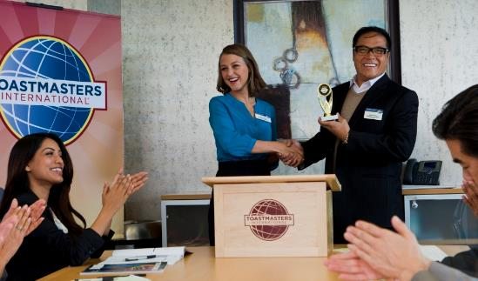
The Club Meeting
Before the club meetings
Upon arrival at club meetings
During club meetings
Notes:
Your club meeting responsibilities are split into three types:
▪ Before Club Meetings
▪ Upon Arrival at Club Meetings
▪ During Club Meetings

Slide 6

Before Club Meetings
Post the previous minutes
Prepare a list of actions for the president
Update the club’s officer list
Notes:
Before Club Meetings:
▪ Post the minutes of the previous club meeting online, and notify club members that the minutes are available for review.
▪ Prepare for the president a list of actions to be taken during the business meeting, including unfinished business, announcements, and correspondence.
▪ Update the club’s officer list online when necessary.

Slide 7
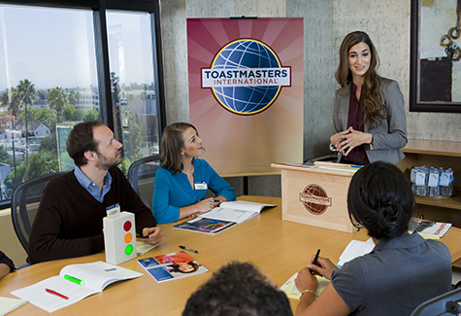
Upon Arrival at Club Meetings
Circulate attendance sheet and guest book
Notes:
Upon Arrival at Club Meetings:
▪ Circulate the club’s attendance sheet and Guest Book for members and guests to sign.

Slide 8

During Club Meetings
Read previous minutes
Note amendments
Record current meeting minutes
Notes:
During Club Meetings:
▪ Read the minutes of the previous meeting (if that is your usual club protocol), note any amendments, and record the minutes of the current meeting.
SUGGESTION: also record all speakers with speech titles and project level/manual.

Slide 9
Outside the Club Meeting
Maintain accurate roster
Submit club officer list
Handle correspondence
Keep club files
Attend club executive committee meetings
Notes:
Outside the club meeting:
▪ Maintain an accurate membership roster and give it to the treasurer to submit with dues.
▪ Submit club officer list to World Headquarters within 10 days after elections.
▪ Handle general club correspondence.
▪ Keep club files, including the club charter, constitution and bylaws, minutes, resolutions, and correspondence.
▪ Attend club executive committee meetings.

Slide 10
Outside the Club Meeting
Submit proxy to District Director for International Convention Business Meeting (communicate with President who will do this)
Facilitate member progress in Base Camp
Arrange for your replacement or assistance
Prepare your successor for office
Notes:
Outside the Club Meeting, continued:
▪ Vote at international business meetings – or submit the club proxy to the District Director to vote on your club’s behalf
▪ Facilitate member progress by verifying education, approving
requests, and tracking progress on Base Camp.
▪ Arrange for a replacement if unable to attend meetings.
▪ Prepare your successor for office.

Slide 11

The Executive Committee
Read the previous meeting minutes
Note amendments
Record current meeting minutes
Notes:
Now that we’ve looked at your club meeting responsibilities, we’ll look at your executive committee responsibilities.
▪ Read minutes of the previous meeting, note amendments and record current meeting minutes

Slide 12

Secretary Responsibility Action Plan
How will you fulfill this responsibility?
When will each action be completed?
Who is available to help you?
What materials and resources can you use?
Notes:
Brainstorm:
▪ How will you fulfill this responsibility? (What specific actions will you complete?)
▪ When will each action need to be completed?
▪ Who is available to help you?
▪ What materials and resources can you use?

Slide 13
Getting Started
Attend district-sponsored club-officer training program (today – thank you!)
Read materials
Meet with outgoing executive committee
Meet with outgoing secretary
Meet with current executive committee
Confirm submission of the newly elected officers list (before June 30)
Review and order any needed materials
Notes:
You have responsibilities related to the club meeting and club executive committee.
▪ All of your responsibilities help to achieve club goals.
▪ Next, we’ll look at some resources to help you fulfill your role.
There are several resources available to help you in your role as
secretary. First, there is a checklist to get started.
▪ Attend district-sponsored club-officer training program.
▪ Read the Club Leadership Handbook (Item 1310) and Distinguished Club Program and Club Success Plan (Item 1111).
▪ Meet with the outgoing executive committee to transfer any necessary information.
▪ Meet with the outgoing secretary to transfer any necessary files or information.
▪ Meet with the current executive committee and develop the Club Success Plan and budget.
▪ Confirm the outgoing secretary submitted the list of newly elected officers to World Headquarters and the district director.
▪ Review and order any needed materials from the Toastmasters Online Store.

Slide 14
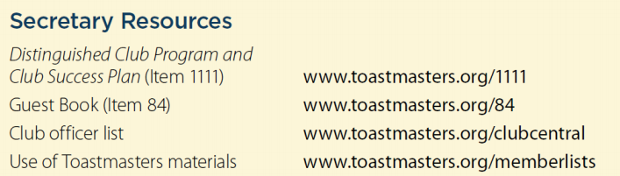
Additional Resources
Notes:
There are many resources available to the secretary through the Toastmasters website and manuals.
Additional resources can be found in the Club Leadership
Handbook (Item 1310) in the Secretary section.

Slide 15

Notes:
PRESENT
▪ In this session, you learned about the role and responsibilities of secretaries. Responsibilities include:
▪ Taking minutes and attendance at meetings.
▪ Handling club correspondence.
▪ Maintaining club files and records.
▪ Assisting with membership dues collection and submission to World Headquarters.
▪ Serving as secretary provides you with an opportunity to learn and practice specific communication and leadership skills, including accurate record keeping, time management and organization.
INSTRUCT secretaries to take the session evaluation.

Slide 16

Notes:
Any questions?
This presentation will be posted on the District website (www.district35.org) in August.

