Slide 1
Sergeant at Arms (SAA or Master Host)
Officer Training Extravaganza
Seek – Learn – Grow
Summer 2019
Notes:
Congratulations! As the sergeant at arms of your club, you ensure that meetings are well-run and set the tone for an organized, successful meeting.

Slide 2

Agenda
SAA Role
SAA Responsibilities
SAA Resources
Notes:
After completing this session, you will be able to:
▪ Identify your role within the club
▪ Fulfill your responsibilities within the club and club executive committee
▪ Find resources that help you fulfill your responsibilities

Slide 3

Sergeant at Arms Role
Notes:
What is the essence of the sergeant at arms role?
▪ Manage club property
▪ Make sure everything is ready for a successful meeting
TELL sergeants at arms they can find information about their role in the Club Leadership Handbook (Item 1310).
▪ Your role as sergeant at arms as stated in the Club Constitution and Standard Bylaws of Toastmasters International is: “The sergeant at arms is responsible for club property management, meeting room preparation, and hospitality. The sergeant at arms chairs the social and reception committee.”
▪ The constitution provides a definition. Yet, there are many responsibilities that make up the day-to-day activities of a sergeant at arms.
▪ Everything you do as sergeant at arms should support the club mission.
What is the club mission?
▪ We provide a supportive and positive learning experience in which members are empowered to develop communication and leadership skills, resulting in greater self-confidence and personal growth.

Slide 4

SAA Responsibilities
The Club Meeting
Outside the Club Meeting
The Executive Committee
Notes:
Your sergeant at arms responsibilities are in three categories:
▪ The Club Meeting
▪ Outside the Club Meeting
▪ The Executive Committee
▪ We’ll start by exploring your club meeting responsibilities.

Slide 5
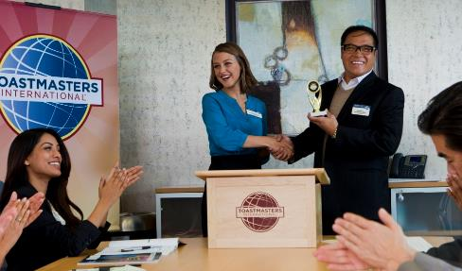
The Club Meeting
Before the club meetings
Upon arrival at club meetings
During club meetings
After club meetings
Notes:
▪ Your club meeting responsibilities are split into four types:
▪ Before Club Meetings
▪ Upon Arrival at Club Meetings
▪ During Club Meetings
▪ After Club Meetings

Slide 6

Before Club Meetings
Confirm room reservation
Ensure there are sufficient amount of club supplies
Notes:
Before Club Meetings:
▪ Confirm meeting room reservations a few days before the meeting.
▪ Ensure that plenty of blank ballots are available for voting for Best Speaker, Best Evaluator, speaker evaluation forms, and so on.

Slide 7

Upon Arrival at Club Meetings
Arrange meeting room early
Arrange tables and chairs
Set out meeting materials and promotional materials
Check room temperature
Ask guests to sign the guest book
Notes:
Upon Arrival at Club meetings:
▪ Arrange the meeting room and equipment at least 30 minutes before, so the meeting starts on time.
▪ Arrange tables and chairs.
▪ Set out the lectern, gavel, club banner, (optional) the national flag, timing device, ballots, trophies, and ribbons.
▪ Place a table near the door to display promotional brochures, name tags, the Guest Book, and educational materials such as manuals, club newsletters, and the Toastmaster magazine for members to see. (Guest folders)
▪ Check the room temperature, and adjust it if the room is too hot or too cold.
▪ Ask all guests to sign the Guest Book (Item 84), and give each a name tag to wear during the meeting.

Slide 8

During Club Meetings
Welcome late arrivals
Coordinate food service, if any
Collect ballots and tally votes when necessary
Notes:
During club meetings:
▪ Sit near the door to welcome late arrivals and help them be seated. Prevent interruptions and perform any necessary errands.
▪ Coordinate food service, if any.
▪ Collect ballots and tally votes for awards when necessary.

Slide 9

After Club Meetings
Return room to original configuration
Pack up and store materials
Dispose of trash
Notes:
After Club Meetings:
▪ Return the room to its original configuration.
▪ Pack up all materials, and store them in a safe place.
▪ Pick up and dispose of any stray items or trash.

Slide 10

Outside the Club Meeting
Schedule meeting location
Ensure adequate supplies are available
Attend executive committee meetings
Arrange for your replacement or assistance
Prepare your successor for office
Notes:
Outside the Club Meeting:
▪ Schedule the meeting location.
▪ Maintain club equipment.
▪ Ensure adequate supplies are always available.
▪ Attend executive committee meetings.
▪ Arrange for a replacement when unable to attend a meeting and for assistance if necessary.
▪ Prepare successor for office.

Slide 11
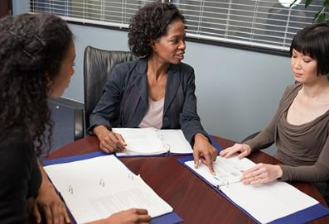
The Executive Committee
Update the executive committee on the club meeting space status
Work to coordinate meeting space
Chair social and reception committee
Replace items as needed
Notes:
Now that we’ve looked at your club meeting responsibilities, we’ll look at your executive committee responsibilities.
▪ Keep the executive committee updated on the status of the club meeting space. Notify the committee of any changes regarding meeting space, size or cost.
▪ Work with the vice president education and vice president public relations to coordinate meeting space for speech contests or special events.
▪ Chair the social and reception committee.
▪ Work with the secretary and treasurer to order replacement items if needed.

Slide 12

SAA Responsibility Action Plan
How will you fulfill this responsibility?
When will each action be completed?
Who is available to help you?
What materials and resources can you use?
Notes:
Group brainstorm:
▪ How will you fulfill this responsibility? (What specific actions will you complete?)
▪ When will each action be completed?
▪ Who is available to help you?
▪ What materials and resources can you use?

Slide 13

Getting Started
Attend district-sponsored club-officer training program (today – thank you!)
Read materials
Meet with outgoing executive committee
Meet with outgoing SAA
Meet with current executive committee
Introduce yourself to meeting space contacts
Ask for volunteers to assist you
Notes:
▪ There are several resources available to help you in your role as sergeant at arms.
▪ First, there is a checklist to get started.
▪ Attend district-sponsored club-officer training program.
▪ Read the Club Leadership Handbook (Item 1310) and Distinguished Club Program and Club Success Plan (Item 1111).
▪ Meet with the outgoing executive committee to transfer any necessary information.
▪ Meet with the outgoing sergeant at arms to transfer any necessary files or information.
▪ Meet with the current executive committee and develop the Club Success Plan and budget.
▪ Contact the people responsible for the meeting place and introduce yourself.
▪ Ask for volunteers to assist you, especially if time is limited.

Slide 14
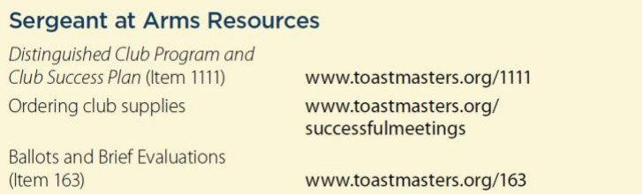
Additional Resources
Notes:
There are many resources available to the sergeant at arms through the Toastmasters website and manuals.
Additional resources can be found in the Club Leadership Handbook (Item 1310) in the Sergeant at Arms section.

Slide 15

Notes:
Never underestimate the role of sergeant at arms. Setting the tone for the club meeting, preparing the room, greeting members and recruiting volunteers demonstrates competent leadership skills.
▪ Be sure to work closely with the executive committee to achieve Distinguished Club status. You are a key member of the team.
▪ Serving as the sergeant at arms improves your organizational skills and gives you the opportunity to practice running successful meetings. You will learn to delegate and be more detail-oriented.

Slide 16

Notes:
Any questions?
This presentation will be posted on the District website (www.district35.org) in August.

