Slide 1
Club President
Officer Training Extravaganza
Seek – Learn – Grow
Summer 2019
Notes:
The purpose of this session is to help presidents understand their role in
the Toastmasters club.
Congratulations! As the elected president of your Toastmasters
club, you have an opportunity to set the tone for your club and
provide supportive leadership.
▪ Your influence and example bring out the best in members and
club officers alike.

Slide 2

Agenda
President Role
President Responsibilities
President Resources
Notes:
First, presidents learn about their role within the club. Then, they identify
the responsibilities of their role within club and club executive committee
meetings. To conclude, presidents find specific resources to help them
fulfill their responsibilities.

Slide 3

President Role
Notes:
TELL presidents they can find information about their role in the Club
Leadership Handbook (Item 1310).
ASK
▪ What is the essence of the president role?
▪ Sets the tone for the club
▪ Provides leadership to executive committee and club members
ASK
▪ What are the responsibilities of the president?
▪ Preside over meetings
▪ Earn distinguished club recognition
▪ Lead and guide
▪ Base Camp Manager
PRESENT: Your role as president as stated in the Club Constitution and Standard Bylaws of Toastmasters International is: “The club president is the chief executive officer of this club and is responsible for fulfilling the mission of the club. The president
presides at meetings of this club and the club executive committee; appoints all committees; and has general supervision of the operation of this club.“
▪ The constitution provides a definition. Yet, there are many responsibilities that make up the day-to-day activities of a president.
▪ Everything you do as president should support the club mission.
And what is our club mission?
We provide a supportive and positive learning experience in which members are empowered to develop communication and leadership skills, resulting in greater self-confidence and personal growth.
Let’s take a closer look at your responsibilities and the tools you can use to fulfill your role.

Slide 4

President Responsibilities
The Club Meeting
Outside the Club Meeting
The Executive Committee
Notes:
Your president responsibilities are in three categories:
▪ The Club Meeting
▪ Outside the Club Meeting
▪ The Executive Committee
▪ We’ll start by exploring your club meeting responsibilities.

Slide 5
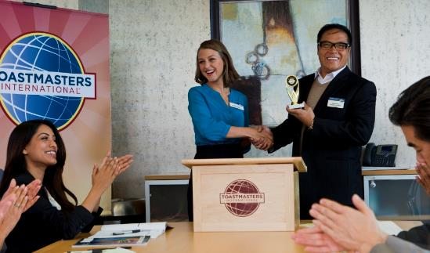
The Club Meeting
Before club meetings
Upon arrival at club meetings
During club meetings
Notes:
Your club meeting responsibilities are split into three types:
▪ Before Club Meetings
▪ Upon Arrival at Club Meetings
▪ During Club Meetings

Slide 6

Before Club Meetings
Ask VPE about special recognition or member inductions
Ask the VP Membership if any new members are to be inducted at the meeting
Plan the business portion of the meeting
Review necessary parliamentary procedure
Notes:
Before Club Meetings:
▪ Ask the vice president education if any members are to receive
special recognition at the meeting.
▪ Ask the vice president membership if any new members are to
be inducted at the meeting.
▪ Plan the business portion of the meeting.
▪ Review necessary parliamentary procedure.

Slide 7
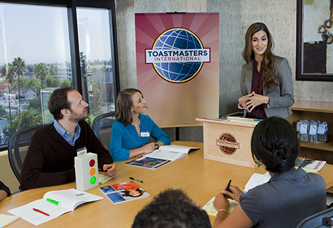
Upon Arrival at Club Meetings
Review the meeting agenda
Greet guests and members
Notes:
Upon Arrival at Club Meetings:
▪ Review the meeting agenda.
▪ Greet guests and members as they arrive to make them feel
welcome.

Slide 8
During Club Meetings
Call the meeting to order
Introduce guests
Explain the meeting’s events
Conduct the business portion of the meeting
Provide information for next meeting
Make any announcements
Adjourn the meeting
Notes:
During Club Meetings:
▪ Call the meeting to order promptly at the scheduled time.
▪ Introduce guests.
▪ Briefly explain the meeting’s events for the benefit of guests.
▪ Introduce the Toastmaster of the meeting.
▪ Conduct the business portion of meeting.
▪ Give the date, time and place of the next meeting.
▪ Make any announcements.
▪ Adjourn the meeting on time.

Slide 9
Outside the Club Meeting
Attend and vote at council meetings
Attend and vote at the District Annual Business Meeting
Appoint and chair the audit committee
Appoint the nominating committee
Conduct Base Camp Manager duties as needed
Receive official correspondence from World HQ
Submit proxy to District Director for International Convention Business Meeting
Notes:
Outside the Club Meeting:
▪ Attend and vote at area and district council meetings.
▪ Attend the Annual Business Meeting at the International Convention to vote on behalf of the club or assign your club’s proxy to a member who is attending the International Convention.
▪ Appoint and chair the club’s audit committee near the end of the term.
▪ Appoint the nominating committee to nominate new club officers before the beginning of the term.
Receive official correspondence from World Headquarters, such as The Leader Letter, and a copy of the Club Leadership Handbook (Item 1310) for each incumbent club officer.

Slide 10
Outside the Club Meeting
Schedule and chair committee meetings
Develop and improve club leadership
Oversee club administration
Advance club and member achievement
Interact effectively with other organization levels
Notes:
▪ Schedule and chair club executive committee meetings.
Develop and improve club leadership.
Club presidents must facilitate the development and achievement of club and member goals. To do this the president must:
▪ Ensure club officers know what their responsibilities are and how to fulfill them.
▪ Search for leaders, ensure all club offices are filled for the succeeding term and conduct timely elections.
▪ Prepare his or her successor for office.
Club administration. Club presidents ensure that the mechanisms of the club run smoothly. This means attending to details and managerial issues such as:
▪ Overseeing the administrative operation of the club in compliance with the Club Constitution and Bylaws.
▪ Scheduling and chairing monthly executive committee meetings.
Advance club and member achievement. Presidents must
focus considerable attention on how to achieve and maintain
quality for the club and members. To accomplish this, a
president must:
▪ Oversee the plan to achieve Distinguished Club Program goals and ensure the club is Distinguished.
▪ Ensure the club has an ongoing membership-building program.
▪ Encourage communication and leadership development by promoting all education awards (Competent Communicator, Competent Leader, Advanced
Communicator Bronze, Advanced Communicator Silver, Advanced Communicator Gold, Advanced Leader Bronze, Advanced Leader Silver, Distinguished Toastmaster, Level 1, Level 2, Level 3, Level 4 and Level 5 of the member’s selected path).
▪ Facilitate member progress in the Toastmasters Pathways learning experience by verifying education, approving requests, and tracking progress on Base Camp.
Effective interaction with other organization levels. The president and the executive committee are liaisons between club members and the area, district and International leadership. Two ways the president maintains a relationship
with the district and World Headquarters are by:
▪ Attending and voting the club’s proxy at district council meetings or authorizing a club member to do so.

Slide 11

The Executive Committee
Oversee the executive committee
Ensure the executive committee completes its duties
Notes:
Now that we’ve looked at your club meeting responsibilities, we’ll
look at your executive committee responsibilities.
▪ Oversee the executive committee.
▪ Ensure that the executive committee has completed its duties

Slide 12
Executive Committee Duties
Create a club budget
Complete a Club Success Plan
  Plan for additional goals beyond the Distinguished Club Program
Strategize for success in the Distinguished Club Program
Create and oversee other club committees as necessary
Notes:
Executive Committee Duties
▪ Create a club budget.
▪ Complete a Club Success Plan.
Don’t forget to plan for additional goals beyond the DCP
▪ Strategize for success in the Distinguished Club Program.
▪ Create and oversee other club committees as necessary.
Now that we’ve looked at your responsibilities in and out of the
club, as well as your executive committee, we can explore the
specifics.

Slide 13

President Responsibility Action Plan
How will you fulfill this responsibility?
When will each action be completed?
Who is available to help you?
What materials and resources can you use?
Notes:
Open discussion among participants

Slide 14

Getting Started
Attend district-sponsored club-officer training program (today – thank you!)
Read materials
Meet with outgoing executive committee
Meet with outgoing president
Meet with current executive
committee
Notes:
There are several resources available to help you in your role as
president.
▪ First, there is a checklist to get started:
Attend district-sponsored club-officer training program.
▪ Read the Club Leadership Handbook (Item 1310) and Distinguished Club Program and Club Success Plan (Item 1111).
▪ Meet with the outgoing executive committee to transfer any necessary information.
▪ Meet with the outgoing president to transfer any necessary files or information.
▪ Meet with the current executive committee and develop the Club Success Plan and budget.

Slide 15
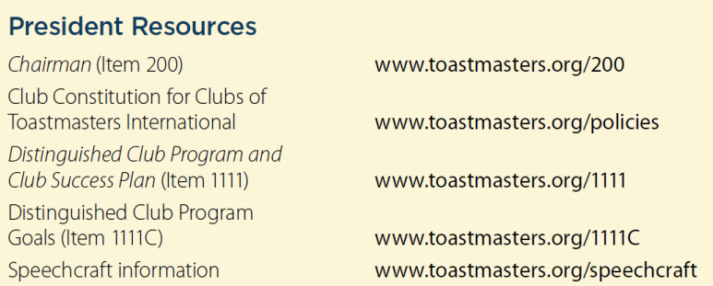
Additional Resources
Notes:
There are many resources available to the president through the
Toastmasters website and manuals.
Additional resources can be found in the Club Leadership Handbook (Item 1310) in the President section.

Slide 16

Notes:
Club presidents open and preside over all club and club executive meetings.
▪ The president sets the tone for the entire club through preparation, conducting well-run meetings and providing leadership whenever required.
▪ Working closely with the executive committee, the president strategizes and communicates with team officers to achieve Distinguished Club status.
▪ The entire executive committee shares responsibilities to deliver a positive member experience, achieve goals, drive membership growth and look for future leaders.
▪ Connect with leaders in other clubs to gain knowledge. The club president can impact individuals, an entire club, community and beyond.
▪ Leadership experience and opportunity await you. Have a great term ahead!
INSTRUCT presidents to take the session evaluation.

Slide 17

Notes:
Any questions?
This presentation will be posted on the District website (www.district35.org) in August.

