Slide 1
Helping Members Achieve Goals
Traditional and Pathways Education Programs
Officer Training Extravaganza
Seek – Learn – Grow
Summer 2019

Slide 2
Meeting Your Members’ Needs & Goals
Assess both member needs and the club DCP goals
  Ambitions: what level do they aspire to this year?
  Pace: how quickly do they want to progress?
  Readiness: how ready are they for that next speech role?
  Encourage, coax, challenge, push: set goals and achieve stretch targets
  DCP goals: how are you going to make sure your club is distinguished?

Slide 3

Help Members with SMART Goals

Slide 4

Scheduling Speakers and Meeting Roles
Assign speakers and meeting roles – plan ahead
Plan out 3-5 meetings (or even the whole year)
  Member roles and speeches
  Meeting themes
  Contests and special events (holiday potluck, year end celebrations)
Take account of requirements of advanced manuals (longer speech times)

Slide 5
Plan for Extra Events
Speak-a-thons (on your off weeks or the fifth week of the month)
Special joint marketing events with other clubs
Area council and marketing events
Workshops (Successful Club Series, Better Speaker Series, Leadership Excellence Series)
Club contests
TLI training sessions or Spring Convention education sessions speaker
Encourage member to reach out to clubs with lower membership and ask to get on their agenda to speak

Slide 6
Sit Down with Each Member
Take 15-20 minutes with each member
  Have an education committee that can help or ask other club officers to assist
Ask them to bring their manuals (traditional program) OR
Ask them to bring their Pathways progress info
When you know their education goals, enter that into your Club Success Plan for education goals

Slide 7
Review the Manuals or Pathways Progress
Traditional program
  Review the record completion page
  Have they completed the Record Completion form in the speaker manual(s)?
    If not, fill it out with them, verifying each speech project has a title and a written evaluation
    Initial for completion
  Ask if they want to complete their traditional program education awards by June 2020 (last date the traditional program will be available to submit for any awards)

Slide 8
To Continue in Traditional Program or Not
If the member wants to finish up education awards, pull out the yearly agenda (spreadsheet is best) and schedule them
Take into consideration the size of your club
  Larger clubs may only have the opportunity for a speaker slot every 3 or 4 months – will this be enough time?
  Encourage member to reach out to other clubs and ask to speak at their club meeting
  Find a way to offer additional speaking opportunities

Slide 9
Traditional Program – Leadership Roles
Review the CL manual’s project completion record
  Review and record evaluations for each project
  Review that the correct number of projects within each skill are completed
Schedule meeting roles as needed throughout the year
Assign projects as needed
  Coordinate an Open House or Membership Campaign
    3 membership campaigns in the year means 12 people can coordinate and receive credit

Slide 10

Unsure about Traditional or Pathways
How many speeches are needed to complete an education goal in Traditional program?
  Suggestion: 1-3 completed in Traditional, transition over to Pathways unless they are dedicated to completing the rest by June

Slide 11

Pathways
Give each member an individual tracking form (similar to the record completion record in traditional program).
They can record their speech titles and projects as they complete each level
Quick reference for the level and path completion

Slide 12
Pathways
Encourage members to proactive – play in Base Camp 10-15 minutes a week
  But NOT during a week they need to prepare for a speech
View different tutorials
See what options are available
Become familiar with Pathways and Base Camp

Slide 13
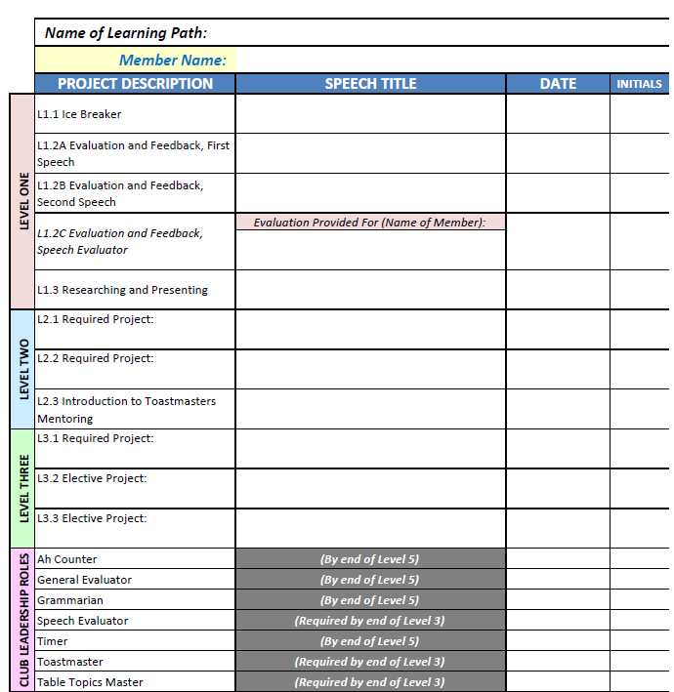
Sample Project Completion Record

Slide 14

Notes:
INSTRUCT ask attendees to take the session evaluation.

Slide 15

Notes:
Any questions?
This presentation will be posted on the District website (www.district35.org) in August.

