Slide 1
Welcome to Club Central
Officer Training Extravaganza
Seek – Learn – Grow
Summer 2019
Notes:
How many of you have logged into Club Central?
How many of you know your roles in Club Central?
How many of you have any idea what Club Central is?
Club Central is the website under Toastmasters.org where you conduct your official club business. We will go over in this session what is possible within Club Central and help you get a better understanding of what we can add, when, whose role it is to add the information, and when to add them.

Slide 2
Agenda
How do I …
  Access Club Central?
  Update where my club meets?
  Change location of the “Find a Club” map?
  Submit a membership application?
  Pay membership dues?
  Download club membership roster?
Notes:
In your club officer training, you will learn a wide range of information about your role as an officer. In this portion of the presentation, you’ll learn about some online tools available to club officers that you will need…and want…to use.
You’ll learn where to find and how to use the tools to update the information about your club, add members, pay dues renewals, and download information you can use to create a club membership roster.

Slide 3
Agenda
How do I …
  Submit officer list to Toastmasters?
  Submit an education award?
  Check my Distinguished Club Program goals (DCP)?
  Check eligibility of members for speech contests?
  Find my past members’ information?
Notes:
You’ll learn how you go about posting your new officer list and submitting education awards. You’ll find a quick way to track your Distinguished Club goals, ensure your speech contestants are eligible, and even find out information about past members. These are just a few of the many resources available to you through Club Central!

Slide 4
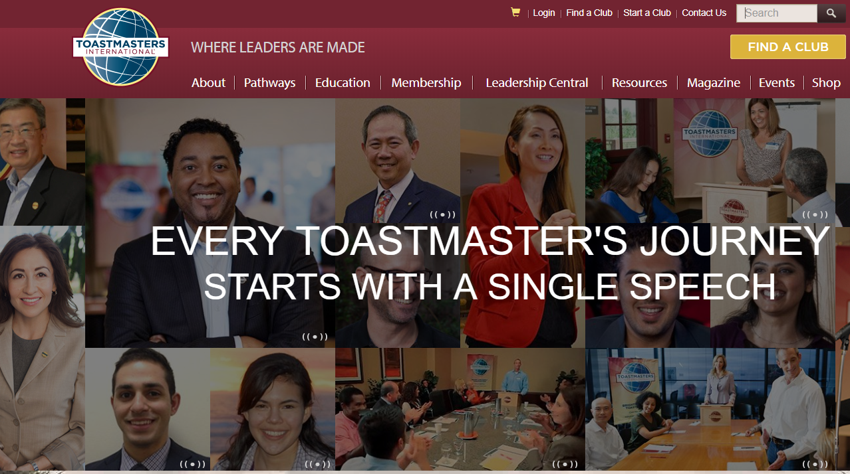
URL: https://www.toastmasters.org
Notes:
Start by going to the Toastmasters International home page at www.toastmasters.org.
Click on “Login.”

Slide 5
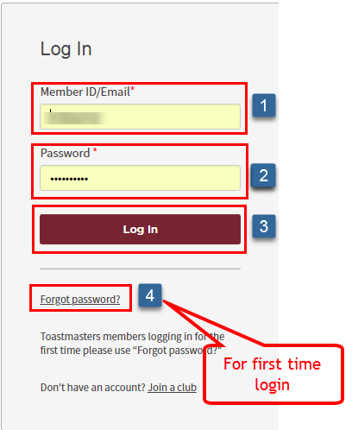
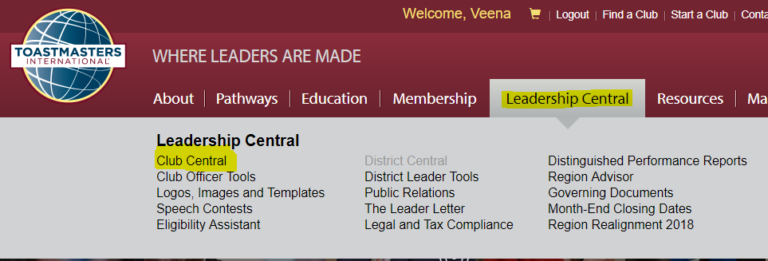
Login to Club Central
User name: Member ID or Email ID
Password: Your password
NOTE: If you have never logged in before, click on “Forgot Password?” Then check your email and, possibly, your junkmail folder.
Leadership Central > Club Central
Notes:
USER name: Member ID or email ID that was used in the membership application.
Password: Your password
NOTE: If you have never logged in before, click on “Forgot Password?” and check your email for instructions. If you don’t see it, be sure to check your junk mail folder.
If a member never received the initial email, login and check if their email ID is correct.

Slide 6
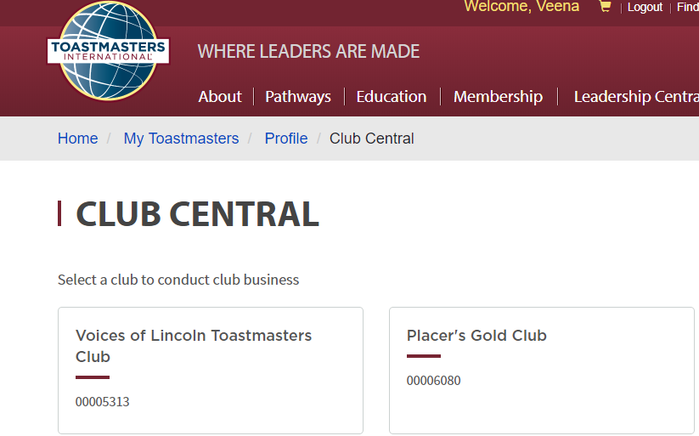
Select Club to Administer
If you are an officer in multiple clubs, you will see them listed here
Select the one you for which you are conducting business
Notes:
If you are an officer in multiple clubs, you will see all the clubs listed here.
Select the club for which you want to conduct business.

Slide 7
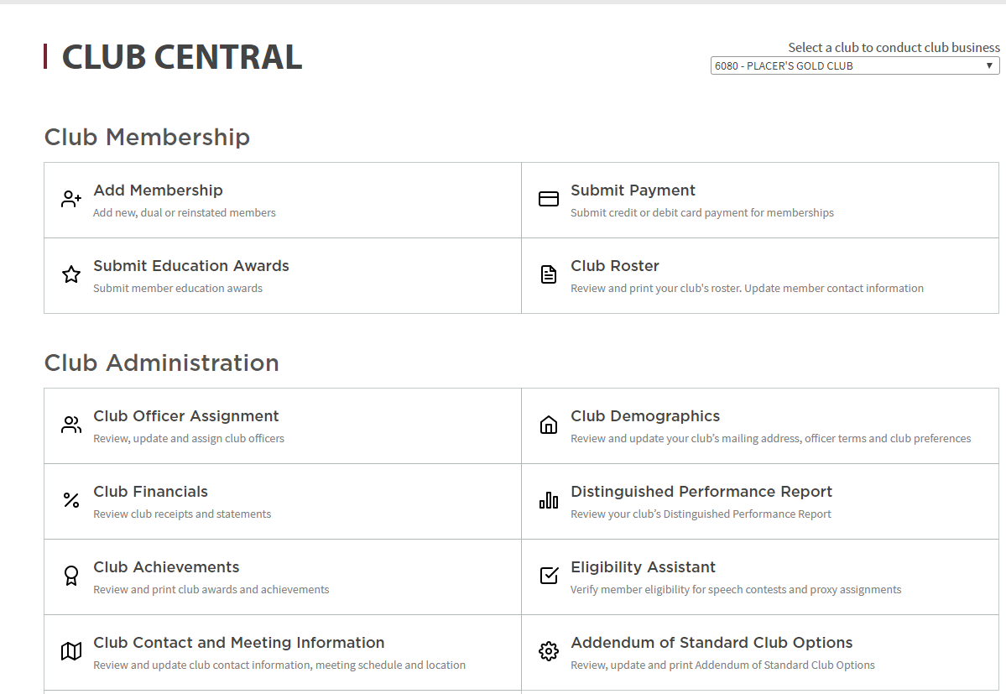
Club Central Home Page
Notes:
After you make your initial club selection, you may wish to later do administrative work for another club. In the upper right area, there is a field that allows you to toggle between multiple clubs.

Slide 8
Club Central Home Page
Notes:
To add new, dual, or reinstated members to your club, select this box.

Slide 9
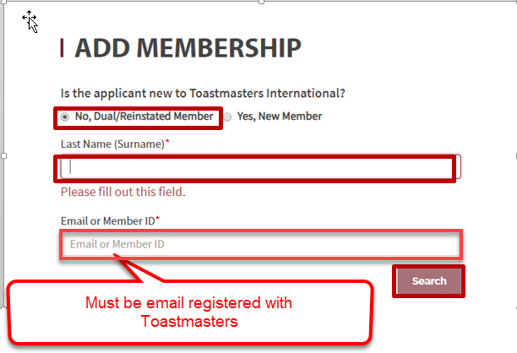
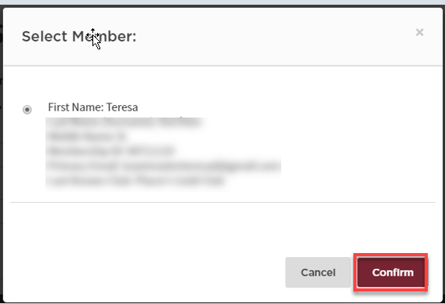
Add Member – Dual and Reinstated
Dual and Reinstated
  Past club member
  Member of another club
Reinstated / Dual Member
Notes:
The last name AND email or member ID must be entered and must be the same as previously registered with Toastmasters International.
If the system finds the person, a new window will open, seen here on the right. Select the correct member name if it exists, then click Confirm.
If either the last name or email/member ID you entered is not correct, you won’t get a result. Check with the member to see if their last name or email has changed since their last login.
Try to submit the application and payment within 2 business days of receipt – The member will not have access to Pathways without them being added and the payment received by Toastmasters International.

Slide 10
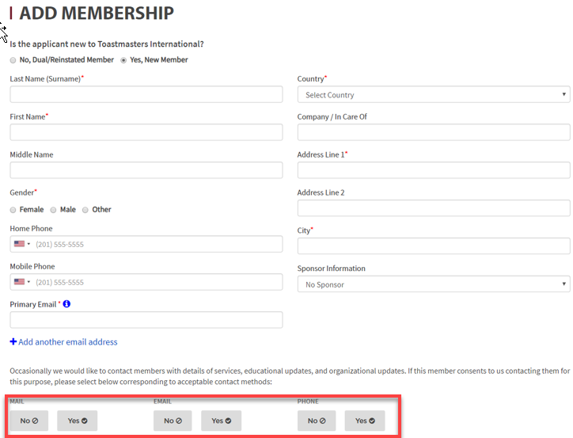
Add Member – New
Confirm the following is correct prior to submission:
Last Name
Email ID
Gender
Phone Number
Address
Sponsor – Receives Credit
Privacy Preferences – Careful
Can be changed by member in “Profile”
Notes:
This screen is used to input information for your member who is new to Toastmasters.
Be sure you enter the name and email for new members accurately. Any errors in member names must be corrected through International—the member or any club officer cannot make the corrections themselves.
If the email is incorrect, they won’t receive their initial information email from International. This email address is where the Pathways information and all communication from Toastmasters will be sent.
Sponsors receive credit from Toastmasters International. If the new member has a sponsor, be sure to include the name.
Privacy settings – If you check “NO”, they will not be able to be contacted by that method. Their information will not show up in the member roster. Members can change the privacy settings in their “Profile.”

Slide 11
Club Central Home Page
Notes:
To submit payment for memberships, select this box.

Slide 12
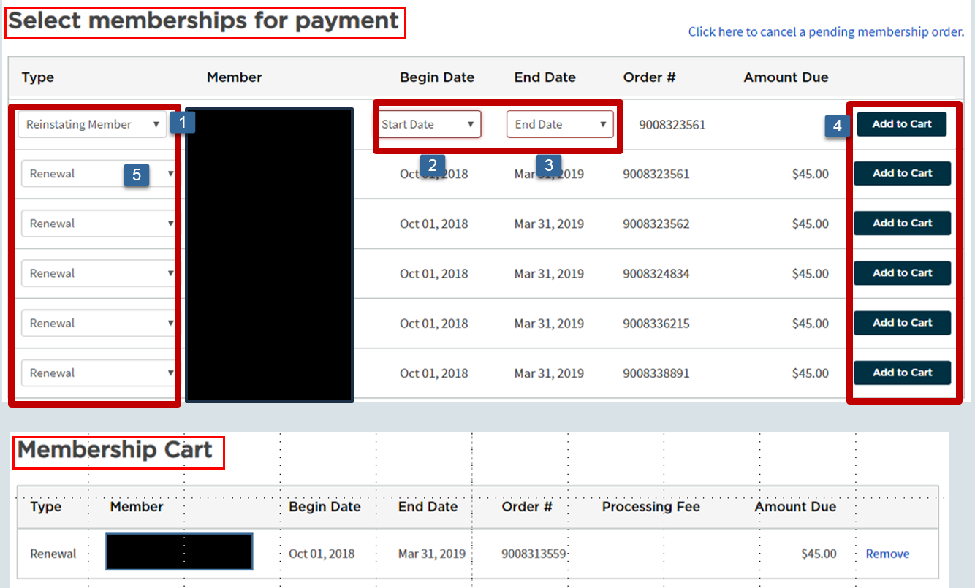
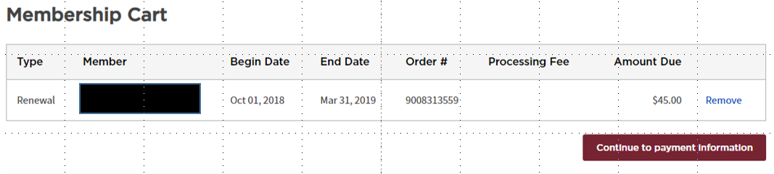
Submit Membership Payment
Notes:
Select either Member “Renewal” or “Reinstating Member”:
If you select “Renewal,” the Begin and End dates will automatically appear.
If you select “Reinstating Member,” you’ll need to enter the Begin and End dates.
Select “Add to Cart”
It will show up in the “Membership Cart” as shown below.
Click on the Continue to Payment button that will lead you to a new screen.

Slide 13
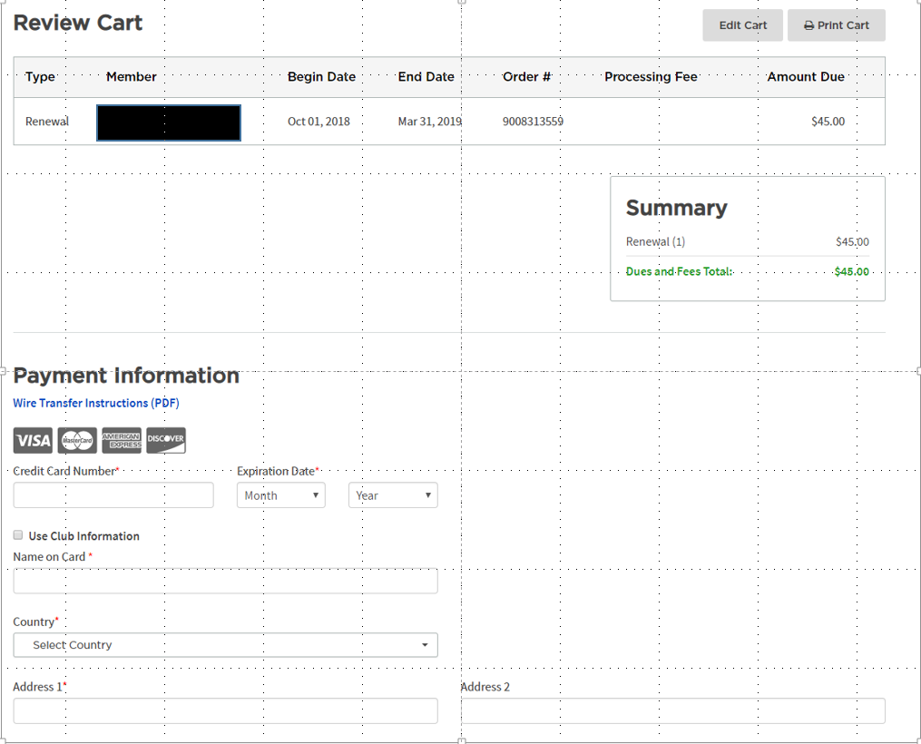
Review Membership Payment
Notes:
Once you review the member name and the amount, you can pay with a credit card.
You will receive an email that the payment went through.

Slide 14
Club Central Home Page
Notes:
Select this box to submit education awards on behalf of your members.

Slide 15
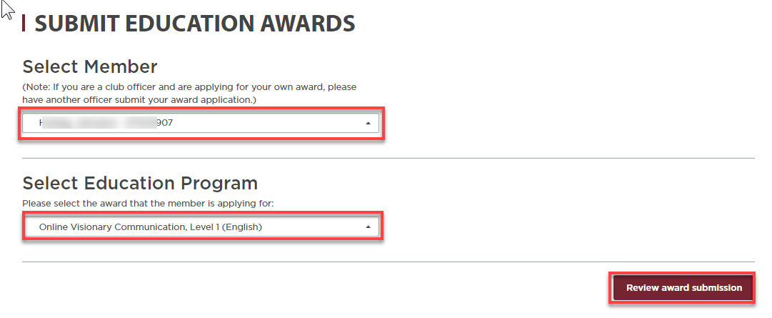
Submit Education Awards
Select member name and education level
Traditional Program - include speech manual, speech names, and dates
You MUST submit Pathways awards in Club Central after approving in Pathways
You CANNOT submit your own awards
Notes:
Under “Select Member,” click on the name of the member for whom you are entering the award. Next, you will need to select the award you are entering.
If the award is for work performed in the traditional education program, you’ll need to identify the name of the speech manual, as well as the dates and titles of the individual speeches.
If the award is for work in Pathways, the Base Camp Manager must submit the award in Club Central in addition to approving it in Pathways.
You CANNOT submit your own awards. Another officer must submit the information for your award.

Slide 16
Club Central Home Page
Notes:
You can view and download information for your club’s roster by selecting this box.

Slide 17
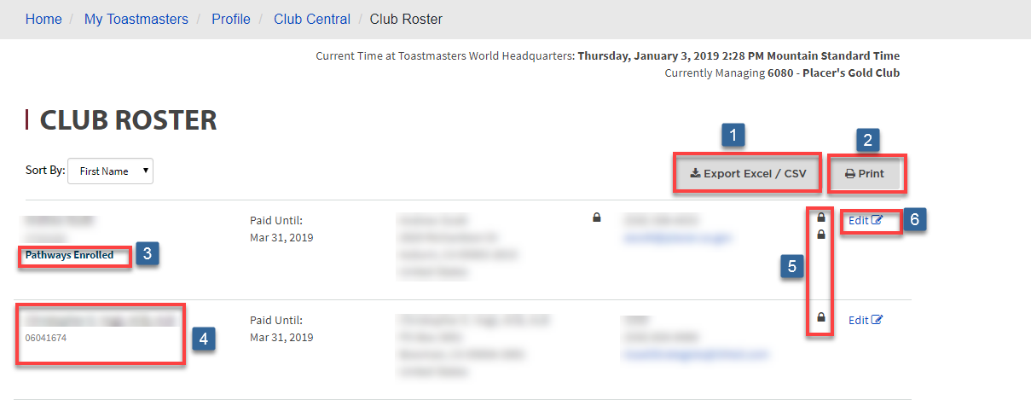
Download Club Roster
Export to CSV/ Excel
Print
Shows up if Enrolled in Pathways
Member not Enrolled in Pathways
Privacy settings – Can be changed by member in Member profile
Edit Member Information
Notes:
You can use this information in different ways.
You can export the data to CSV/Excel. There you can choose the data you want to include to create a roster to be used amongst your members.
You can simply print the roster as it appears on the screen.
Under the member’s name, you’ll see additional information including their member number; what, if any, club officer role they hold; and if they are enrolled in Pathways.
If the member is not enrolled in Pathways, you will see their name, club officer role, and member number, but no mention of Pathways.
To the right, you will see a padlock, indicating their privacy settings.
And to the far right, you can select the edit box to modify some of the member’s information.

Slide 18
Club Central Home Page
Notes:
By selecting this box, you can review, update, and assign club officers.

Slide 19
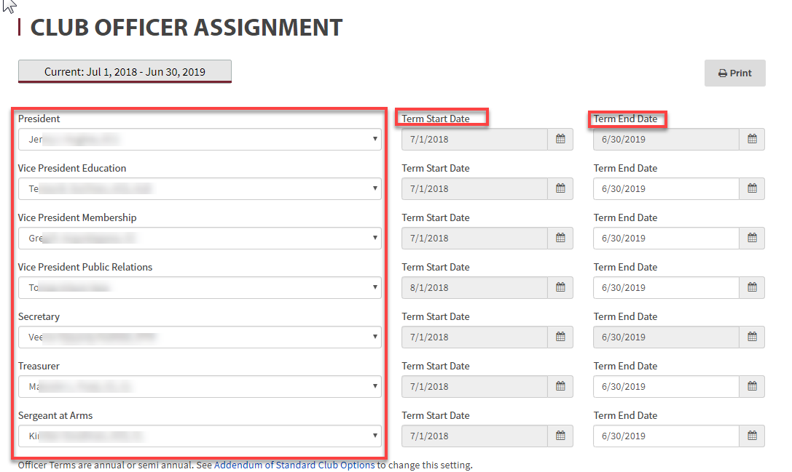
Club Officer Assignment
For DCP points, officers must be updated before June 30 (and December 31 if done semi-annually)
Notes:
It is critical that after your club has elected its officers, that the information at Toastmasters International about your officers is updated.
Clubs can elect officers for either semi-annual or annual terms.
For clubs with semi-annual elections, the updates must be entered by June 30 for the following July through December term, and by December 31 for the following January through June term.
For clubs with annual elections, you need update your officer list by June 30 for the following term of July of that year through June of the next.
NOTE: if a position becomes vacant during the year, a new officer should be elected and updates made in Club Central

Slide 20
Club Central Home Page
Notes:
This box is where you go to review and update your club’s mailing address, officer terms, and club preferences.

Slide 21
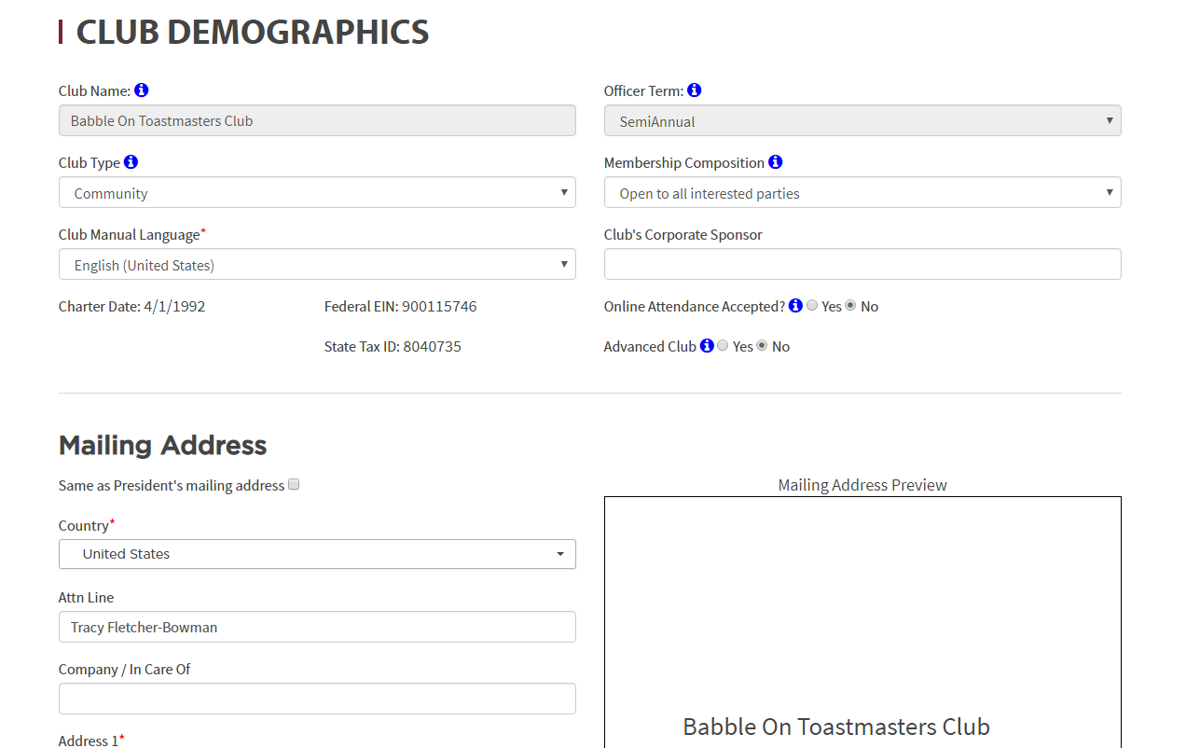
Club Demographics
Notes:
Club Demographics tells information about your club. Is it a community club or a corporate club? What is the primary language spoken at the club meetings? Is the club open to anyone or is it limited to only a certain group? When did we charter? Time to file taxes—what are our club’s tax numbers? Can members attend online? Is it an advanced club? All that information is located here, as well as the mailing address for the club, which is critical you keep up to date.

Slide 22
Club Central Home Page
Notes:
By selecting this box, you can look at up to two years of receipts for items purchased from Toastmasters International by your club.
We will not be going into any detail today. You are encouraged to review this at your leisure.

Slide 23
Club Central Home Page
Notes:
Information accessed through this box will help your club stay on top of its progress towards Distinguished Club status.

Slide 24
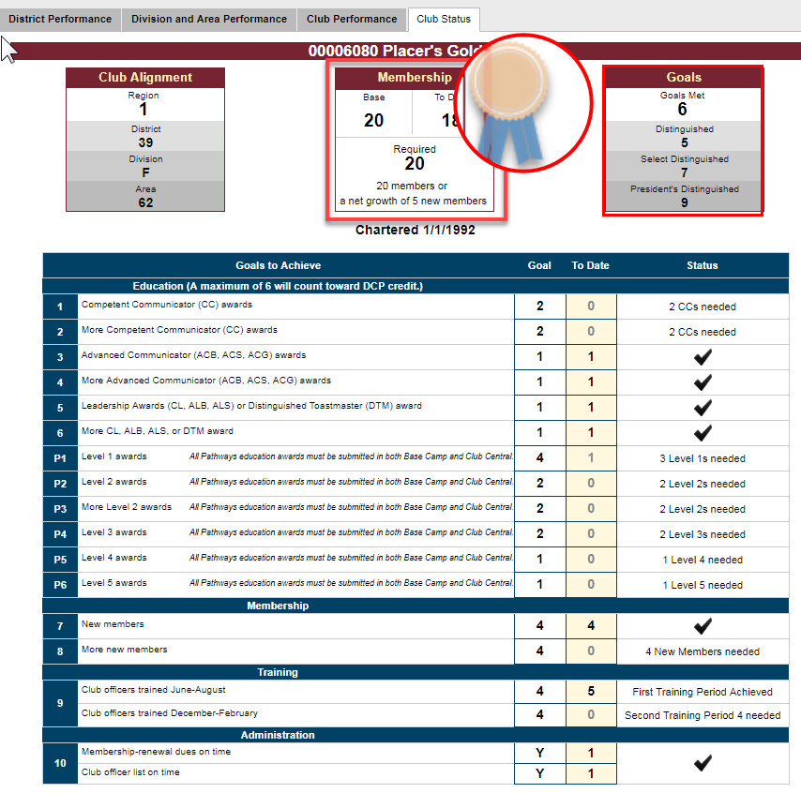
Distinguished Club Program (DCP)
Overview during Exec Meetings
Track Goals
MUST meet membership goals to achieve Distinguished Club status
Notes:
This is the “Dashboard” for your club. Information tracked here helps your club monitor its progress towards meeting your DCP goals. It allows you to identify what goals you have already achieved, as well as those you still need to work on. You may need to add new members, or perhaps nudge a few members to complete their next education goal.
Keep a watchful eye on your “Membership” numbers at the top of the page-- you need a minimum of 20 or a net gain of 5 to be a distinguished club.

Slide 25
Club Central Home Page
Notes:
Here is where you can see and print out a list of your club’s awards and achievements!

Slide 26
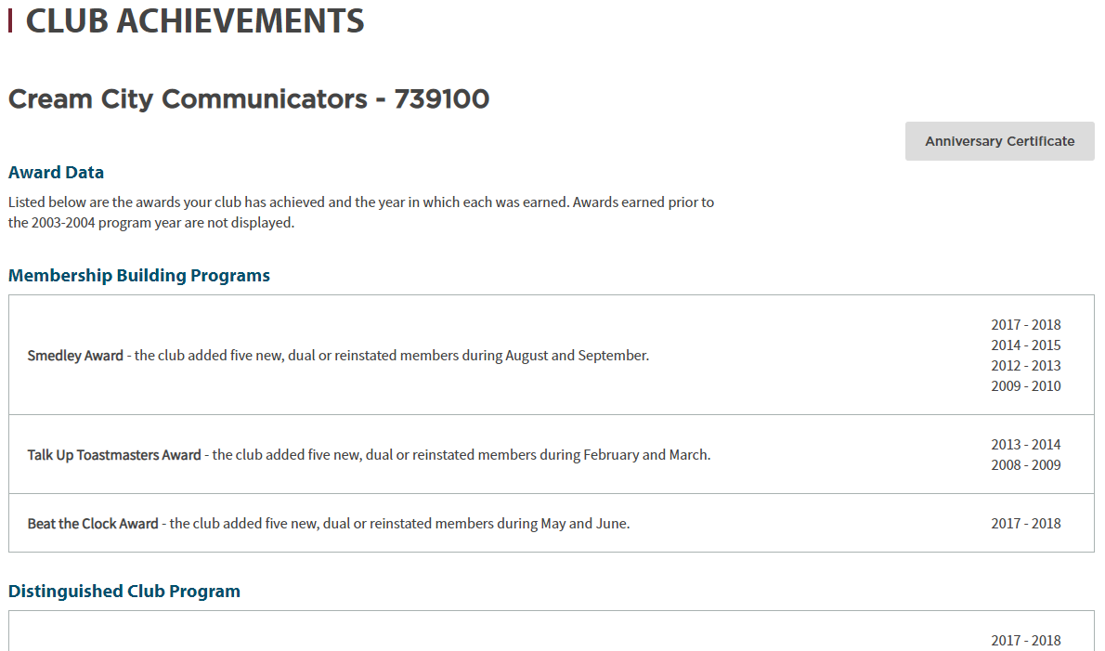
Club Achievements
Notes:
You will see a list of the awards your club has achieved since 2003-2004. The list includes various Membership Building Programs and the Distinguished Club Program.

Slide 27
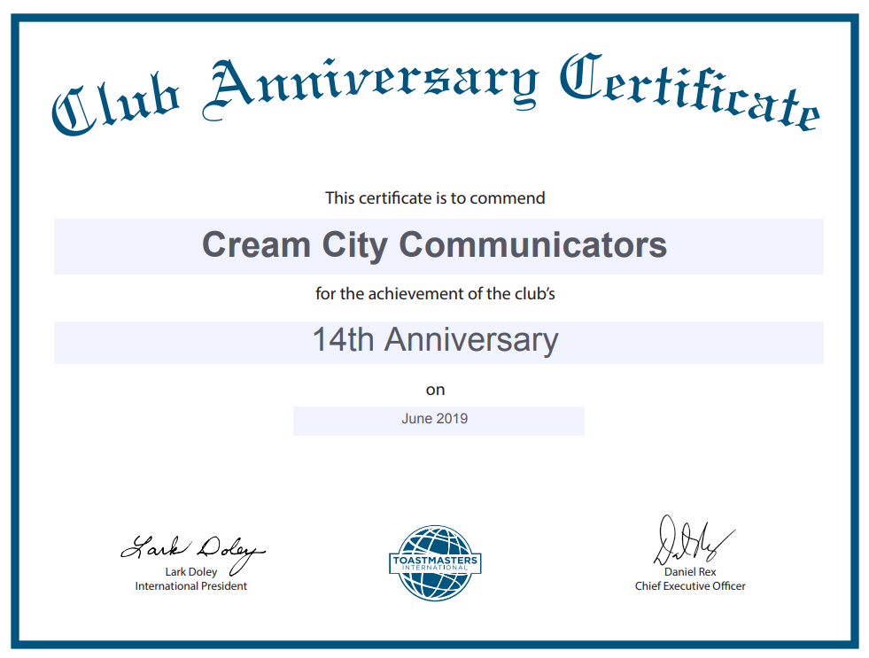
Club Achievements
Print anniversary certificates and celebrate!
Notes:
You can even print your club’s annual Anniversary certificates. This is great for celebrating the club!

Slide 28
Club Central Home Page
Notes:
Looking ahead for contest season, the Eligibility Assistant will prove very handy.

Slide 29
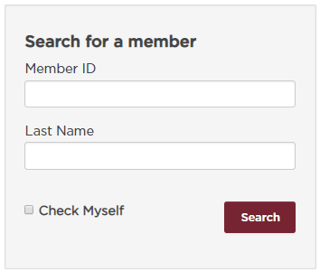
Eligibility Assistant
Online Tool
  Check membership status
  Club status
  If a member is serving as a club or district officer
Determining member eligibility to:
  Compete in speech contests and/or
  Be a proxy
NOTE: You can look at information only for members within your own scope of responsibility
Notes:
This tool is used to check membership status, club status, and if a member is serving as a club or district officer. Why would you want to know? Because you need to check for an individual’s eligibility to compete in a speech contest or be a proxy.
You are limited to looking at information at your own level of responsibility. For example: club officers can look at their own club members; Area Directors can look at members in their own area; Division Directors can check members within their own division; and a
District director can check members only within their own district.
A link is provided to the Speech Contest Rulebook (Item 1171) so you can review the complete list of eligibility requirements.
To verify the eligibility of members in recently chartered clubs, or for additional questions regarding eligibility, you should contact Toastmasters International’s Education Services at speechcontests@toastmasters.org for further assistance.

Slide 30
Club Central Home Page
Notes:
If you have changed your club contact person, moved your meeting location or date, updated the website or Facebook addresses, you need to click on this box.

Slide 31
Toastmasters International Website
www.toastmasters.org
Notes:
In the upper right portion of the Toastmasters International home page, there is a Find a Club button that allows the public to find a club that meets in a location and on a day and time that works for them. The search results include a map with the club meeting location noted.

Slide 32
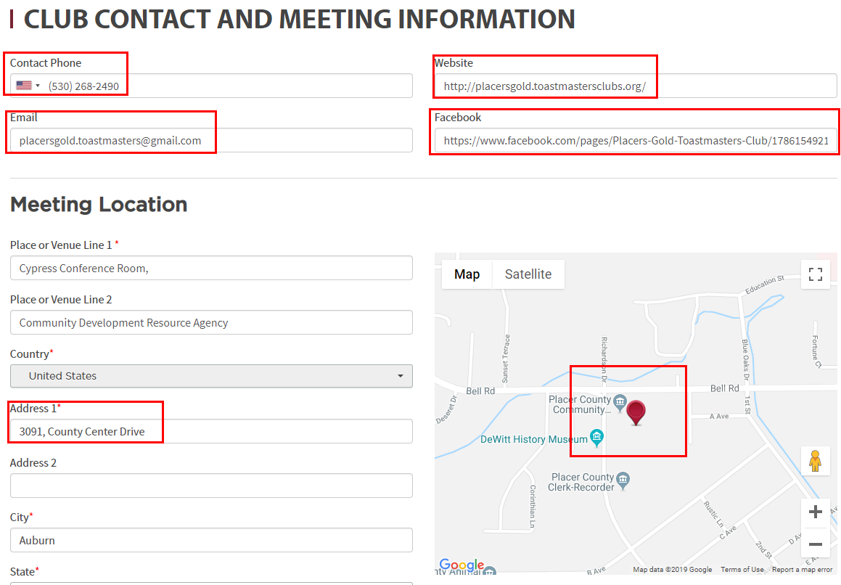
Club Contact and Meeting Location,
Find My Club
NOTE:
You MUST move the map marker to the new location on the map. This will not occur automatically.
Notes:
The information in this section is used to populate the information displayed in the results of a “Find a Club” search.
If you see your club’s information on the Find a Club page is out of date, it can be updated through this screen in Club Central.
Please note: if the meeting address has changed, you must move the map marker to the new location on the map. This does not occur automatically.
The contact email address is also used as the Base Camp Manager contact – it is suggested to have a group email address that all club officers can access. Base Camp Managers (President, VP Education, Secretary) can see Pathways approval requests. All officers can view and respond to membership inquiries.

Slide 33
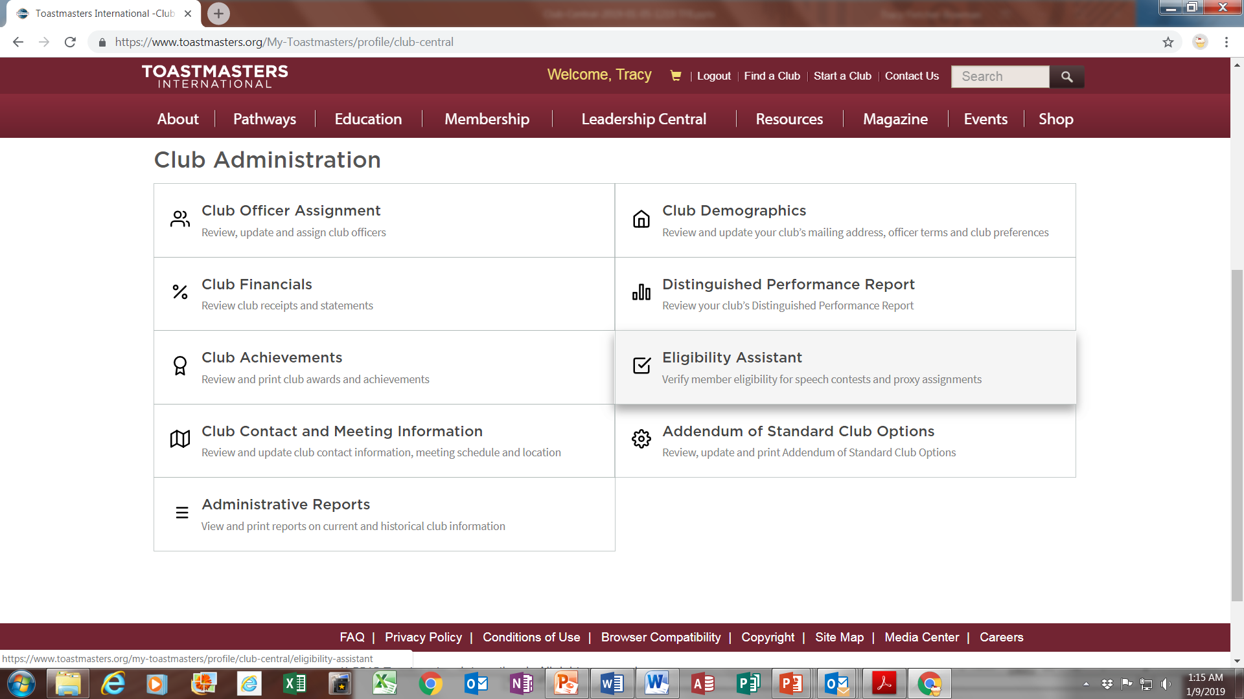
Club Central Home Page
Notes:
Clicking on this box leads you to a number of helpful administrative reports.

Slide 34
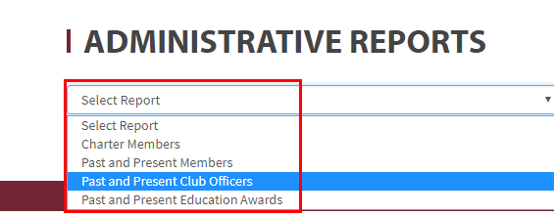
Reports on Past Administrative Events
Charter members
Past and present members
Past and present club officers
Past and present education awards
Notes:
You can select to see reports on:
Charter members
Past and present members
Past and present club officers; and
Past and present education awards
The reports can be printed as is or exported to Excel.

Slide 35
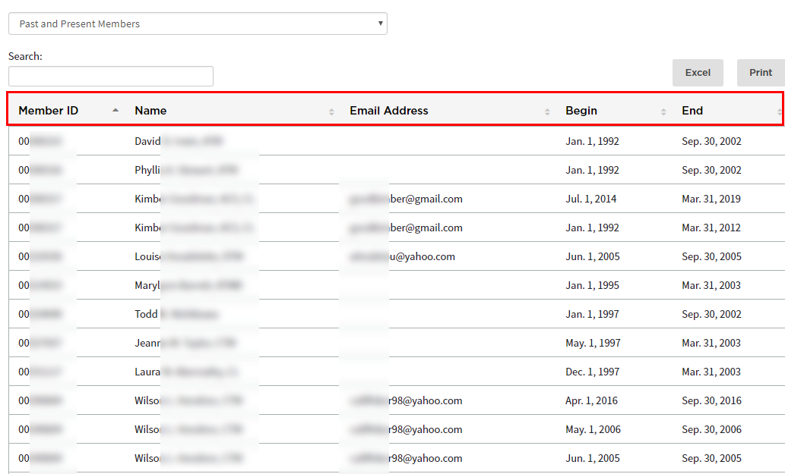
Past Member and Email IDs
Reach out to them and have an Open House
Notes:
One way these reports can be useful is outreach.
For example, you can run a report on your past and present members.
Export the report to Excel.
Sort the results to identify past members who were members within the last 5 years.
Schedule an Open House and invite them. Have a celebration!
Bring them back. Increase your membership.

Slide 36
Frequently Asked Questions

Slide 37
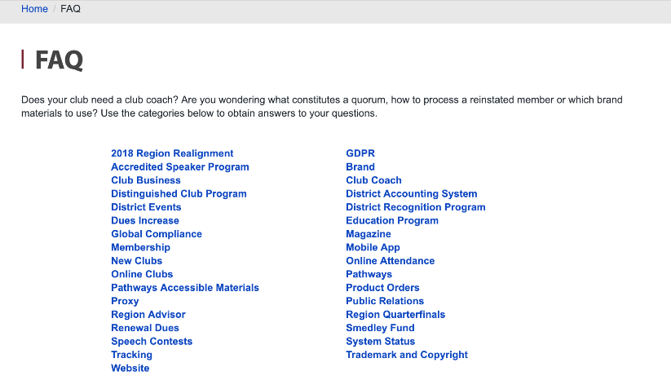
Toastmasters FAQ
www.toastmasters.org/footer/faq
FAQ menu is on always on footer
Notes:
You find it on the footer bar at the bottom of each page. A simple click on FAQ will lead you to a wealth of information. (https://www.toastmasters.org/footer/faq/)

Slide 38
Frequently Asked Questions
What is DCP?
Who can update club information?
How can club information be updated?
How can I get a copy of our Bylaws?
What club business can an officer conduct online?
Who submits a member application?
Notes:
What is DCP?
Who can update club information?
How can club information be updated?
How can I get a copy of our Bylaws?
What club business can an officer conduct online?
Who submits a member application?

Slide 39
Frequently Asked Questions
Who pays member dues?
Can you submit an application and pay dues at the same time?
When are dues due?
Who should submit the officers list?
When do you submit the officer list?
Notes:
Who pays member dues?
Can you submit an application and pay dues at the same time?
When are dues due?
Who should submit the officers list?
When do you submit the officer list?

Slide 40
Frequently Asked Questions
When do you submit education awards?
Who is responsible to submit Education Awards?
Can ANY officer do any of these jobs?
Will education points show up in DCP if you don’t submit awards in Club Central?
Can I use my membership contact information for non-Toastmaster related communication?
Notes:
When do you submit education awards?
Who is responsible to submit Education Awards?
Can ANY officer do any of these jobs?
Will education points show up in DCP if you don’t submit awards in Club Central?
Can I use my membership contact information for non-Toastmaster related communication?
So MANY good questions, and answers are waiting for you!

Slide 41
Toastmasters FAQ
www.toastmasters.org/footer/faq
Notes:
Lots of those questions can be answered by clicking on “Club Business” in the main FAQ list.
That will take you to the Club Business FAQ page.

Slide 42
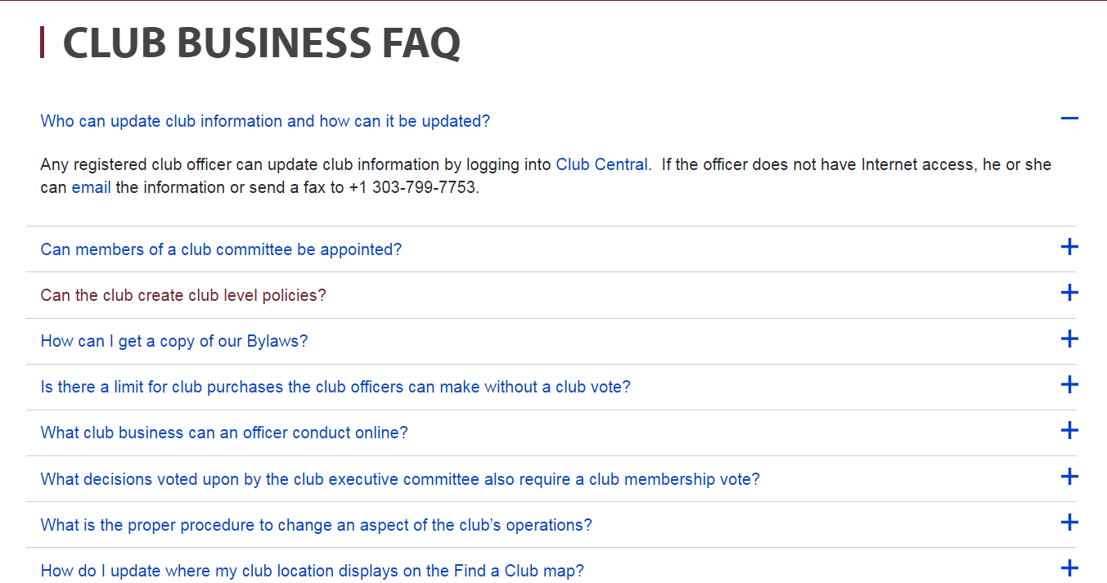
Club Business FAQ
www.toastmasters.org/footer/faq/Club%20Business
Notes:
When you click on the plus sign to the right of your selected question, the section will expand to show you the answer.
There is lots of great stuff here! You don’t even have to wait until you have a question—you can simply go in and browse to find questions that interest you.
(https://www.toastmasters.org/footer/faq/Club%20Business)

Slide 43

Notes:
Any questions?
This presentation will be posted on the District website (www.district35.org) in August.

Slide 44


