Slide 1
Base Camp Managers
Officer Training Extravaganza
Seek – Learn – Grow
Summer 2019
Notes:
As one of the three officers that are Base Camp Managers, you will have additional access regarding Pathways.
As Vice President Education, you will help members achieve their goals by giving them speaking opportunities and tracking their progress.
The President and Secretary will back up the Vice President Education in your role as base camp manager.
We will go over in this session your responsibilities as a Base Camp Manager.

Slide 2
Agenda
How do I …
  Learn Base Camp as a Member?
  Access Base Camp as a Manager?
  Learn what to do?
  Approve a pending request?
  Print a completion certificate?
  View member progress in Pathways?
  Support members with printed materials?
Notes:
In your club officer training, you will learn a wide range of information about your role as an officer. In this session, the club President, Vice President Education, and Secretary will learn about the duties of a Base Camp Manager

Slide 3
Learn Base Camp as a Member
Start at www.toastmasters.org/start-pathways (which launches your member login)
Click Go to Base Camp from Access my path through Base Camp box
Click on Tutorials and Resources
Explore resources available within Base Camp Manager (tutorials, reference guides in English)

Slide 4
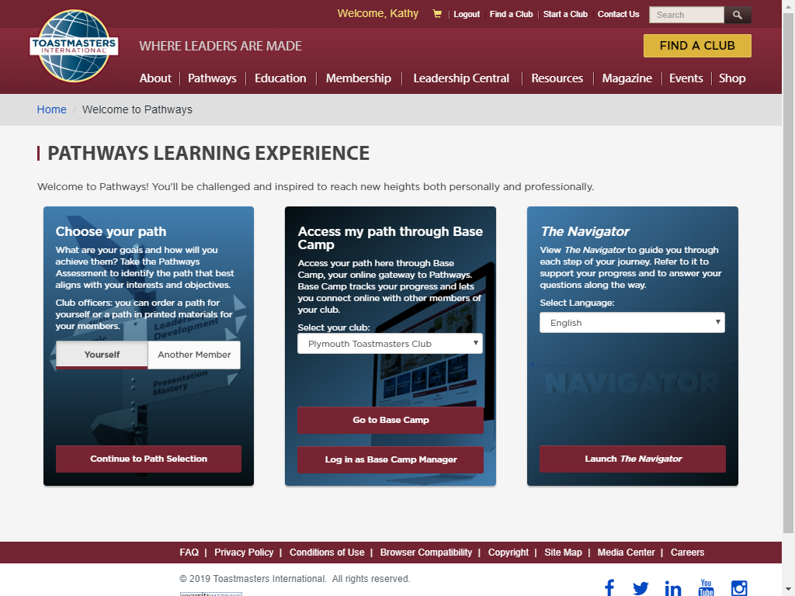

Slide 5
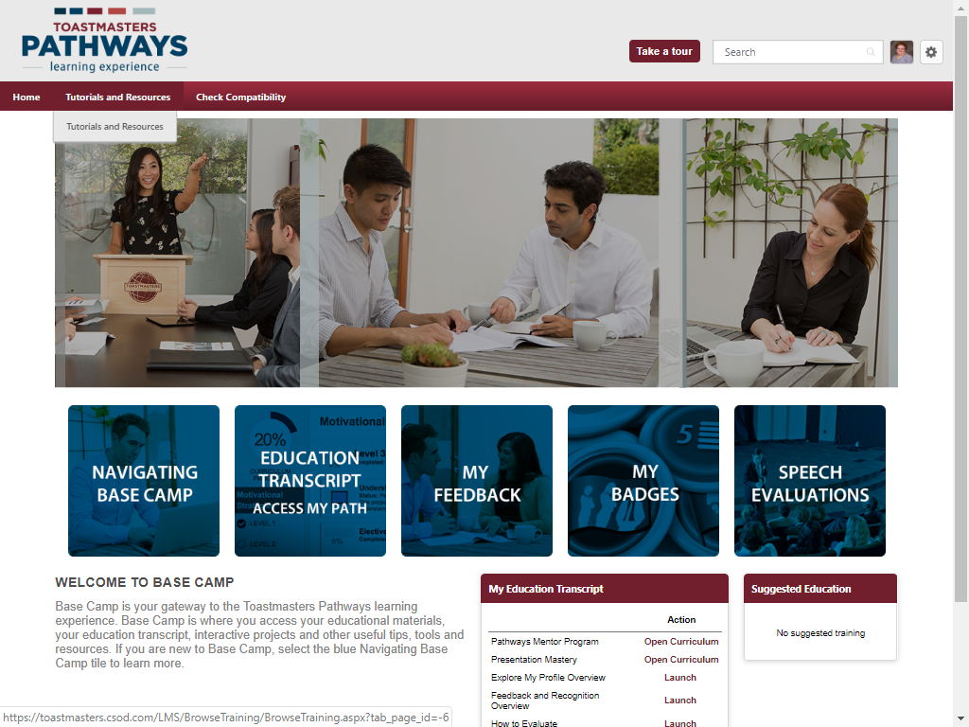

Slide 6
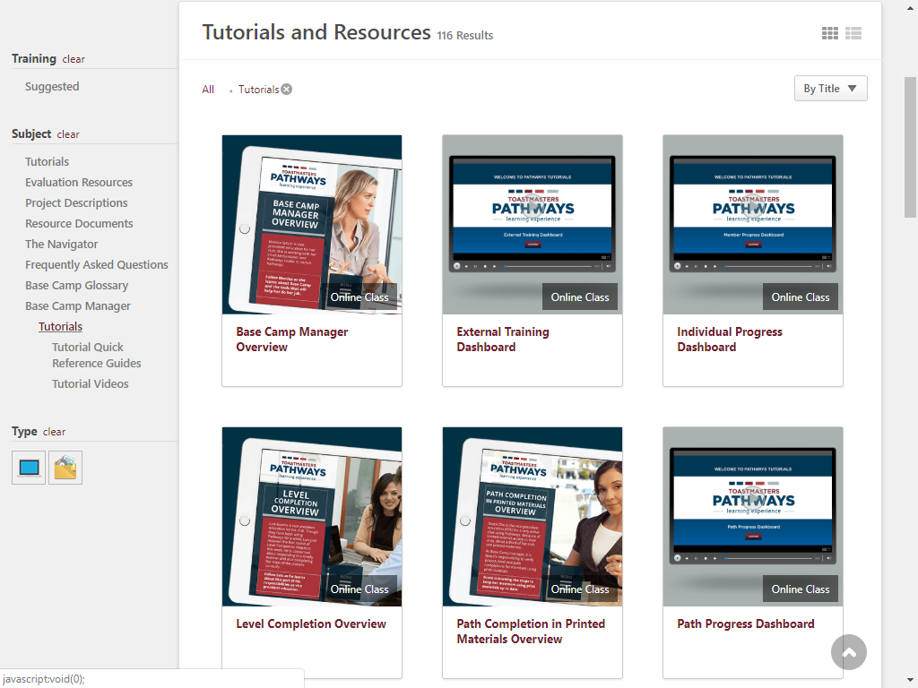

Slide 7
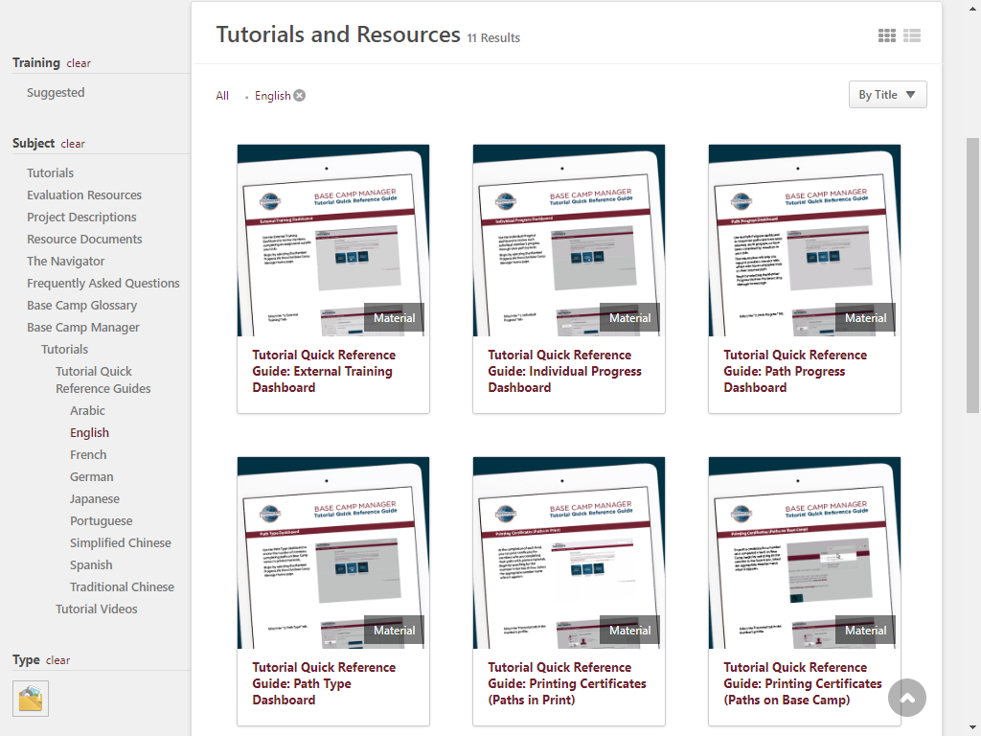

Slide 8
Access Base Camp as a Manager
Start at www.toastmasters.org/start-pathways (which launches your member login)
Click Log in as Base Camp Manager from Access my path through Base Camp box (if you belong to multiple clubs, select the appropriate club name)
Don’t see this option? Ask another officer to verify in Club Central (Club Administration) that you are listed correctly as President, VPE or Secretary. Access begins July 1.

Slide 10
Learn what to do with built-in Tutorials!
Base Camp Managers have multiple training resources
Click the Manager Tutorials icon
Click on any blue tile for a menu of training resources
Click on the item you want to learn, then launch

Slide 11
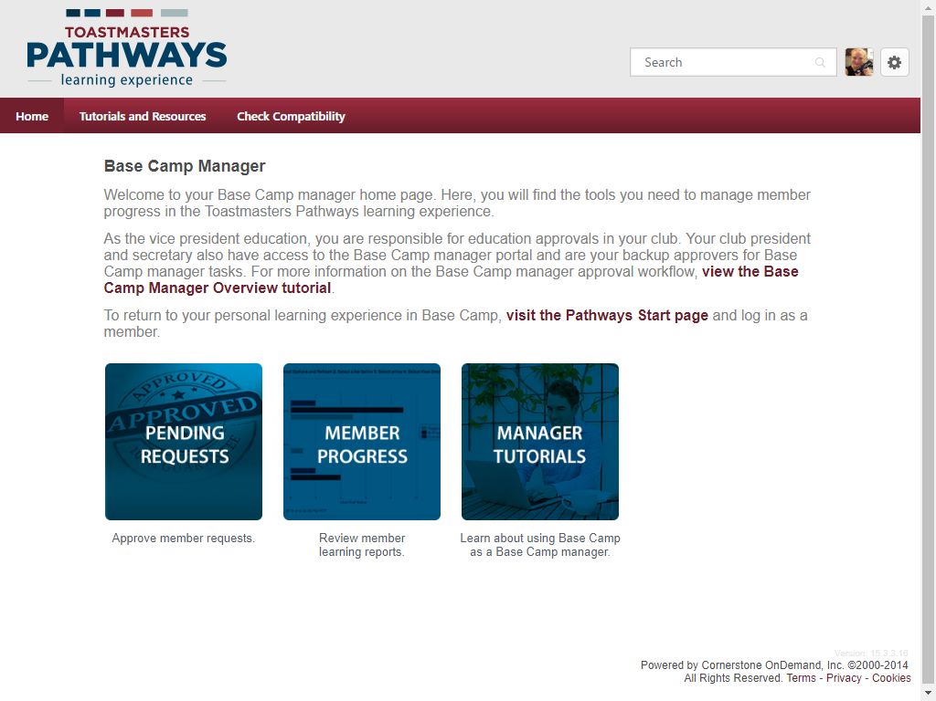

Slide 12
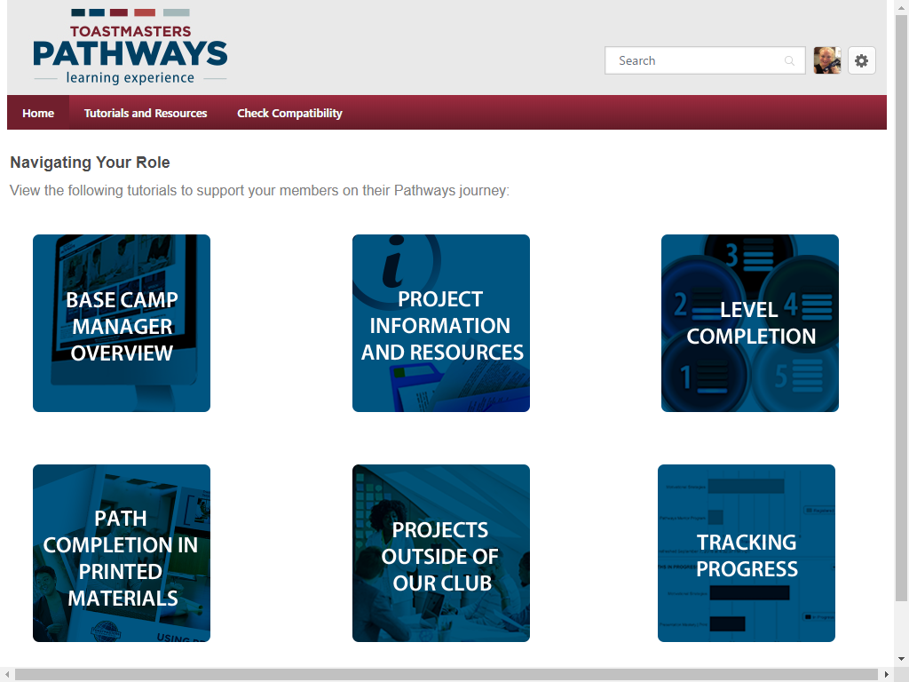

Slide 13
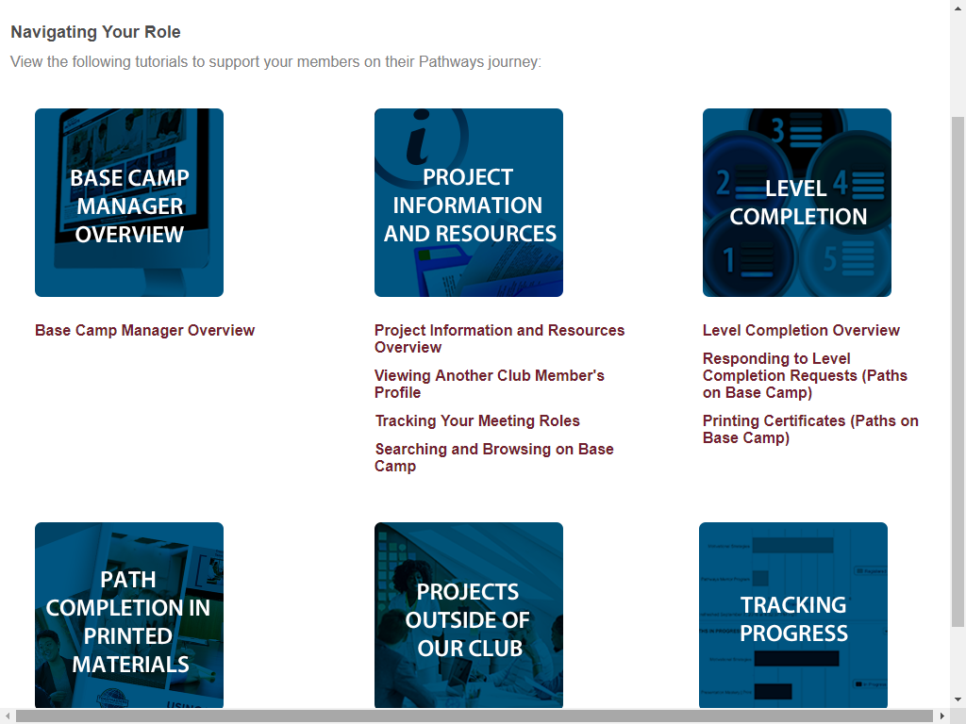

Slide 14

Approve a Pending Request
Log in as a Base Camp manager
Click the Pending Requests icon
Training Pending Approval table shows all pending requests
To approve, click the green checkmark (after confirming the member’s “paperwork”); record your name and date
After approving a level, go to Club Central to process the educational award for DCP credit!

Slide 16
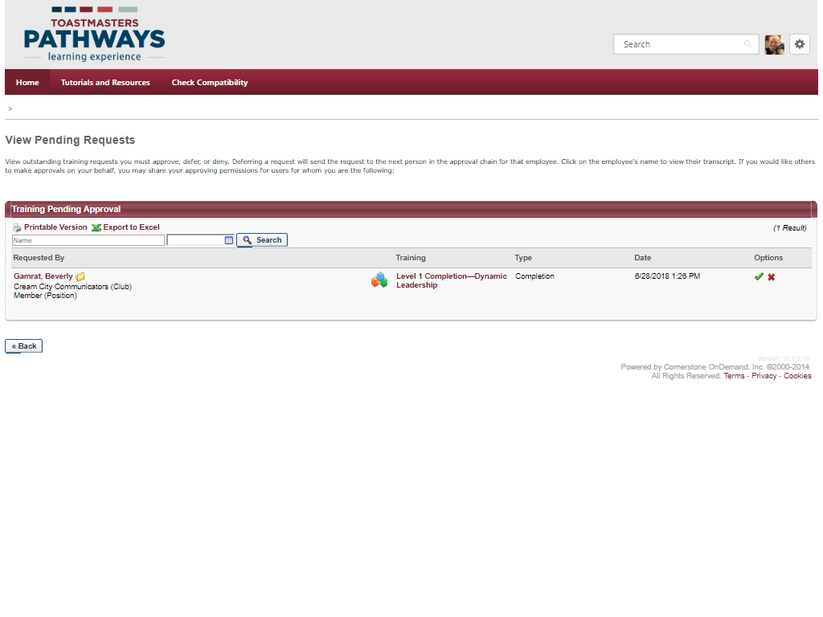

Slide 17
Print Certificate (20-30 seconds)
In the Search box (top right), type the member’s first name
Click on the member’s name when it appears
Click the member’s Transcript tab
Click Open Curriculum next to their Path
Click View Details next to the level you are approving
Click View Certificate next to the level completion item; it will open in a pop-up window
Print certificate

Slide 18
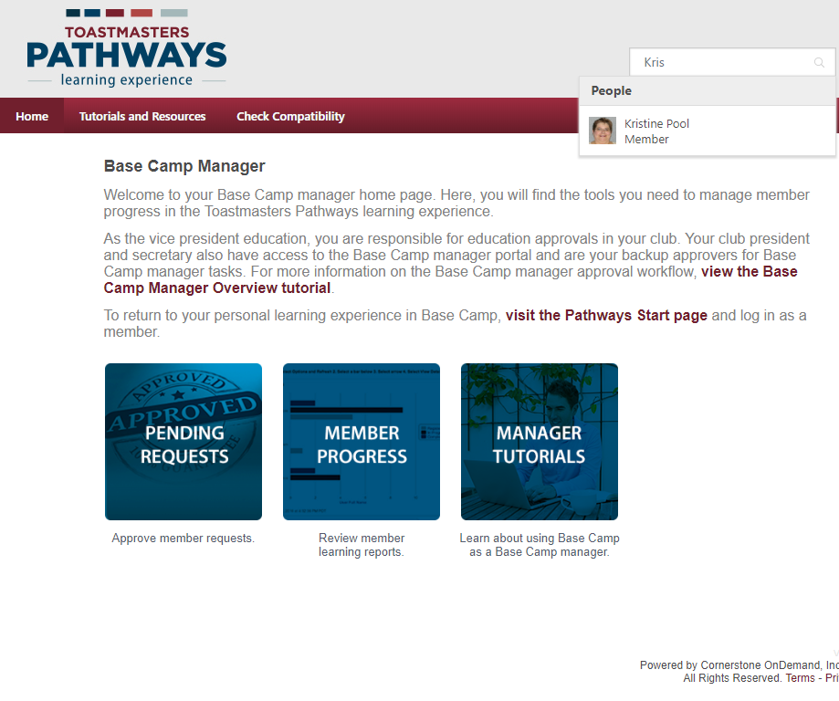

Slide 19
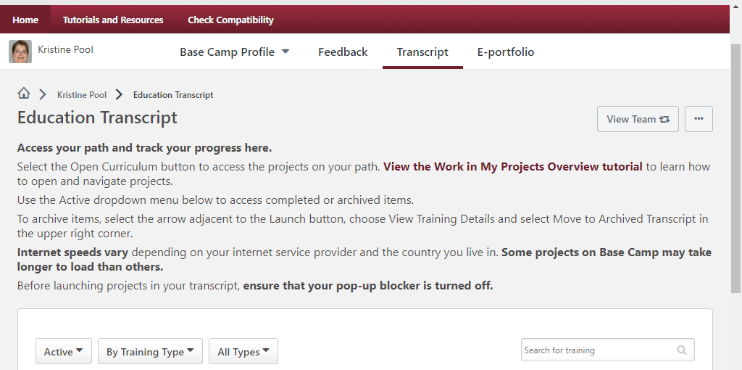
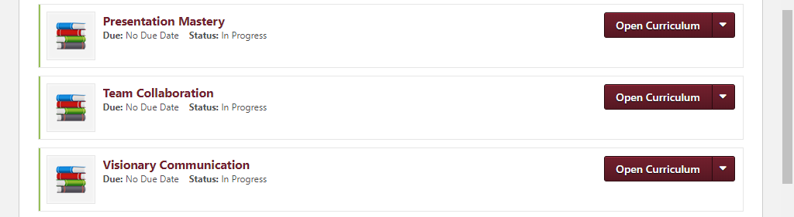

Slide 20
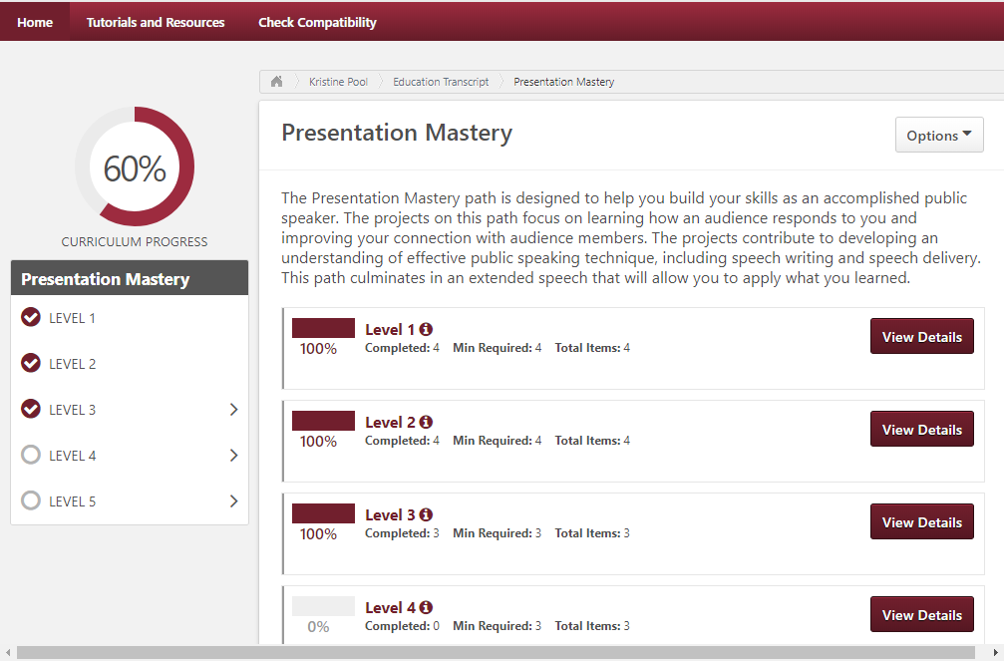

Slide 21
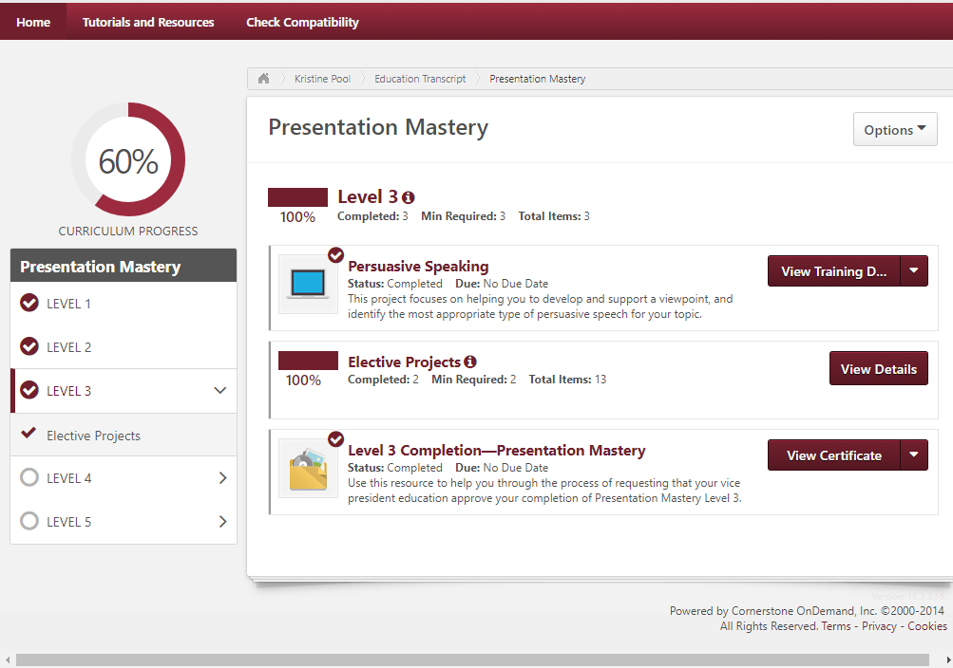

Slide 22
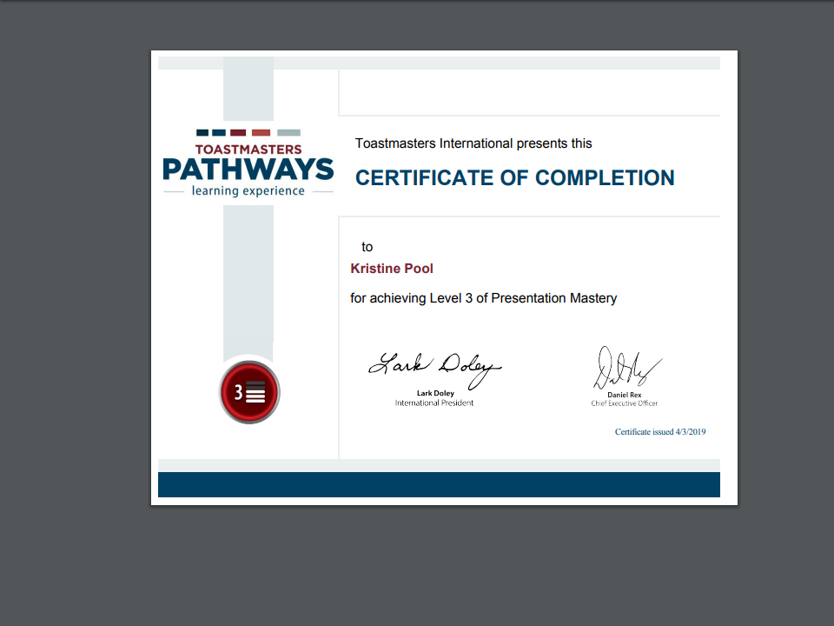

Slide 23
View Progress Dashboards
After accessing Base Camp manager, click the Member Progress icon
Select the report you want to view (on left)
Click the Options menu in any level (tiny arrow upper right) and select Refresh . . . may take minutes!
Click the Options menu again to View Details (or Export to Excel)
“Progress” aligns with member’s view
Notes:
May Take Minutes to REFRESH . . . Not just members of your club, members worldwide being pulled to generate your report.

Slide 25
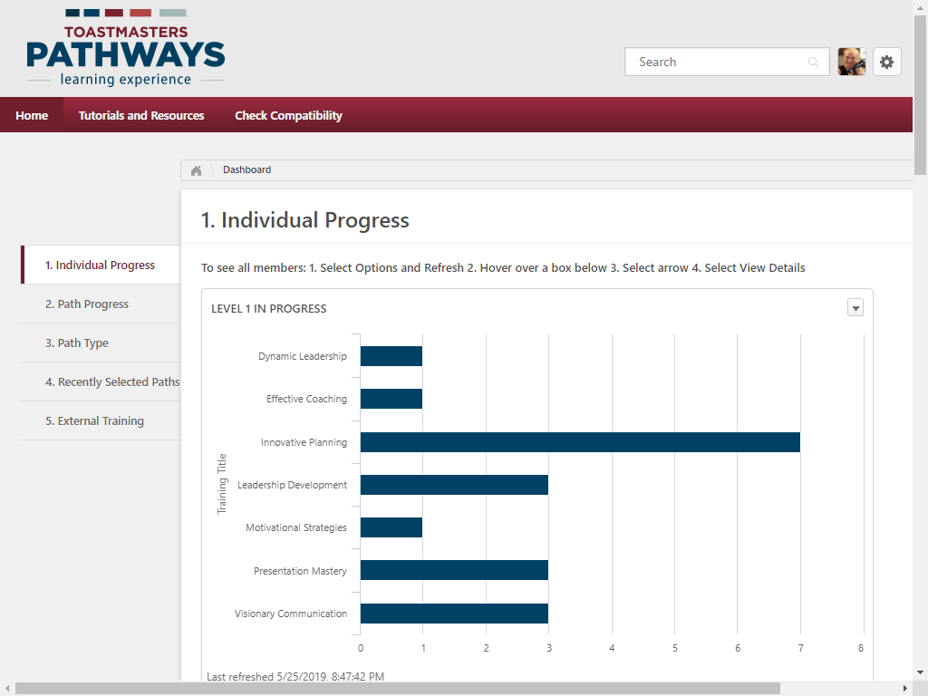
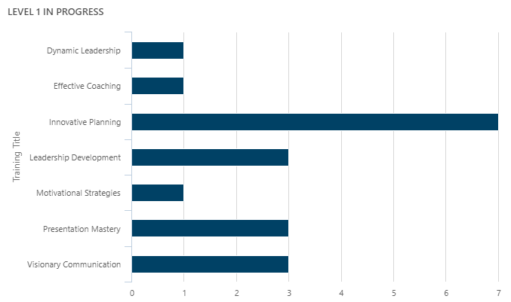
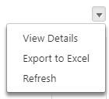

Slide 26
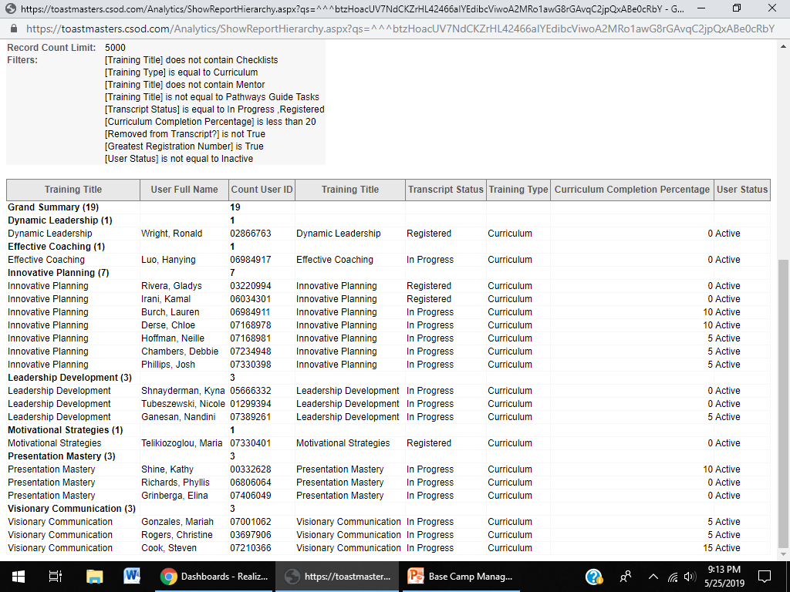
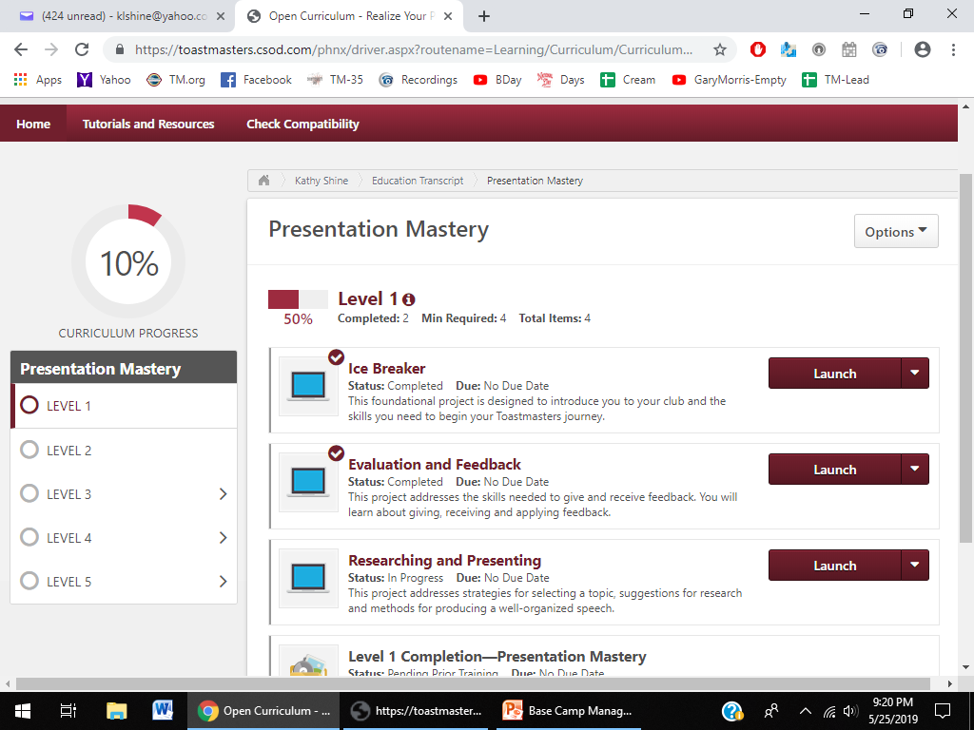
Notes:
Note: This is a split screen . . . illustrates the Base Camp Managers’ “View Details” . . . at the bottom, the member’s view inside their curriculum

Slide 27
Support Members with Print Materials
Start at home page; click on Manager Tutorials (located on the right)
Click on Path Completion in Printed Materials for three tutorials
  Path Completion in Printed Materials Overview
  Validating Project and Level Completion (Paths in Print)
  Printing Certificates (Paths in Print)
Select the desired tutorial, then launch. Once the tutorial opens, click continue.
Notes:
For additional resources, please view the Manager Tutorials.
Any member (one does not need to be a Base Camp Manager) who has access to Base Camp can view all the training materials and resources for Base Camp Managers by opening the Tutorials and Resources (located at the top of the page in the burgundy bar; this feature is located to the right of "home").
Under the Subject category (on the left side of the screen) select "Base Camp Manager". There are 116 results. To drill down a bit more, I personally recommend to click on "Tutorials" then "Tutorial Videos" (just beneath "Base Camp Manager"), which narrows the search results down to 17.
All the online classes and material resources are located here. Scroll through the list to open the resource desired (e.g. look for items marked "Paths in Print").
The benefit of this step is that ANY MEMBER can access the training. One does not need to be a Base Camp Manager to learn what / how to serve as a Base Camp Manager. The actual validation of project and level completions for members working in printed paths does need to be performed by a Base Camp Manager.

Slide 30

Notes:
Thank you for learning more about the duties and responsibilities for Base Camp Manager. Reach out to other clubs Base Camp Managers or the district leadership if you have questions.

Slide 31

Notes:
Any questions?
This presentation will be posted on the District website in August, https://district35.org

